Slide 1
HW#3 solution
By TA: Lai,Jui-Shun

Slide 2
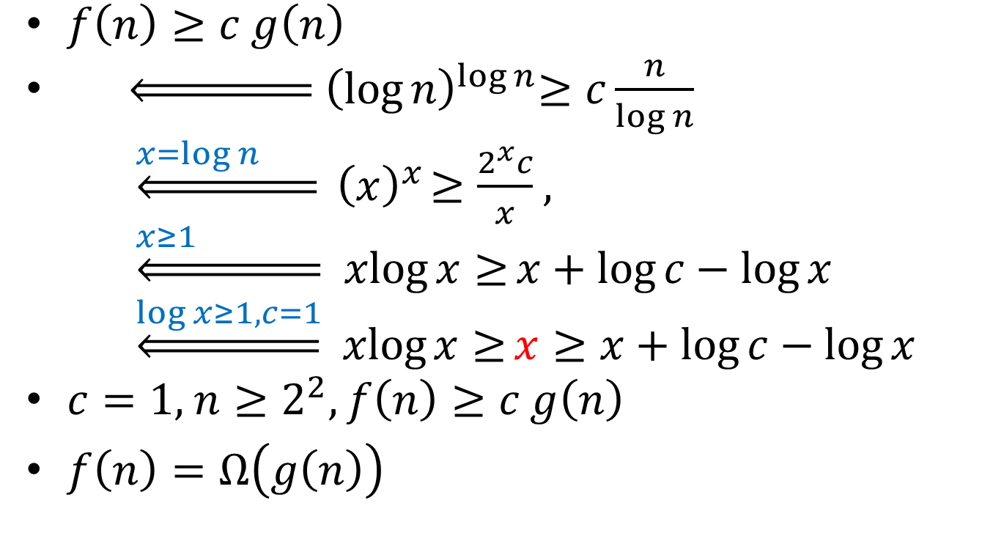
HW#3 Problem 2(a)
$f\left(n\right)≥c$ $g\left(n\right)$
$\underset{⇐}{ }{ \left(\log{n}\right)}^{\log{n}}≥c\frac{n}{\log{n}}$
    $\underset{⇐}{x=\log{n} }{ \left(x\right)}^{x}≥\frac{2^{x}c}{x}$ ,
    $\underset{⇐}{x≥1 }$ $\operatorname{xlog}{x≥}x+\log{c}−\log{x}$
    $\underset{⇐}{\log{x≥1,c=1}}$ $\operatorname{xlog}{x≥}x≥x+\log{c}−\log{x }$
$c=1,$ $n≥2^{2},$ $f\left(n\right)≥c$ $g\left(n\right)$
$f\left(n\right)=Ω\left(g\left(n\right)\right)$
Notes:
Log沒寫底是2

Slide 3
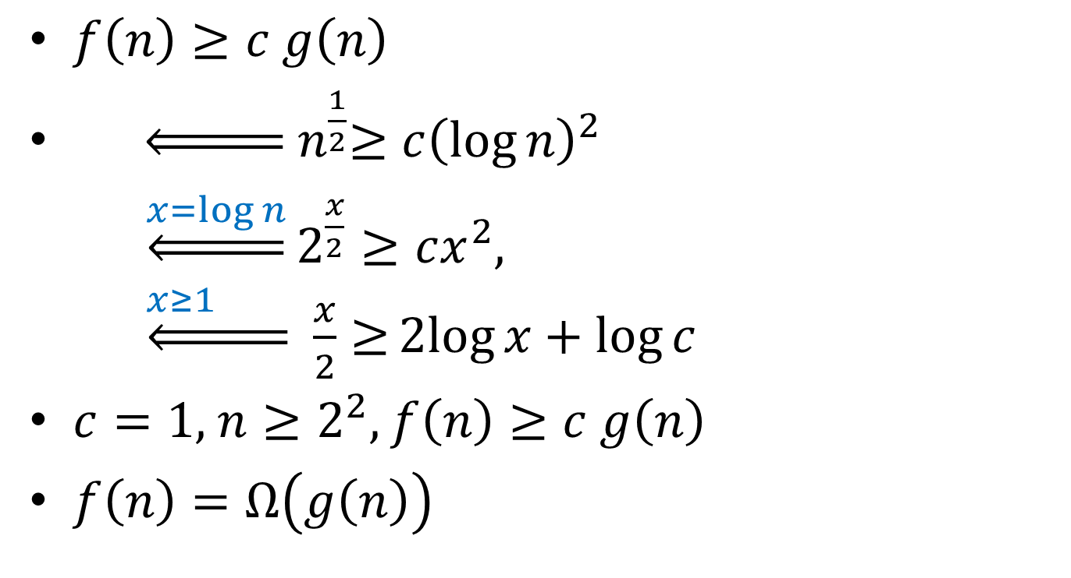
HW#3 Problem 2(b)
$f\left(n\right)≥c$ $g\left(n\right)$
$\underset{⇐}{ }{ n}^{\frac{1}{2}}≥c{\left(\log{n}\right)}^{2}$
    $\underset{⇐}{x=\log{n}}2^{\frac{x}{2}}≥cx^{2}$,
    $\underset{⇐}{x≥1 }$ $\frac{x}{2}{≥}2log{x}+\log{c}$
$c=1,$ $n≥2^{2},$ $f\left(n\right)≥c$ $g\left(n\right)$
$f\left(n\right)=Ω\left(g\left(n\right)\right)$

Slide 4
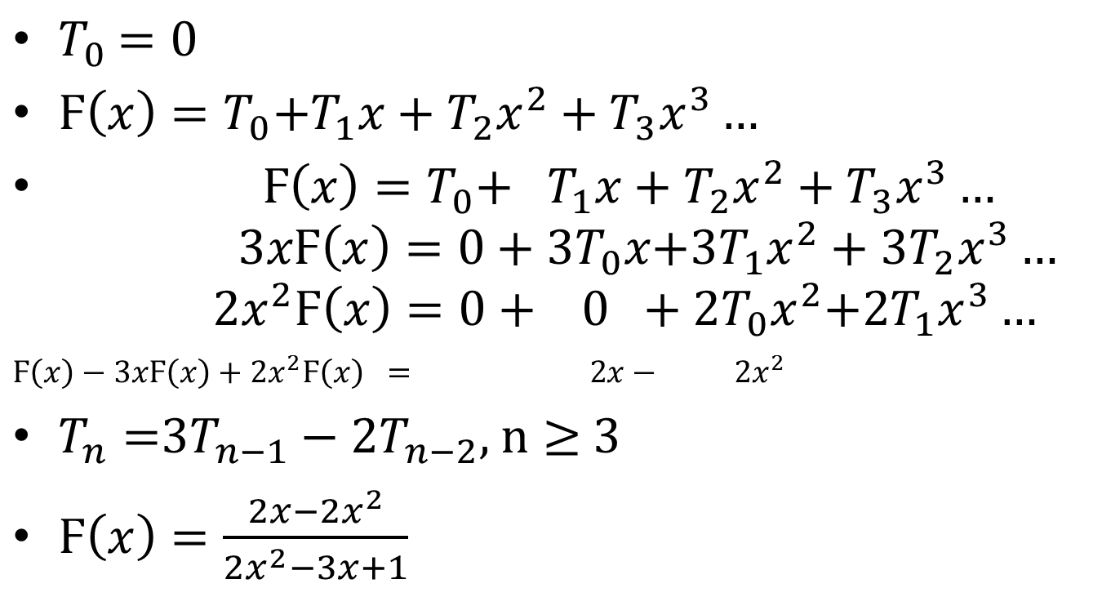
HW#3 Problem 4
$T_{0}$ $=0$
$Ϝ\left(x\right)=T_{0}{+T}_{1}x+T_{2}x^{2}+T_{3}x^{3}…$
$Ϝ\left(x\right)=T_{0}{+ T}_{1}x+T_{2}x^{2}+T_{3}x^{3}…$
$$3xϜ\left(x\right)={0+3T}_{0}x{+3T}_{1}x^{2}+{3T}_{2}x^{3}…$$
$$2x^{2}Ϝ\left(x\right)={0+ 0 +2T}_{0}x^{2}{+2T}_{1}x^{3}…$$
$Ϝ\left(x\right)−3xϜ\left(x\right)+2x^{2}Ϝ\left(x\right) = 2x− 2x^{2}$
$T_{n}=$3$T_{n−1}−\text{2}T_{n−2}$, $n≥$ 3
$Ϝ\left(x\right)=\frac{2x−2x^{2}}{2x^{2}−3x+1}$

Slide 5
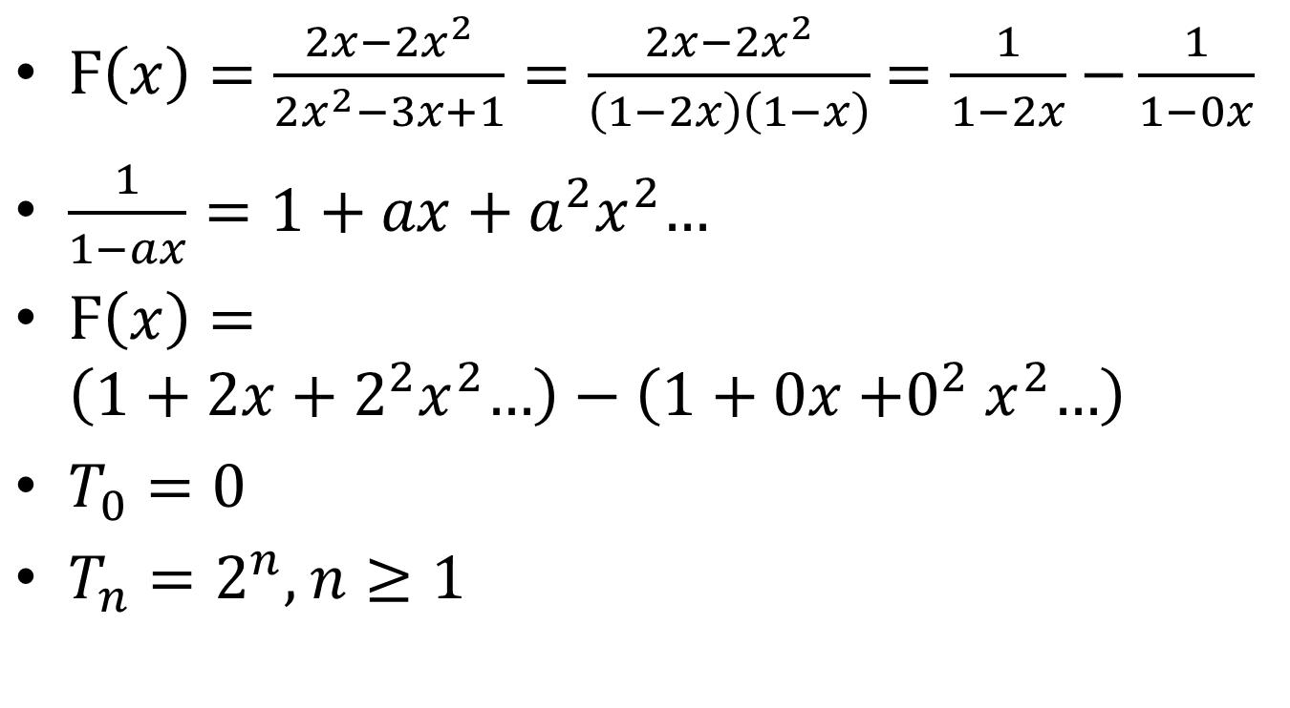
HW#3 Problem 4 (cont.)
$Ϝ\left(x\right)=\frac{2x−2x^{2}}{2x^{2}−3x+1}=\frac{2x−2x^{2}}{\left(1−2x\right)\left(1−x\right)}$ $=\frac{1}{1−2x}$ $−\frac{1}{1−0x}$
$\frac{1}{1−ax}=1+$ $ax+a^{2}x^{2}$…
$Ϝ\left(x\right)=\left(1+2x+2^{2}x^{2}\text{…}\right)−\left(1+0x{+0}^{2}x^{2}\text{…}\right)$
$T_{0}=0$
$T_{n}=2^{n},$ $n≥1$

