Slide 1
Algorithms
Homework Assignment #7
Jui-Shun Lai, Wei-Hsien Chang

Slide 2
Problem 1
Compute the next table as in the KMP algorithm for the string aabbaabaaa. Show the details of your calculation.
Algorithm Compute_Next (B, m);
begin
next[1] := 1; next[2] := 0;
for i := 3 to m do
j := next[i -1] + 1;
  while b_{i-1} ≠ b_{j} and j > 0 do
  j := next[j] + 1;
next[i] := j
end

Slide 3
Problem 1 (cont.)
i | 1 | 2 | 3 | 4 | 5 | 6 | 7 | 8 | 9 | 10
B | a | a | b | b | a | a | b | a | a | a
next | -1 | 0 | 1 | 0 | 0 | 1 | 2 | 3 | 1 | 2
Initial : next[1] = -1; next[2] = 0
i = 3: j = next[2]+1=1 ;
b₂= b₁ ; next[3] = 1 ;
i = 4: j = next[3]+1=2 ;
b₃≠ b₁ =>...=> j = next[1]+1 = 0 ;
next[4] = 0
i = 5: j = next[4]+1=1 ;
b₄ ≠ b₁ => j = next[1]+1 = 0 ;
next[5] = 0 ;
i = 6: j = next[5]+1=1 ;
b₅= b₁ ; next[6] = 1
i = 7: j = next[6]+1=2 ;
b₆ = b₂ ; next[7] = 2
i = 8: j = next[7]+1=3 ;
b₇ = b₃ ; next[8] = 3
i = 9: j = next[8]+1=4 ;
b₈ ≠ b₄ => j = next[4]+1 = 1 ;
b₈ =b₁ ; next[9]=1;
i=10: j = next[9]+1=2 ;
b₉=b₂ ; next[10]=2;

Slide 4
Problem 2
Given two strings aacbb and baacab, compute the minimal cost matrix C[0..5, 0..6] for changing the first string character by character to the second one. Aside from giving the cost matrix, please show the details of how the entry C[5, 6] is computed.

Slide 5
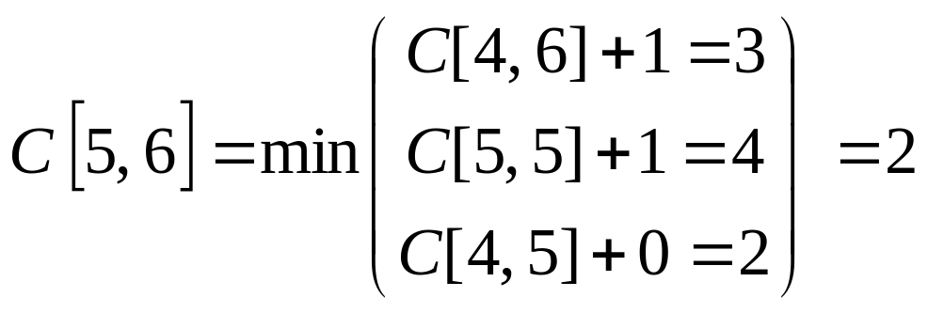
Problem 2 (cont.)
i\j |  | b | a | a | c | a | b
 | 0 | 1 | 2 | 3 | 4 | 5 | 6
a | 1 | 1 | 1 | 2 | 3 | 4 | 5
a | 2 | 2 | 1 | 1 | 2 | 3 | 4
c | 3 | 3 | 2 | 2 | 1 | 2 | 3
b | 4 | 3 | 3 | 3 | 2 | 2 | 2
b | 5 | 4 | 4 | 4 | 3 | 3 | 2

Slide 6
Problem 3
Let A and B be two sets, both with n elements, such that A resides in computer P and B in computer Q.
P and Q can communicate by sending messages, and they can perform any kind of local computation.
Design an algorithm to find the nth smallest element (i.e., the median) of the union of A and B.
  You can assume, for simplicity, that all the elements are distinct.
  Your goal is to minimize the number of messages, where a message can contain one element or one integer.
  Please present your algorithm in an adequate pseudo code and make assumptions wherever necessary.
  What is the number of messages in the worst case?

Slide 7
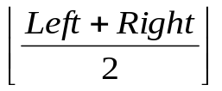
Problem 3 (cont.)
Algorithm FindNthElement(X, Left, Right)
1 begin
2 Middle := ;
3 EvenFlag := (Right - Left) mod 2;
4 my_mid := X[Middle];
5 Send(my_mid);
6 Receive(other_mid);
7
8 if my_mid = other_mid then
9 return my_mid;
10 if Left = Right then
11 return min(my_mid, other_mid);
12 if my_mid > other_mid then
13 FindNthElement(X, Left, Middle);
14 else
15 FindNthElement
16 (X, Middle + EvenFlag, Right);
17 end
Number of messages (worst case): 2*log n
Input: X (the sorted array that stores the set)
Left (the left boundary of the remaining array, set to 1 initially)
Right (the right boundary of the remaining array, set to n initially)
Output: the nth smallest element of the union of A and B.

Slide 8

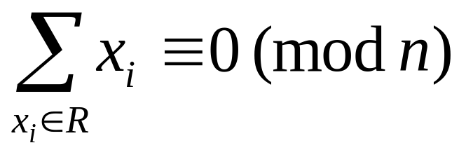
Problem 4
Design an algorithm that, given a set of integers S = {x₁, x₂, …, x_{n}}, finds a nonempty subset , such that

Slide 9
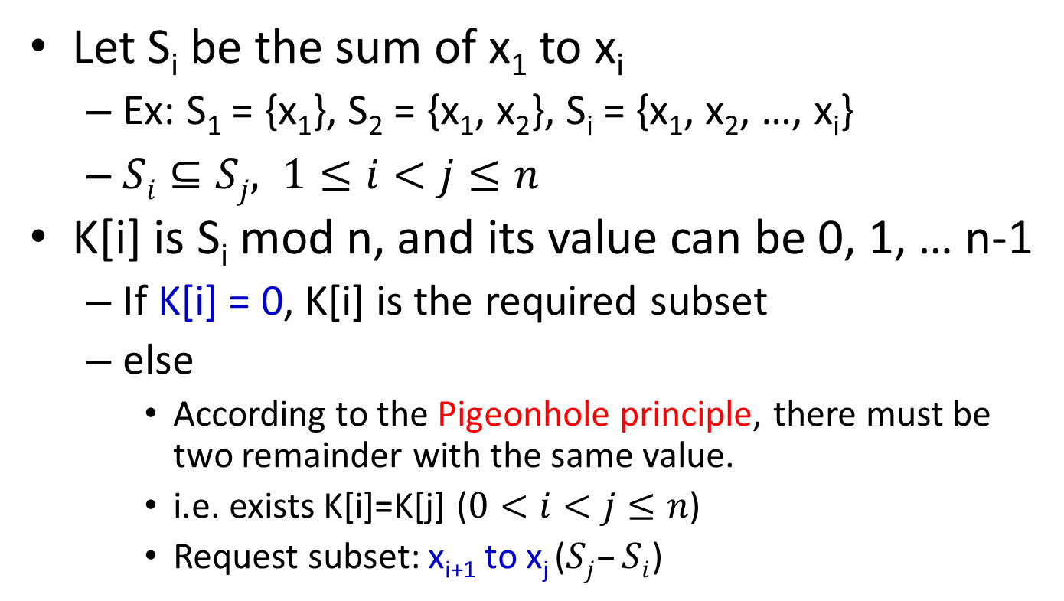
Problem 4 (cont.)
Let S_{i} be the sum of x₁ to x_{i}
  Ex: S₁ = {x₁}, S₂ = {x₁, x₂}, S_{i} = {x₁, x₂, …, x_{i}}
  $Si⊆Sj, 1≤i<j≤n$
K[i] is S_{i} mod n, and its value can be 0, 1, … n-1
  If K[i] = 0, K[i] is the required subset
  else
    According to the Pigeonhole principle, there must be two remainder with the same value.
    i.e. exists K[i]=K[j] ($0<i<j≤n$)
    Request subset: x_{i+1} to x_{j} ($Sj–Si$)
Notes:
Si為從x1加到xi
餘數可能為 0…n-1
S1~Sn共n個數，鴿籠原理，必有兩數的餘數相同(Rm=Rn)，取Rm-Rn

Slide 10
Problem 4 (cont.)
Algorithm FindSubset(S, n)
begin
sum := 0;
self:=-1;
for i := 0 to n-1 do
count[i].exist := false;
sum := S[i] + sum;
k[i] := sum mod n;
if k[i] = 0 then
self:= i;
break;
else if count[k[i]].exist then
count[k[i]].array2 := i;
break;
else
count[k[i]].array1 := i;
count[k[i]].value ++;
od
if self != -1 then
start:= 0;
end:= i;
else
start:=count[k[i]].array1+1;
end:= count[k[i]].array2;
for j := start to end do
print S[j];
od
end

