Slide 1
Algorithms
Homework Assignment #1
施舜元,李孟

Slide 2
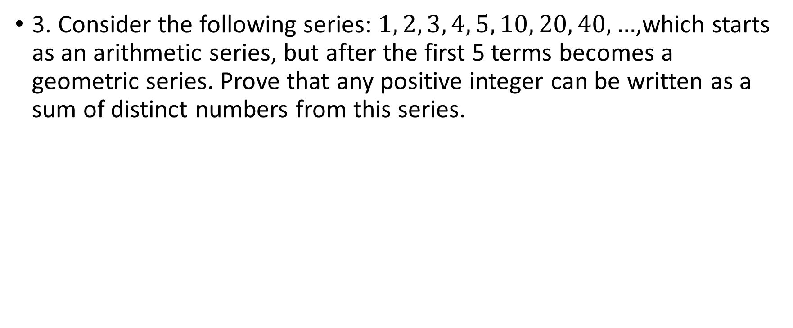
Problem 3
3. Consider the following series: $1, 2, 3, 4, 5, 10, 20, 40, …$,which starts as an arithmetic series, but after the first 5 terms becomes a geometric series. Prove that any positive integer can be written as a sum of distinct numbers from this series.

Slide 3
Problem 3 (cont.)
We let any positive number k=10N+r
Base case:
(Numbers < 10) and (Nmbers ≥ 10)
< 10
  1, 2, 3, 4, 5
  6, 7, 8, 9: (1, 2, 3, 4) + 5

Slide 4
≥ 10
  We have to prove the remain sequence S_{r}: 10, 20, 40, 80, … can compose to any positive number N multiplied by 10 (that is, number 10*N) with strong induction.
Base Case: N = 1, 10 is trivially proved.
N = 2, 20 is trivially proved.
Inductive Hypothesis: We assume that for all N s.t. 1<N<n can be summed up by some numbers of the sequence S_{r}.

Slide 5
Inductive Step: N = n
  When n is even(2k): Because k < n and no matter k is odd or even, we have the sum-up combination of k*10 (due to inductive hypothesis). For example, S_{k} = {a₁, a₂, …, a_{t}} are the subset of S_{r} that can sum up to k*10.
  There must exist a subset of S_{r} that can sum up to 2k*10, and the content of this subset is 2S_{k} = {2*a₁, 2*a₂, …, 2*a_{t}}. Because S_{r} is a geometric sequence with r=2, we know 2S_{k} will exist.
  When n is odd(2k+1): Because 2k < n, there exist a subset S_{k} from S_{r} that sum up to 10*2k. And we can observe that S_{k} will never contain “10” from S_{r.}
  So we can easily take “10” from S_{r} and add it into S_{k}. So that the new set will sum up to (2k+1)*10

Slide 6
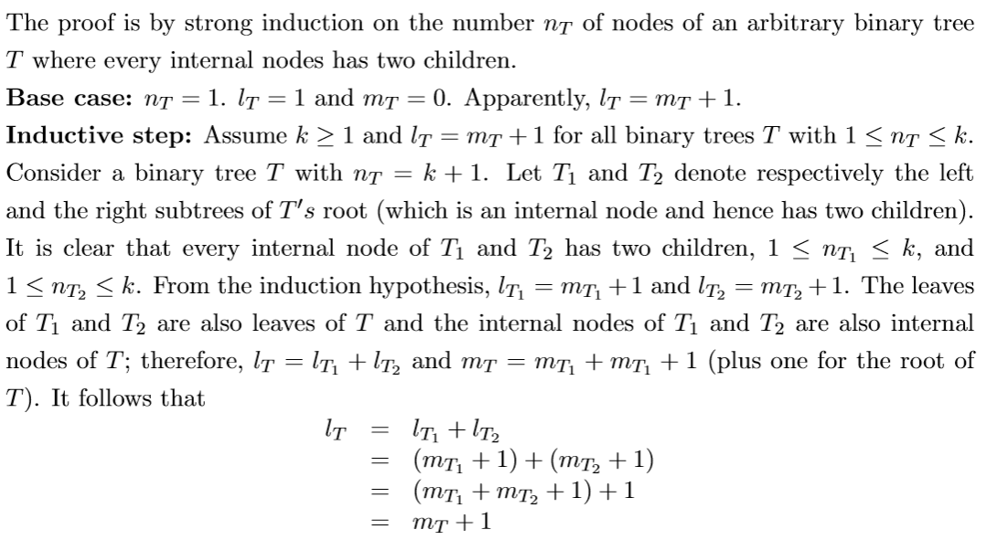
Problem 4

