Slide 1
Algorithms
Homework Assignment #2
施舜元,李孟

Slide 2
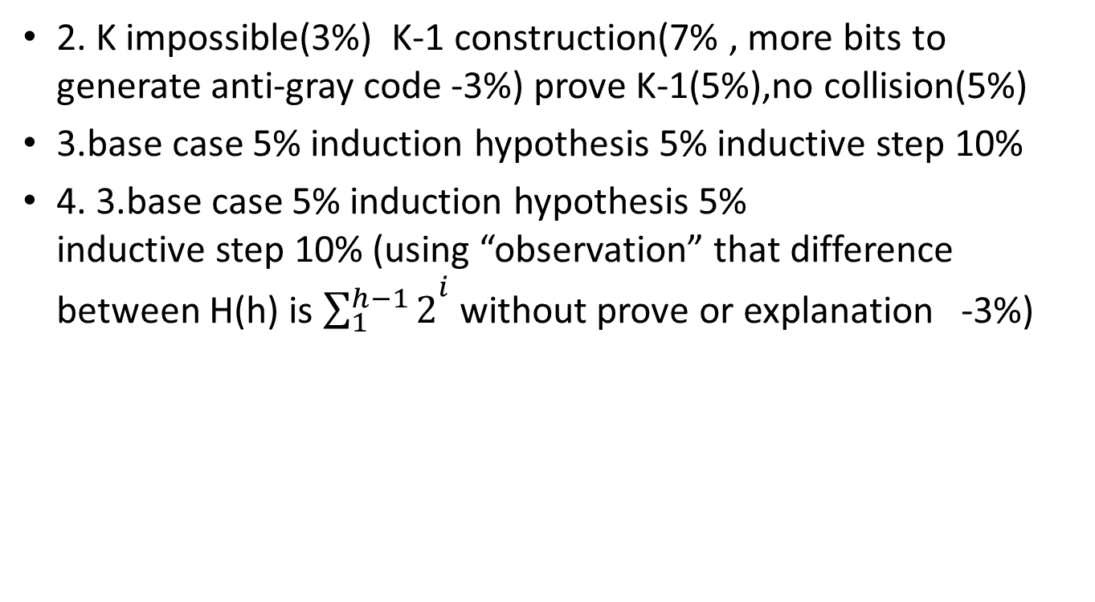
Rating criteria
2. K impossible(3%) K-1 construction(7% , more bits to generate anti-gray code -3%) prove K-1(5%),no collision(5%)
3.base case 5% induction hypothesis 5% inductive step 10%
4. 3.base case 5% induction hypothesis 5% inductive step 10% (using “observation” that difference between H(h) is ${\sum_{1}^{h−1}{2}}^{i}$ without prove or explanation -3%)

Slide 3
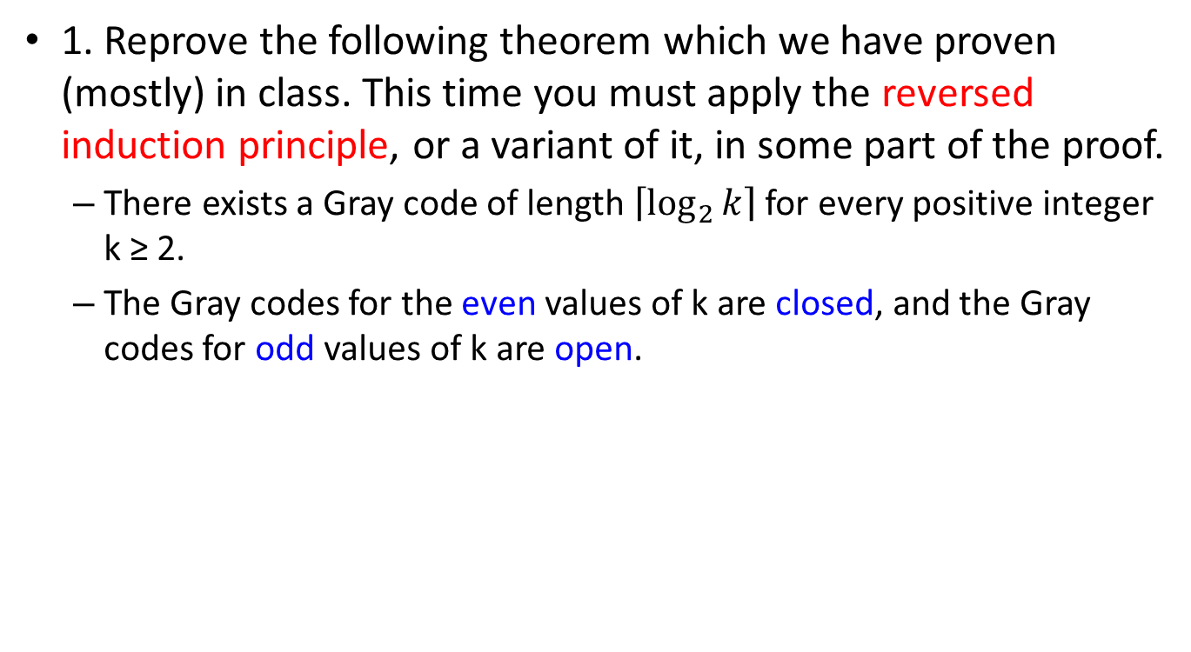
Problem 1
1. Reprove the following theorem which we have proven (mostly) in class. This time you must apply the reversed induction principle, or a variant of it, in some part of the proof.
  There exists a Gray code of length $\left\lceil \log_{2}{k}\right\rceil$ for every positive integer k ≥ 2.
  The Gray codes for the even values of k are closed, and the Gray codes for odd values of k are open.

Slide 4
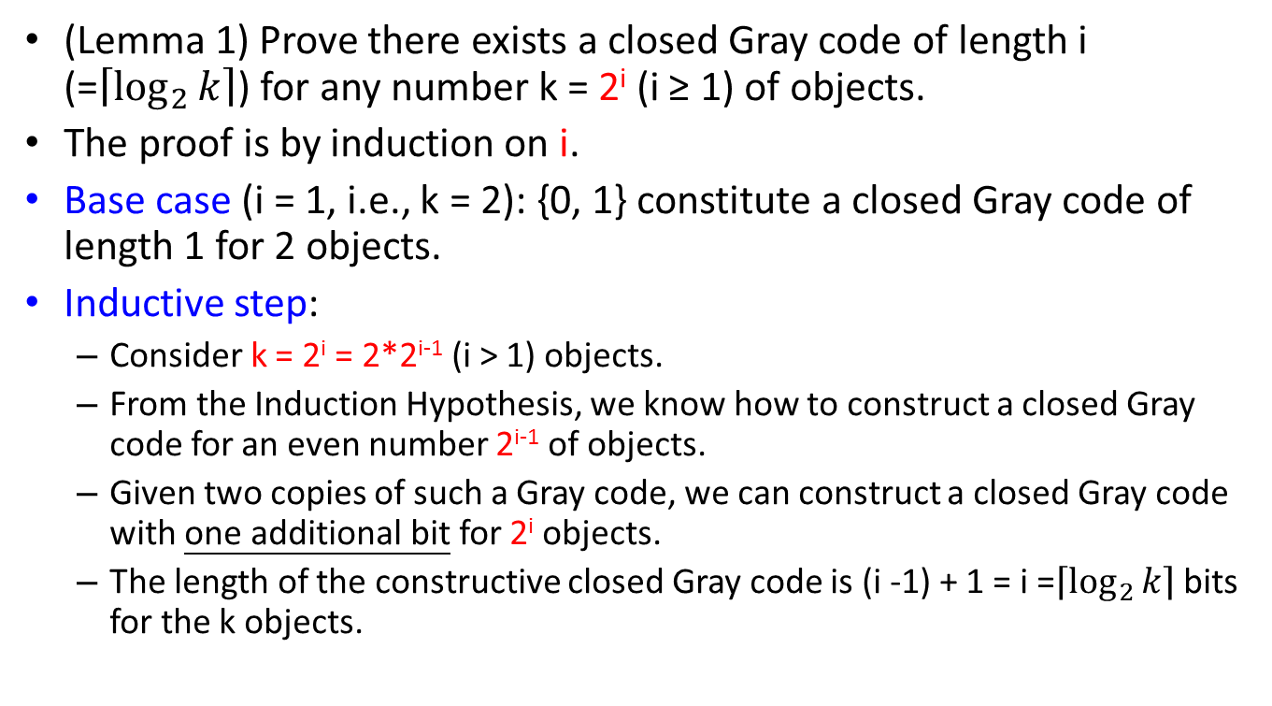
Problem 1 (cont.)
(Lemma 1) Prove there exists a closed Gray code of length i (=$\left\lceil \log_{2}{k}\right\rceil$) for any number k = 2^{i} (i ≥ 1) of objects.
The proof is by induction on i.
Base case (i = 1, i.e., k = 2): {0, 1} constitute a closed Gray code of length 1 for 2 objects.
Inductive step:
  Consider k = 2^{i} = 2*2^{i-1} (i > 1) objects.
  From the Induction Hypothesis, we know how to construct a closed Gray code for an even number 2^{i-1} of objects.
  Given two copies of such a Gray code, we can construct a closed Gray code with one additional bit for 2^{i} objects.
  The length of the constructive closed Gray code is (i -1) + 1 = i =$\left\lceil \log_{2}{k}\right\rceil$ bits for the k objects.
Notes:
給一偶數k個object的Gray code，增加1 bit 長度便可建2k個object的Gray code

Slide 5
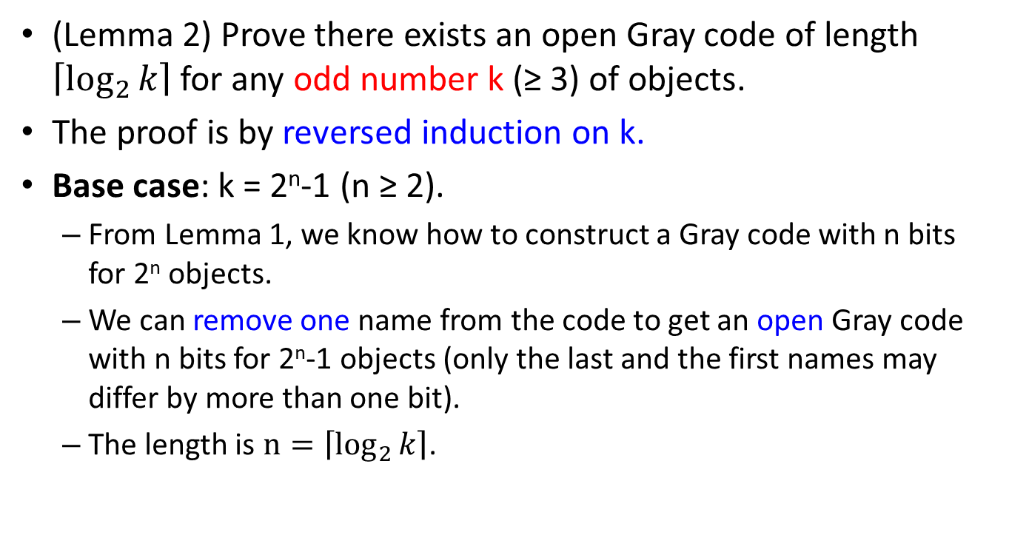
Problem 1 (cont.)
(Lemma 2) Prove there exists an open Gray code of length $\left\lceil \log_{2}{k}\right\rceil$ for any odd number k (≥ 3) of objects.
The proof is by reversed induction on k.
Base case: k = 2^{n}-1 (n ≥ 2).
  From Lemma 1, we know how to construct a Gray code with n bits for 2^{n} objects.
  We can remove one name from the code to get an open Gray code with n bits for 2^{n}-1 objects (only the last and the first names may differ by more than one bit).
  The length is $n=\left\lceil \log_{2}{k}\right\rceil$.

Slide 6
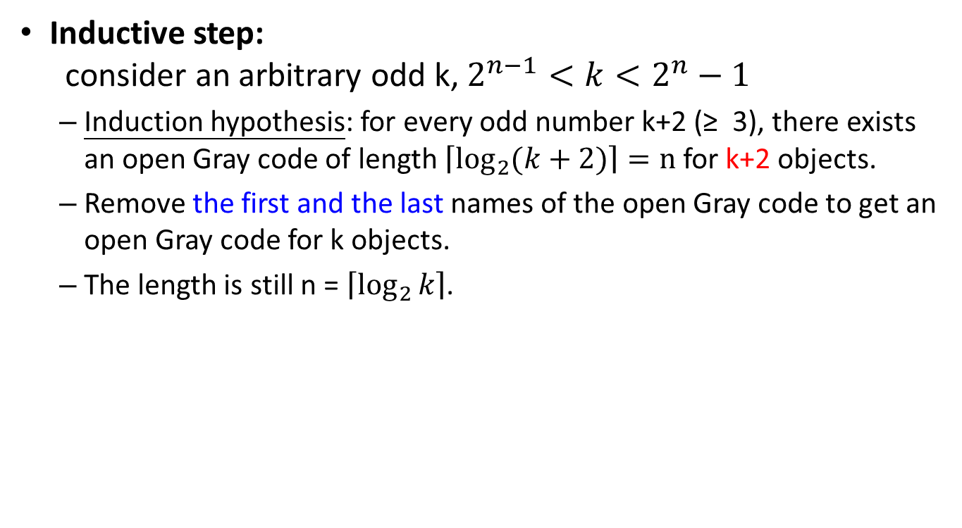
Problem 1 (cont.)
Inductive step:
consider an arbitrary odd k, $2^{n−1}<k<2^{n}−1$
  Induction hypothesis: for every odd number k+2 (≥ 3), there exists an open Gray code of length $\left\lceil \log_{2}{(k+2)}\right\rceil =n$ for k+2 objects.
  Remove the first and the last names of the open Gray code to get an open Gray code for k objects.
  The length is still n = $\left\lceil \log_{2}{k}\right\rceil$.

Slide 7
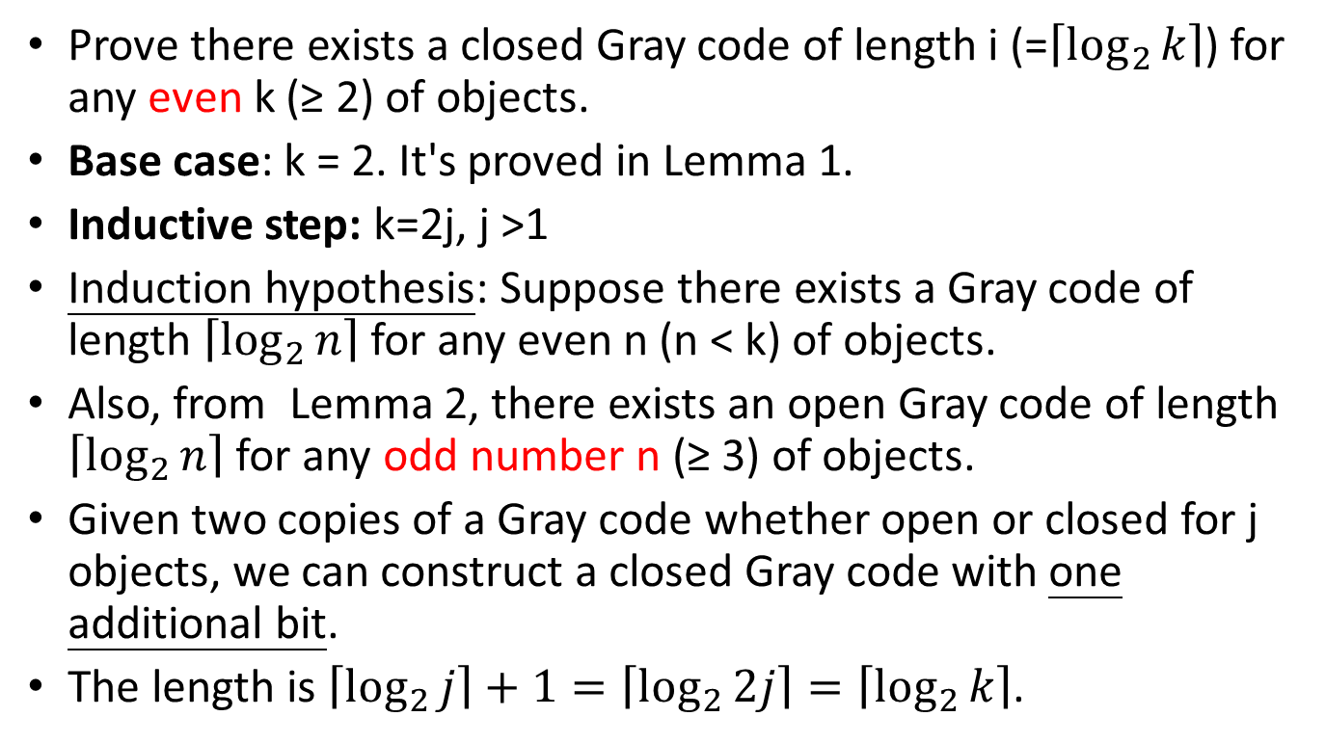
Problem 1 (cont.)
Prove there exists a closed Gray code of length i (=$\left\lceil \log_{2}{k}\right\rceil$) for any even k (≥ 2) of objects.
Base case: k = 2. It's proved in Lemma 1.
Inductive step: k=2j, j >1
Induction hypothesis: Suppose there exists a Gray code of length $\left\lceil \log_{2}{n}\right\rceil$ for any even n (n < k) of objects.
Also, from Lemma 2, there exists an open Gray code of length $\left\lceil \log_{2}{n}\right\rceil$ for any odd number n (≥ 3) of objects.
Given two copies of a Gray code whether open or closed for j objects, we can construct a closed Gray code with one additional bit.
The length is $\left\lceil \log_{2}{j}\right\rceil +1=\left\lceil \log_{2}{2j}\right\rceil =\left\lceil \log_{2}{k}\right\rceil$.
Notes:
Strong induction
對於所有小於n大於2的k個物件，Gray code長度是i

Slide 8
Problem 2
1. We can define anti-Gray codes in the following way. Instead of minimizing the difference between two consecutive strings, we can try to maximize it. Is it possible to design an encoding for any even number of objects such that each pair of two consecutive strings differ by k bits (where k is the number of bits in each string)? How about k - 1 bits (or k -2, k -3, etc.)? If it is possible, find an efficient construction.

Slide 9
Problem 2 (cont.)
It is impossible to design an encoding for an even number of objects such that each pair of two consecutive strings differ by K bits
  if we want to make each pair of two consecutive strings differ by k bits, we will find that we can only construct two-object anti-Gray codes because the third string will be the same as the first.
Notes:
給一偶數k個object的Gray code，增加1 bit 長度便可建2k個object的Gray code

Slide 10
Problem 2 (cont.)
We try to make each pair of two consecutive strings differ by k -1 bits.
  Construct Gray codes for the n/2 object (n is even)
01
1bits
1bits
11
00
1bits
1bits
10
Notes:
給一偶數k個object的Gray code，增加1 bit 長度便可建2k個object的Gray code

Slide 11
Problem 2 (cont.)
We try to make each pair of two consecutive strings differ by k -1 bits.
  Construct Gray codes for the n/2 object (n is even)
  Add 0-bit to all name in Gray code (00,01,10,11)
001
1bits
1bits
011
000
1bits
1bits
010
Notes:
給一偶數k個object的Gray code，增加1 bit 長度便可建2k個object的Gray code

Slide 12
Problem 2 (cont.)
We try to make each pair of two consecutive strings differ by k -1 bits.
  Repeat after each “name” in the list (000,001,010,011) => (000,000,001,001,010,010,011,011)
001
1bits
011
001
1bits
011
000
1bits
010
000
010
1bits
Notes:
給一偶數k個object的Gray code，增加1 bit 長度便可建2k個object的Gray code

Slide 13
Problem 2 (cont.)
We try to make each pair of two consecutive strings differ by k -1 bits.
  complement the duplicate “name” => (000,111,001,110,010,101,011,100)
001
Kbits
K-1bits
001
001
011
110
100
Kbits
K-1bits
011
011
000
000
K-1bits
Kbits
010
101
000
111
010
Kbits
010
K-1bits
Notes:
給一偶數k個object的Gray code，增加1 bit 長度便可建2k個object的Gray code

Slide 14
Problem 2 (cont.)
The construction is correct if each pair of two consecutive strings differ by k and k-1 bits which is the difference we can maximize and there is no collision for all objects.
  Because each pair of consecutive strings differ by 1 bit in Gray codes , we insert a string between two original consecutive Gray code, which differ from previous string by k bits and next string by k-1 bits .
001
Kbits
K-1bits
001
001
011
110
100
Kbits
K-1bits
011
011
000
000
K-1bits
Kbits
010
101
000
111
010
Kbits
010
K-1bits

Slide 15
Problem 2 (cont.)
To see that there is no collision for all objects, we consider the p-th object in our construction.
  If p is odd, p does not conflict with 2k-th object in Gray code Besides p does not conflict with other 2k+1-th object because we reversed the added 0-bit to “1” .
  Similarly, we can prove the case when p is even.
001
Kbits
K-1bits
001
001
011
110
100
Kbits
K-1bits
011
011
000
000
K-1bits
Kbits
010
101
000
111
010
Kbits
010
K-1bits

Slide 16
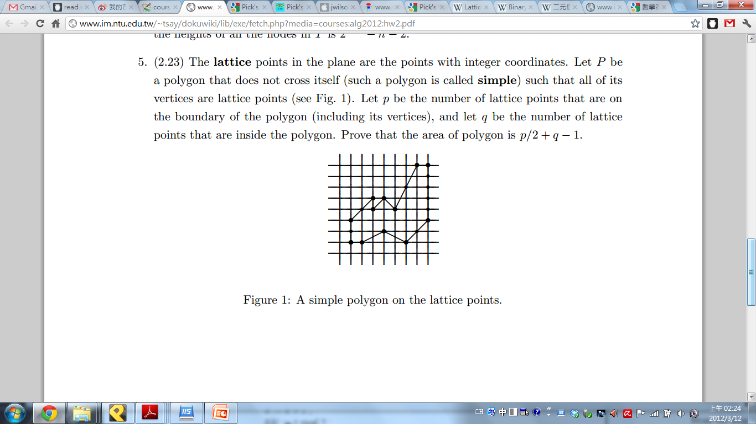
Problem 5
5. The lattice points in the plane are the points with integer coordinates.
  Let P be a polygon that does not cross itself (such a polygon is called simple) such that all of its vertices are lattice points (see Fig. 1).
  Let p be the number of lattice points that are on the boundary of the polygon (including its vertices),and
  let q be the number of lattice points that are inside the polygon.
  Prove that the area of polygon is p/2+q-1.

Slide 17
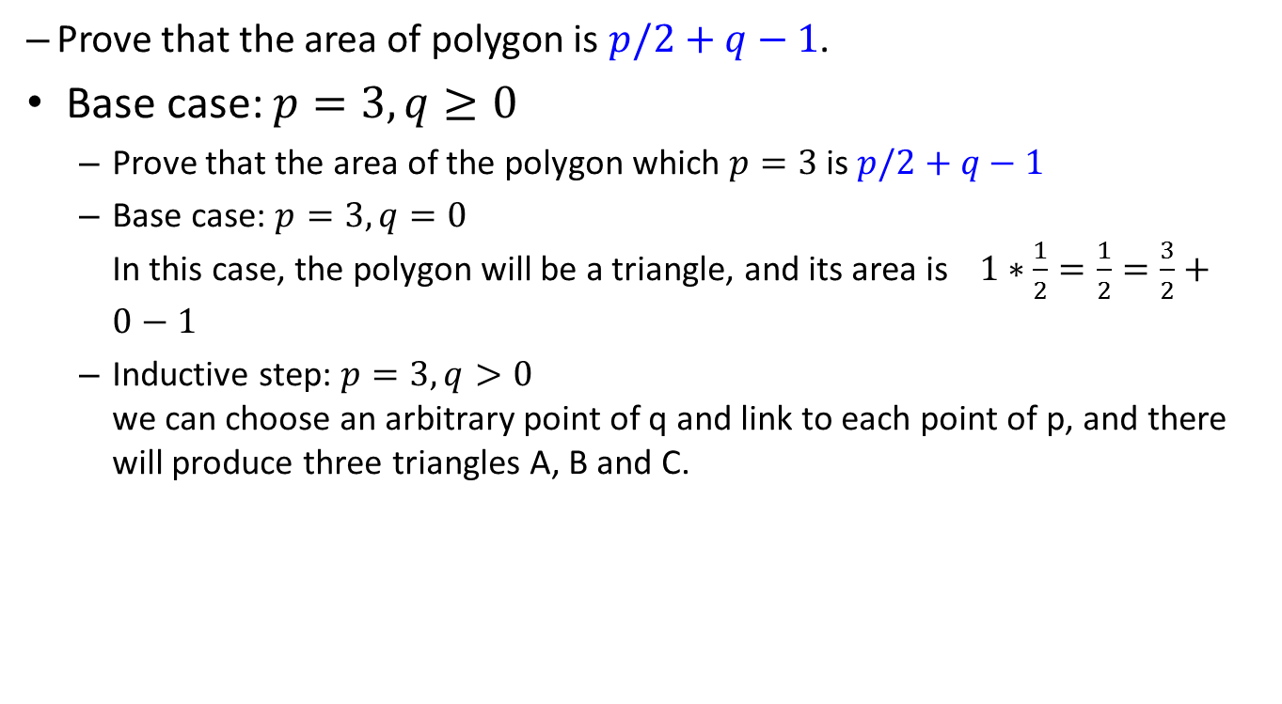
Problem 5 (cont.)
  Prove that the area of polygon is $p/2+q−1$.
Base case: $p=3, q≥0$
  Prove that the area of the polygon which $p=3$is $p/2+q−1$
  Base case: $p=3, q=0$
  In this case, the polygon will be a triangle, and its area is $1∗\frac{1}{2}=\frac{1}{2}=\frac{3}{2}+0−1$
  Inductive step: $p=3, q>0$
  we can choose an arbitrary point of q and link to each point of p, and there will produce three triangles A, B and C.

Slide 18
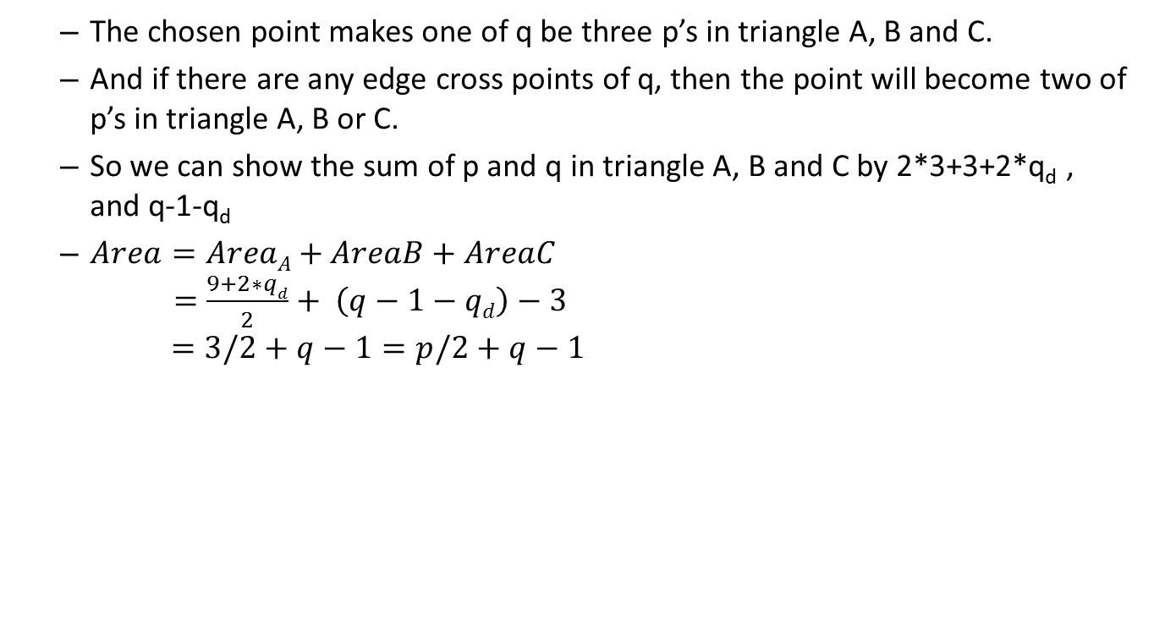
Problem 5 (cont.)
  The chosen point makes one of q be three p’s in triangle A, B and C.
  And if there are any edge cross points of q, then the point will become two of p’s in triangle A, B or C.
  So we can show the sum of p and q in triangle A, B and C by 2*3+3+2*q_{d} , and q-1-q_{d}
  $Area=AreaA+AreaB+AreaC$
  $=\frac{9+2∗qd}{2}+ \left(q−1−qd\right)−3$
  $=3/2+q−1=p/2+q−1$

Slide 19

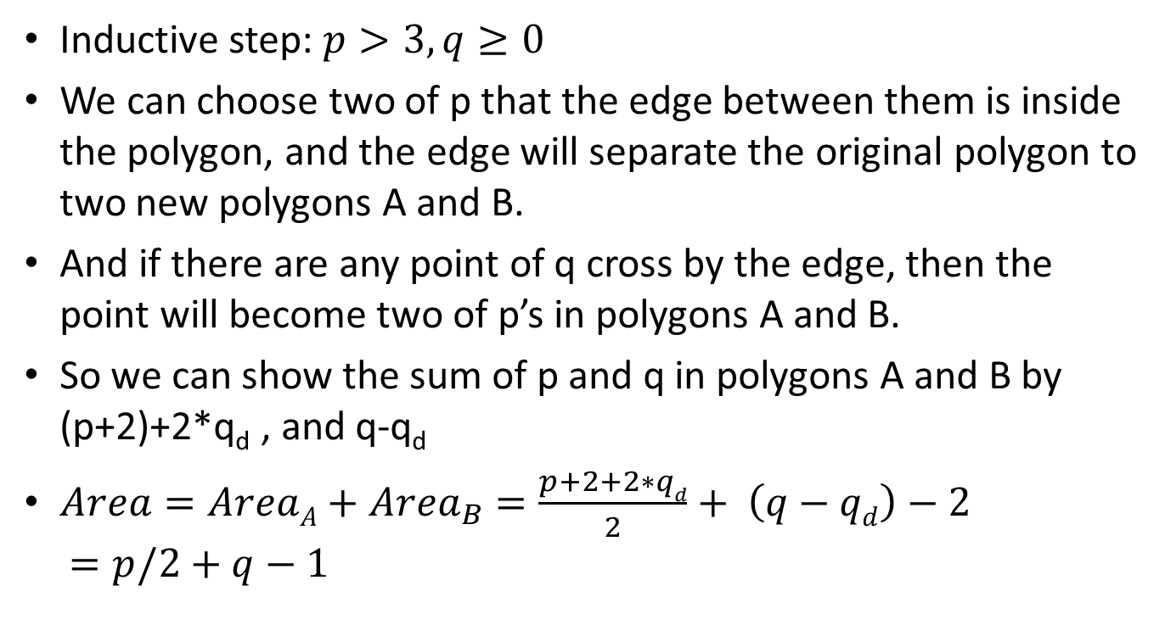
Problem 5 (cont.)
Inductive step: $p>3, q≥0$
We can choose two of p that the edge between them is inside the polygon, and the edge will separate the original polygon to two new polygons A and B.
And if there are any point of q cross by the edge, then the point will become two of p’s in polygons A and B.
So we can show the sum of p and q in polygons A and B by (p+2)+2*q_{d} , and q-q_{d}
$Area=AreaA+{Area}_{B}=\frac{p+2+2∗qd}{2}+ \left(q−qd\right)−2$
$=p/2+q−1$

