Slide 1
Algorithms TA Session #1
Carlos & Rick
2017/03/21

Slide 2
Homework #1
Avg:61.4, std:13.8

Slide 3
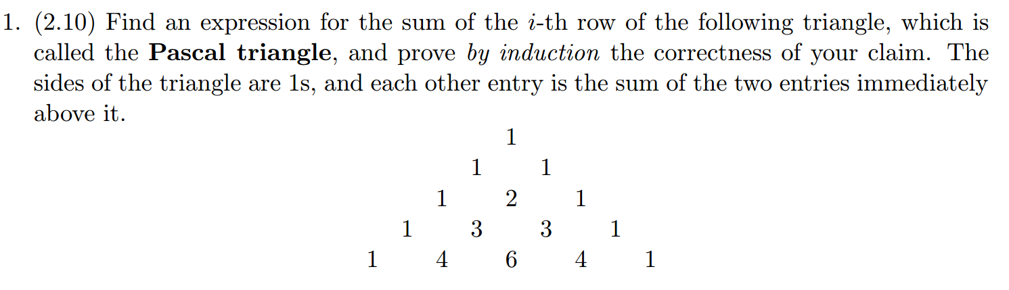

Slide 4

Make of the Formula
By observing the first few rows, we may guess that the sum of the i^{th} row is${ 2}^{i−1}$.
Proposition:
The sum of i^{th} row in Pascal Triangle is ${ 2}^{i−1}$

Slide 5
Proof
The proof is by induction on n.
Base case(n=1): the sum of the first row is 1 = 2¹⁻¹.
Inductive step: Let the elements of n^{th} row are (1,a₁,a₂,…,a_{n-2},1), the elements of n+1th row are (1,b₁,b₂,…,b_{n-2}, b_{n-1},1).
The sum of the n+1th row
=1+b₁+b₂+…+b_{n-2}+b_{n-1}+1
=1+(1+a₁)+(a₁+a₂)+…+(a_{n-3}+a_{n-2})+(a_{n-2}+1)+1
=2*(1+a₁+a₂+…+a_{n-3}+a_{n-2}+1)
=2*(2^{n-1}) (inductive hypothesis)
=2^{n} = 2^{(n+1)-1}
By M.I., we proved the proposition.

Slide 6
Prove by Induction
appendix

Slide 7
Induction in High School
Base case
假設n=k成立
證明n=k+1成立
By induction

Slide 8

Induction Now
Base case
Inductive step$:∀n(P\left(n\right)⇒P(n+1))$
By induction

Slide 9
Example
Prove A(n) = B(n) for all positive integer n
A(1) = B(1)
A(n+1) = … = A(n) + C = B(n) + C = … = B(n+1)
By induction

Slide 10
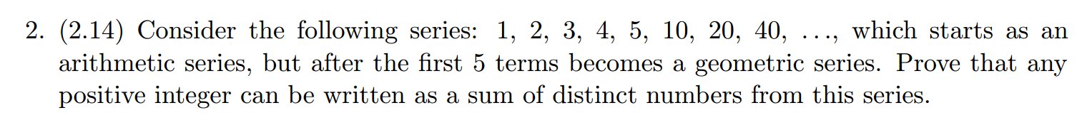

Slide 11

Proof(1)
Proposition: Any positive integer can be written as a sum of distinct numbers from this series.
Any positive integer can be presented as $10(n)+r, 1≤r≤9,n∈ℕ∪\{0\}$ form.
It is easy to prove that any r can be written as a sum of distinct numbers from the series.
ex: 1,2,3,4,5,(5+1),(5+2),(5+3),(5+4)

Slide 12

Proof(2)
The thing we have to prove is that any 10n can be written as a sum of distinct numbers from infinity series S = {10,20,40…}
The proof is by induction on n.
Base case(n=0,1):can be proved intuitively
Strongly Inductive Hypothesis: for all $x$,
1$≤$ $x≤$n$, x∈ℕ$ can be written as a sum of distinct numbers S_{x}, which is a subset of S.

Slide 13
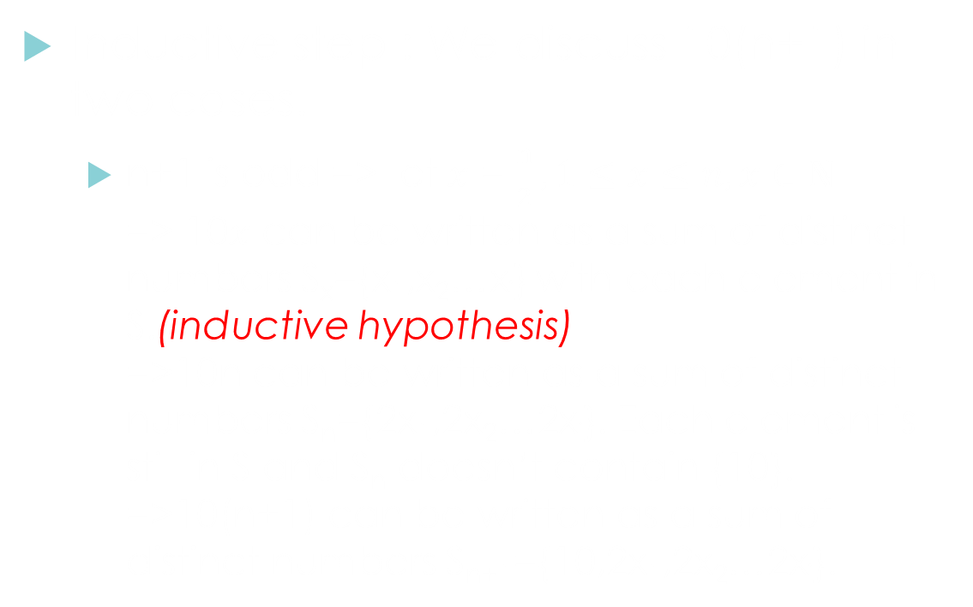
Proof(3)
Inductive step : We discuss 10(n+1) in two cases.
  n+1 is odd => let $x$ = $\frac{n}{2},1≤x≤n, x∈ℕ$
  => 10$x$ can be written as a sum of distinct numbers S_{x}={x₁,x₂…x_{i}} with each element in S.(inductive hypothesis)
  =>10n can be written as a sum of distinct numbers S_{n}={2x₁,2x₂…2x_{i}}. Each element is still in S and S_{n} doesn’t contain {10}.
  =>10(n+1) can be written as a sum of distinct numbers S_{n+1}={10,2x₁,2x₂…2x_{i}}.

Slide 14
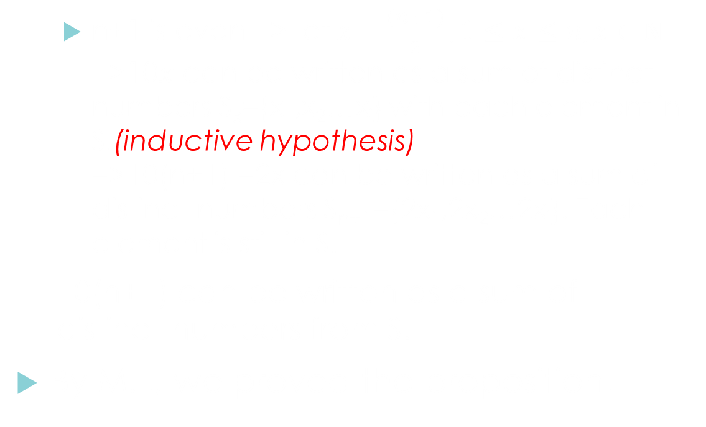
Proof(4)
  n+1 is even => let $x$ = $\frac{(n+1)}{2},1≤x≤n, x∈ℕ$
  =>10$x$ can be written as a sum of distinct numbers S_{x}={x₁,x₂…x_{i}} with each element in S.(inductive hypothesis)
  =>10(n+1) =2x can be written as a sum of distinct numbers S_{n+1}={2x₁,2x₂…2x_{i}}. Each element is still in S.
  10(n+1) can be written as a sum of distinct numbers from S.
By M.I., we proved the proposition.

Slide 15
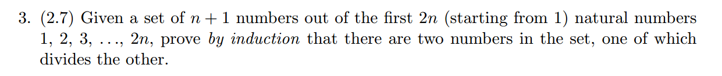

Slide 16
Proof(1)
Proposition:
Given a set of n + 1 numbers out of the first 2n (starting from 1) natural numbers 1, 2, 3, . . ., 2n, there must be two numbers in the set, one of which divides the other.
The proof is by induction on n.
Base case(n=1):Select 2 numbers from the first 2 numbers. We must choose 1 and 2, and 1 divides 2.

Slide 17
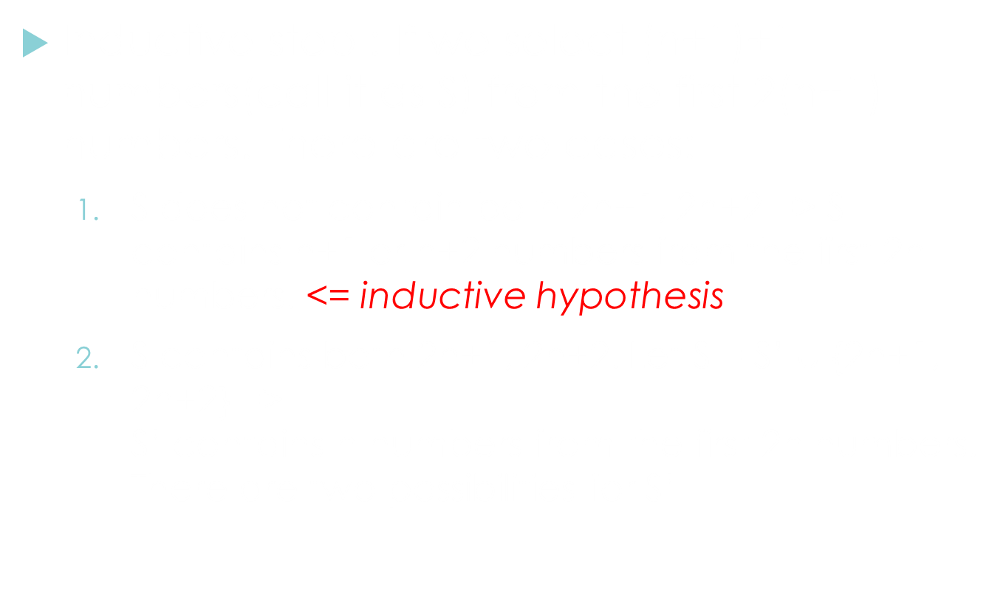
Proof(2)
Inductive step : If we select (n+1)+1 numbers(call it as S) from the first 2(n+1) numbers. There are two cases:
  S does not contain both 2n+1, 2n+2 => S contains n+1 or n+2 numbers from the first 2n numbers. <= inductive hypothesis
  S contains both 2n+1, 2n+2. Let S = S’ $∪$ {2n+1, 2n+2} =>
  S’ contains n numbers from the first 2n numbers.
  There are two possibilities for S’

Slide 18
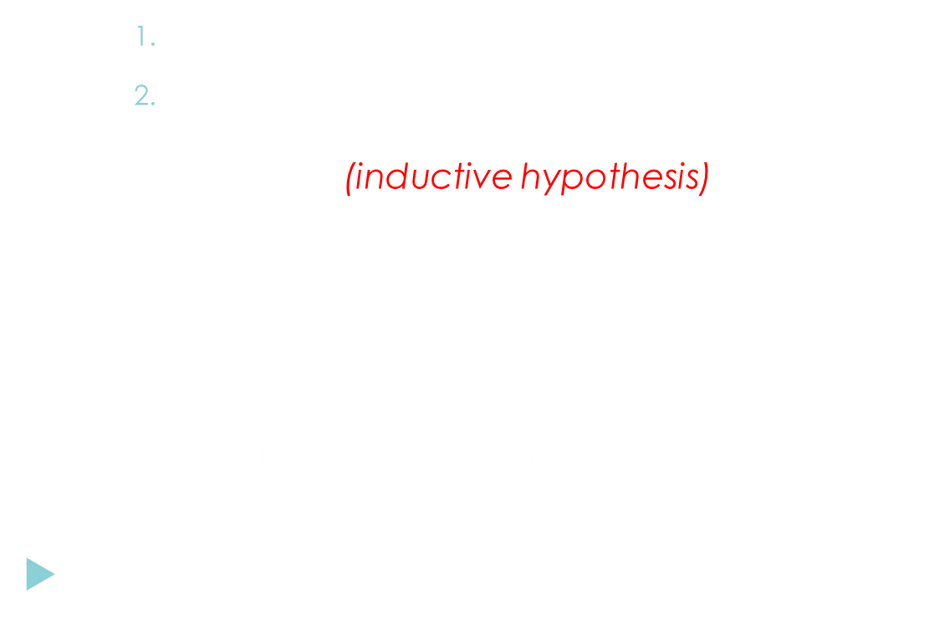
Proof(3)
    S’ contains n+1 => n+1 is a divider of 2n+2
    S’ does not contain n+1 => S’ $∪$ {n+1} contains n+1 numbers out of the first 2n numbers(inductive hypothesis) and n+1 is not a divider for any number in the first 2n numbers. => S’ either contains two numbers, one of which divides the other or contains the divider of n+1.The divider of n+1 also divides 2n+2.
  S contains two numbers, one of which divides the other
By M.I., we proved the proposition.

Slide 19
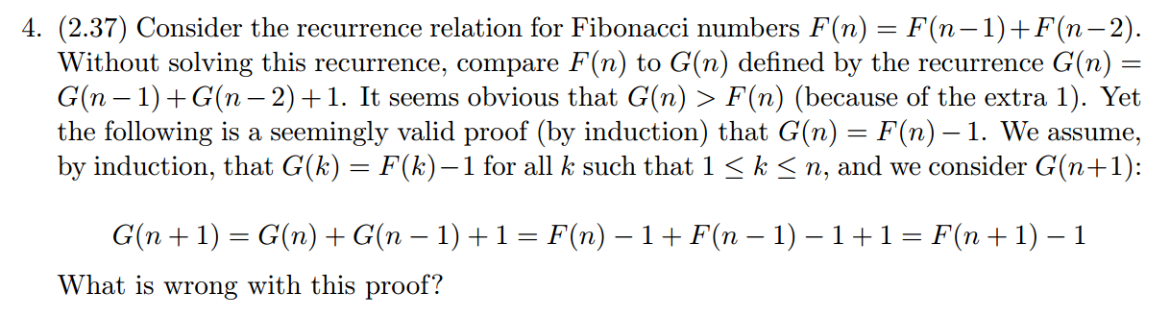

Slide 20
Try to prove
Base case (n=1):
F(1) = 1, G(1) = 1+1 =2
=> G(1) ≠ F(1) - 1
Mathematical Induction fails!!

Slide 21
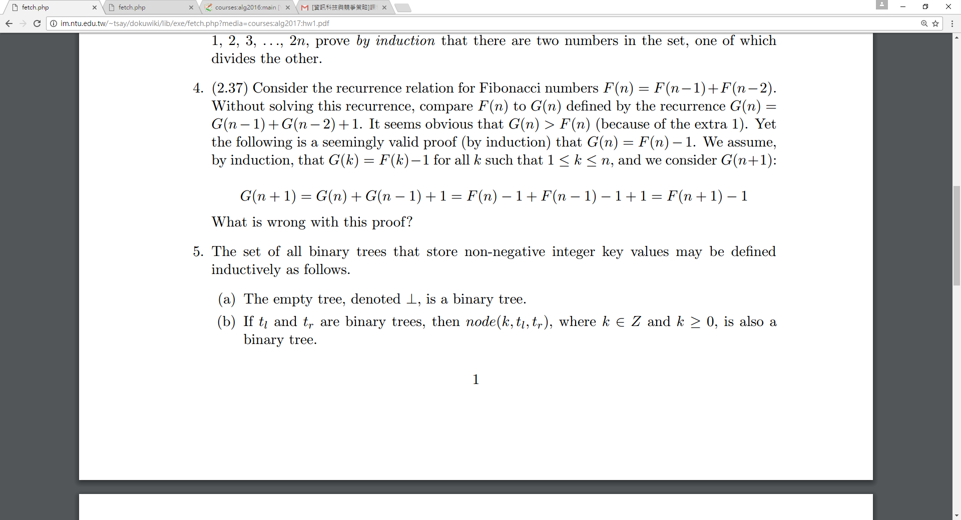
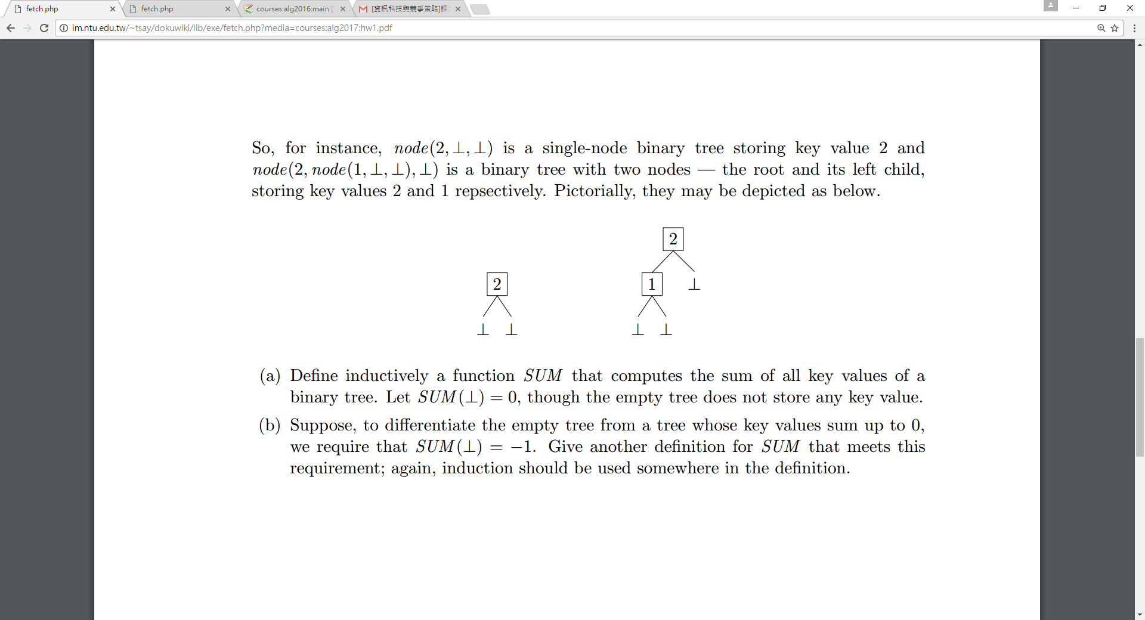

Slide 22

(a)
$\left\{\begin{aligned}SUM(\text{⊥})=0 \\ SUM(node(k,t_{l},t_{r}))=k+SUM(t_{l})+SUM(t_{r})\end{aligned}\right.$

Slide 23
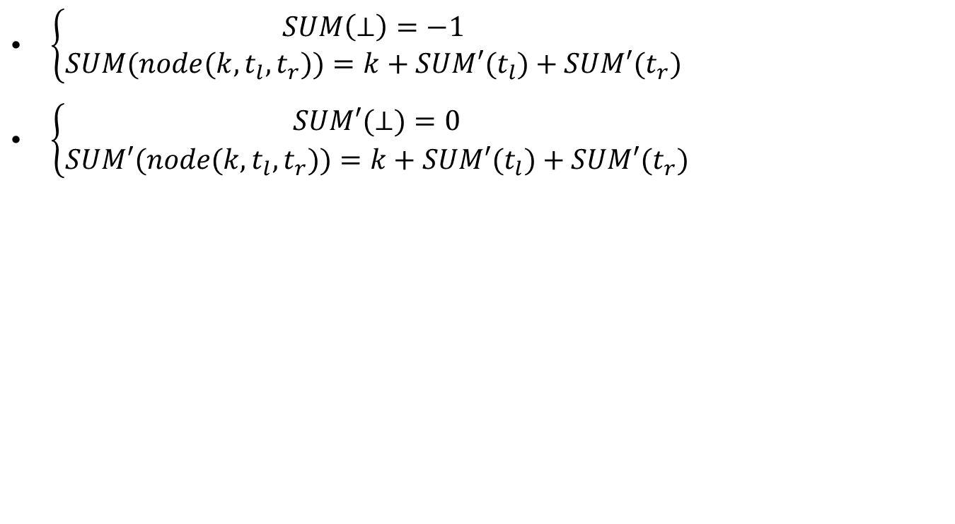
(b)
$\left\{\begin{aligned}SUM\left(\text{⊥}\right)=−1 \\ SUM(node(k,t_{l},t_{r}))=k+SUM′(t_{l})+SUM′(t_{r})\end{aligned}\right.$
$\left\{\begin{aligned}SUM′(\text{⊥})=0 \\ SUM′(node(k,t_{l},t_{r}))=k+SUM′(t_{l})+SUM′(t_{r})\end{aligned}\right.$

