Slide 1
Homework #2
Rick Lee

Slide 2
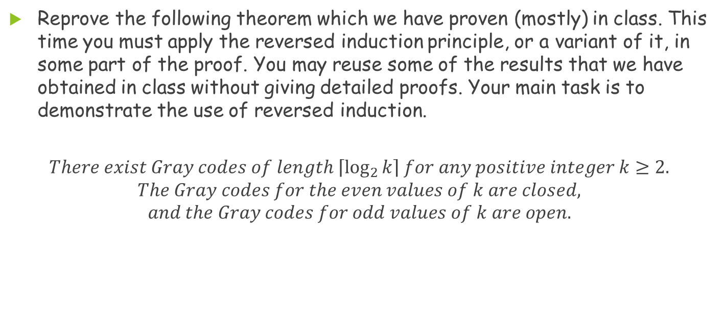
Problem1
Reprove the following theorem which we have proven (mostly) in class. This time you must apply the reversed induction principle, or a variant of it, in some part of the proof. You may reuse some of the results that we have obtained in class without giving detailed proofs. Your main task is to demonstrate the use of reversed induction.
$$There exist Gray codes of length \left\lceil \log_{2}{k}\right\rceil for any positive integer k≥2.$$
$$The Gray codes for the even values of k are closed,$$
$$and the Gray codes for odd values of k are open.$$

Slide 3
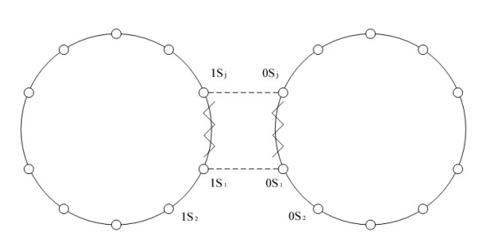
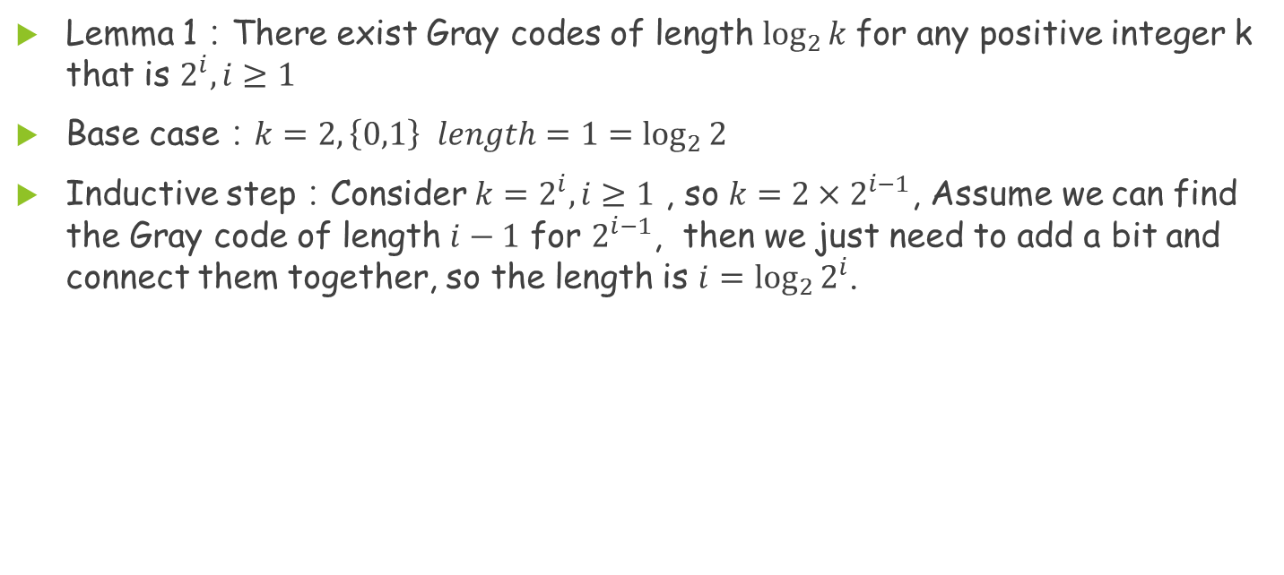
Problem 1(Cont.)
Lemma 1：There exist Gray codes of length $\log_{2}{k}$for any positive integer k that is $2^{i},i≥1$
Base case：$k=2, \left\{0,1\right\}$ $length=1=\log_{2}{2}$
Inductive step：Consider $k=2^{i}, i≥1$ , so $k=2×2^{i−1}$, Assume we can find the Gray code of length $i−1$ for $2^{i−1}$, then we just need to add a bit and connect them together, so the length is $i=\log_{2}{2^{i}}$.

Slide 4
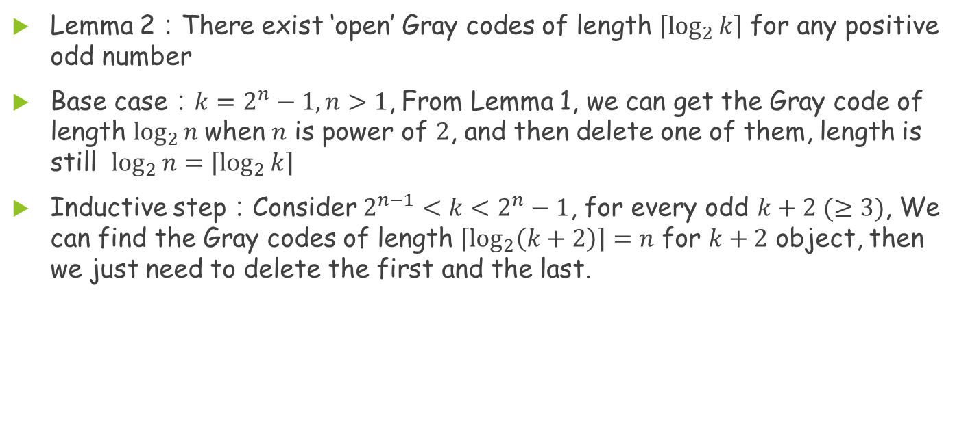
Problem 1(Cont.)
Lemma 2：There exist ‘open’ Gray codes of length $\left\lceil \log_{2}{k}\right\rceil$ for any positive odd number
Base case：$k=2^{n}−1, n>1$, From Lemma 1, we can get the Gray code of length $\log_{2}{n}$when $n$ is power of $2$, and then delete one of them, length is still $\log_{2}{n}=\left\lceil \log_{2}{k}\right\rceil$
Inductive step：Consider $2^{n−1}<k<2^{n}−1$, for every odd $k+2 (≥3)$, We can find the Gray codes of length $\left\lceil \log_{2}\left(k+2\right)\right\rceil =n$ for $k+2$ object, then we just need to delete the first and the last.

Slide 5
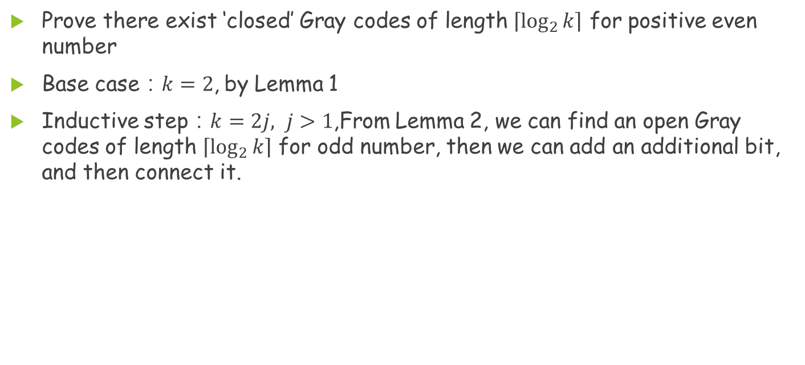
Problem 1 (Cont.)
Prove there exist ‘closed’ Gray codes of length $\left\lceil \log_{2}{k}\right\rceil$ for positive even number
Base case：$k=2$, by Lemma 1
Inductive step：$k=2j, j>1$,From Lemma 2, we can find an open Gray codes of length $\left\lceil \log_{2}{k}\right\rceil$ for odd number, then we can add an additional bit, and then connect it.

Slide 6
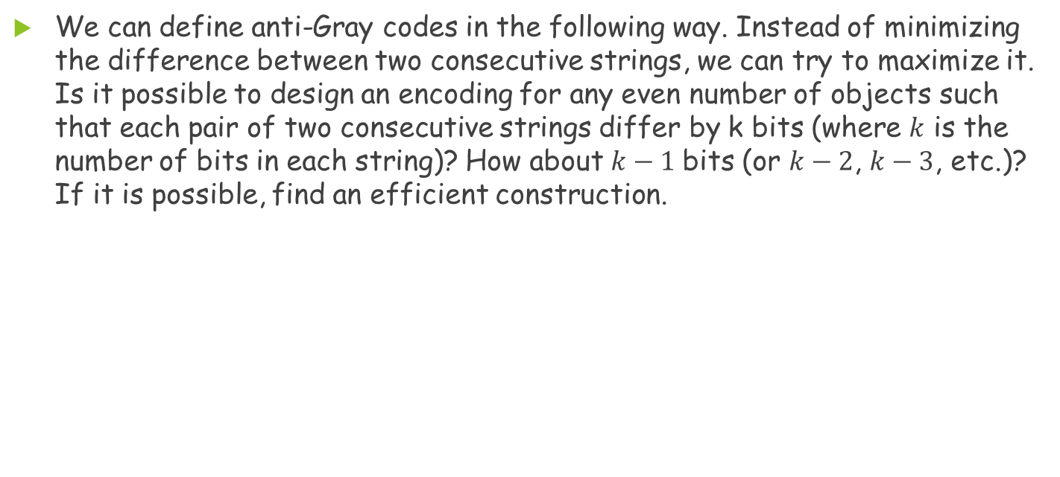
Problem 2
We can define anti-Gray codes in the following way. Instead of minimizing the difference between two consecutive strings, we can try to maximize it. Is it possible to design an encoding for any even number of objects such that each pair of two consecutive strings differ by k bits (where $k$ is the number of bits in each string)? How about $k−1$bits (or $k−2$, $k−3$, etc.)? If it is possible, find an efficient construction.

Slide 7
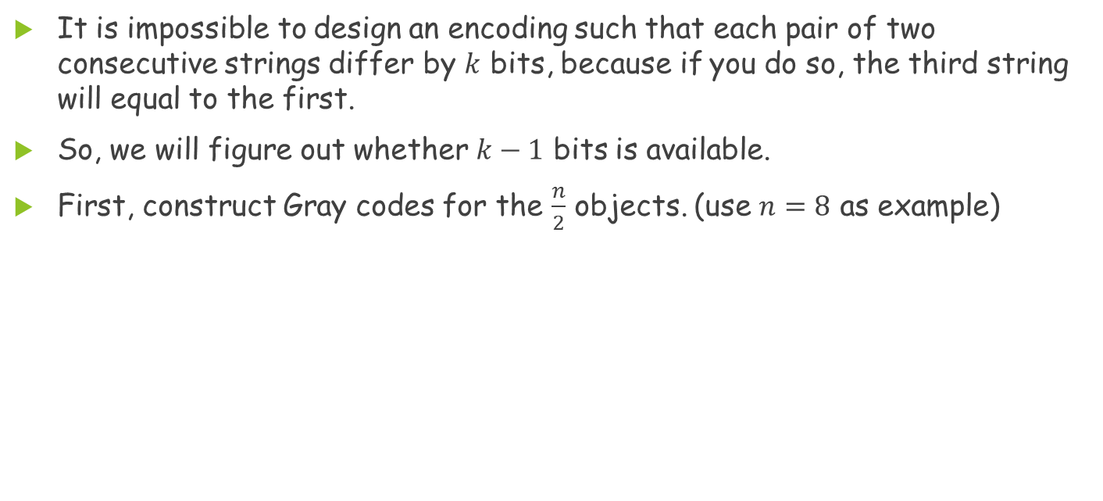
Problem 2(Cont.)
It is impossible to design an encoding such that each pair of two consecutive strings differ by $k$ bits, because if you do so, the third string will equal to the first.
So, we will figure out whether $k−1$ bits is available.
First, construct Gray codes for the $\frac{n}{2}$ objects. (use $n=8$ as example)
00
10
01
11

Slide 8
Problem 2(Cont.)
Second, add 0-bit to all the Gray code, and then duplicate all once.
Finally, change the duplicated object to its complement
000
000
000
010
000
101
111
010
001
010
001
010
001
011
001
100
110
011
011
011

Slide 9
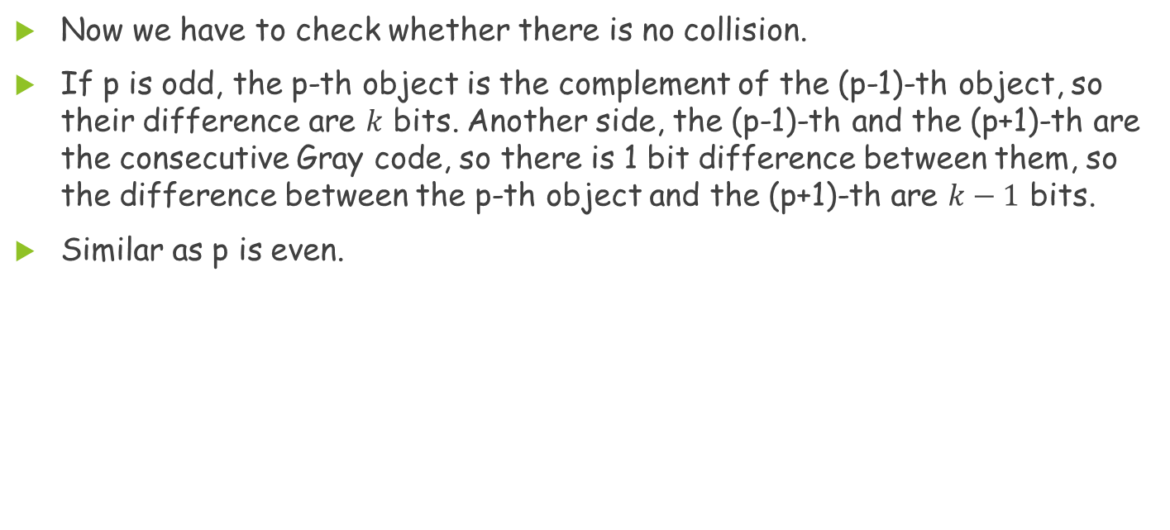
Problem 2(Cont.)
Now we have to check whether there is no collision.
If p is odd, the p-th object is the complement of the (p-1)-th object, so their difference are $k$ bits. Another side, the (p-1)-th and the (p+1)-th are the consecutive Gray code, so there is 1 bit difference between them, so the difference between the p-th object and the (p+1)-th are $k−1$ bits.
Similar as p is even.

Slide 10
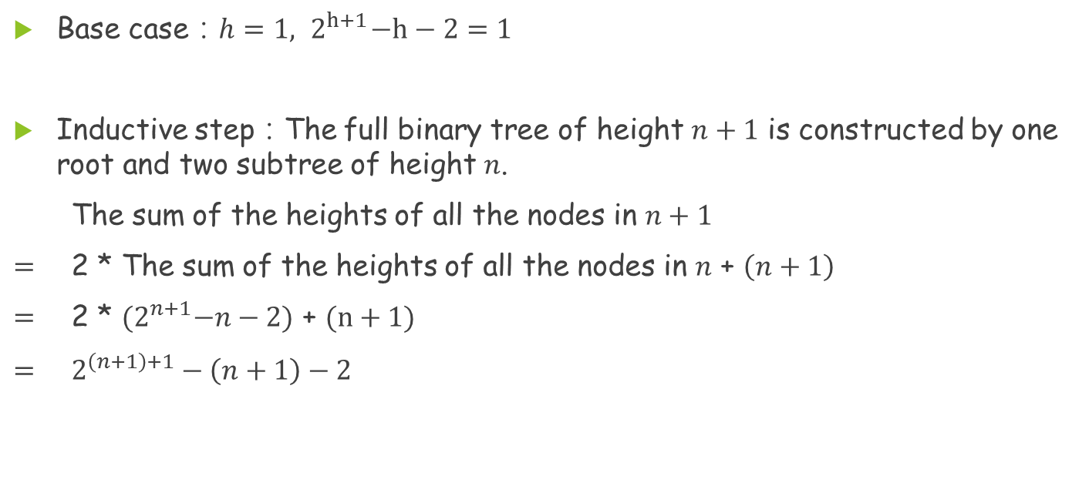
Problem 3(Cont.)
Root
Base case：$h=1, { 2}^{h+1}−h−2=1$
Inductive step：The full binary tree of height $n+1$ is constructed by one root and two subtree of height $n$.
The sum of the heights of all the nodes in $n+1$
$=$ 2 * The sum of the heights of all the nodes in $n$ + $\left(n+1\right)$
$=$ 2 * ${(2}^{n+1}−n−2)$ + $(n+1)$
$=$ $2^{\left(n+1\right)+1}−\left(n+1\right)−2$
Root

Slide 11
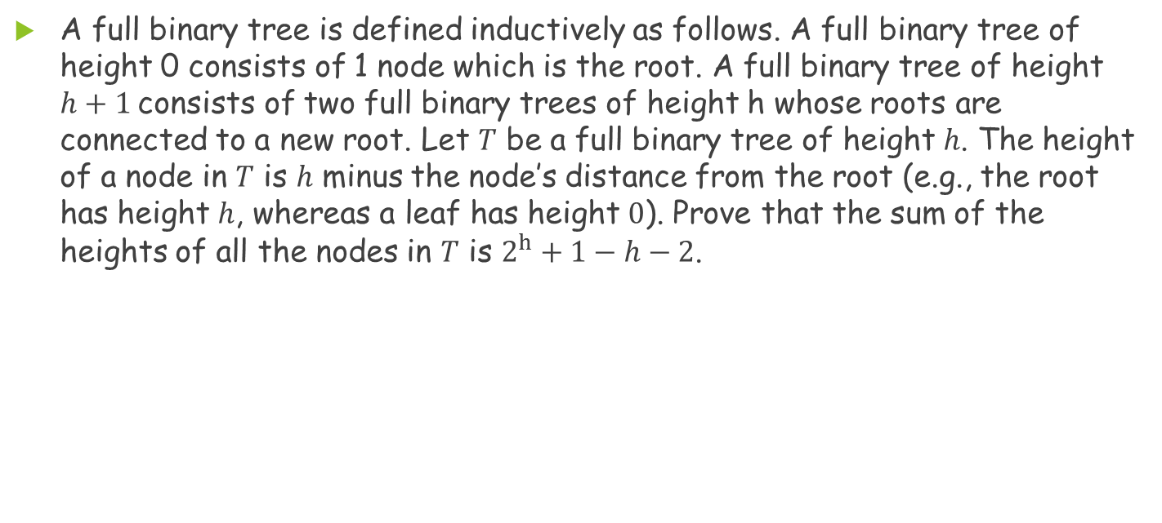
Problem 3
A full binary tree is defined inductively as follows. A full binary tree of height 0 consists of 1 node which is the root. A full binary tree of height $h+1$consists of two full binary trees of height h whose roots are connected to a new root. Let $T$ be a full binary tree of height $h$. The height of a node in $T$ is $h$ minus the node’s distance from the root (e.g., the root has height $h$, whereas a leaf has height $0$). Prove that the sum of the heights of all the nodes in $T$ is $2^{h}+1−h−2$.

Slide 12
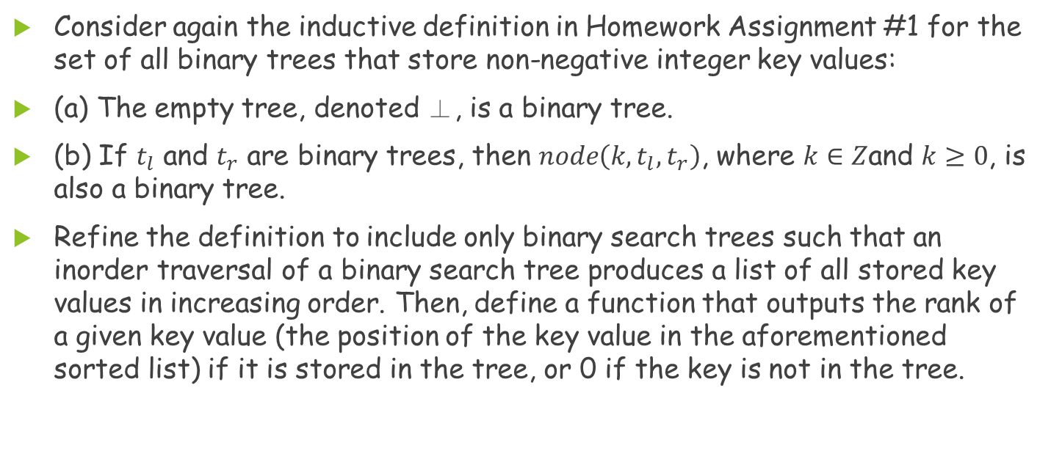
Problem 4
Consider again the inductive definition in Homework Assignment #1 for the set of all binary trees that store non-negative integer key values:
(a) The empty tree, denoted ⊥, is a binary tree.
(b) If $t_{l}$ and $t_{r}$ are binary trees, then $node\left(k,t_{l},t_{r}\right)$, where $k∈Z$and $k≥0$, is also a binary tree.
Refine the definition to include only binary search trees such that an inorder traversal of a binary search tree produces a list of all stored key values in increasing order. Then, define a function that outputs the rank of a given key value (the position of the key value in the aforementioned sorted list) if it is stored in the tree, or 0 if the key is not in the tree.

Slide 13
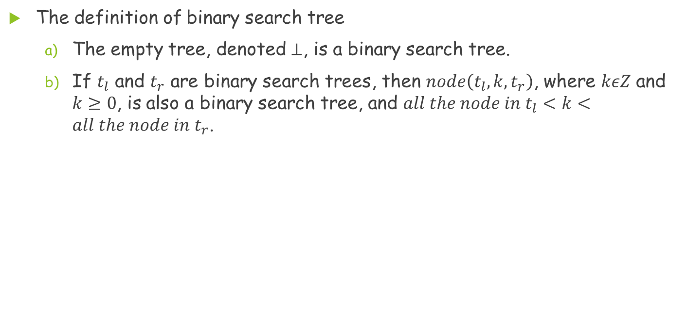
Problem 4(Cont.)
The definition of binary search tree
  The empty tree, denoted $⊥$, is a binary search tree.
  If $t_{l}$ and $t_{r}$ are binary search trees, then $node\left(t_{l},k,t_{r}\right)$, where $kεZ$ and $k≥0$, is also a binary search tree, and $all the node in t_{l}<k<all the node in t_{r}$.

Slide 14
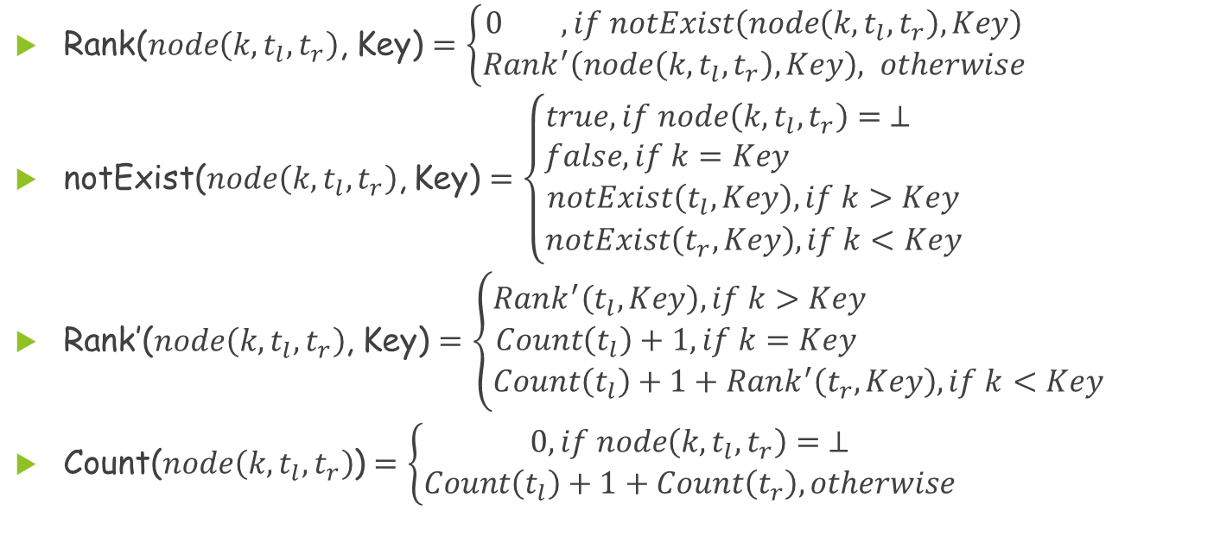
Problem 4(Cont.)
Rank($node\left(k,t_{l},t_{r}\right)$, Key) $=\left\{\begin{aligned}0 ,if notExist\left(node\left(k,t_{l},t_{r}\right),Key\right) \\ Rank^{′}\left(node\left(k,t_{l},t_{r}\right),Key\right), otherwise\end{aligned}\right.$
notExist($node\left(k,t_{l},t_{r}\right)$, Key) $=\left\{\begin{aligned}true, if node\left(k,t_{l},t_{r}\right)= ⊥ \\ false, if k=Key \\ notExist\left(t_{l},Key\right), if k>Key \\ notExist\left(t_{r},Key\right), if k<Key\end{aligned}\right.$
Rank’($node\left(k,t_{l},t_{r}\right)$, Key) $=\left\{\begin{aligned}Rank^{′}\left(t_{l},Key\right), if k>Key \\ Count\left(t_{l}\right)+1, if k=Key \\ Count\left(t_{l}\right)+1+Rank^{′}\left(t_{r},Key\right), if k<Key\end{aligned}\right.$
Count($node\left(k,t_{l},t_{r}\right)$) $=\left\{\begin{aligned}0, if node\left(k,t_{l},t_{r}\right)= ⊥ \\ Count\left(t_{l}\right)+1+Count\left(t_{r}\right), otherwise\end{aligned}\right.$

Slide 15
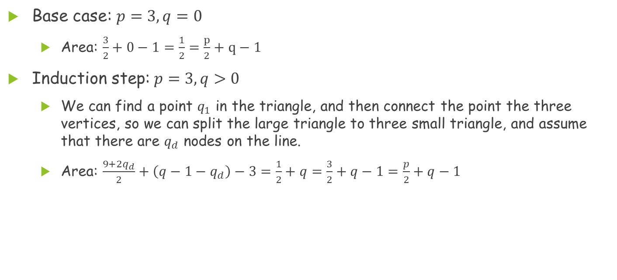
Problem 5
Base case: $p=3, q=0$
  Area: $\frac{3}{2}+0−1=\frac{1}{2}=\frac{p}{2}+q−1$
Induction step: $p=3, q>0$
  We can find a point $q_{1}$ in the triangle, and then connect the point the three vertices, so we can split the large triangle to three small triangle, and assume that there are $q_{d}$ nodes on the line.
  Area: $\frac{9+2q_{d}}{2}+\left(q−1−q_{d}\right)−3=\frac{1}{2}+q=\frac{3}{2}+q−1=\frac{p}{2}+q−1$

Slide 16
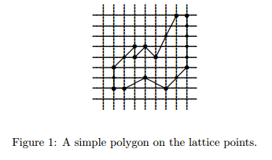
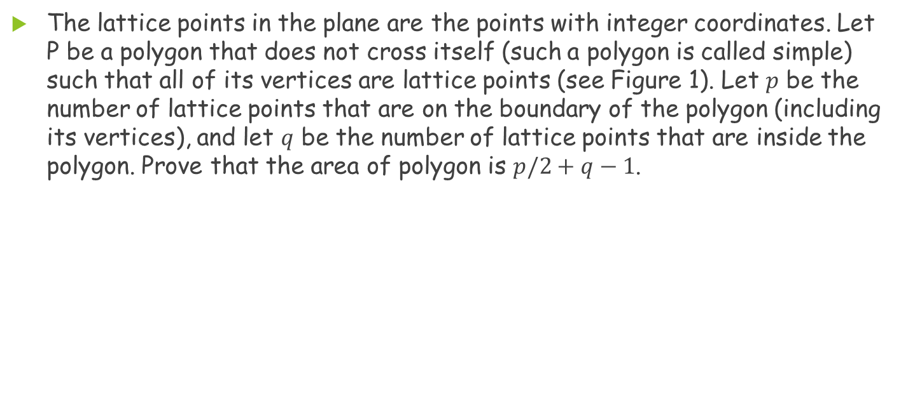
Problem 5
The lattice points in the plane are the points with integer coordinates. Let P be a polygon that does not cross itself (such a polygon is called simple) such that all of its vertices are lattice points (see Figure 1). Let $p$ be the number of lattice points that are on the boundary of the polygon (including its vertices), and let $q$ be the number of lattice points that are inside the polygon. Prove that the area of polygon is $p/2+q−1$.

Slide 17
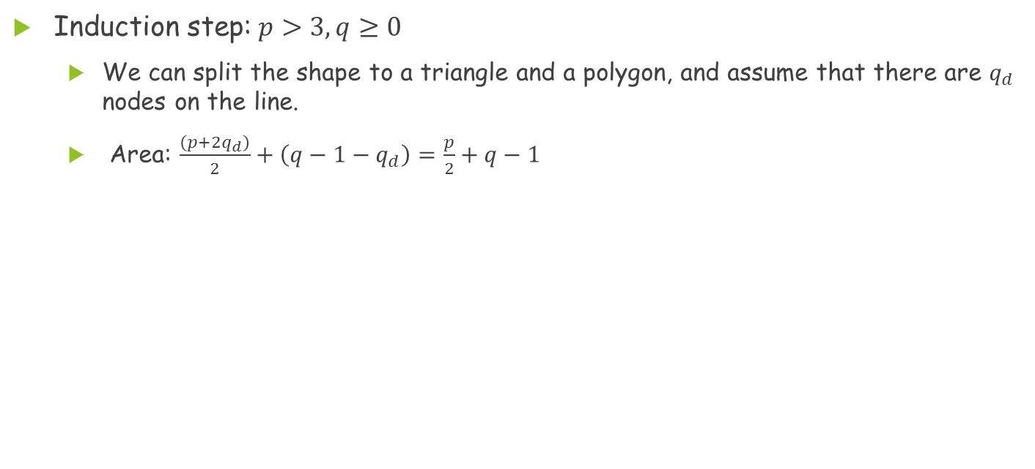
Problem 5(Cont.)
Induction step: $p>3, q≥0$
  We can split the shape to a triangle and a polygon, and assume that there are $q_{d}$ nodes on the line.
  Area: $\frac{\left(p+2q_{d}\right)}{2}+\left(q−1−q_{d}\right)=\frac{p}{2}+q−1$

