Slide 1
Algorithms
TA Session #2
2016/03/28
Prepared by Carlos & Rick

Slide 2
Solution for HW#4

Slide 3
Q1

Slide 4
Answer
S cannot be empty
反證法

Slide 5
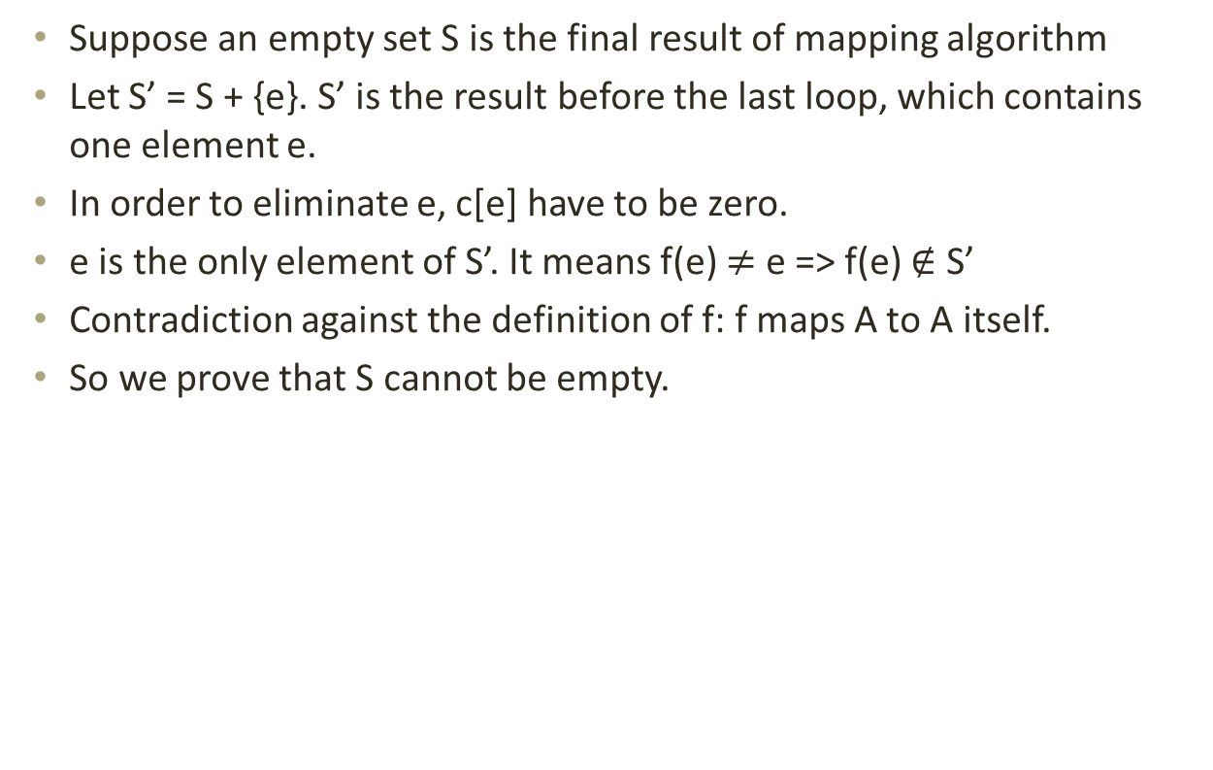
Proof
Suppose an empty set S is the final result of mapping algorithm
Let S’ = S + {e}. S’ is the result before the last loop, which contains one element e.
In order to eliminate e, c[e] have to be zero.
e is the only element of S’. It means f(e) $≠$ e => f(e) $∉$ S’
Contradiction against the definition of f: f maps A to A itself.
So we prove that S cannot be empty.

Slide 6
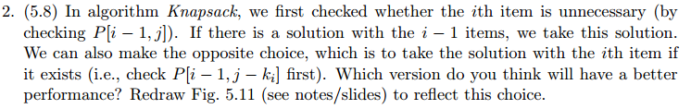
Q2

Slide 7
Algorithm Original_Knapsack (S, K);
1 begin
2 P[0, 0].exist := true;
3 for k := 1 to K do
4 P[0, k].exist := false;
5 for i := 1 to n do
6 for k := 0 to K do
7 P[i, k].exist := false;
8 if P[i – 1, k].exist then
9 P[i, k].exist := true;
10 P[i, k].belong := false;
11 else if k - S[i] ≥ 0 then
12 if P[i-1, k - S[i]].exist then
13 P[i, k].exist := true;
14 P[i, k].belong := true;
15 end
Algorithm Modified_Knapsack (S, K);
1 begin
2 P[0, 0].exist := true;
3 for k := 1 to K do
4 P[0, k].exist := false;
5 for i := 1 to n do
6 for k := 0 to K do
7 P[i, k].exist := false;
8 if k - S[i] ≥ 0 then
9 if P[i – 1, k-S[i]].exist then
10 P[i, k].exist := true;
11 P[i, k].belong := true;
12 else if P[i – 1, k].exist then
13 P[i, k].exist := true;
14 P[i, k].belong := false;
15 end

Slide 8
Which one is more efficient?
We compare the performance of “if P[i – 1, k].exist” and “if k - S[i] ≥ 0”
The cost of calculation is higher than check
On average, the original method is slightly more efficient.

Slide 9
Redraw the figure
 | 0 | 1 | 2 | 3 | 4 | 5 | 6 | 7 | 8 | 9 | 10 | 11 | 12 | 13 | 14 | 15 | 16
 | O | - | - | - | - | - | - | - | - | - | - | - | - | - | - | - | -
k₁=2 | O | - | I | - | - | - | - | - | - | - | - | - | - | - | - | - | -
k₂=3 | O | - | O | I | - | I | - | - | - | - | - | - | - | - | - | - | -
k₃=5 | O | - | O | O | - | I | - | I | I | - | I | - | - | - | - | - | -
k₄=6 | O | - | O | O | - | O | I | O | I | I | O | I | - | I | I | - | I

Slide 10
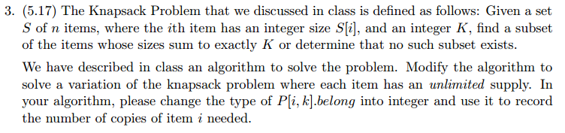
Q3

Slide 11
Modifications
Algorithm Knapsack (S, K);
1 begin
2 P[0, 0].exist := true;
3 P[0, 0].belong := 0;
4 for k := 1 to K do
5 P[0, k].exist := false;
6 for i := 1 to n do
7 for k := 0 to K do
8 P[i, k].exist := false;
9 if P[i – 1, k]:exist then
10 P[i, k].exist := true;
11 P[i, k].belong := 0;
12 else if k - S[i] ≥ 0 then
13 if P[i, k - S[i]].exist then
14 P[i, k].exist := true;
15 P[i, k].belong :=
16 P[i, k - S[i]].belong + 1;
17 end
 | 0 | 1 | 2 | 3 | 4 | 5 | 6
 | 0 | - | - | - | - | - | -
k₁=2 | 0 | - | 1 | - | 2 | - | 3
k₂=3 | 0 | - | 0 | 1 | 0 | 1 | 0
Notes:
[i, k – S[i]] states the solution for i, k – S[i] (existing sol containing i, and k – S[i])
Eg: K = 10 取 k1=2, k1一個 可以變成 k1兩個
[1, 10 - 2] 解法存在 -> [2, 10]

Slide 12

Q4

Slide 13
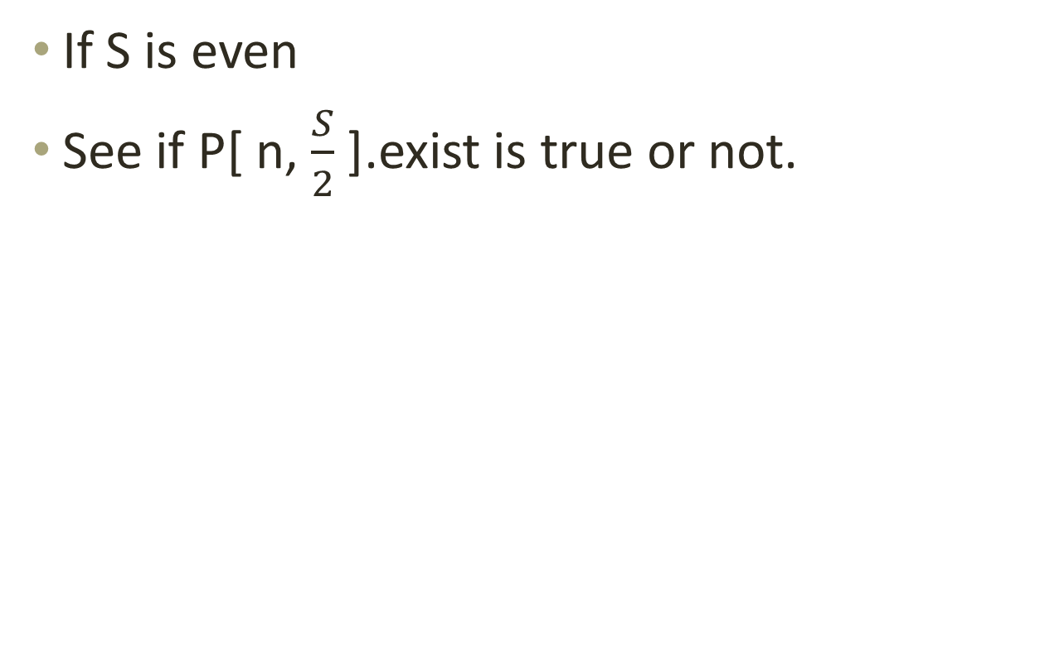
How to check the feasibility?
If S is even
See if P[ n, $\frac{S}{2}$ ].exist is true or not.

Slide 14
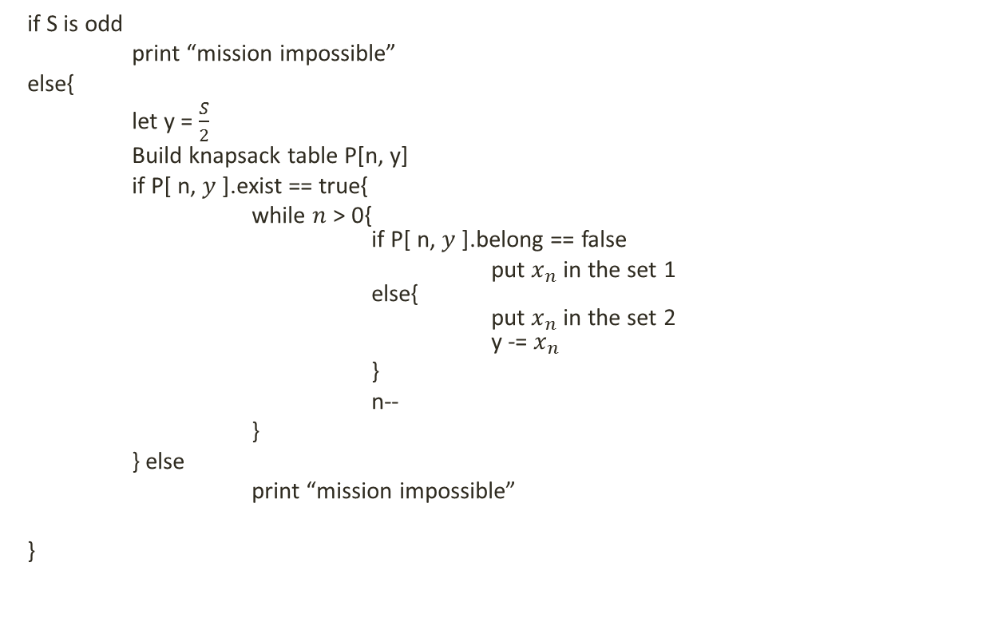
How to get the contents?
if S is odd
print “mission impossible”
else{
let y = $\frac{S}{2}$
Build knapsack table P[n, y]
if P[ n, $y$ ].exist == true{
while $n$ > 0{
if P[ n, $y$ ].belong == false
put $x_{n}$ in the set 1
else{
put $x_{n}$ in the set 2
y -= $x_{n}$
}
n--
}
} else
print “mission impossible”
}

Slide 15
Q5

Slide 16
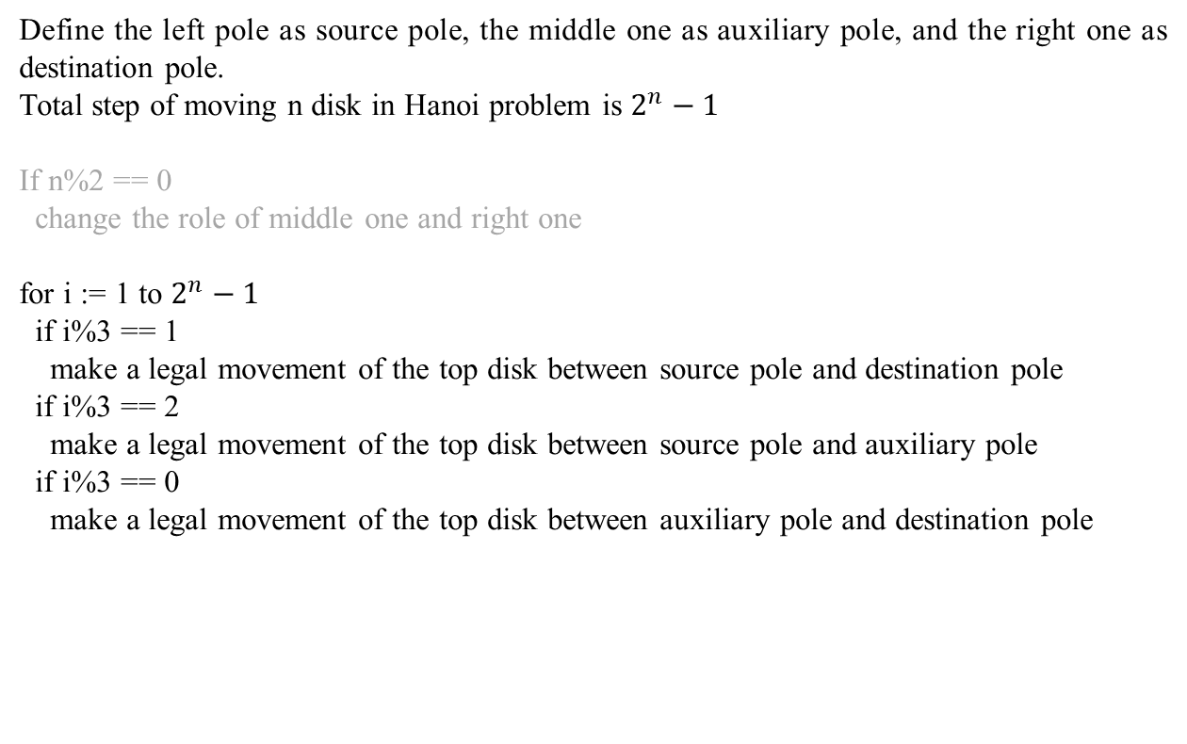
Pseudocode
Define the left pole as source pole, the middle one as auxiliary pole, and the right one as destination pole.
Total step of moving n disk in Hanoi problem is $2^{n}−1$
If n%2 == 0
change the role of middle one and right one
for i := 1 to $2^{n}−1$
if i%3 == 1
make a legal movement of the top disk between source pole and destination pole
if i%3 == 2
make a legal movement of the top disk between source pole and auxiliary pole
if i%3 == 0
make a legal movement of the top disk between auxiliary pole and destination pole

