Slide 1
Algorithm HW #6
Prepared by Carlos
Avg:84 Std:16.4

Slide 2
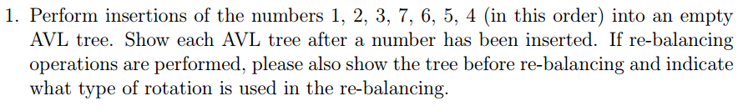

Slide 3
Part 1
1
1
1
2
2
3
Single rotation
2
2
1
3
7
1
3

Slide 4
Part 2
2
2
1
3
1
3
7
7
6
2
Double rotation
1
6
2
3
7
1
6
5
3
7

Slide 5
Part 3
3
2
Double rotation
2
6
1
6
1
5
7
3
7
5
3
2
6
1
5
7
4
Final Result

Slide 6
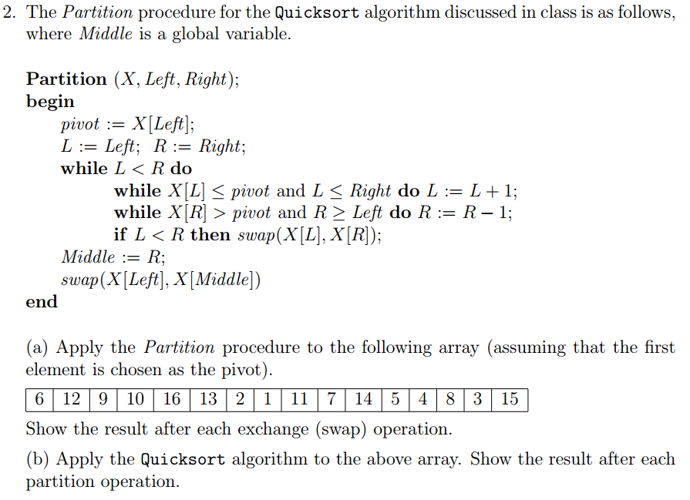

Slide 7
(a)
6 | 12 | 9 | 10 | 16 | 13 | 2 | 1 | 11 | 7 | 14 | 5 | 4 | 8 | 3 | 15
 | 3 |  |  |  |  |  |  |  |  |  |  |  |  | 13
 |  | 4 |  |  |  |  |  |  |  |  |  | 9
 |  |  | 5 |  |  |  |  |  |  |  | 10
 |  |  |  | 1 |  |  | 16
 |  |  |  |  | 2 | 13
2 |  |  |  |  | 6

Slide 8
(b)
6 | 12 | 9 | 10 | 16 | 13 | 2 | 1 | 11 | 7 | 14 | 5 | 4 | 8 | 3 | 15
2 | 3 | 4 | 5 | 1 | 6 | 13 | 16 | 11 | 7 | 14 | 10 | 9 | 8 | 12 | 15
1 | 2 | 4 | 5 | 3 | 6 | 13 | 16 | 11 | 7 | 14 | 10 | 9 | 8 | 12 | 15
1 | 2 | 3 | 4 | 5 | 6 | 13 | 16 | 11 | 7 | 14 | 10 | 9 | 8 | 12 | 15
1 | 2 | 3 | 4 | 5 | 6 | 9 | 12 | 11 | 7 | 8 | 10 | 13 | 14 | 16 | 15
1 | 2 | 3 | 4 | 5 | 6 | 7 | 8 | 9 | 11 | 12 | 10 | 13 | 14 | 16 | 15
1 | 2 | 3 | 4 | 5 | 6 | 7 | 8 | 9 | 10 | 11 | 12 | 13 | 14 | 16 | 15
1 | 2 | 3 | 4 | 5 | 6 | 7 | 8 | 9 | 10 | 11 | 12 | 13 | 14 | 15 | 16
1 | 2 | 3 | 4 | 5 | 6 | 7 | 8 | 9 | 10 | 11 | 12 | 13 | 14 | 15 | 16

Slide 9
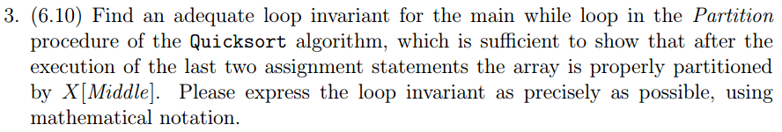

Slide 10
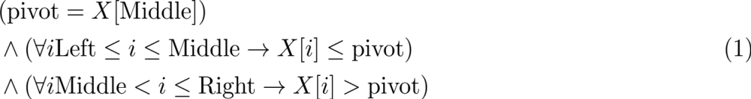
Problem 3 (Cont’d).
Algorithm Partition (X, Left, Right)
begin
pivot := X[Left];
L : = Left; R := Right;
while L < R do
while X[L] <= pivot and L <= Right do L := L + 1;
while X[R] > pivot and R >= Left do R := R - 1;
if L < R then swap(X[L], X[R]);
Middle := R;
swap(X[Left], X[Middle]);
end

Slide 11
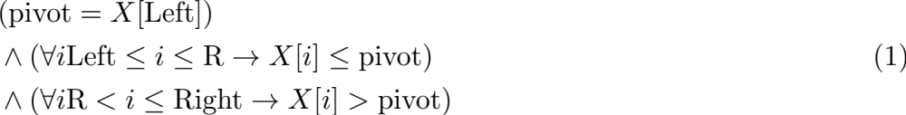
Problem 3 (Cont’d).
Algorithm Partition (X, Left, Right)
begin
pivot := X[Left];
L : = Left; R := Right;
while L < R do
while X[L] <= pivot and L <= Right do L := L + 1;
while X[R] > pivot and R >= Left do R := R - 1;
if L < R then swap(X[L], X[R]);
Middle := R;
swap(X[Left], X[Middle]);
end
That’s what holds right after the main while loop.
Notes:
\begin{equation}
\begin{aligned}
&(\text{pivot} = X[\text{Left}]) \\
&\wedge (\forall i \text{Left} \leq i \leq \text{R} \rightarrow X[i] \leq \text{pivot}) \\
&\wedge (\forall i \text{R} < i \leq \text{Right} \rightarrow X[i] > \text{pivot}) \\
\end{aligned}
\end{equation}

Slide 12
Problem 3 (Cont’d).
while L < R do
while X[L] <= pivot and L <= Right do L := L + 1;
while X[R] > pivot and R >= Left do R := R - 1;
if L < R then swap(X[L], X[R]);
Notes:
\begin{equation}
\begin{aligned}
&(\text{pivot} = X[\text{Left}]) \\
&\wedge (\forall i \text{Left} \leq i < \text{L} \rightarrow X[i] \leq \text{pivot}) \\
&\wedge (\forall i \text{R} < i \leq \text{Right} \rightarrow X[i] > \text{pivot}) \\
&\wedge (\text{Left} \leq L \leq \text{Right} + 1) \wedge (\text{Left} \leq R \leq \text{Right}) \\
&\wedge ((\text{L} \geq \text{R}) \rightarrow (\text{L} -1 = \text{R}))
\end{aligned}
\end{equation}

Slide 13
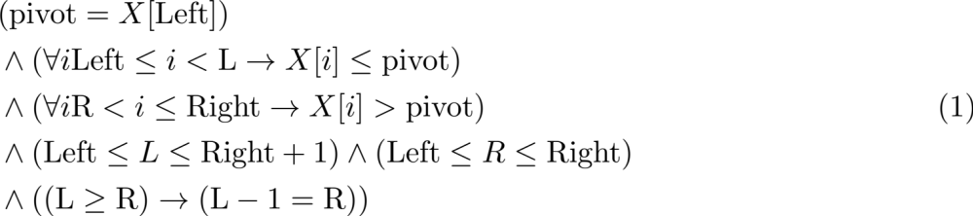
Problem 3 (Ans.).
Algorithm Partition (X, Left, Right)
begin
pivot := X[Left];
L : = Left; R := Right;
while L < R do
while X[L] <= pivot and L <= Right do L := L + 1;
while X[R] > pivot and R >= Left do R := R - 1;
if L < R then swap(X[L], X[R]);
Middle := R;
swap(X[Left], X[Middle]);
end
Notes:
\begin{equation}
\begin{aligned}
&(\text{pivot} = X[\text{Left}]) \\
&\wedge (\forall i \text{Left} \leq i \leq \text{R} \rightarrow X[i] \leq \text{pivot}) \\
&\wedge (\forall i \text{R} < i \leq \text{Right} \rightarrow X[i] > \text{pivot}) \\
\end{aligned}
\end{equation}

Slide 14
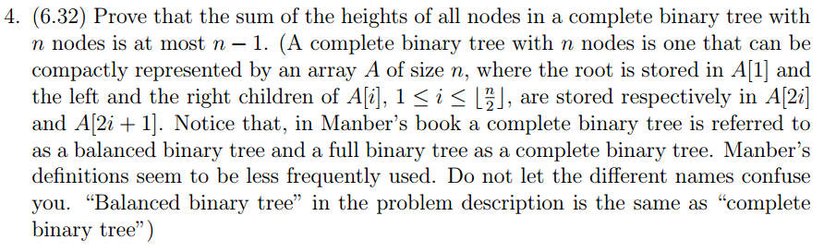

Slide 15
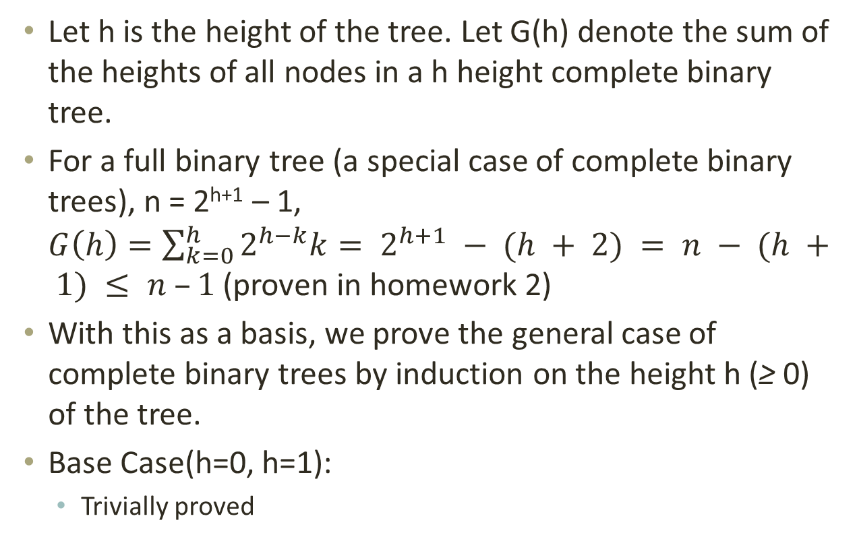
Problem 4
Let h is the height of the tree. Let G(h) denote the sum of the heights of all nodes in a h height complete binary tree.
For a full binary tree (a special case of complete binary trees), n = 2^{h+1} – 1,
$G\left(h\right)=\sum_{k=0}^{h}{2^{h−k}k}= 2^{h+1} − (h + 2) = n − (h + 1) ≤ n –1$ (proven in homework 2)
With this as a basis, we prove the general case of complete binary trees by induction on the height h (≥ 0) of the tree.
Base Case(h=0, h=1):
  Trivially proved
Notes:
G(n)公式可用induction證明

Slide 16
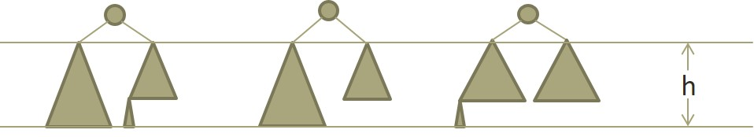
Problem 4 (cont.)
Inductive Step(h > 1):
There will be four cases on complete binary tree:
  full binary tree(we have proven this case before)
  Left subtree is full and right one is complete (both height = h)
  Both Left and right subtree are full (h_{L} = h and h_{R} = h-1)
  Right subtree is full and left subtree is complete (h_{L} = h and h_{R} = h-1)
Notes:
對於full者以其高度套已知公式，對於complete者以其高度套induction hypothesis(<= n-1)
→ 新加的點(root)最後加入，高度為h+1
→ 全部height相加 <= (n-1)即得證

Slide 17
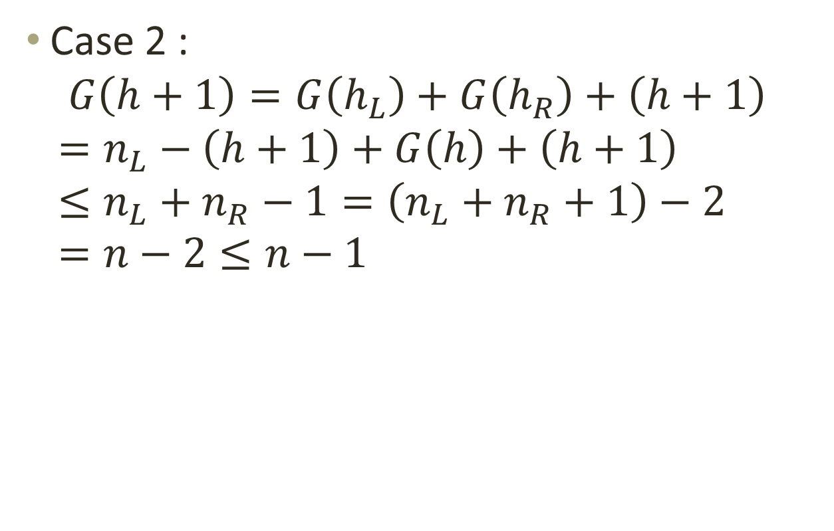
Problem 4 (cont.)
Case 2 :
$G\left(h+1\right)=G\left(h_{L}\right)+G\left(h_{R}\right)+\left(h+1\right)$
$=n_{L}−\left(h+1\right)+G\left(h\right)+\left(h+1\right)$
$≤n_{L}+n_{R}−1=\left(n_{L}+n_{R}+1\right)−2$
$=n−2≤n−1$

Slide 18
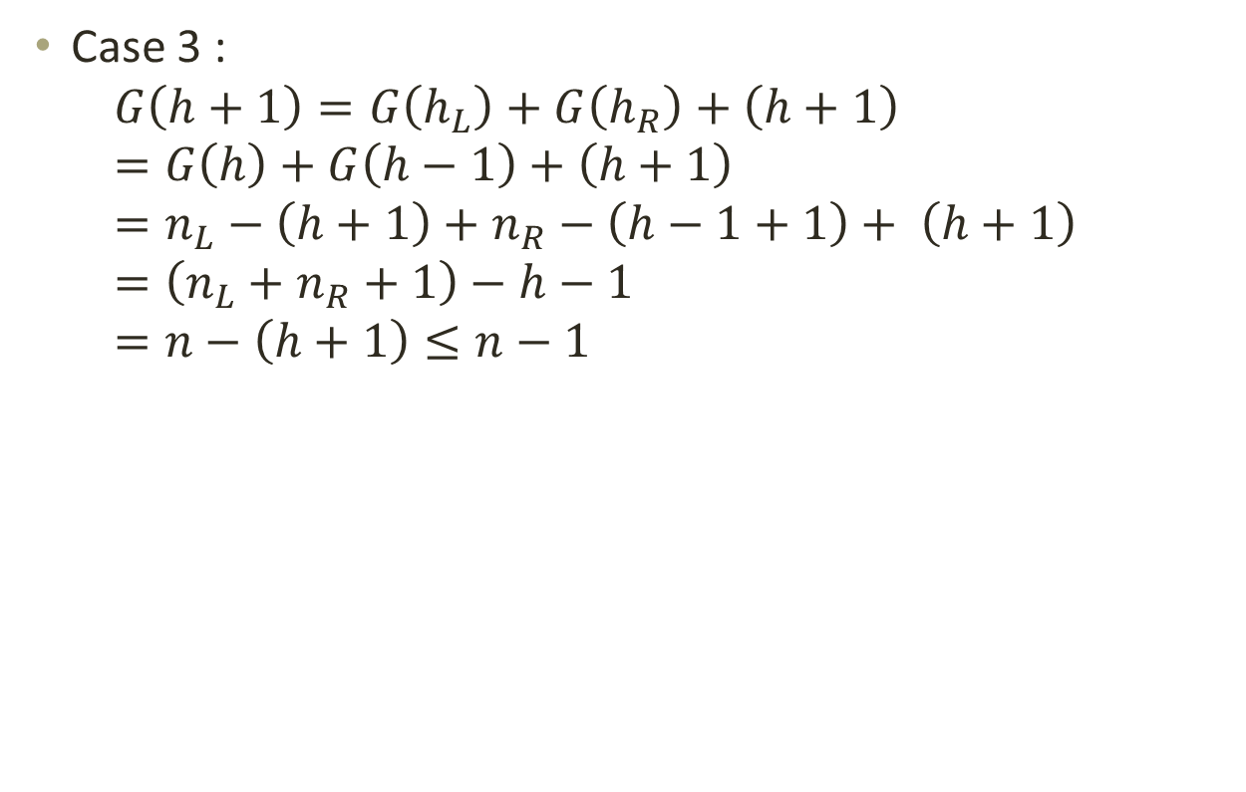
Problem 4 (cont.)
Case 3 :
$G\left(h+1\right)=G\left(h_{L}\right)+G\left(h_{R}\right)+\left(h+1\right)=G\left(h\right)+G\left(h−1\right)+\left(h+1\right)=n_{L}−\left(h+1\right)+n_{R}−\left(h−1+1\right)+ \left(h+1\right)=\left(n_{L}+n_{R}+1\right)−h−1$
$=n−\left(h+1\right)≤n−1$

Slide 19
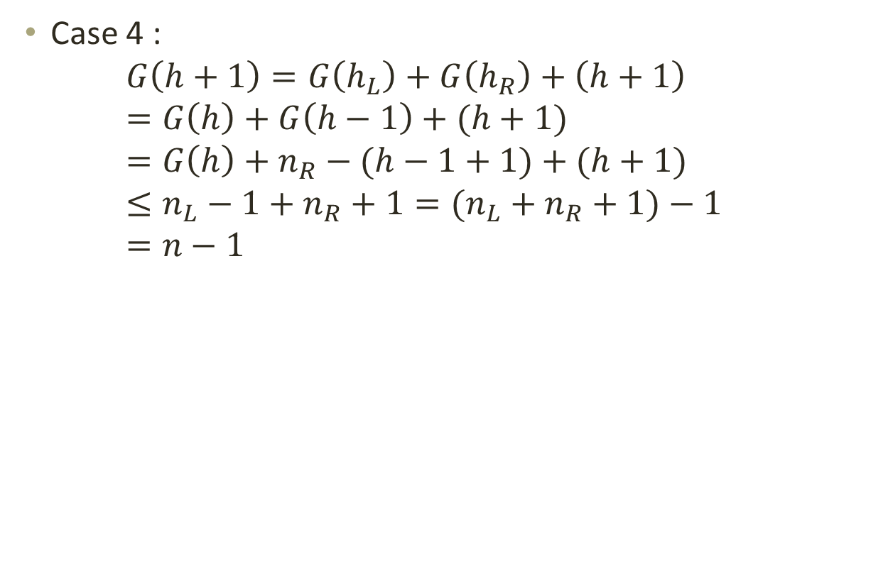
Problem 4 (cont.)
Case 4 :
$G\left(h+1\right)=G\left(h_{L}\right)+G\left(h_{R}\right)+\left(h+1\right)=G\left(h\right)+G\left(h−1\right)+(h+1)$
$=G\left(h\right)+n_{R}−(h−1+1)+(h+1)$
$≤n_{L}−1+n_{R}+1=(n_{L}+n_{R}+1)−1$
$=n−1$

Slide 20
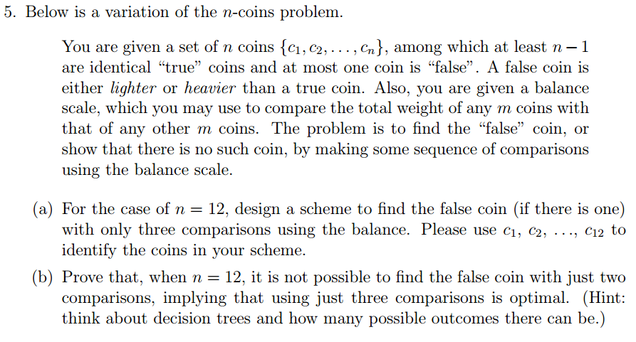

Slide 21
Problem 5 (Cont’d).
First weighing | Second weighing | Third weighing
C1C2C3C4 = C5C6C7C8 | C1C9 = C10C11 | C1 = C12 (no fake coin)
 |  | C1 > C12 (C12 light)
 |  | C1 < C12 (C12 heavy)
 | C1C9 > C10C11 | C10 = C11 (C9 heavy)
 |  | C10 > C11 (C11 light)
 |  | C10 < C11 (C10 light)
 | C1C9 < C10C11 | C10 = C11 (C9 light)
 |  | C10 > C11 (C10 heavy)
 |  | C10 < C11 (C11 heavy)
Notes:
first weighing: the suspect lies in C9 ~ C12
second weighing: we used C1 to compare the rest.
equation: either one side is too heavy or the other side is too light.

Slide 22
Problem 5 (Cont’d).
First weighing | Second weighing | Third weighing
C1C2C3C4 > C5C6C7C8 | C1C2C5 = C3C6C12 | C7 = C8, C4 heavy
 |  | C7 > C8, C8 ligher
 |  | C7 < C8, C7 ligher
 | C1C2C5 > C3C6C12 | C1 = C2, C6 lighter
 |  | C1 > C2, C1 heavier
 |  | C1 < C2, C2 heavier
 | C1C2C5 < C3C6C12 | C3 = C12, C5 light
 |  | C3 > C12, C3 heavier
 |  | C3 < C12, (impossible)
Notes:
第一次秤重不平衡的話，從重的地方拿兩個然後從輕的地方拿一個放到秤重上面。
第三秤重等式同一邊不會是嫌疑犯 (ex: if C5 is heavier, which would be false in first weighing.)
找出前兩次秤重方向同一遍的成員

Slide 23
Problem 5 (Cont’d).
First weighing | Second weighing | Third weighing
C1C2C3C4 < C5C6C7C8 | C1C2C5 = C3C6C12 | C7 = C8, C4 ligher
 |  | C7 > C8, C7 heavy
 |  | C7 < C8, C8 heavy
 | C1C2C5 > C3C6C12 | C3 = C12, C5 heavier
 |  | C3 > C12, (impossible)
 |  | C3 < C12, C3 lighter
 | C1C2C5 < C3C6C12 | C1 = C2, C6 heavier
 |  | C1 > C2, C2 lighter
 |  | C1 < C2, C1 lighter
Notes:
第三秤重等式同一邊不會是嫌疑犯

Slide 24
Problem 5(decision tree)
C₁C₂C₃C₄ vs C₅C₆C₇C₈
< → Left
= → Middle
> → Right
Red : heavier
Blue : lighter
C₁C₂C₅ vs C₃C₆C₁₂
C₁C₉ vs C₁₀C₁₁
C₁C₂C₅ vs C₃C₆C₁₂
C₁ vs C₂
C₇ vs C₈
C₃ vs C₁₂
C₁₀ vs C₁₁
C₁ vs C₁₂
C₁₀ vs C₁₁
C₃ vs C₁₂
C₇ vs C₈
C₁ vs C₂
C₁
C₆
C₂
C₈
C₄
C₇
C₃
C₅
C₁₁
C₉
C₁₀
C₁₂
C₁₂
C₁₀
C₉
C₁₁
X
C₅
C₃
C₇
C₄
C₈
C₂
C₆
C₁
X
N

Slide 25
Problem 5 (Cont’d).
The number of possible outcomes is (12*2) + 1 = 25
12*2 : heavier or lighter for each coin cases
1 : no false coin case
One comparison can produce 3 outcomes (3 branches of decision tree)
2 comparisons can produce 3^2 = 9 outcomes, less than 25.
However, 3 comparisons can produce 3^3 = 27 outcomes, greater than 25. Therefore, three comparisons is optimal.

