Slide 1
Homework #7
Rick Lee

Slide 2
Problem 1
Compute the next table as in the KMP algorithm for the string “babbabbbb”. Show the details of your calculation
i | 1 | 2 | 3 | 4 | 5 | 6 | 7 | 8 | 9
B | B | a | b | b | a | b | b | b | b
next | -1 | 0 | 0 | 1 | 1 | 2 | 3 | 4 | 1

Slide 3
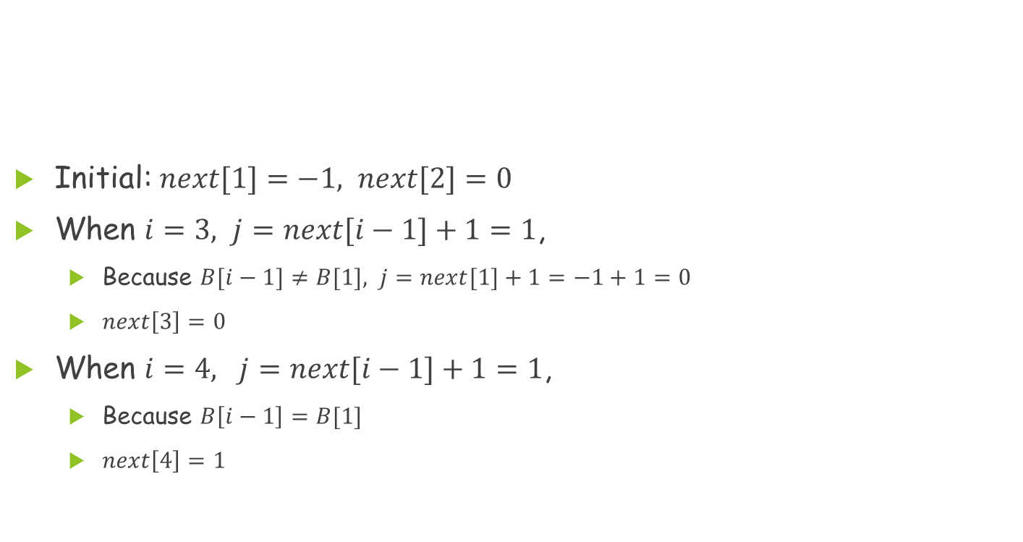
Problem 1(Cont.)
i | 1 | 2 | 3 | 4 | 5 | 6 | 7 | 8 | 9
B | b | a | b | b | a | b | b | b | b
next | -1 | 0 | 0 | 1
Initial: $next[1]=−1, next[2]=0$
When $i=3, j=next[i−1]+1=1$,
  Because $B[i−1]≠B[1], j=next[1]+1=−1+1=0$
  $next\left[3\right]=0$
When $i=4, j=next[i−1]+1=1$,
  Because $B\left[i−1\right]=B[1]$
  $next\left[4\right]=1$

Slide 4
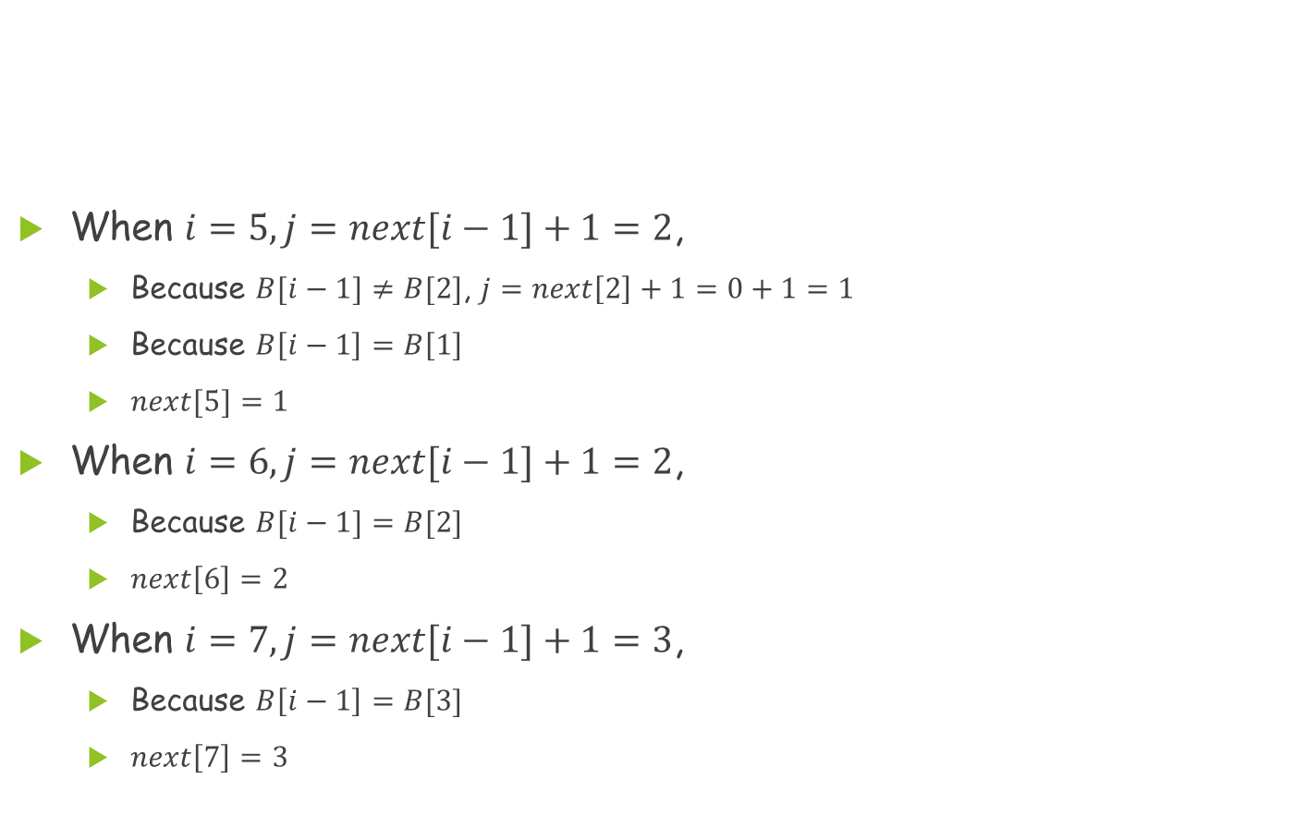
Problem 1(Cont.)
i | 1 | 2 | 3 | 4 | 5 | 6 | 7 | 8 | 9
B | b | a | b | b | a | b | b | b | b
next | -1 | 0 | 0 | 1 | 1 | 2 | 3
When $i=5, j=next[i−1]+1=2$,
  Because $B[i−1]≠B[2]$, $j=next\left[2\right]+1=0+1=1$
  Because $B\left[i−1\right]=B\left[1\right]$
  $next[5]=1$
When $i=6, j=next[i−1]+1=2$,
  Because $B[i−1]=B[2]$
  $next\left[6\right]=2$
When $i=7, j=next[i−1]+1=3$,
  Because $B\left[i−1\right]=B[3]$
  $next\left[7\right]=3$

Slide 5
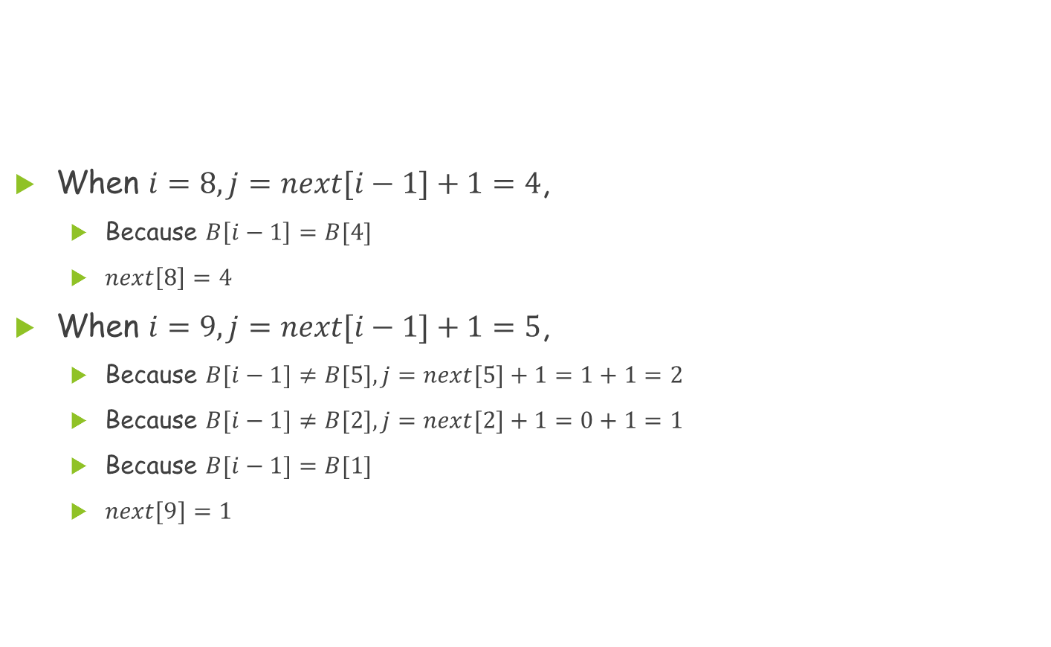
Problem 1(Cont.)
i | 1 | 2 | 3 | 4 | 5 | 6 | 7 | 8 | 9
B | b | a | b | b | a | b | b | b | b
next | -1 | 0 | 0 | 1 | 1 | 2 | 3 | 4 | 1
When $i=8, j=next[i−1]+1=4$,
  Because $B\left[i−1\right]=B[4]$
  $next\left[8\right]=4$
When $i=9, j=next[i−1]+1=5$,
  Because $B[i−1]≠B[5], j=next[5]+1=1+1=2$
  Because $B[i−1]≠B[2], j=next[2]+1=0+1=1$
  Because $B[i−1]=B[1]$
  $next[9]=1$

Slide 6
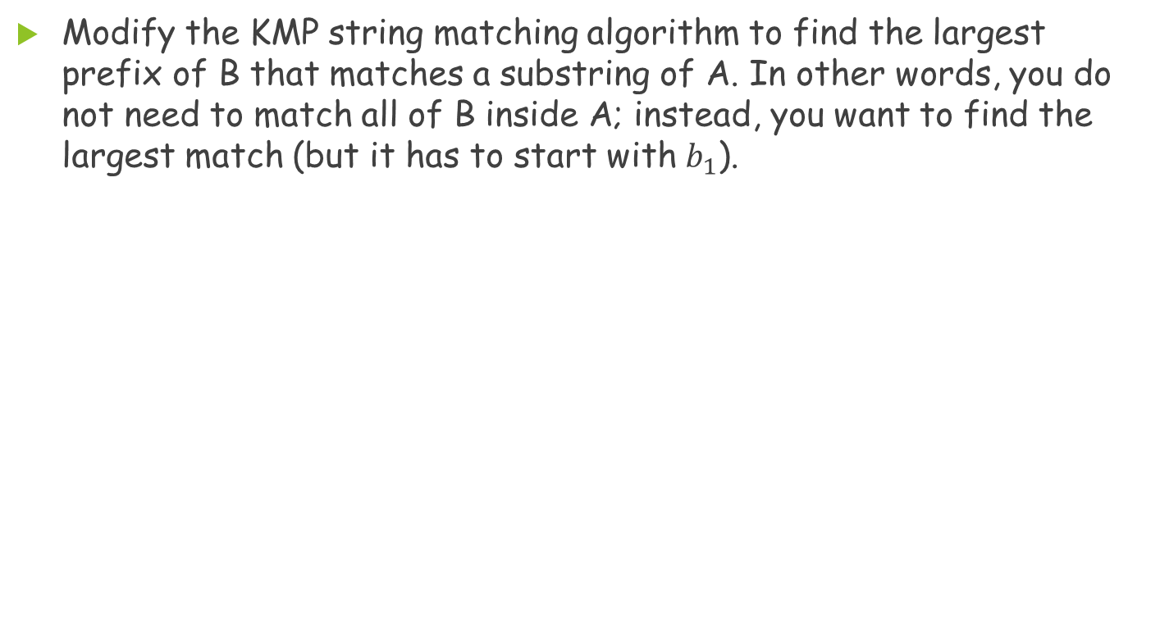
Problem 2
Modify the KMP string matching algorithm to find the largest prefix of B that matches a substring of A. In other words, you do not need to match all of B inside A; instead, you want to find the largest match (but it has to start with $b_{1}$).

Slide 7
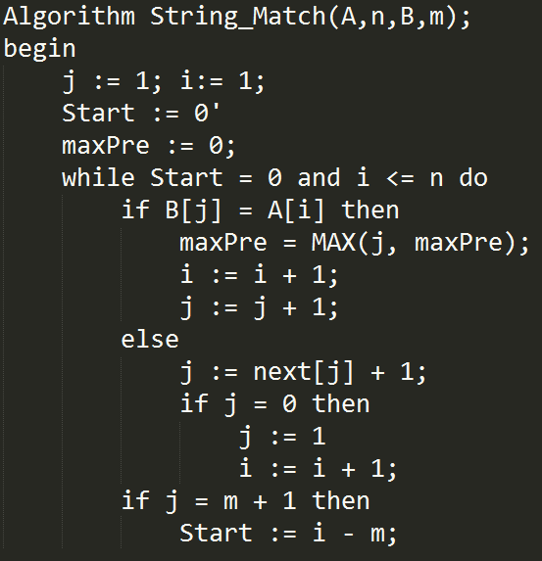
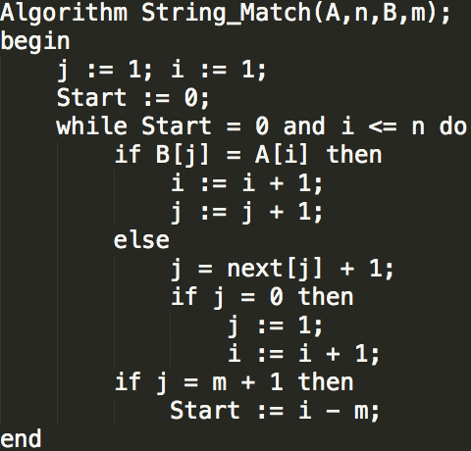
Problem 2(Cont.)

Slide 8
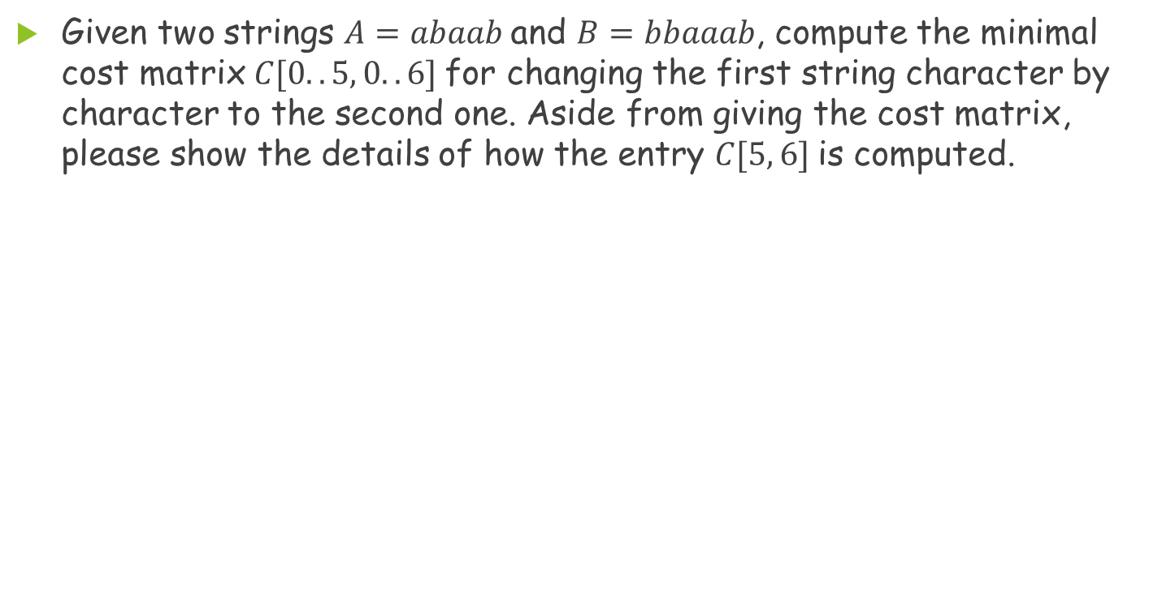
Problem 3
Given two strings $A=abaab$and $B=bbaaab$, compute the minimal cost matrix $C[0..5, 0..6]$for changing the first string character by character to the second one. Aside from giving the cost matrix, please show the details of how the entry $C[5, 6]$is computed.

Slide 9
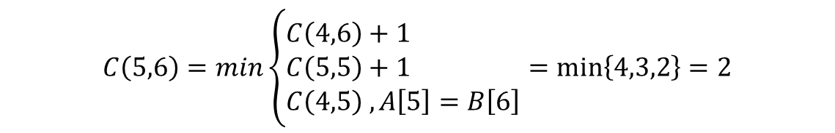
Problem 3(Cont.)
 |  |  | b | b | a | a | a | b
 |  | 0 | 1 | 2 | 3 | 4 | 5 | 6
 | 0 | 0 | 1 | 2 | 3 | 4 | 5 | 6
a | 1 | 1 | 1 | 2 | 2 | 3 | 4 | 5
b | 2 | 2 | 1 | 1 | 2 | 3 | 4 | 4
a | 3 | 3 | 2 | 2 | 1 | 2 | 3 | 4
a | 4 | 4 | 3 | 3 | 2 | 1 | 2 | 3
b | 5 | 5 | 4 | 3 | 3 | 2 | 2 | 2
$$C\left(5,6\right)=min\left\{\begin{aligned}C\left(4,6\right)+1 \\ C\left(5,5\right)+1 \\ C\left(4,5\right) ,A\left[5\right]=B\left[6\right]\end{aligned}\right.=min\left\{4,3,2\right\}=2$$

Slide 10
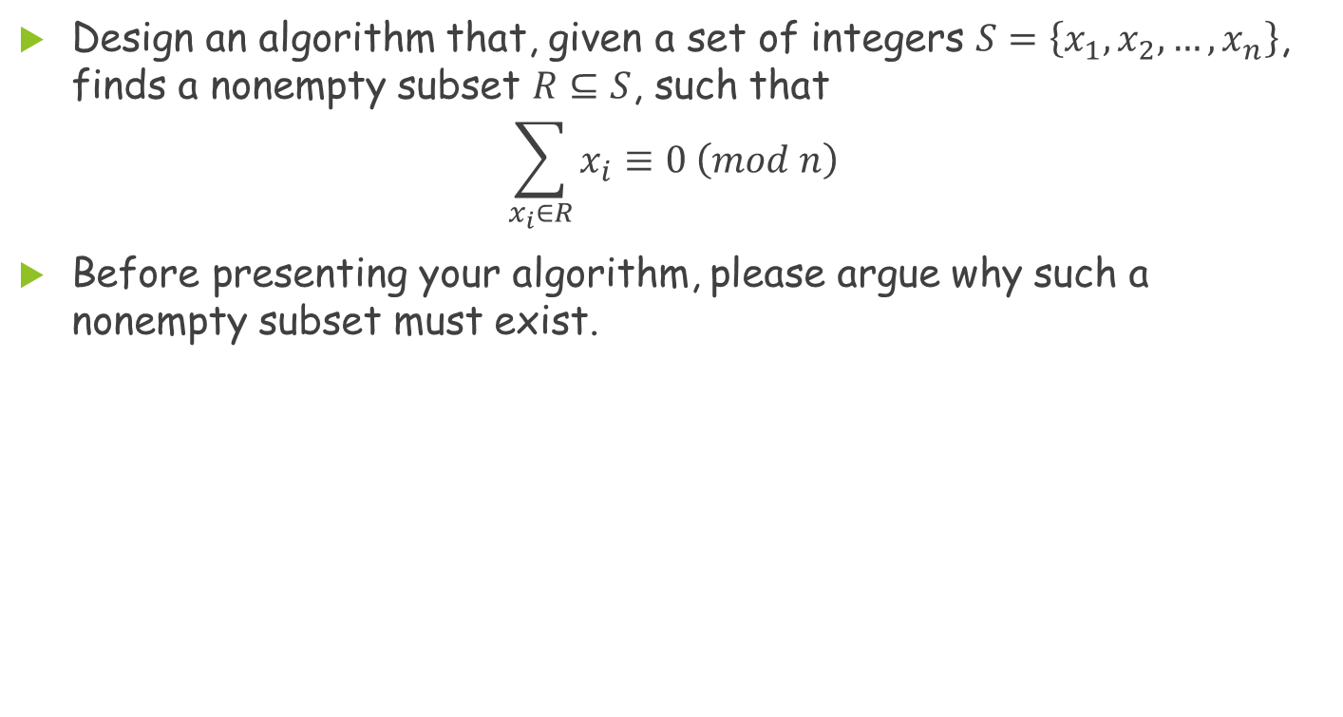
Problem 4
Design an algorithm that, given a set of integers $S=\left\{x_{1}, x_{2},…,x_{n}\right\}$, finds a nonempty subset $R⊆S$, such that
$$\sum_{x_{i}∈R}{x_{i}}≡0 \left(mod n\right)$$
Before presenting your algorithm, please argue why such a nonempty subset must exist.

Slide 11
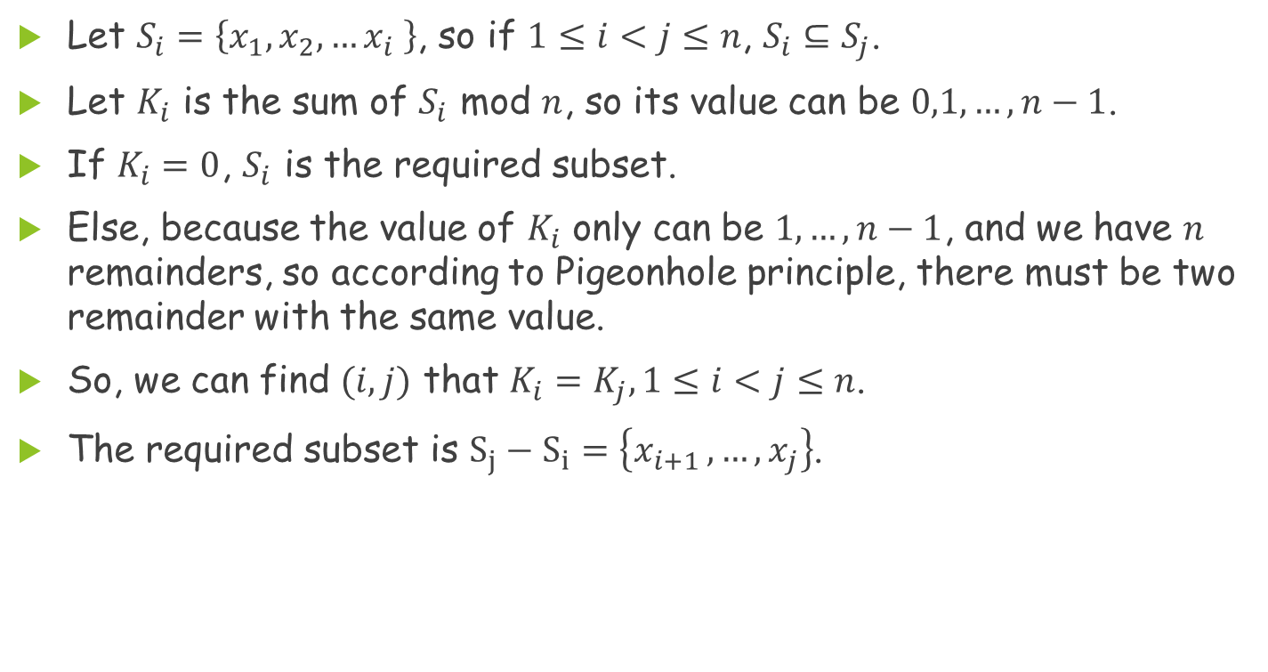
Problem 4(Cont.)
Let $S_{i}=\left\{x_{1},x_{2},…x_{i} \right\}$, so if $1≤i<j≤n$, $S_{i}⊆S_{j}$.
Let $K_{i}$ is the sum of $S_{i}$ mod $n$, so its value can be $0,1,…,n−1$.
If $K_{i}=0$, $S_{i}$ is the required subset.
Else, because the value of $K_{i}$ only can be $1,…,n−1$, and we have $n$ remainders, so according to Pigeonhole principle, there must be two remainder with the same value.
So, we can find $(i,j)$ that $K_{i}=K_{j}, 1≤i<j≤n$.
The required subset is $S_{j}−S_{i}=\left\{x_{i+1 },…,x_{j}\right\}$.

Slide 12
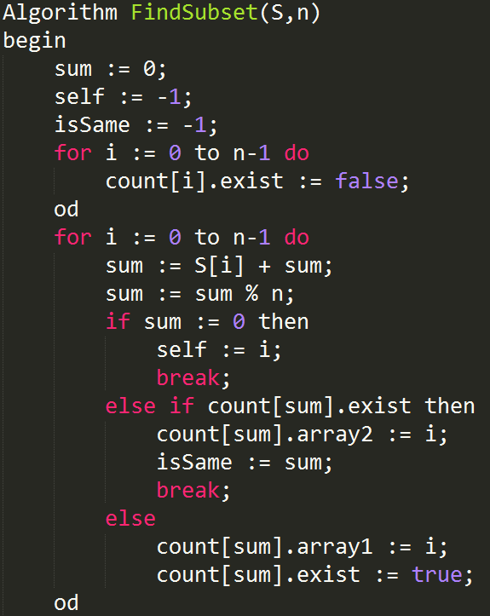
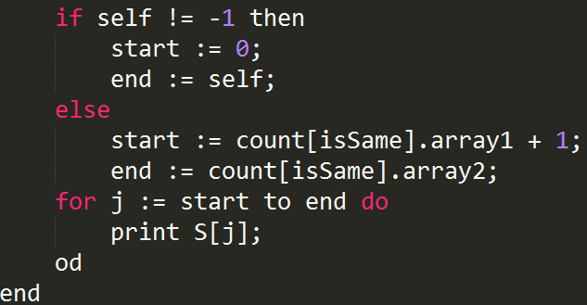
Problem 4(Cont.)

Slide 13
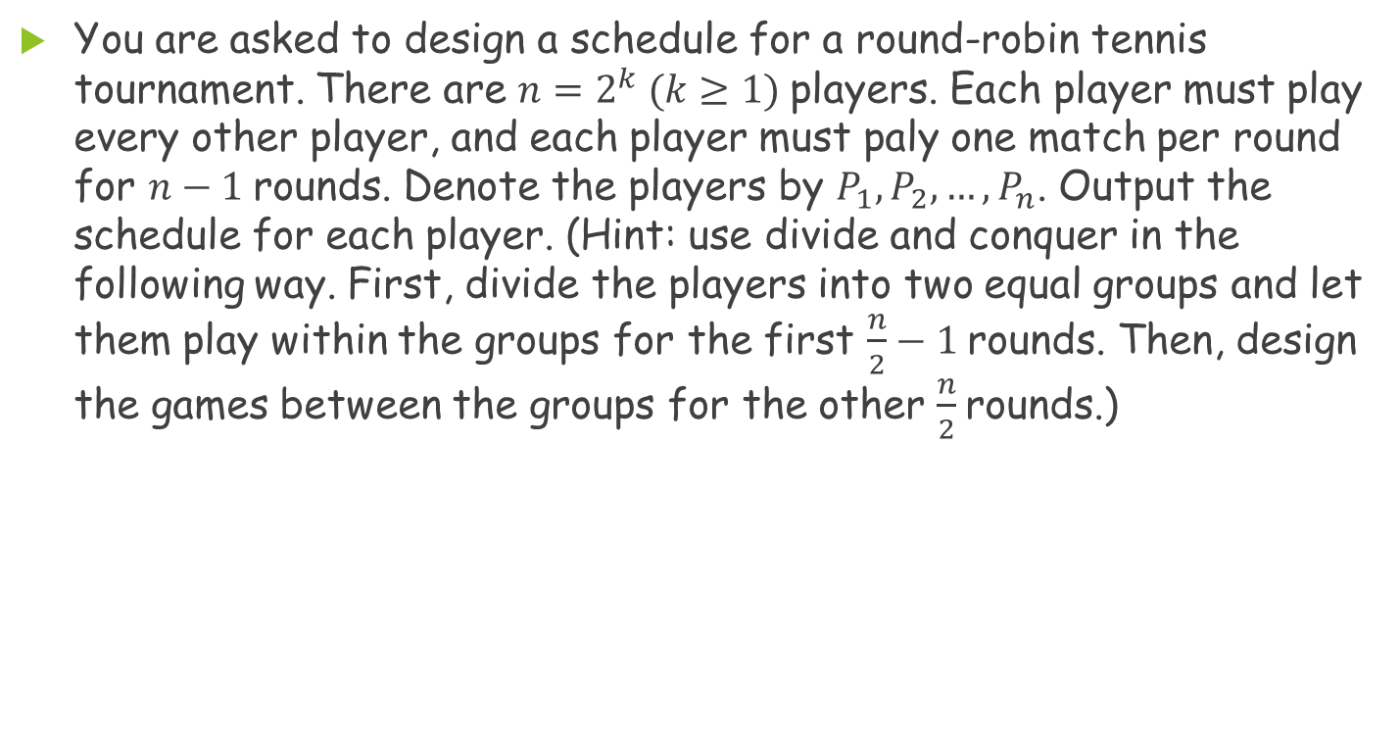
Problem 5
You are asked to design a schedule for a round-robin tennis tournament. There are $n=2^{k} (k≥1)$players. Each player must play every other player, and each player must paly one match per round for $n−1$rounds. Denote the players by $P_{1},P_{2},…,P_{n}$. Output the schedule for each player. (Hint: use divide and conquer in the following way. First, divide the players into two equal groups and let them play within the groups for the first $\frac{n}{2}−1$rounds. Then, design the games between the groups for the other $\frac{n}{2}$rounds.)

Slide 14
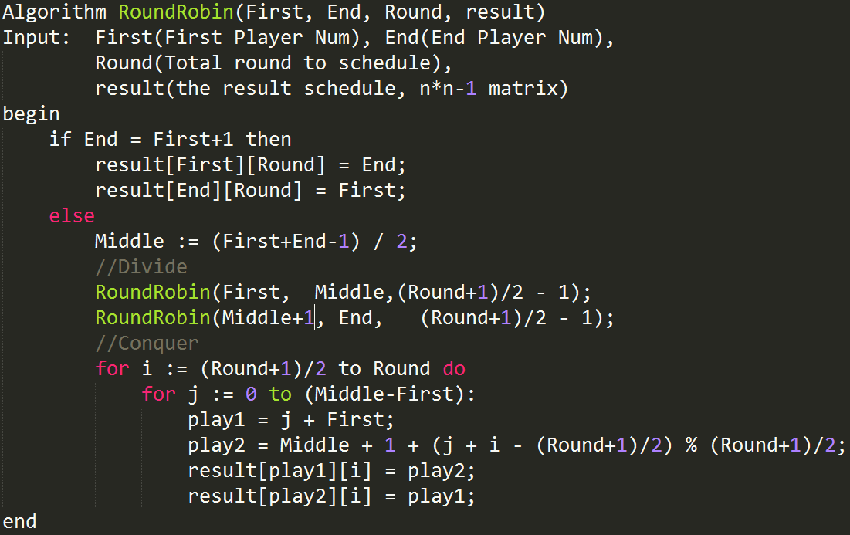
Problem 5(Cont.)

Slide 15
Problem 5(Cont.)
 | 1 | 2 | 3 |  |  | 4 | 5 | 6 | 7
1 | 2 | 3 | 4 |  |  | 5 | 6 | 7 | 8
2 | 1 | 4 | 3 |  |  | 6 | 7 | 8 | 5
3 | 4 | 1 | 2 |  |  | 7 | 8 | 5 | 6
4 | 3 | 2 | 1 |  |  | 8 | 5 | 6 | 7
5 | 6 | 7 | 8 |  |  | 1 | 4 | 3 | 2
6 | 5 | 8 | 7 |  |  | 2 | 1 | 4 | 3
7 | 8 | 5 | 6 |  |  | 3 | 2 | 1 | 4
8 | 7 | 6 | 5 |  |  | 4 | 3 | 2 | 1

