Slide 1
Homework #8
Rick Lee

Slide 2
Problem 1
Consider the problem of finding balance factors in binary trees discussed in class (see slides for “Design by Induction”). Solve this problem using DFS. You need only to define preWORK and postWORK.

Slide 3
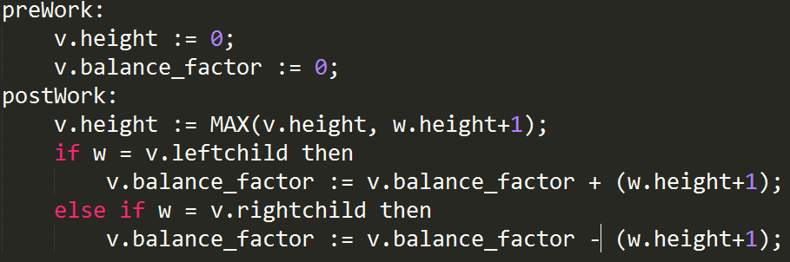
Problem 1(Cont.)

Slide 4
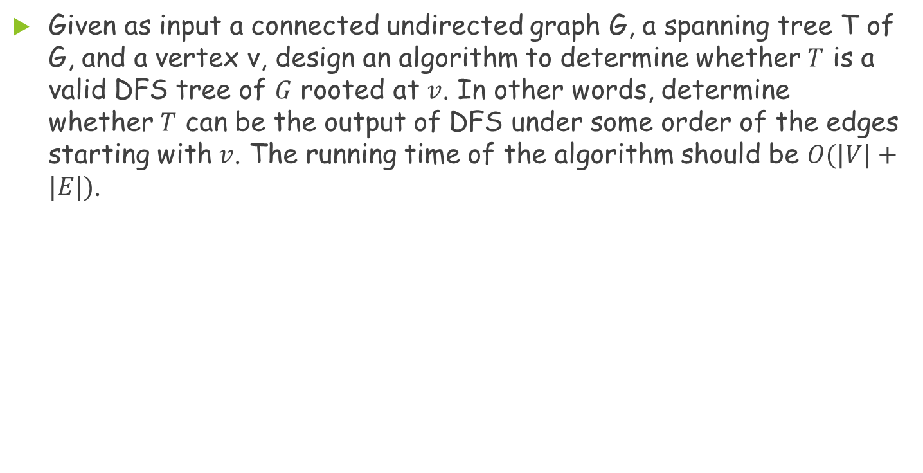
Problem 2
Given as input a connected undirected graph G, a spanning tree T of G, and a vertex v, design an algorithm to determine whether $T$ is a valid DFS tree of $G$ rooted at $v$. In other words, determine whether $T$ can be the output of DFS under some order of the edges starting with $v$. The running time of the algorithm should be $O(|V|+|E|)$.

Slide 5
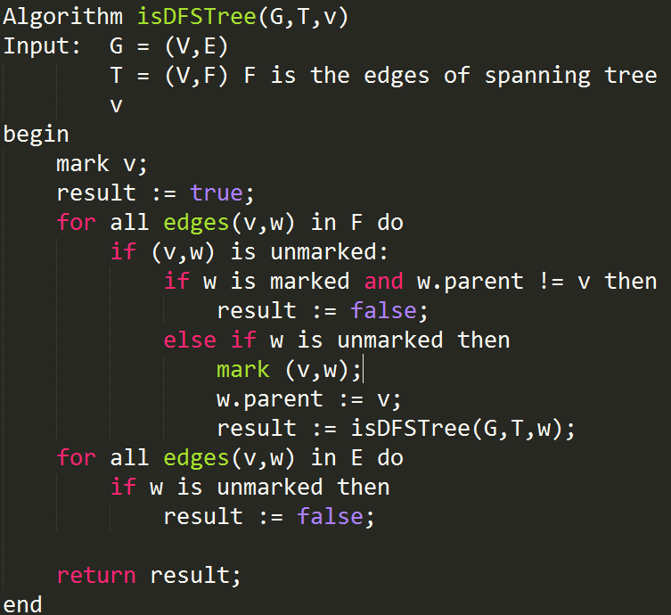
Problem 2(Cont.)
The initial V must be the root node!!

Slide 6
Problem 3
Describe an efficient implementation of the algorithm discussed in class for finding an Eulerian circuit in a graph. The algorithm should run in linear time and space. (Hint: the discovery of a cycle and that of the Eulerian circuits in individual connected components with the cycle removed, in the induction step, can be interweaved.)

Slide 7
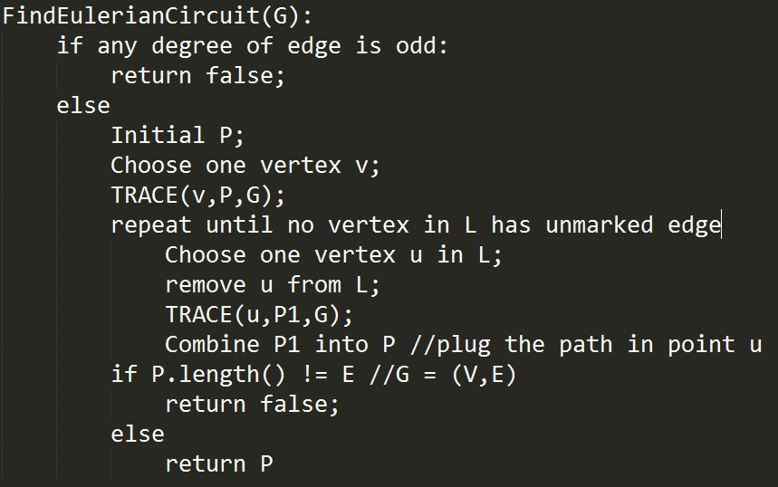
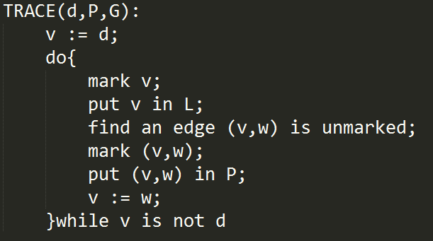
Problem 3

Slide 8
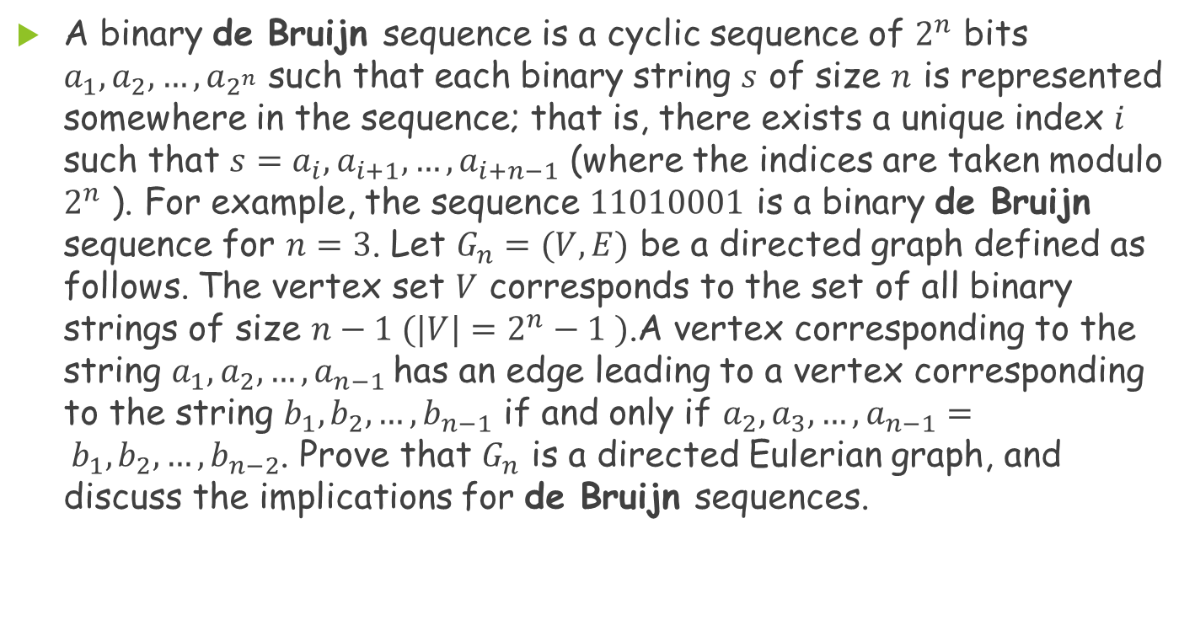
Problem 4
A binary de Bruijn sequence is a cyclic sequence of $2^{n}$ bits $a_{1},a_{2},…,a_{2^{n}}$ such that each binary string $s$ of size $n$ is represented somewhere in the sequence; that is, there exists a unique index $i$ such that $s=a_{i},a_{i+1}, …,a_{i+n−1}$ (where the indices are taken modulo $2^{n}$ ). For example, the sequence $11010001$ is a binary de Bruijn sequence for $n=3$. Let $G_{n}=(V, E)$ be a directed graph defined as follows. The vertex set $V$ corresponds to the set of all binary strings of size $n−1 (|V|=2^{n}−1 )$.A vertex corresponding to the string $a_{1},a_{2},…,a_{n−1}$has an edge leading to a vertex corresponding to the string $b_{1},b_{2},…,b_{n−1}$ if and only if $a_{2},a_{3},…,a_{n−1}= b_{1},b_{2}, …,b_{n−2}$. Prove that $G_{n}$ is a directed Eulerian graph, and discuss the implications for de Bruijn sequences.

Slide 9
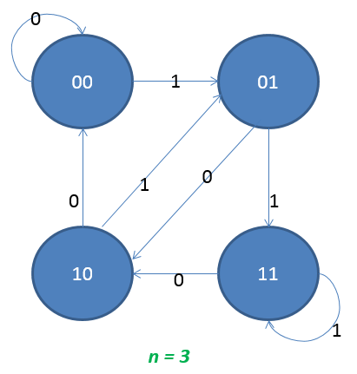
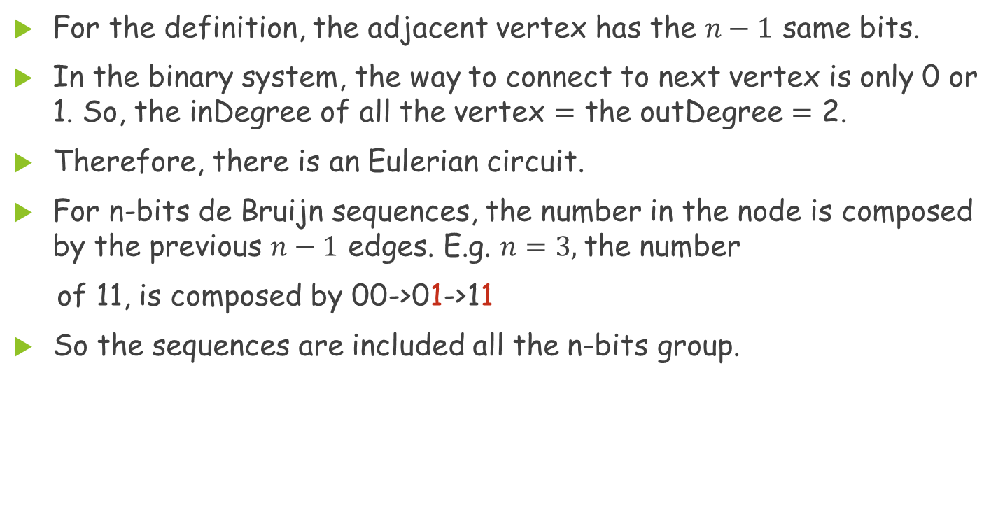
Problem 4(Cont.)
For the definition, the adjacent vertex has the $n−1$ same bits.
In the binary system, the way to connect to next vertex is only 0 or 1. So, the inDegree of all the vertex $=$ the outDegree $=$ 2.
Therefore, there is an Eulerian circuit.
For n-bits de Bruijn sequences, the number in the node is composed by the previous $n−1$ edges. E.g. $n=3,$the number
of 11, is composed by 00->01->11
So the sequences are included all the n-bits group.

Slide 10
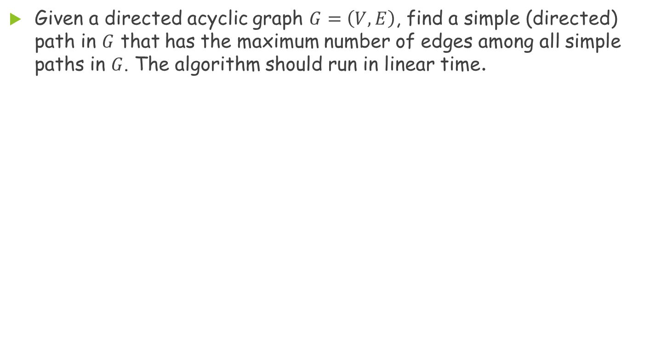
Problem 5
Given a directed acyclic graph $G=\left(V, E\right)$, find a simple (directed) path in $G$ that has the maximum number of edges among all simple paths in $G$. The algorithm should run in linear time.

Slide 11
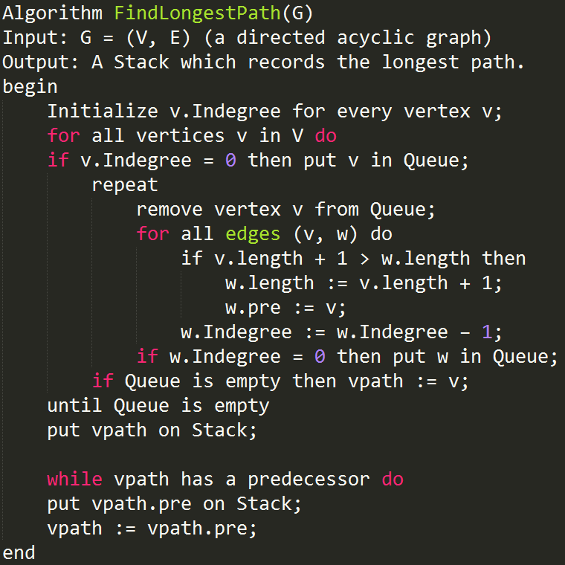
Problem 5

