Slide 1
Algorithms 2017
TA session #4
Carlos Chang
2017.06.06

Slide 2
Homework #9
Avg. : 80.2
Std. : 23.6

Slide 4
Problem 1.
Proof by contradiction
  Suppose there exists two minimum-cost spanning trees A and B.
  Sort by the cost of edge (e₁<e₂<…)
    A: {e₁, e₂, …} B: {e₁’, e₂’, …}
  Find the minimum of different cost edge e_{i} that e_{i} ≠ e_{i}’
  Assume e_{i} < e_{i}’, then B∪{e_{i}} will create a circle
  Find the maximum cost edge k in the circle
  Since all edge costs are distinct and k is the maximum cost edge in a cycle, k does not belong to any minimum spanning tree. But k is in B
  → B is not minimum-cost spanning tree (Contradiction)
  → The original statement proved true.
  (Write “proof by contradiction” to show your proving method, and the
  “Contradiction. The original statement proved true.” to conclude.)

Slide 5
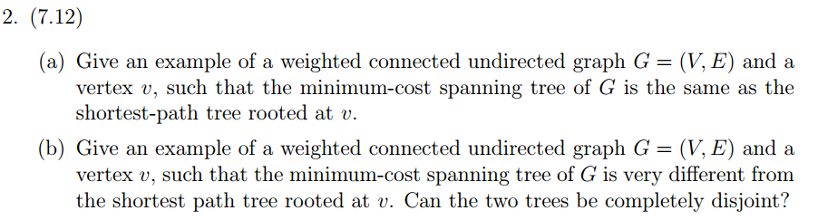

Slide 6
Problem 2
V
1
A
Minimum-cost spanning tree
1
1
(a)
(b)
V
1
A
C
10
B
V
1
A
1
1
1
1
Shortest path tree
C
10
B
C
10
B
V
V
Minimum-cost spanning tree
2
5
5
2
A
4
B
V
A
4
B
5
2
Shortest path tree
A
4
B

Slide 7
Problem 2. (Cont.)
(b) No, it is impossible that the two trees are completely disjointed.
Let T_{m} denote the minimum cost spanning tree of G
T_{s} be the shortest path tree rooted at v.
  v has only one edge
  The only edge must be both in T_{m} and in T_{s}.
  Otherwise v will be disconnected from Tm and from T
  v has more than one edge
Let (v, u) be the minimum weighted edge among all edges of v.
Then (v, u) must belong to both T_{m} and T_{s}.
  If (v, u) is not in T_{m}, T_{m} must include some other edge (v, w).
  But by replacing (v, w) with (v, u) in T_{m} => a new tree with lower weight
  If (v, u) is not in T_{s}, the shortest path π from v to u must include some other edge (v, w), but the edge (v, u) is shorter than π
→ The original statement proved true.

Slide 8
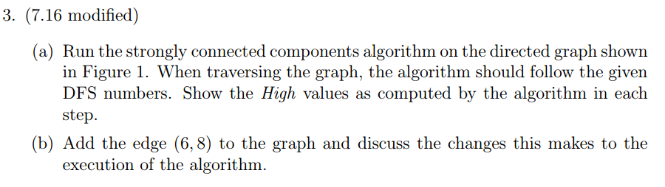
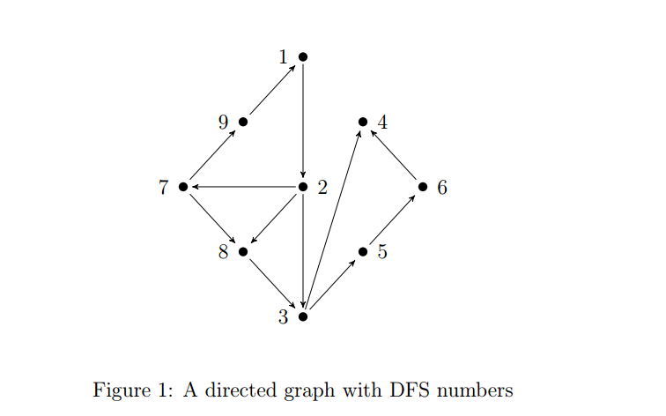

Slide 9
(a)
Vertex | 1 | 2 | 3 | 4 | 5 | 6 | 7 | 8 | 9
DFS_N | 9 | 8 | 7 | 6 | 5 | 4 | 3 | 2 | 1
1 | 9 | - | - | - | - | - | - | - | -
2 | 9 | 8 | - | - | - | - | - | - | -
3 | 9 | 8 | 7 | - | - | - | - | - | -
4 | 9 | 8 | 7 | 6 | - | - | - | - | -
3 | 9 | 8 | 7 | 6 | - | - | - | - | -
5 | 9 | 8 | 7 | 6 | 5 | - | - | - | -
6 | 9 | 8 | 7 | 6 | 5 | 4 | - | - | -
5 | 9 | 8 | 7 | 6 | 5 | 4 | - | - | -
3 | 9 | 8 | 7 | 6 | 5 | 4 | - | - | -
2 | 9 | 8 | 7 | 6 | 5 | 4 | - | - | -
7 | 9 | 8 | 7 | 6 | 5 | 4 | 3 | - | -
8 | 9 | 8 | 7 | 6 | 5 | 4 | 3 | 2 | -
7 | 9 | 8 | 7 | 6 | 5 | 4 | 3 | 2 | -
9 | 9 | 8 | 7 | 6 | 5 | 4 | 3 | 2 | 9
7 | 9 | 8 | 7 | 6 | 5 | 4 | 9 | 2 | 9
2 | 9 | 9 | 7 | 6 | 5 | 4 | 9 | 2 | 9
1 | 9 | 9 | 7 | 6 | 5 | 4 | 9 | 2 | 9
1
9
4
7
2
6
8
8
5
3

Slide 10
(b)
Vertex | 1 | 2 | 3 | 4 | 5 | 6 | 8 | 7 | 9
DFS_N | 9 | 8 | 7 | 6 | 5 | 4 | 3 | 2 | 1
1 | 9 | - | - | - | - | - | - | - | -
2 | 9 | 8 | - | - | - | - | - | - | -
3 | 9 | 8 | 7 | - | - | - | - | - | -
4 | 9 | 8 | 7 | 6 | - | - | - | - | -
3 | 9 | 8 | 7 | 6 | - | - | - | - | -
5 | 9 | 8 | 7 | 6 | 5 | - | - | - | -
6 | 9 | 8 | 7 | 6 | 5 | 4 | - | - | -
8 | 9 | 8 | 7 | 6 | 5 | 4 | 7 | - | -
6 | 9 | 8 | 7 | 6 | 5 | 7 | 7 | - | -
5 | 9 | 8 | 7 | 6 | 7 | 7 | 7 | - | -
3 | 9 | 8 | 7 | 6 | 7 | 7 | 7 | - | -
2 | 9 | 8 | 7 | 6 | 7 | 7 | 7 | - | -
7 | 9 | 8 | 7 | 6 | 7 | 7 | 7 | 2 | -
9 | 9 | 8 | 7 | 6 | 7 | 7 | 7 | 2 | 9
7 | 9 | 8 | 7 | 6 | 7 | 7 | 7 | 9 | 9
2 | 9 | 9 | 7 | 6 | 7 | 7 | 7 | 9 | 9
1 | 9 | 9 | 7 | 6 | 7 | 7 | 7 | 9 | 9

Slide 11
(b)
1
9
4
7
2
6
8
5
3

Slide 12
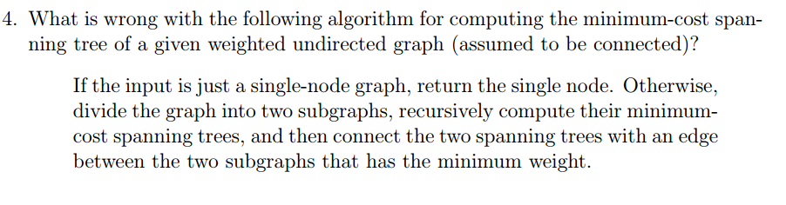

Slide 13
Problem 4
The following example will make this algorithm failed
5
1
10
5
5
10
5
1
10

Slide 14
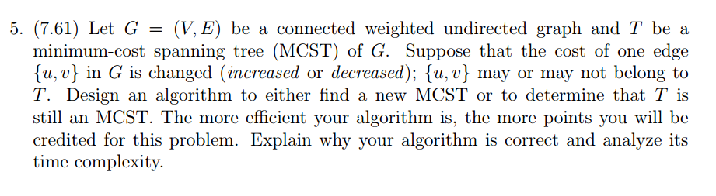

Slide 15
Problem 5. (cont.)
{u, v}
T1
T2
f
 | {u, v} in T | {u, v} NOT in T
{u, v} increase | Delete {u, v} edge from T T becomes two subtrees T1, T2. Find the minimum cost edge f that connecting T1 and T2. If f= {u, v} ) same MCST else add the edge k to T. (※Lemma) | Same MCST
{u, v } decrease | Same MCST | Add {u, v} edge to T. There is a cycle in T. Find the maximum cost edge k in the cycle. Delete the edge k from T.
Lemma: Adding additional edge k to a minimal cost spanning tree T, it will create a cycle .
In the cycle, k is the maximum cost edge.

Slide 16
Input: G(V, E): undirected graph, T: MCST, e={u, v} 2 G
Output: T’: new MCST or print “No Change”
Algorithm newMCST (G, T, e);
1 begin
2 w := e.weight;
3 new_edge := e;
4 if e ∈ T and e is increase then
5 T’ := T - e;
6 T1 := DFS_Tree(T’, u);
7 T2 := DFS_Tree(T’, v);
8 for all edges k connecting T1 and T2 do
9 if k.weight < w then
10 w := k.weight;
11 new_edge := k;
12 if k = e then
13 print “No Change”
14 else
15 T’ := T’ + new_edge;
16 return T’;
17 else if e ∉ T and e is decrease then
18 T’ := T + e;
19 C := Find_Cycle(T, e);
20 for all edge k in C do
21 if k.weight > w then
22 w := k.weight;
23 new_edge := k;
24 T’ := T’ – new_edge;
25 if new_edge = e then
26 print “No Change”
27 else
28 return T’;
29 else
30 print “No Change”
O(|V|+|E|)
O(|V|)
O(|V1|+|E1|)
O(|V2|+|E2|)
O(|E|)
Time Complexity: O(|V|+|E|)

