Slide 1
Algorithms TA Session #1
Carlos & Bo-REN
2018/03/27

Slide 2
Homework #1
Avg:75.2, std:24.7

Slide 3
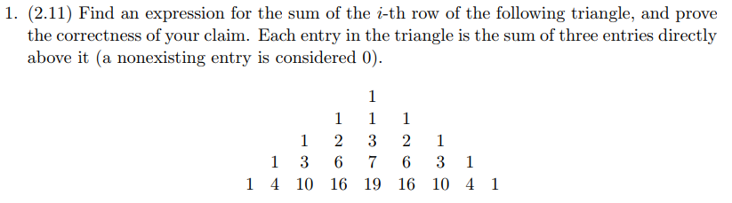

Slide 4

Make of the Formula
By observing the definition of the entry, we may guess that the sum of the n^{th} row is${ 3}^{n−1}$.
(The number of entries in the n^{th} row is 2n-1)
Proposition:
The sum of n^{th} row in the triangle is ${ 3}^{n−1}$

Slide 5
Proof
The proof is by induction on n.
Base case(n=1): the sum of the first row is 1 = 3¹⁻¹.
Inductive step: Let the elements of n^{th} row are (1,a₁,a₂,…,a_{2n-3},1), the elements of n+1th row are (1,b₁,b₂,…,b_{2n-1},1).
The sum of the n+1th row
=1+b₁+b₂+…+b_{2n-2}+b_{2n-1}+1
=1+(1+a₁)+(1+a₁+a₂)+…+(a_{2n-4}+a_{2n-3}+1)+(a_{2n-3}+1)+1
=3*(1+a₁+a₂+…+a_{2n-4}+a_{2n-3}+1)
=3*(3^{n-1}) (induction hypothesis)
=3^{n} = 3^{(n+1)-1}
By M.I., we proved the proposition.

Slide 6
Prove by Induction
appendix

Slide 7
Induction in High School
Base case
假設n=k成立
證明n=k+1成立
By induction

Slide 8
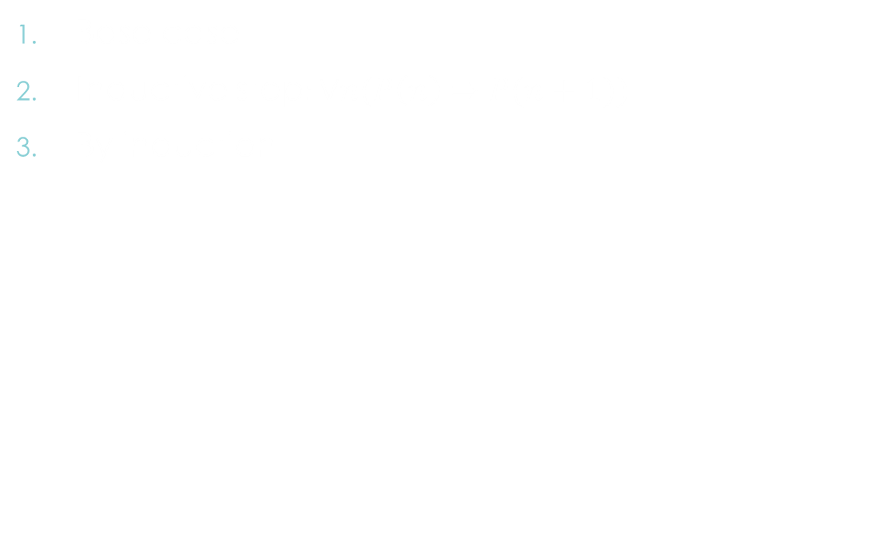
Induction Now
Base case
Inductive step$:∀n(P\left(n\right)⇒P(n+1))$
By induction

Slide 9
Example
Prove A(n) = B(n) for all positive integer n
A(1) = B(1)
A(n+1) = … = A(n) + C = B(n) + C = … = B(n+1)
By induction

Slide 11

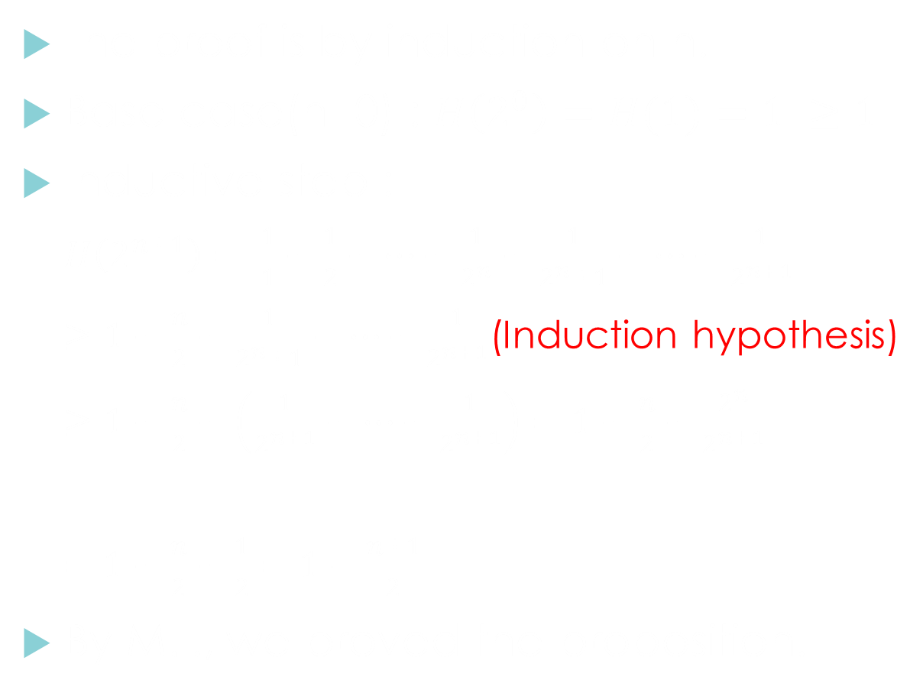
Proof
The proof is by induction on n.
Base case(n=0) : $H\left(2^{0}\right)=H(1)=1 ≥1$
Inductive step :
$H\left(2^{n+1}\right)= \frac{1}{1}+\frac{1}{2}+…+\frac{1}{2^{n}}+\frac{1}{2^{n}+1}+…+\frac{1}{2^{n+1}}$
$≥1+\frac{n}{2}+\frac{1}{2^{n}+1}+…+\frac{1}{2^{n+1}}$(Induction hypothesis)
$≥1+\frac{n}{2}+\left(\frac{1}{2^{n+1}}+…+\frac{1}{2^{n+1}}\right)=1+\frac{n}{2}+\frac{2^{n}}{2^{n+1}}$
$=1+\frac{n}{2}+\frac{1}{2}=1+\frac{n+1}{2}$
By M.I., we proved the proposition.
$2^{n}$個

Slide 12
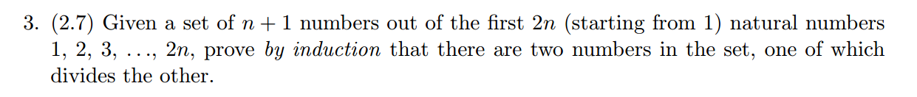

Slide 13
Proof(1)
Proposition:
Given a set of n + 1 numbers out of the first 2n (starting from 1) natural numbers 1, 2, 3, . . ., 2n, there must be two numbers in the set, one of which divides the other.
The proof is by induction on n.
Base case(n=1):Select 2 numbers from the first 2 numbers. We must choose 1 and 2, and 1 divides 2.

Slide 14
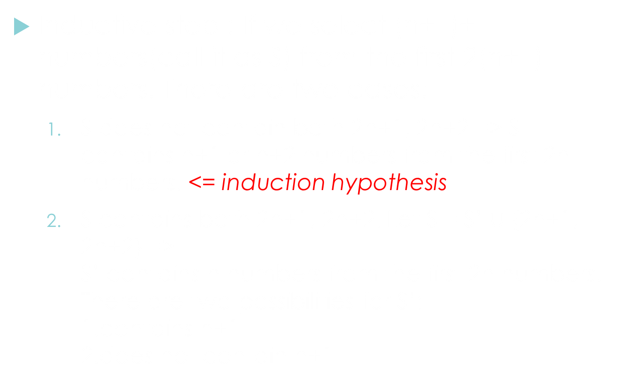
Proof(2)
Inductive step : If we select (n+1)+1 numbers(call it as S) from the first 2(n+1) numbers. There are two cases:
  S does not contain both 2n+1, 2n+2 => S contains n+1 or n+2 numbers from the first 2n numbers. <= induction hypothesis
  S contains both 2n+1, 2n+2. Let S = S’ $∪$ {2n+1, 2n+2} =>
  S’ contains n numbers from the first 2n numbers.
  There are two possibilities for S’:
  1.contains n+1
  2.does not contain n+1

Slide 15
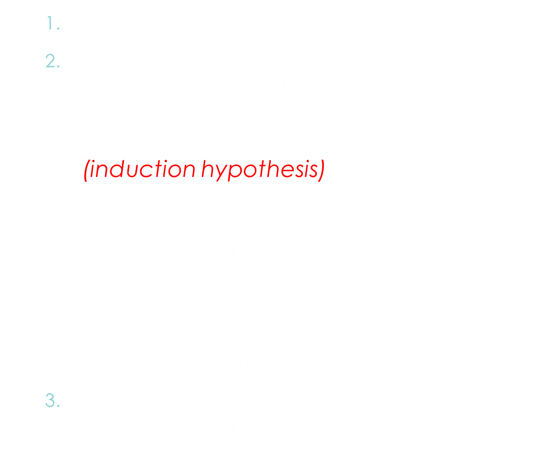
Proof(3)
  S’ contains n+1 => n+1 is a divider of 2n+2
  S’ does not contain n+1 => S’ $∪$ {n+1} contains n+1 numbers out of the first 2n numbers, so there must be one number divides another one in S’ $∪$ {n+1}. (induction hypothesis)
  More, n+1 is not a divider for any number in the first 2n numbers. => S’ either contains two numbers, one of which divides the other and they are not both n+1, or
  contains the divider of n+1. We all know that the divider of n+1 also divides 2n+2.
  By 1,2, there must be one number divides another one in S’

Slide 16
Proof(4)
  By the statements above, S contains two numbers, one of which divides the other
By M.I., we proved the proposition.

Slide 17
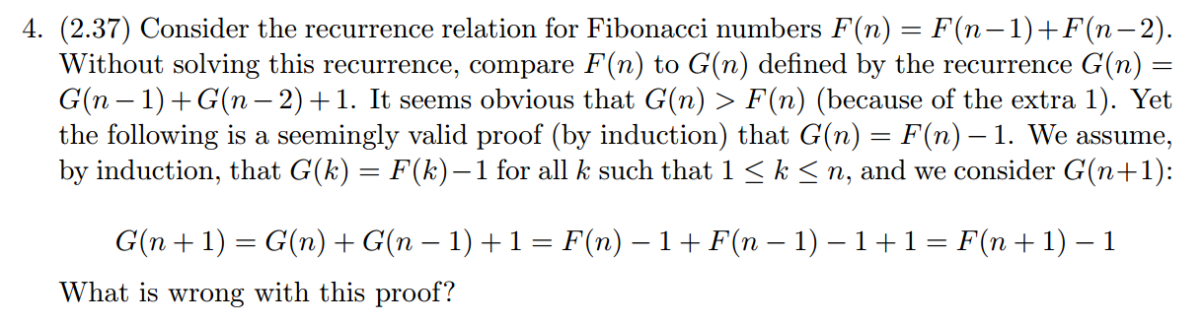

Slide 18
Try to prove
Base case (n=1):
F(1) = 1, G(1) = 1+1 =2
=> G(1) ≠ F(1) - 1
Mathematical Induction fails!!

Slide 19
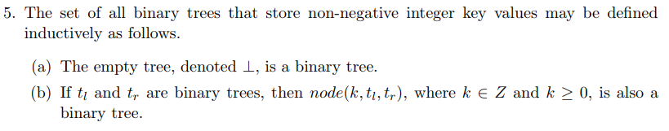
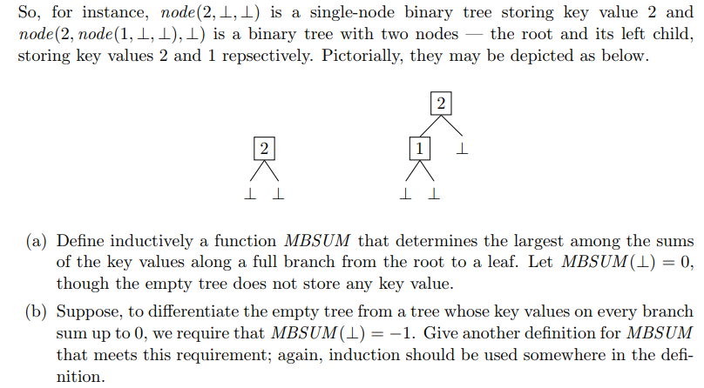

Slide 20

(a)
$\left\{\begin{aligned}MBSUM(\text{⊥})=0 \\ MBSUM(node(k,t_{l},t_{r}))=k+Max(MBSUM\left(t_{l}\right),MBSUM\left(t_{r}\right))\end{aligned}\right.$

Slide 21

(b)
$\left\{\begin{aligned}MBSUM\left(\text{⊥}\right)=−1 \\ MBSUM(node(k,t_{l},t_{r}))=k+Max(MBSUM^{′}\left(t_{l}\right),MBSUM^{′}\left(t_{r}\right))\end{aligned}\right.$
$\left\{\begin{aligned}MBSUM′(\text{⊥})=0 \\ MBSUM′(node(k,t_{l},t_{r}))=k+Max(MBSUM^{′}\left(t_{l}\right),MBSUM^{′}\left(t_{r}\right))\end{aligned}\right.$

