Slide 1
Homework #7
Boren Xiao

Slide 2
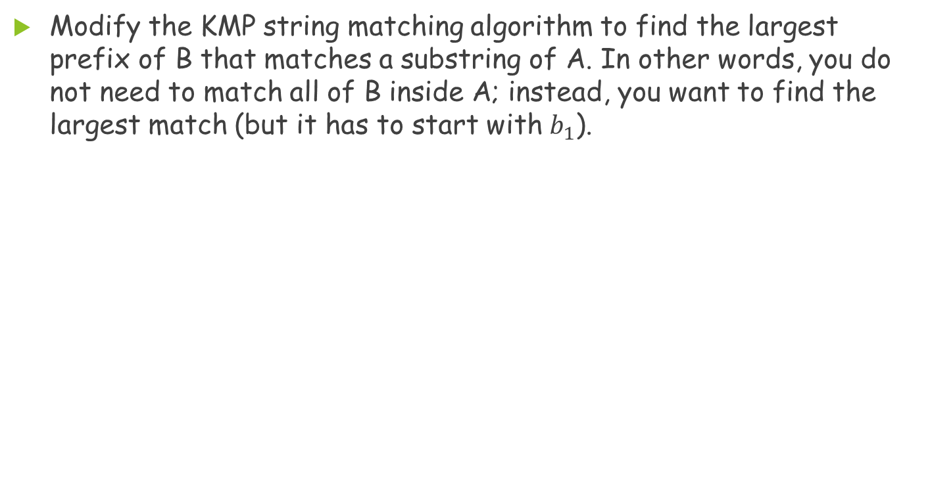
Problem 1
Modify the KMP string matching algorithm to find the largest prefix of B that matches a substring of A. In other words, you do not need to match all of B inside A; instead, you want to find the largest match (but it has to start with $b_{1}$).

Slide 3
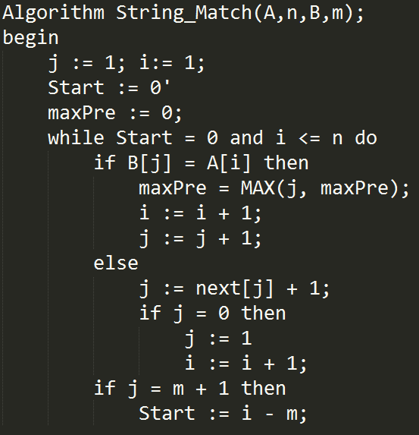
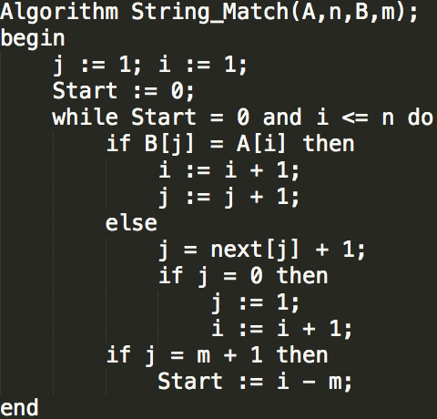
Problem 1(Cont.)

Slide 4
Problem 2
Consider the next table as in the KMP algorithm for string B[1::9] = abaababaa.
Suppose that, during an execution of the KMP algorithm, B[6] (which is an a) is being compared with a letter in A, say A[i], which is not an a and so the matching fails. The algorithm will next try to compare B[next[6]+1], i.e., B[3] which is also an a, with A[i]. The matching is bound to fail for the same reason. This comparison could have been avoided, as we know from B itself that B[6] equals B[3] and, if B[6] does not match A[i], then B[3] certainly will not, either. B[5], B[8], and B[9] all have the same problem, but B[7] does not.
Please adapt the computation of the next table so that such wasted comparisons can be avoided.
i | 1 | 2 | 3 | 4 | 5 | 6 | 7 | 8 | 9
B | a | b | a | a | b | a | b | a | a
next | -1 | 0 | 0 | 1 | 1 | 2 | 3 | 2 | 3

Slide 5
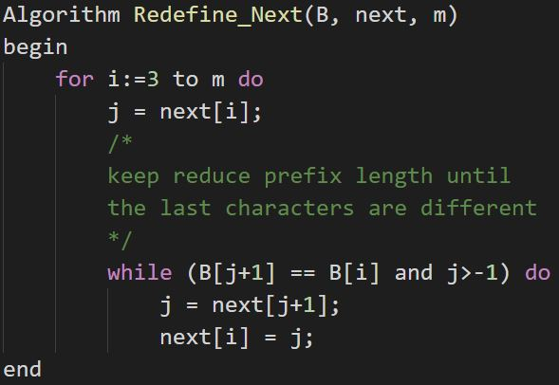
Problem 2(Cont.)
redefine the next table

Slide 6
Problem 2(Cont.)
i | 1 | 2 | 3 | 4 | 5 | 6 | 7 | 8 | 9
B | a | b | a | a | b | a | b | a | a
next | -1 | 0 | 0 | 1 | 1 | 2 | 3 | 2 | 3
i | 1 | 2 | 3 | 4 | 5 | 6 | 7 | 8 | 9
B | a | b | a | a | b | a | b | a | a
next | -1 | 0 | -1 | 1 | 0 | -1 | 3 | -1 | 1

Slide 7
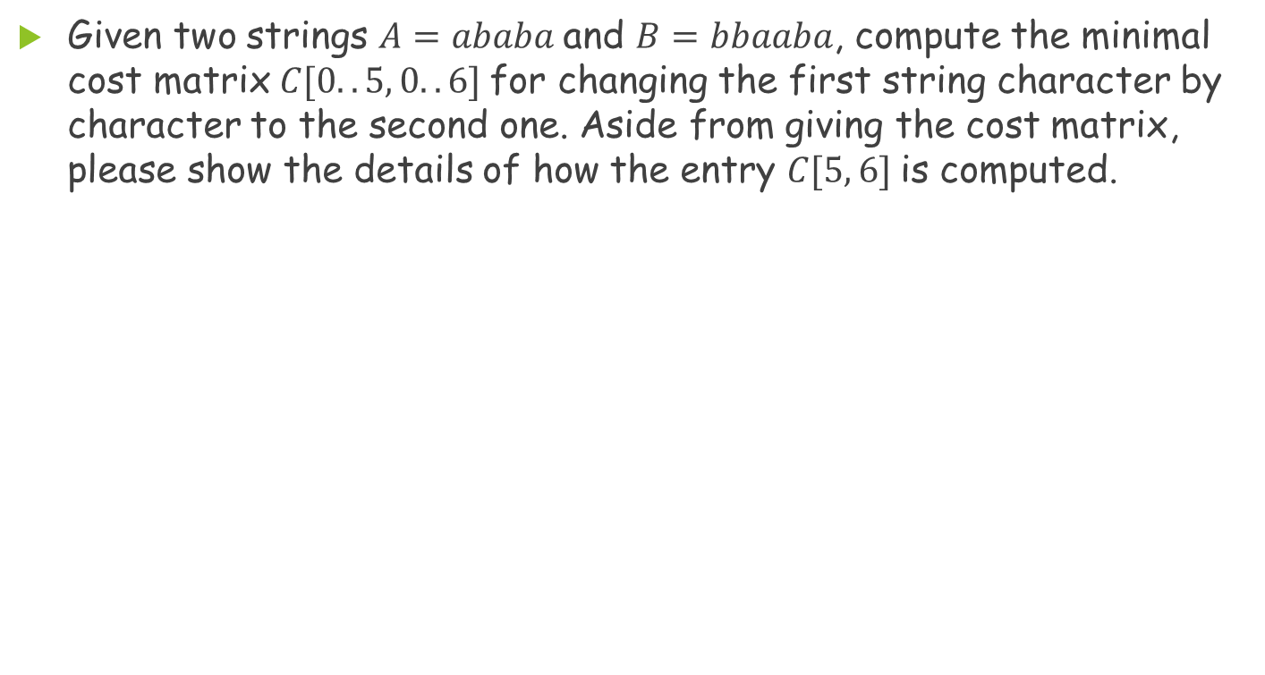
Problem 3
Given two strings $A=ababa$and $B=bbaaba$, compute the minimal cost matrix $C[0..5, 0..6]$for changing the first string character by character to the second one. Aside from giving the cost matrix, please show the details of how the entry $C[5, 6]$is computed.

Slide 8
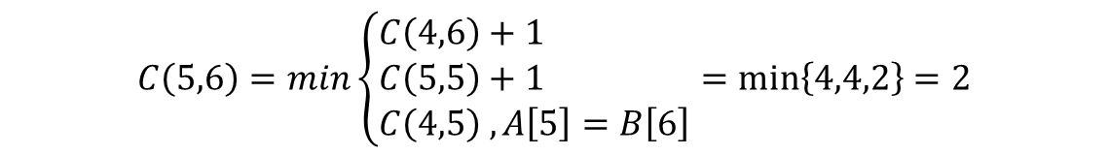
Problem 3(Cont.)
 |  |  | b | b | a | a | b | a
 |  | 0 | 1 | 2 | 3 | 4 | 5 | 6
 | 0 | 0 | 1 | 2 | 3 | 4 | 5 | 6
a | 1 | 1 | 1 | 2 | 2 | 3 | 4 | 5
b | 2 | 2 | 1 | 1 | 2 | 3 | 3 | 4
a | 3 | 3 | 2 | 2 | 1 | 2 | 3 | 3
b | 4 | 4 | 3 | 2 | 2 | 2 | 2 | 3
a | 5 | 5 | 4 | 3 | 2 | 2 | 3 | 2
$$C\left(5,6\right)=min\left\{\begin{aligned}C\left(4,6\right)+1 \\ C\left(5,5\right)+1 \\ C\left(4,5\right) ,A\left[5\right]=B\left[6\right]\end{aligned}\right.=min\left\{4,4,2\right\}=2$$

Slide 9
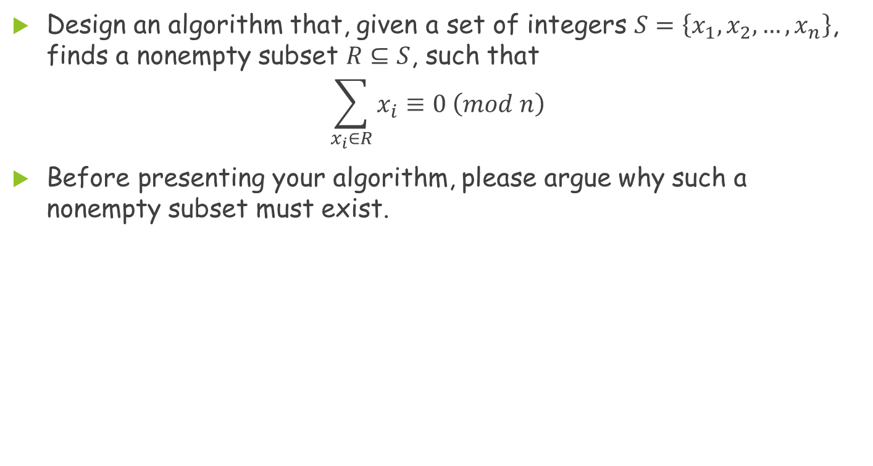
Problem 4
Design an algorithm that, given a set of integers $S=\left\{x_{1}, x_{2},…,x_{n}\right\}$, finds a nonempty subset $R⊆S$, such that
$$\sum_{x_{i}∈R}{x_{i}}≡0 \left(mod n\right)$$
Before presenting your algorithm, please argue why such a nonempty subset must exist.

Slide 10
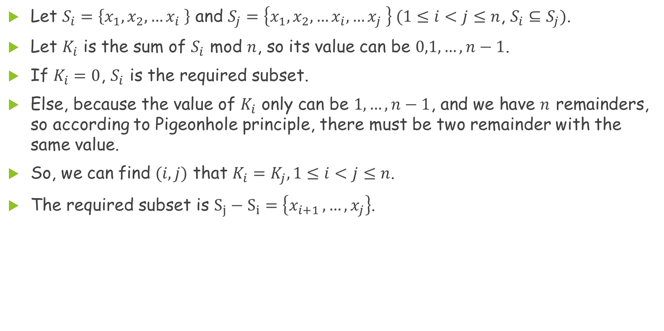
Problem 4(Cont.)
Let $S_{i}=\left\{x_{1},x_{2},…x_{i} \right\}$ and $S_{j}=\left\{x_{1},x_{2},…x_{i},…x_{j} \right\} (1≤i<j≤n$, $S_{i}⊆S_{j})$.
Let $K_{i}$ is the sum of $S_{i}$ mod $n$, so its value can be $0,1,…,n−1$.
If $K_{i}=0$, $S_{i}$ is the required subset.
Else, because the value of $K_{i}$ only can be $1,…,n−1$, and we have $n$ remainders, so according to Pigeonhole principle, there must be two remainder with the same value.
So, we can find $(i,j)$ that $K_{i}=K_{j}, 1≤i<j≤n$.
The required subset is $S_{j}−S_{i}=\left\{x_{i+1 },…,x_{j}\right\}$.

Slide 11
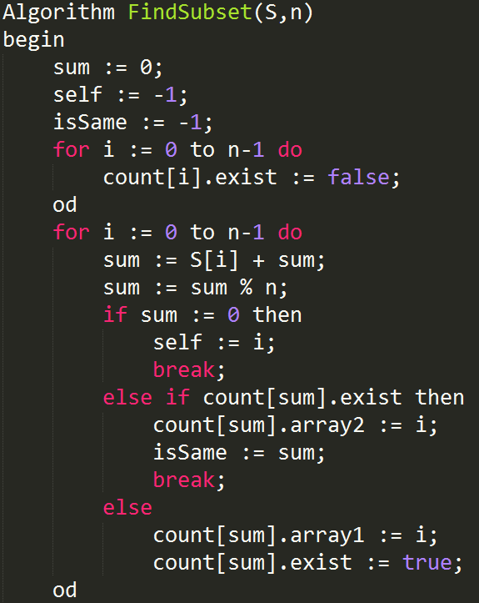
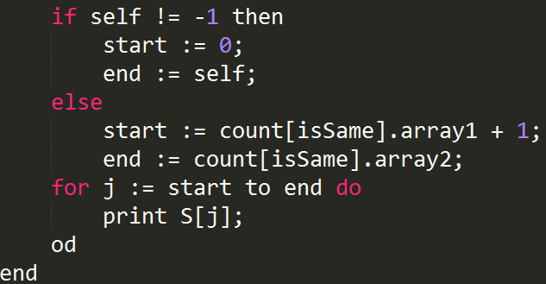
Problem 4(Cont.)

Slide 12
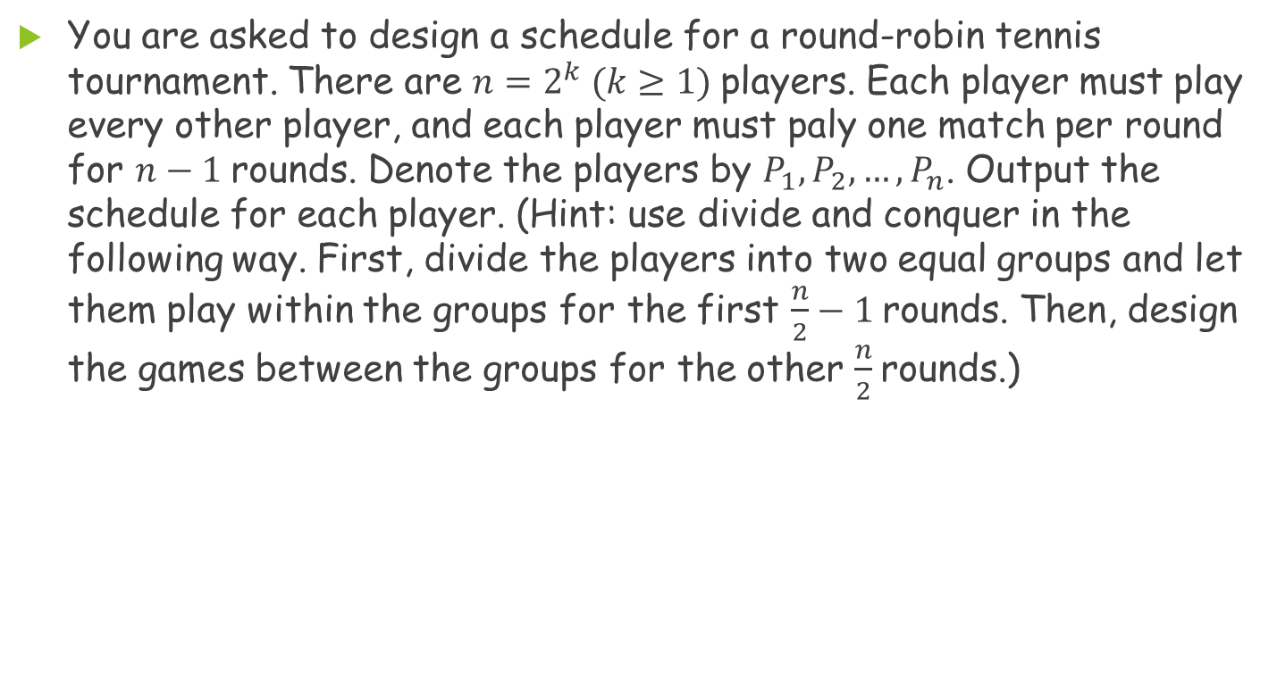
Problem 5
You are asked to design a schedule for a round-robin tennis tournament. There are $n=2^{k} (k≥1)$players. Each player must play every other player, and each player must paly one match per round for $n−1$rounds. Denote the players by $P_{1},P_{2},…,P_{n}$. Output the schedule for each player. (Hint: use divide and conquer in the following way. First, divide the players into two equal groups and let them play within the groups for the first $\frac{n}{2}−1$rounds. Then, design the games between the groups for the other $\frac{n}{2}$rounds.)

Slide 13
Problem 5(Cont.)
1 | 2 | 3 | 4 | 5 | 6 | 7 | 8
1 | 2 | 3 | 4
5 | 6 | 7 | 8
1 | 2
3 | 4
5 | 6
7 | 8
1
2
3
4
5
6
7
8
Divide：divide a group into two sub-group
Conquer：let two sub-group play against each other

Slide 14
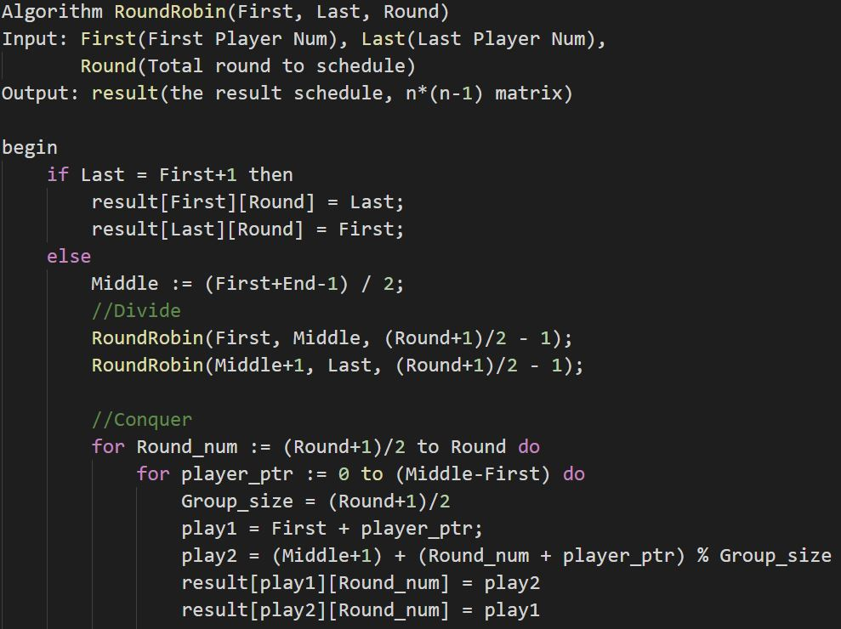
Problem 5(Cont.)
Notes:
沒解釋做法-10

Slide 15
Problem 5(Cont.)
 | 1 | 2 | 3 |  |  | 4 | 5 | 6 | 7
1 | 2 | 3 | 4 |  |  | 5 | 6 | 7 | 8
2 | 1 | 4 | 3 |  |  | 6 | 7 | 8 | 5
3 | 4 | 1 | 2 |  |  | 7 | 8 | 5 | 6
4 | 3 | 2 | 1 |  |  | 8 | 5 | 6 | 7
5 | 6 | 7 | 8 |  |  | 1 | 4 | 3 | 2
6 | 5 | 8 | 7 |  |  | 2 | 1 | 4 | 3
7 | 8 | 5 | 6 |  |  | 3 | 2 | 1 | 4
8 | 7 | 6 | 5 |  |  | 4 | 3 | 2 | 1

