Slide 1
Recursion
Yih-Kuen Tsay
Dept. of Information Management
National Taiwan University
Based on [Carrano and Henry 2013]
With help from Chien Chin Chen

Slide 2
Overview
Get a basic understanding of recursion, one of the most powerful techniques in computer science.
Examine the thought process leading to recursive solutions.
Learn techniques that help understanding the mechanics of recursion.

Slide 3
The Basic Idea
Recursion is an extremely powerful problem-solving technique.
Recursion tries to
  break a problem into smaller identical problems.
  solve the problem by solving smaller instances of the same problem.
    (The solutions of the smaller problems will lead to the solution of the original problem.)
Problems that at first appear to be quite difficult often have simple recursive solutions.

Slide 4
About Efficiency
The technique of recursion, though powerful, does not guarantee you an efficient solution.
Some recursive solutions are so inefficient that they should not be used.
  Overhead associated with function calls.
  Inherent inefficiency of some recursive algorithms.
We will come back to the efficiency issue later.

Slide 5
An Example (1/2)
Looking up a word in a dictionary using binary search:
  if (the dictionary contains only one page)
  Scan the page for the word
  else {
  Open the dictionary to a point near the middle
  Determine which half contains the word
  if (the word is in the first half)
  Search the first half for the word
  else
  Search the second half for the word
  }

Slide 6
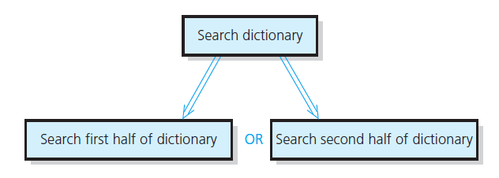
An Example (2/2)
The binary search strategy reduces the search problem to a smaller instance of the same problem:
Source: FIGURE 2-1 in [Carrano and Henry 2013].

Slide 7
Deriving a Recursive Solution (1/2)
Binary search reduces the problem of searching the dictionary for a word to a problem of searching half of the dictionary for the word.
Two important points:
  Once you have divided the dictionary in halves, you already know how to search the appropriate half.
  There is a special case that is different from all the other cases: dictionary with a single page.
    Stop dividing and solve the problem directly.
    This special case is called the base case (or basis).

Slide 8
Deriving a Recursive Solution (2/2)
Binary search falls into the general strategy of divide and conquer.
  You solve the dictionary search problem by first dividing the dictionary into two halves.
  And then conquering the appropriate half (a smaller problem).
  You solve the smaller problem by using the same divide-and-conquer strategy until you reach the base case.
Many recursive solutions utilize the divide-and-conquer strategy.

Slide 9
The Search Example Revisited
More rigorous pseudocode:
  search(aDcitionary: Dictionary, word: string)
  if (aDictionary is one page in size)
  Scan the page for word
  else {
  Open aDictionary to a point near the middle
  Determine which half contains word
  if (word is in the first half of aDictionary)
  search(first half of aDictionary, word)
  else
  search(second half of aDictionary, word)
  }

Slide 10
Observations from a Recursive Solution
A recursive function calls itself.
  E.g., the search function calls search(first/second half of aDictionary, word).
Each recursive call solves an identical, but smaller, problem.
The solution to at least one smaller problem— the base case—is known.
  When you reach the base case, the recursive calls stop and you solve the problem directly.
  E.g., the function search scan the page for the word when the dictionary contains only one page.
The diminishing size of the problem ensures that you will eventually reach the base case.

Slide 11
Four Questions to Ask/Answer
How can you define the problem in terms of smaller problems of the same type?
How does each recursive call diminish the size of the problem?
What instance(s) of the problem can serve as the base case?
As the problem size diminishes, will you reach this base case?

Slide 12
A Recursive Function: Factorial (1/4)
An iterative definition of factorial(n):
  factorial(n) = n * (n – 1) * (n – 2) * … * 1
  for any integer n > 0
  factorial(0) = 1
  (Note: the factorial of a negative integer is undefined.)
A recursive definition of factorial(n)
  factorial(n) = n * factorial(n–1) if n > 0
  = 1 if n = 0
  (Note: the base case is deliberately given later.)

Slide 13
A Recursive Function: Factorial (2/4)
It is easy to construct a C++ function that implements the definition.
/** Computes the factorial of the nonnegative integer n.
@pre n must be greater than or equal to 0.
@post None.
@return The factorial of n; n is unchanged. */
int fact(int n)
{
if (n == 0)
return 1;
else // n > 0
return n * fact(n-1);
} // end fact
base case

Slide 14
A Recursive Function: Factorial (3/4)
Does function fact fit the mold of a recursive solution?
  One action of fact is to call itself.
  Each recursive call to fact diminishes the size of the problem by 1.
  fact(0) is the base case.
  Given that n is nonnegative, you always reach the base case.
Note that fact assumes the input n is non-negative, as stated in its precondition.

Slide 15
A Recursive Function: Factorial (4/4)
cout << fact(3);
6
return 3*fact(2);
3*2
fact(n-1) is evaluated
return 2*fact(1);
2*1
int fact(int n)
{
if (n == 0)
return 1;
else // n > 0
return n * fact(n-1);
} // end fact
return 1*fact(0);
1*1
base case
return 1;

Slide 16
Box Traces
A box trace is an illustration of how a compiler usually implements recursion.
You may use it to help you understand recursion and to debug a recursive function.
Each box in a box trace roughly corresponds to an “activation record.”

Slide 17
Constructing a Box Trace (1/7)
Label each recursive call in the body of the recursive function.
  These labels help you keep track of the correct place to which you must return after a function call completes.
int fact(int n)
{ if (n == 0)
return 1;
else
return n * fact(n-1);
}
(A)

Slide 18
Constructing a Box Trace (2/7)
During the course of an execution, represent each call to the function by a new box, containing:
  A copy of the actual value arguments.
  A placeholder for the value returned by each recursive call from the current box.
    Label this placeholder to correspond to the label in Step 1.
  The value of the function itself.
  The function’s local variables.
cout << fact(3);
n = 3;
A: factor(n-1) = ?
return ?
when you first create a box, you will know only the values of the
input arguments. You fill in the values of the other items as you
determine them from the function’s execution.

Slide 19
Constructing a Box Trace (3/7)
When you create a new box after a recursive call, draw an arrow from the box that makes the call to the newly created box.
  Label each arrow to correspond to the label of the recursive call.
After you create the new box and arrow, start executing the body of the function.
n = 3
A: fact(n-1) = ?
return ?
n = 2
A: fact(n-1) = ?
return ?
cout << fact(3);
A

Slide 20
Constructing a Box Trace (4/7)
On existing the function, cross off the current box and follow its arrow back to the box that called the function.
  Substitute the value returned by the just-terminated function call into the appropriate item in the current box.
…
n = 1
A: fact(n-1) = ?
return ?
n = 0 (current)
return 1
A
…
n = 1 (current)
A: fact(n-1) = ?
return?
n = 0 (cross off)
return 1
1

Slide 21
Constructing a Box Trace (5/7)
When you return to point A and substitute the computed value for fact(n-1):
  Continue execution by evaluating the expression return n * fact(n-1).
…
n = 1 (current)
A: fact(n-1) = 1
return?
n = 0 (cross off)
return 1
if (n == 0)
return 1;
else
return n * fact(n-1);
(A)

Slide 22
Constructing a Box Trace (6/7)
Box trace of fact(2):
int fact(int n)
{ if (n == 0)
return 1;
else
return n * fact(n-1);
}
The initial call is made, and fact begins execution:
n = 2
A: fact(n-1)=?
return ?
(A)
At point A a recursive call is made, and the new invocation of fact begins execution:
n = 2
A: fact(n-1)=?
return ?
A
n = 1
A: fact(n-1)=?
return ?
At point A a recursive call is made, and the new invocation of fact begins execution:
n = 2
A: fact(n-1)=?
return ?
A
n = 1
A: fact(n-1)=?
return ?
A
n = 0
return ?
This is the base case, so this invocation of fact completes:
n = 2
A: fact(n-1)=?
return ?
A
n = 1
A: fact(n-1)=?
return ?
A
n = 0
return 1

Slide 23
Constructing a Box Trace (7/7)
The method value is returned to the calling box, which continues execution:
n = 2
A: fact(n-1)=?
return ?
A
n = 1
A: fact(n-1)=1
return ?
n = 0
return 1
int fact(int n)
{ if (n == 0)
return 1;
else
return n * fact(n-1);
}
The current invocation of fact completes:
n = 2
A: fact(n-1)=?
return ?
A
n = 1
A: fact(n-1)=1
return 1
n = 0
return 1
(A)
The method value is returned to the calling box, which continues execution:
n = 2
A: fact(n-1)=1
return ?
n = 1
A: fact(n-1)=1
return 1
n = 0
return 1
The current invocation of fact completes:
n = 2
A: fact(n-1)=1
return 2
n = 1
A: fact(n-1)=1
return 1
n = 0
return 1
The value 2 is returned to the initial call.

Slide 24
Invariants for Recursive Functions
Writing invariants for recursive functions is as important as writing them for iterative functions.
  An invariant is a condition that is always true at a particular point in an algorithm/program.
/**
@pre n must be greater than or equal to 0.
@return the factorial of n. */
int fact(int n)
{
if (n == 0)
return 1;
else
// Invariant: n > 0, so n-1 >= 0.
// Thus, fact(n-1) returns (n-1)!
return n * fact(n-1);
} // end fact
The recursive call satisfies
fact’s precondition, so you
can expect from the post-
condition that fact(n-1) will
return the factorial of n-1.

Slide 25
A Recursive Procedure: writeBackward (1/5)
Problem:
  Given a string of characters, write it in reverse order.
  E.g., “cat” → “tac”, “im” → “mi”
To construct a recursive solution, you should ask/answer the four questions.
Note that a procedure is implemented as a “void function” in C++ (and several other languages).

Slide 26
A Recursive Procedure: writeBackward (2/5)
Question 1: how can you define the problem in terms of smaller problems of the same type?
  Find a solution to the problem of writing a string of length n backward in terms of the solution to the problem of writing a string of length n–1 backward.
  Which string of length n–1?
  The ability to write a substring of length n–1 backward, combined with the ability to perform some minor task, must result in the ability to write the original string backward.
  Which character to strip away?

Slide 27
A Recursive Procedure: writeBackward (3/5)
Question 2: how does each recursive call diminish the size of the problem?
  The length of the string goes from n down to n–1.
Question 3: what instance of the problem can serve as the base case?
  Write the empty string backward.
    Do nothing at all.
Question 4: as the problem size diminishes, will you reach this base case?
  Yes.

Slide 28
A Recursive Procedure: writeBackward (4/5)
Consider stripping away the last character:
  For the solution to be valid, you must write the last character in the string first.
writeBackward(s: string)
if (the string is empty)
Do nothing – this is the base case
else {
Write the last character of s
writeBackward(s minus its last character)
}
minor task
strip away the last character

Slide 29
A Recursive Procedure: writeBackward (5/5)
The C++ function writeBackward:
/** Writes a character string backward.
@pre The string s to write backward.
@post None.
@param s The string to write backward. */
void writeBackward(string s)
{
int length = s.size(); // Length of s
if (length > 0) {
// Write the last character
cout << s.substr(length - 1, 1);
// Write the rest of the string backward
writeBackward(s.substr(0, length – 1)); // Point A
} // end if
// length == 0 is the base case - do nothing
} // end writeBackward

Slide 30
A Box Trace of writeBackward (1/3)
Box trace of writeBackward(“im”):
  Each box contains the local environment of the recursive call:
    The input argument s.
    The local variable length.
    No placeholder for the value returned by each recursive call or the value of the function itself.
      Because the void function writeBackward does not use a return statement to return a computed value.

Slide 31
A Box Trace of writeBackward (2/3)
The initial call is made, and the function begins execution:
s = “im”
length = 2
Output line: m
Point A (writeBackward(s.substr(0, length-1)) is reached, and
the recursive call is made.
The new invocation begins execution:
s = “im”
length = 2
A
s = “i”
length = 1
Output line: mi
Point A is reached, and the recursive call is made.
The new invocation begins execution:
s = “im”
length = 2
A
s = “i”
length = 1
A
s = “”
length = 0

Slide 32
A Box Trace of writeBackward (3/3)
This (length==0) is the base case, so this invocation completes.
Control returns to the calling box, which continues execution:
s = “im”
length = 2
A
s = “i”
length = 1
s = “”
length = 0
This invocation completes.
Control returns to the calling box, which continues execution:
s = “im”
length = 2
s = “i”
length = 1
s = “”
length = 0
This invocation completes.
Control returns to the statement following the initial call.

Slide 33
An Alternative writeBackward (1/2)
How is the second alternative?
  Strip away the first character:
writeBackward2(s: string)
if (the string s is empty)
Do nothing – this is the base case
else {
writeBackward2(s minus its first character)
Write the first character of s
}

Slide 34
An Alternative writeBackward (2/2)
When debugging (or tracing) a recursive function, try to use cout statements at the beginning, interior, and end of the function to report the values of local variables.
writeBackward2(s: string)
cout << “Enter writeBackward2 with string: “ << s << endl;
if (the string is empty)
Do nothing – this is the base case
else {
writeBackward2(s minus its first character) // Point A
cout << “About to write first character of string:” << s << endl;
Write the first character of s
}
cout << “Leave writeBackward2 with string: “ << s << endl;

Slide 35
A Box Trace of writeBackward2
Box trace of writeBackward2(“im”):
s=“im”
Enter writeBackward2 with string: im
Enter writeBackward2 with string: m
Enter writeBackward2 with string:
Leave writeBackward2 with string:
About to write first character of string: m
m
Leave writeBackward2 with string: m
About to write first character of string: im
i
Leave writeBackward2 with string: im
A
s=“im”
s=“m”
A
A
s=“im”
s=“m”
s=“”
A
s=“im”
s=“m”
s=“”
s=“im”
s=“m”
s=“”

Slide 36
Searching an Array: Binary Search (1/8)
A high-level binary search:
  Search a sorted array of integers for a given value.
    anArray[0] <= anArray[1] <= … <= anArray[size-1]
  binarySearch(anArray: ArrayType, target: ValueType)
  if (anArray is of size 1)
  Determine if anArray’s value is equal to target
  else {
  Find the midpoint of anArray
  Determine which half of anArray contains target
  if (target is in the first half of anArray)
  binarySearch(first half of anArray, target)
  else
  binarySearch(second half of anArray, target)
  }

Slide 37
Searching an Array: Binary Search (2/8)
How will you pass “half of anArray” to the recursive calls to binarySearch?
  binarySearch(anArray, first, last, target)
    Pass the entire array at each call, but have binarySearch search only anArray[first..last].
  The midpoint in [first..last] is:
    mid = (first + last) / 2
  Then binarySearch(first half of anArray, value):
  binarySearch(anArray, first, mid-1, target)
  binarySearch(second half of anArray, target):
  binarySearch(anArray, mid+1, last, target)

Slide 38
Searching an Array: Binary Search (3/8)
How do you determine which half of the array contains target?
  The first half will be: if (target < anArray[mid]).
  Remember to test the equality between target and anArray[mid].
What should the base case(s) be?
  target == anArray[mid]
    When target is in the array.
  first > last
    When target is not in the array.

Slide 39
Searching an Array: Binary Search (4/8)
How will binarySearch indicate the result of the search?
  A negative value if it does not find target in the array.
  The index of the array item that is equal to target.

Slide 40
Searching an Array: Binary Search (5/8)
int binarySearch(const int anArray[], int first, int last, int target)
{
int index;
if (first > last)
index = -1; // target not in original array
else {
int mid = first + (last - first)/2;
if (target == anArray[mid])
index = mid; // value found at anArray[mid]
Base cases.

Slide 41
Searching an Array: Binary Search (6/8)
Determine which half by comparison.
else if (target < anArray[mid])
// Point X
index = binarySearch(anArray, first, mid-1,
target);
else
// Point Y
index = binarySearch(anArray, mid+1, last,
target);
} // end if
return index;
} // end binarySearch
Specify the range of the half array.

Slide 42
Searching an Array: Binary Search (7/8)
Box trace of binarySearch:
  anArray = <1, 5, 9, 12, 15, 21, 29, 31>
  Search for 9.
target = 9
first = 0
last = 7
mid = (0+7)/2 = 3
target < anArray[3]
X: binarySearch =
return
target = 9
first = 0
last = 2
mid = (0+2)/2 = 1
target > anArray[1]
Y: binarySearch =
return
target = 9
first = 2
last = 2
mid = (2+2)/2 = 2
target = anArray[2]
return 2
X
Y
2
2
2
2

Slide 43
Searching an Array: Binary Search (8/8)
Box trace of binarySearch:
  anArray = <1, 5, 9, 12, 15, 21, 29, 31>
  Search for 6.
target = 6
first = 0
last = 7
mid = (0+7)/2 = 3
target < anArray[3]
X: binarySearch =
return
target = 6
first = 0
last = 2
mid = (0+2)/2 = 1
target > anArray[1]
Y: binarySearch =
return
target = 6
first = 2
last = 2
mid = (2+2)/2 = 2
target < anArray[2]
X: binarySearch =
return
target = 6
first = 2
last = 1
first > last
return -1
X
Y
X
-1
-1
-1
-1
-1
-1

Slide 44
Searching an Array: Another Binary Search
int binarySearch2(const int anArray[], int first, int last,
int target)
{ int index;
if (first == last)
if (target == anArray[first])
index = first; // target found at anArray[first]
else
index = -1; // target not in original array
else {
int mid = first + (last - first)/2;
if (target < anArray[mid])
index = binarySearch2(anArray, first, mid-1, target);
else
index = binarySearch2(anArray, mid, last, target);
}
return index;
}
Base case

Slide 45
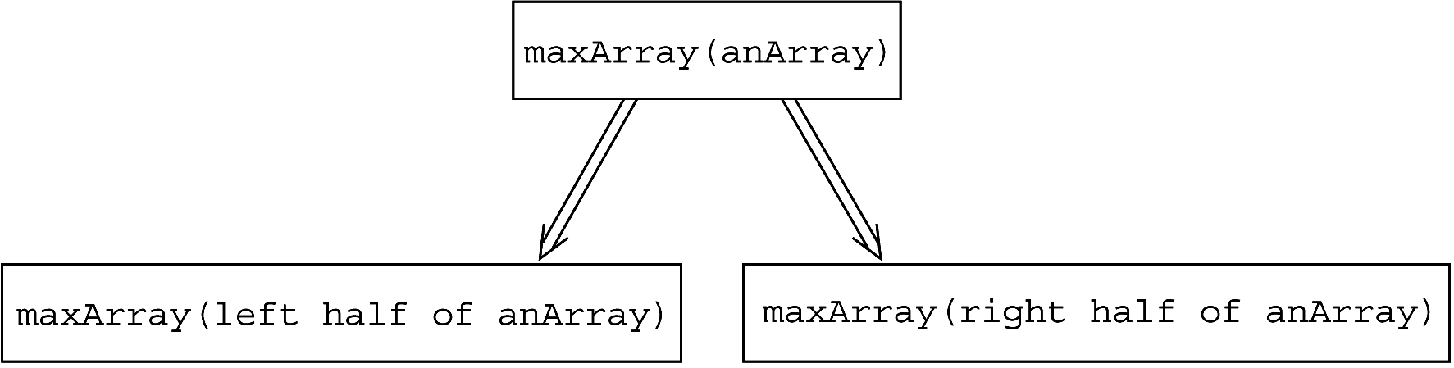
Searching an Array: the Largest Item (1/2)
A recursive solution
  if (anArray has only one entry)
  maxArray(anArray) is the entry in anArray
  else if (anArray has more than one entry) maxArray(anArray) is the maximum of
  maxArray(left half of anArray) and
  maxArray(right half of anArray)
AND
Source: FIGURE2-12 in [Carrano and Henry 2013]

Slide 46
Searching an Array: the Largest Item (2/2)
maxArray(<1,6,8,3>)
return max( maxArray(<1,6>), maxArray(<8,3>) )
= 8
6
8
maxArray(<1,6>)
return max( maxArray(<1>), maxArray(<6>) )
maxArray(<8,3>)
return max( maxArray(<8>), maxArray(<3>) )
1
6
8
3
maxArray(<1>)
return 1
maxArray(<6>)
return 6
maxArray(<8>)
return 8
maxArray(<3>)
return 3

Slide 47
Searching an Array: the k^{th} Smallest Item (1/4)
You can solve this problem by sorting the array.
  Then the k^{th} smallest item would be anArray[k-1].
A more efficient solution is possible.
  Without completely sorting the array.
The recursive solution proceeds by:
  Selecting a pivot item in the array.
  Cleverly arranging, or partitioning, the items in the array about this pivot item.
  Recursively applying the strategy to one of the partitions.

Slide 48
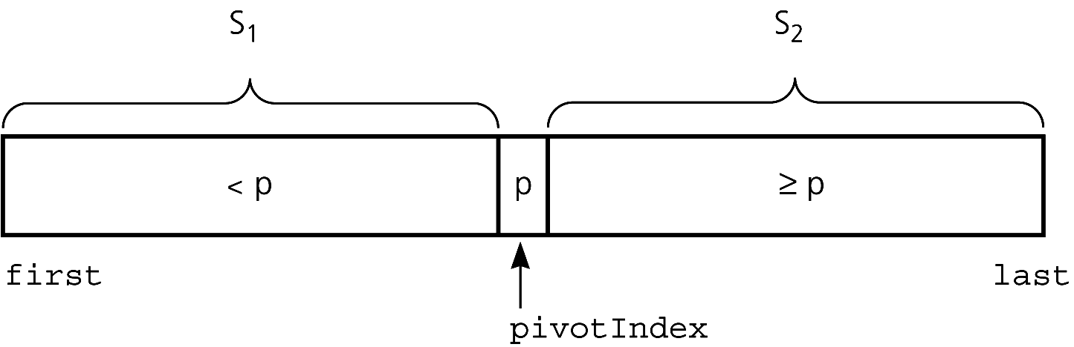
Searching an Array: the k^{th} Smallest Item (2/4)
Suppose that you want to find the k^{th} smallest item in the array segment anArray[first..last]:
  Let p be any item of the array segment such that:
If S₁ contains k-1 items: k = pivotIndex – first + 1, which is the rank of p in anArray[first..last].
If S₁ contains k or more items: k < pivotIndex – first + 1.
If S₁ contains fewer than k-1 items (S₁ & p contains fewer than k items): k > pivotIndex – first + 1.

Slide 49
Searching an Array: the k^{th} Smallest Item (3/4)
Let
  kSmall(k, anArray, first, last) =
  k^{th} smallest item in anArray[first..last]
Solution:
  kSmall(k, anArray, first, last) =
  kSmall(k,anArray,first,pivotIndex-1)
  if k < pivotIndex – first + 1
  p if k = pivotIndex – first + 1
  kSmall(k-(pivotIndex-first+1), anArray,
  pivotIndex+1, last)
  if k > pivotIndex – first + 1
base case

Slide 50
Searching an Array: the k^{th} Smallest Item (4/4)
Two more questions:
  How to choose the pivot item p?
    The choice of p is arbitrary.
  How to partition the array?
    Chapter 11 gives an algorithm for partitioning the array.

Slide 51
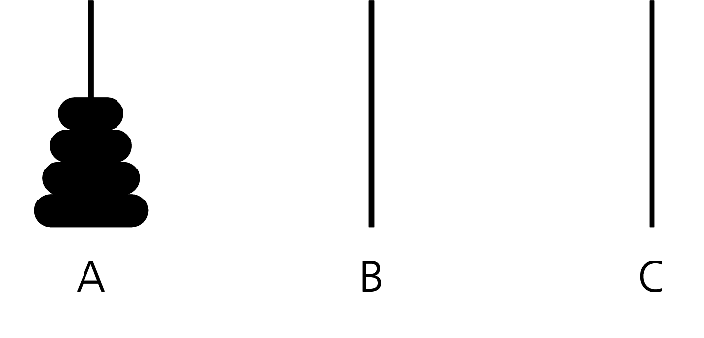
The Towers of Hanoi (1/11)
Rules:
  To move n disks, one by one, from pole A to pole B.
  Pole C can be used for the help of the transfer.
  A disk could be placed only on top of a larger disk.
(source)
(destination)
(spare)

Slide 52
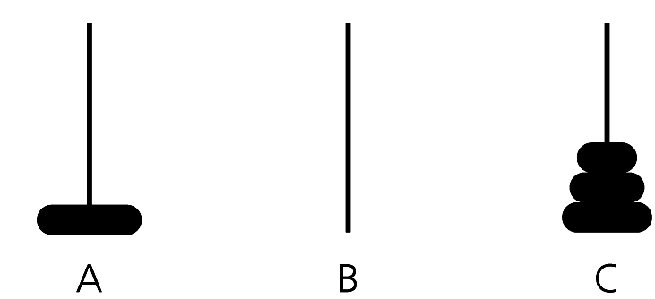
The Towers of Hanoi (2/11)
Recursive thinking:
  If you have only one disk (that is, n=1):
    Move it from source to destination directly.
  If you have more than one disk (that is, n>1):
    Ignore the bottom disk and solve the problem for n-1 disks, with the small modification that pole C is the destination and pole B is the spare.
(source)
(spare)
(destination)

Slide 53
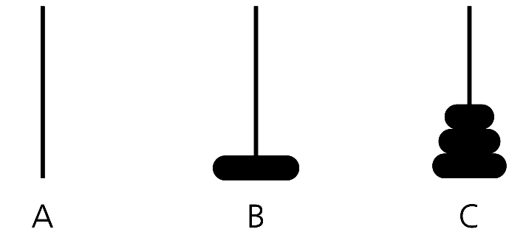
The Towers of Hanoi (3/11)
Then, solve the problem for n=1 by moving the largest disk from A to B.
(source)
(destination)
(spare)

Slide 54
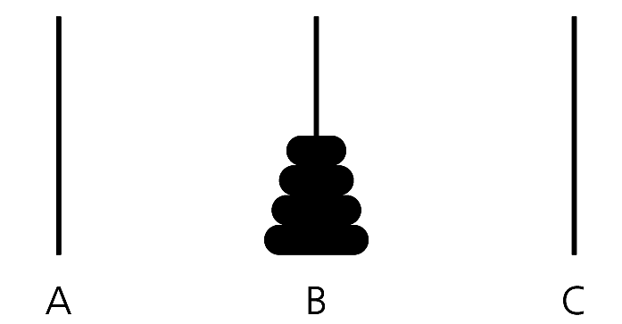
The Towers of Hanoi (4/11)
Now, all you have to do is move the n-1 disks from pole C to pole B.
  C as the source, B as the destination, and A as the spare.
(spare)
(destination)
(source)

Slide 55
The Towers of Hanoi (5/11)
Pseudocode:
  solveTowers(count, source, destination, spare)
  if (count is 1)
  Move a disk directly from source to destination
  else {
  solveTowers(count-1, source, spare, destination)
  solveTowers(1, source, destination, spare)
  solveTowers(count-1, spare, destination, source)
  }
the base case
Meet the four questions ?

Slide 56
The Towers of Hanoi (6/11)
1
solveTowers(3, A, B, C)
2
6
7
solveTowers(2, A, C, B)
solveTowers(1, A, B, C)
solveTowers(2, C, B, A)
3
8
solveTowers(1, A, B, C)
solveTowers(1, C, A, B)
4
9
solveTowers(1, A, C, B)
solveTowers(1, C, B, A)
5
10
solveTowers(1, B, C, A)
solveTowers(1, A, B, C)
: base case, move disk from source to destination directly.

Slide 57
The Towers of Hanoi (7/11)
With N disks, how many moves does solveTowers make?
Let moves(N) be the number of moves made starting with N disks.
  When N = 1, moves(1) = 1.
  When N > 1,
  moves(N) = moves(N–1) + moves(1) +
  moves(N–1).

Slide 58
The Towers of Hanoi (8/11)
Recurrence relation for the number of moves that solveTowers requires for N disks:
  moves(N) = 1, if N = 1,
  = 2 * moves(N –1) + 1, if N > 1.
Example: moves(3) = 2 * moves(2) + 1
= 2 * (2 * moves(1) + 1) + 1
= 2 * (2 * 1 + 1) + 1
= 7

Slide 59
The Towers of Hanoi (9/11)
Although the recurrence relation gives you a way to compute moves(N), A closed-form formula is more satisfactory.
  Closed-form formula: such as an algebraic expression.
  With the formula, you can substitute any given value for N and obtain the number of moves made.
  moves(N) = 2^{N} – 1, for all N ≥ 1.
    E.g., moves(3) = 2³ – 1 = 8 – 1 = 7.

Slide 60
The Towers of Hanoi (10/11)
N = 1
1
: move the disk once from source to
destination directly.
1 move
N = 2
1
1
3 moves
N=1
N=1
1
1
N = 3
1
1
7 moves
N=2
N=2
1
1
moves(N) equals to
the numer of nodes in
a binary tree.
2^{N}-1
1
1
1
1

Slide 61
The Towers of Hanoi (11/11)
The towers of Hanoi is a very difficult problem.
N | moves(N) | Time
2 | 3 | 3 seconds
3 | 7 | 7 seconds
4 | 15 | 15 seconds
10 | 1023 | 17 minutes
11 | 2047 | 34 minutes
20 | 1048575 | 12 days!!
double moves
1025 times
The recursive solveTowers is an exponential algorithm.

Slide 62
The Fibonacci Sequence (1/5)
(Multiplying Rabbits)
“Facts” about rabbits:
  Rabbits never die.
  A rabbit reaches sexual maturity exactly two months after birth, that is, at the beginning of its third month of life.
  Rabbits are always born in male-female pairs. At the beginning of every month, each sexually mature male-female pair gives birth to exactly one male-female pair.

Slide 63
The Fibonacci Sequence (2/5)
Problem:
  How many pairs of rabbits are alive in month n?
    Started with a single newborn male-female pair.
Recurrence relation:
  rabbit(n) = rabbit(n – 1) + rabbit(n – 2).
Differences to the previous examples:
  You can solve a problem by solving more than one smaller problems of the same type.
old members: the number of
pairs alive just prior to the month n.
new members: the number of pairs
born at the start of month n.

Slide 64
The Fibonacci Sequence (3/5)
When you employ more than one recursive calls in problem solving, you must be very careful when selecting the base case.
  Assume rabbit(1) = 1 is the base case.
  Then rabbit(2) = rabbit(1) + rabbit(0).
You have to define more than one base case.
  Either rabbit(0) = 0 or rabbit(2) = 1.
Keep recursive rabbit(-1), rabbit(-2) …
Violate the question 4, will you reach the base case?

Slide 65
The Fibonacci Sequence (4/5)
Base cases: rabbit(2), rabbit(1).
Recursive definition:
  rabbit(n) = 1 if n is 1 or 2
  = rabbit(n – 1) + rabbit(n – 2)
  if n > 2
Fibonacci sequence
  The series of numbers rabbit(1), rabbit(2), rabbit(3), and so on; that is, 1, 1, 2, 3, 5, 8, 13, …
  Which models many naturally occurring phenomena.

Slide 66
The Fibonacci Sequence (5/5)
A C++ function to compute rabbit(n):
/** Computes a term in the Fibonacci sequence.
@pre n is a positive integer. (n > 0)
@post None.
@param n The given integer.
@return The nth Fibonacci number. */
int rabbit(int n)
{
if (n <= 2)
return 1;
else // n > 2, so n-1 > 0 and n-2 > 0
return rabbit(n-1) + rabbit(n-2);
} // end rabbit

Slide 67
Organizing a Parade (1/3)
Problem:
  How many ways can you organize a parade of length n?
  The parade will consist of bands and floats in a single line.
  One band cannot be placed immediately after another.
Let
  P(n): the number of ways to organize a parade of length n.
  F(n): the number of parades of length n ending with a float.
  B(n): the number of parades of length n ending with a band.
Then
  P(n) = F(n) + B(n).

Slide 68
Organizing a Parade (2/3)
F(n) = P(n – 1)
  You can have a parade of length n that ends with a float simply by placing a float at the end of any acceptable parade of length n – 1.
B(n) = F(n – 1)
  The only way a parade can end with a band is if the unit just before the end is a float.
  Or, B(n) = P(n – 2).
Number of acceptable parades of length n
  P(n) = F(n) + B(n) = P(n – 1) + P(n – 2)

Slide 69
Organizing a Parade (3/3)
Again, two base cases are necessary.
Base cases:
  P(1) = 2 (The parades of length 1 are float and band.)
  P(2) = 3 (The parades of length 2 are float-float, band- float, and float-band.)
Solution:
  P(n) = 2 for n = 1
  = 3 for n = 2
  = P(n – 1) + P(n – 2) for n > 2
The recurrence relation is identical to rabbit,
but the base cases are different.

Slide 70
Choosing k out of n Things (1/6)
Problem:
  How many different choices are possible for exploring k planets out of n planets in a solar system?
Let g(n, k) be the number of groups of k planets chosen from n.
  In terms of Planet X:
  g(n, k) = the number of groups of k planets that include Planet X
  +
  the number of groups of k planets that do not include Planet X

Slide 71
Choosing k out of n Things (2/6)
g(n, k) = g(n – 1, k – 1) + g(n – 1, k)
Base cases:
  g(k, k) = 1. There is one group of everything.
    Will you reach this base case?
      If n > k, it is easy to see that the second term in the recursive definition (g(n–1,k)) is closer to the base case g(k,k) than is g(n,k).
      However, the first term (g(n–1,k–1)) is not closer to g(k,k) than is g(n,k) — they are the same distance apart.
Including X,
the number of ways to
choose k – 1 out of n – 1
Not including X,
the number of ways to
choose k out of n – 1

Slide 72
Choosing k out of n Things (3/6)
g(n, 0) = 1. There is one group of nothing.
  If n > k, the first term g(n–1,k–1) is closer to it than g(n,k).
We have shown that, when n > k, the two terms in the recursive definition would eventually reach a base case.
  But … what if n < k?
g(n, k) = 0 if k > n. Although k cannot exceed n here, we want our solution to be general.

Slide 73
Choosing k out of n Things (4/6)
Recursive solution:
g(n, k) =
1 if k = 0
  1 if k = n
  0 if k > n
  g(n – 1, k – 1) + g(n – 1, k) if 0 < k < n

Slide 74
Choosing k out of n Things (5/6)
A C++ function to compute g(n, k) :
/** Computes the number of groups of k out of n things.
@pre n and k are nonnegative integers.
@post None.
@param n The given number of things.
@param k The given number to choose.
@return g(n,k). */
int g(int n, int k)
{
if ( (k == 0) || (k == n) )
return 1;
else if (k > n)
return 0;
else
return g(n-1,k-1) + g(n-1,k);
} // end g

Slide 75
Choosing k out of n Things (6/6)
g(4,2) =
6
g(4,2)
return g(3,1) + g(3,2)
3
3
g(3,1)
return g(2,0) + g(2,1)
g(3,2)
Return g(2,1) + g(2,2)
1
2
2
1
g(2,0)
return 1
g(2,1)
return g(1,0) + g(1,1)
g(2,1)
return g(1,0) + g(1,1)
g(2,2)
return 1
1
1
1
1
g(1,0)
return 1
g(1,1)
return 1
g(1,0)
return 1
g(1,1)
return 1

Slide 76
Recursion and Efficiency (1/4)
Recursion is a powerful problem-solving technique that often produces very clear solutions to complex problems.
Some recursive solutions are so inefficient that they should not be used.
  binarySearch and solveTowers are exceptions; they are quite efficient.
Factors that contribute to the inefficiency of some recursive solutions:
  Overhead associated with function calls.
  Inherent inefficiency of some recursive algorithms.

Slide 77
Recursion and Efficiency (2/4)
In most programming languages, a function call incurs a bookkeeping overhead.
  Local variables, the returning address, … etc.
  Recursive functions can generate a lot of recursive calls → magnify this overhead.

Slide 78
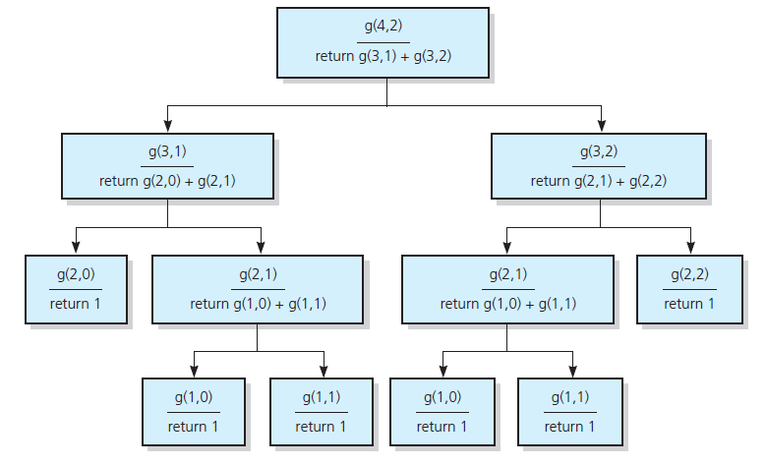
Recursion and Efficiency (3/4)
An example of inefficient recursive algorithms:
  c(n, k) = c(n – 1, k – 1) + c(n – 1, k)
Source: FIGURE 2-20 in [Carrano and Henry 2013].

Slide 79
Recursion and Efficiency (4/4)
Do not use a recursive solution if it is inefficient and there is a clear, efficient iterative solution.
You may need to convert a recursive solution to an iterative solution.
void writeBackward(string s)
{ int length = s.size();
if (length > 0) {
cout << s.substr(length-1, 1);
writeBackward(s.substr(0,length-1));
}
}
void writeBackward(string s)
{ int length = s.size();
while (length > 0) {
cout << s.substr(length-1, 1);
length--;
}
}
Tail recursion: the recursive call is the last action
that the function takes.

Slide 80
Summary (1/2)
Recursion solves a problem by solving smaller problems of the same type.
Four questions:
  How can you define the problem in terms of smaller problems of the same type?
  How does each recursive call diminish the size of the problem?
  What instance(s) of the problem can serve as the base case?
  As the problem size diminishes, will you reach a base case?

Slide 81
Summary (2/2)
A box trace can be used to trace the actions of a recursive method.
Some recursive solutions are much less efficient than a corresponding iterative solution due to their inherently inefficient algorithms and the overhead of function calls.
If you can easily, clearly, and efficiently solve a problem by using iteration, you should do so.

Slide 82
Remarks (1/4)
“Recursive thinking” should be better repositioned as “inductive thinking.”
Inductive thinking tries to solve a problem in essentially the same way as recursive thinking.
More importantly, induction is associated with principles of precise mathematical reasoning.
Basically, when you have a positive answer to each of the “four questions” for recursion, you have a proper induction.

Slide 83
Remarks (2/4)
When you use induction backward, you get recursive solutions (as you have seen).
/** Computes a term in the Fibonacci sequence.
@pre n is a positive integer. (n > 0)
@post None.
@param n The given integer.
@return The nth Fibonacci number . */
int rabbit(int n)
{
if (n <= 2)
return 1;
else // n > 2, so n-1 > 0 and n-2 > 0
return rabbit(n-1) + rabbit(n-2);
}

Slide 84
Remarks (3/4)
When you use induction forward, you get iterative solutions.
int iterativeRabbit(int n)
{ // Declarations of locals omitted.
if (n <= 2)
return 1;
else {
fn_2 = 1;
fn_1 = 1;
for (i = 3; i <= n; i++) {
fn = fn_2 + fn_1;
fn_2 = fn_1;
fn_1 = fn;
}
return fn;
}
}

Slide 85
Remarks (4/4)
Why does induction work?
  Many data sets have natural inductive definitions.
    Examples: the natural numbers, lists, binary trees
  Functions from such a data set to another data set also have natural inductive definitions.
    Examples: “factorial of n”, “n-th Fibonacci number”, “length of a list”, “number of tree nodes”
  Such inductive definitions provide the basis for simple and effective solutions.
Finally, it is often possible to attain efficiency, while maintaining the simplicity of the solution.

