Slide 1
Array-Based Implementations
The ADT Bag as an Example
Yih-Kuen Tsay
Dept. of Information Management
National Taiwan University
Based on [Carrano and Henry 2013]
With Contributions by Ling-Chieh Kung

Slide 2
Outline
The ADT Bag (of Strings)
Implementation with an Array
Recursion and DMA
The (Generic) ADT Bag
Self-Defined Header Files
The Standard Library <vector>

Slide 3
The ADT Bag
We want to implement an ADT “Bag” of items whose types are “ItemType:”
  +getCurrentSize(): integer
  +isEmpty(): boolean
  +add(newEntry: ItemType): boolean // duplicates are allowed
  +remove(anEntry: ItemType): boolean // remove only one copy
  +clear(): void
  +getFrequencyOf(anEntry: ItemType): integer
  +contains(anEntry: ItemType): boolean
  +print(): void
  Specifications indicate what the operations do, not how they are implemented.
  Let’s begin with a bag of C++ strings.

Slide 4
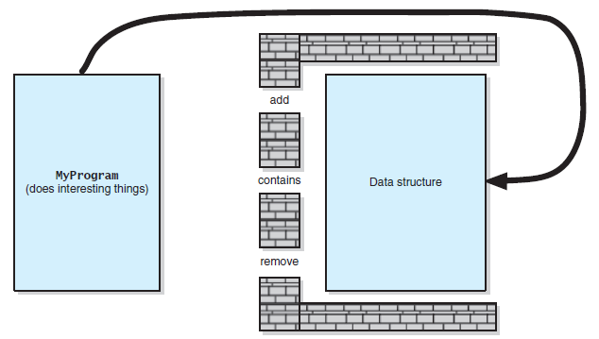
Implementing the ADT Bag (1/4)
Implementing the ADT as a C++ class provides ways to enforce a wall:
  This prevents one from accessing the data without using the defined operations.
Source: Figure 3-1 [Carrano and Henry 2015]

Slide 5
Implementing the ADT Bag (2/4)
The abstract class BagInterface defines the behaviors of the ADT.
  In many cases, no member variable is needed for the abstract class.
class BagInterface
{
public:
virtual int getCurrentSize() const = 0;
virtual bool isEmpty() const = 0;
virtual bool add(const string& newEntry) = 0;
virtual bool remove(const string& anEntry) = 0;
virtual void clear() = 0;
virtual int getFrequencyOf(const string& anEntry) const = 0;
virtual bool contains(const string& anEntry) const = 0;
virtual void print() const = 0;
};

Slide 6
Implementing the ADT Bag (3/4)
To implement the ADT, we write a (concrete) class to inherit BagInterface and implement all the operations.
class ArrayBag : public BagInterface
{
private:
// ...
public:
ArrayBag();
int getCurrentSize() const;
bool isEmpty() const;
bool add(const string& newEntry);
bool remove(const string& anEntry);
void clear();
bool contains(const string& anEntry) const;
int getFrequencyOf(const string& anEntry) const;
void print() const;
};

Slide 7
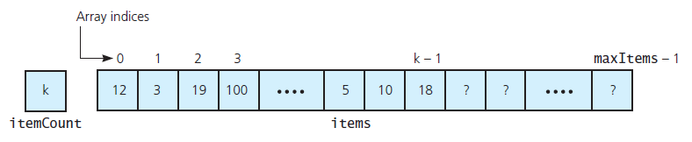
Implementing the ADT Bag (4/4)
Now it is time to choose a data structure.
For the ADT Bag, we will try two different data structures:
  An array and a linked list.
Let’s use a fixed-size (static) array first.
  In a fixed-size array, each item occupies one entry of the array.
  These items are unsorted. A one-dimensional unsorted array will be used.
Source: Figure 3-2 [Carrano and Henry 2015]

Slide 8
Outline
The ADT Bag (of Strings)
Implementation with an Array
Recursion and DMA
The (Generic) ADT Bag
Self-Defined Header Files
The Standard Library <vector>

Slide 9
Using a Fixed-Size Array
What else should we keep track of when we use a fixed-size array?
  The maximum size of the array.
  The number of items currently stored.
We add member variable declarations to the private section.
class ArrayBag : public BagInterface
{
private:
static const int DEFAULT_CAPACITY = 6;
string items[DEFAULT_CAPACITY];
int itemCount;
int maxItems;
// may have something else...
public:
// those member functions...
};

Slide 10
Implementing Member Functions
Some member functions are pretty straightforward.
  Note that these should be constant member functions.
How would you add a constructor to choose a maximum number of items?
ArrayBag::ArrayBag()
: itemCount(0),
maxItems(DEFAULT_CAPACITY) {}
int ArrayBag::getCurrentSize() const
{
return itemCount;
}
bool ArrayBag::isEmpty() const
{
return itemCount == 0;
}
void ArrayBag::print() const
{
for(int i = 0; i < itemCount; i++)
cout << items[i] << " ";
cout << endl;
}

Slide 11
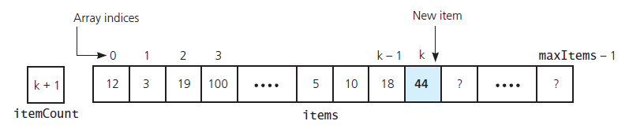
The Member Function add() (1/2)
For adding an item:
  If there is room, store the item somewhere in the array (where?)
  Return true if there is room, or false otherwise.
Let’s put it in the first empty cell.
  If the array has no “hole,” its index is exactly itemCount.
  Otherwise, we may need to search from the beginning.
Source: Figure 3-3 [Carrano and Henry 2015]: After adding an item

Slide 12
The Member Function add() (2/2)
As long as the array has no hole, adding an item is easy.
  When we remove an item, we need to maintain this property!
Why using a constant reference? Why not just string newEntry?
bool ArrayBag::add(const string& newEntry)
{
bool hasRoomToAdd = (itemCount < maxItems);
if(hasRoomToAdd)
{
items[itemCount] = newEntry;
itemCount++;
}
return hasRoomToAdd;
}

Slide 13
Testing the Implementations
Before we try to implement something more, test your existing member functions.
Once you have your add() function, you may test the constructor, isEmpty(), getCurrentSize(), and print().
In fact, print() is to test add() and other member functions.
int main()
{
ArrayBag bag;
bag.add("aaa");
bag.print();
cout << bag.isEmpty();
cout << bag.getCurrentSize();
bag.add("bbb");
bag.print();
cout << bag.isEmpty();
cout << bag.getCurrentSize();
return 0;
}

Slide 14
The Member Function remove()
For removing a given item:
  Remove one copy if it exists in the array.
  Return true if the item exists, or false otherwise.
Note that we need to determine whether a given item exists.
  This is exactly the function contains().
  Moreover, we need to locate that item.
We may enhance modularity (and make the development more efficient) by implementing a member function to be a building block.

Slide 15
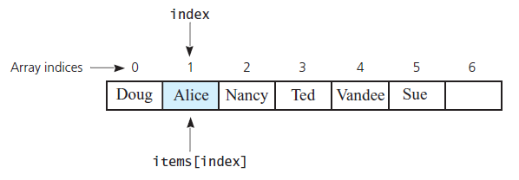
The Member Function getIndexOf()
Let’s implement a member function getIndexOf().
  getIndexOf(anEntry: ItemType): integer
  Given an item, return the index of its first copy in the array or –1 otherwise.
Define things precisely: Returning an array index or a rank of an item?
Source: Figure 3-4 [Carrano and Henry 2015]

Slide 16
The Member Function getIndexOf()
int ArrayBag::getIndexOf(const string& target) const
{
bool found = false;
int result = -1;
int searchIndex = 0;
while(!found && (searchIndex < itemCount))
{
if(items[searchIndex] == target)
{
found = true;
result = searchIndex;
}
else
searchIndex++;
}
return result;
}

Slide 17
Privatizing getIndexOf()
The function getIndexOf() should be private!
If it is public, clients will know some details of the private array.
  Data hiding (encapsulation, the “wall”) would be damaged.
As long as one thing is useless to clients, hide it!
class ArrayBag : public BagInterface
{
private:
static const int DEFAULT_CAPACITY = 6;
string items[DEFAULT_CAPACITY];
int itemCount;
int maxItems;
int getIndexOf(const string& target) const;
public:
// those member functions...
};

Slide 18
The Member Function remove()
With getIndexOf(), remove() can be easily implemented.
How to “remove the item while ensuring no hole?”
remove(anEntry)
{
Search the array items for anEntry
if(anEntry is in the bag at items[index])
{
Decrement the counter itemCount
remove the item while ensuring no hole
return true
}
else
return false
}

Slide 19
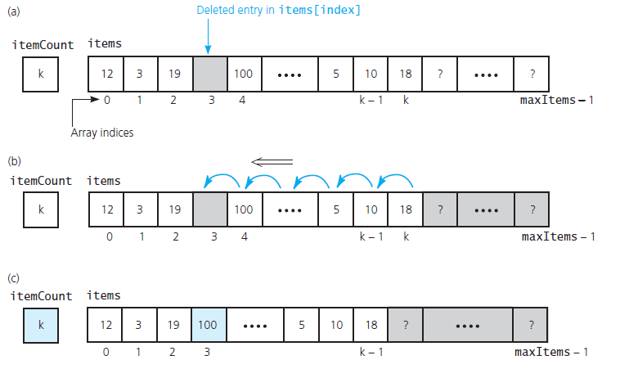
Ensuring No Hole (Idea 1)
Source: Figure 3-5 [Carrano and Henry 2015]

Slide 20
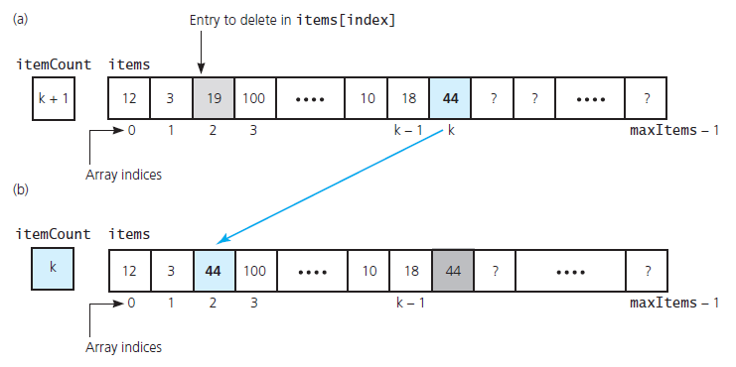
Ensuring No Hole (Idea 2)
Source: Figure 3-6 [Carrano and Henry 2015]

Slide 21
Implementing remove()
bool ArrayBag::remove(const string& anEntry)
{
int locatedIndex = getIndexOf(anEntry);
bool canRemoveItem = (locatedIndex > -1);
if(canRemoveItem)
{
itemCount--;
items[locatedIndex] = items[itemCount];
}
return canRemoveItem;
}
remove(anEntry)
{
Search the array items for anEntry
if(anEntry is in the bag at items[index])
{
Decrement the counter itemCount
remove the item while ensuring no hole
return true
}
else
return false
}

Slide 22
Functions contains() and clear()
The functions contains() is straightforward.
How about clear()? Which one is better?
bool ArrayBag::contains(const string& anEntry) const
{
return getIndexOf(anEntry) > -1;
}
void ArrayBag::clear()
{
while(!isEmpty())
remove(items[1]);
}
void ArrayBag::clear()
{
itemCount = 0;
}

Slide 23
Member function getFrequencyOf()
getFrequencyOf() returns the number of occurrences of a given item.
int ArrayBag::getFrequencyOf(const string& anEntry) const
{
int frequency = 0;
int curIndex = 0;
while(curIndex < itemCount)
{
if(items[curIndex] == anEntry)
frequency++;
curIndex++;
}
return frequency;
}

Slide 24
Remarks
Before starting the implementation, always “design” the program first.
  Design the ADT. In particular, design the operations and behaviors.
  Write an abstract class to specify the operations.
  Write a concrete class to inherit the abstract class. Implement the class.
  For a specific function, pseudocodes are helpful.
  Test the implementation.
Do not forget data hiding:
  If something is not useful for clients, hide it.
  E.g., do not let clients know whether you starts at items[0] or items[1].

Slide 25
Outline
The ADT Bag (of Strings)
Implementation with an Array
Recursion and DMA
The (Generic) ADT Bag
Self-Defined Header Files
The Standard Library <vector>

Slide 26
Recursion
Though not required, some functions can be implemented with recursion.
In many cases, a task that needs to go through a data structure can be implemented with recursion.
Let’s look at two examples.

Slide 27
Using recursion for getIndexOf()
int ArrayBag::getIndexOf(const string& target, int searchIndex) const
{ // search within items[searchIndex..(itemCount – 1)]
int result = -1;
if(searchIndex < itemCount)
{
if(items[searchIndex] == target)
result = searchIndex;
else
result = getIndexOf(target, searchIndex + 1);
}
return result;
}

Slide 28
Using recursion for getFrequencyOf()
int ArrayBag::getFrequencyOf(const string& anEntry) const
{
return countFrequency(anEntry, 0);
}
int ArrayBag::countFrequency(const string& target, int searchIndex) const
{ // count within items[searchIndex..(itemCount – 1)]
int frequency = 0;
if (searchIndex < itemCount)
{
if (items[searchIndex] == target)
frequency = 1 + countFrequency(target, searchIndex + 1);
else
frequency = countFrequency(target, searchIndex + 1);
}
return frequency;
}

Slide 29
Using Recursion for the Two Functions
The ways of applying recursion on getIndexOf() and getFrequencyOf() are different.
  We add a second parameter to getIndexOf() .
  We create a new function countFrequency() for getFrequencyOf().
The key factor determining the difference is their visibility.
  A private function is only used in the class. Its header can be modified.
  A public function is called by a client. Its header should remain unchanged.
  If we add searchIndex to the public function header, we reveal some information about the implementation. This violates data hiding.

Slide 30
Dynamically Adjusting the Array Size
In the previous implementation, the array size is fixed.
With dynamic memory allocation (DMA), we may make it changeable.
  E.g., let’s double the array length when it is full.

Slide 31
Modifying the Class Definition
To do so, first we change the class definition.
  items becomes (purely) a pointer rather than a (static) array.
  When we implement DMA, we need a destructor.
  All others are unchanged.
class ArrayBag : public BagInterface
{
private:
static const int DEFAULT_CAPACITY = 6;
string* items;
int itemCount;
int maxItems;
int getIndexOf(const string& target) const;
public:
ArrayBag();
~ArrayBag();
// others are not changed
};

Slide 32
The Constructor and Destructor
The constructor is modified to initialize items.
  It points to a dynamic array.
The destructor releases the dynamic array.
ArrayBag::ArrayBag()
: itemCount(0), maxItems(DEFAULT_CAPACITY)
{
items = new string[DEFAULT_CAPACITY];
}
ArrayBag::~ArrayBag()
{
delete [] items;
}

Slide 33
The Member Function add()
add() is modified:
  When the array is full, double the array length.
We use a local pointer oldArray to point to the existing array.
  Do this before you use items to point to the new array.
  Otherwise, you will have memory leak.
Then release the old space.
bool ArrayBag::add(const string& newEntry)
{
bool hasRoomToAdd = (itemCount < maxItems);
if(!hasRoomToAdd)
{
string* oldArray = items;
items = new string[2 * maxItems];
for(int index = 0; index < maxItems; index++)
items[index] = oldArray[index];
delete [] oldArray;
maxItems = 2 * maxItems;
}
items[itemCount] = newEntry;
itemCount++;
return true;
}

Slide 34
Should We Make the Array Dynamic?
A dynamic array is of course useful.
  There is no need to worry about whether the array is full.
Disadvantages:
  It can hurt efficiency: Every time when the array is full, we need to allocate a new space, copy and paste, and releasing an old space.
  It can waste spaces (as all static arrays do).
Another way to prevent your bag from being full is to use a link-based implementation.

Slide 35
Outline
The ADT Bag (of Strings)
Implementation with an Array
Recursion and DMA
The (Generic) ADT Bag
Self-Defined Header Files
The Standard Library <vector>

Slide 36
Items in the ADT Bag
Our ADT Bag contains items.
We implemented it as a bag of (C++) strings.
What if we want to implement it as a bag of integers?
  class ArrayBag : public BagInterface
  {
  private:
  static const int DEFAULT_CAPACITY = 6;
  string items[DEFAULT_CAPACITY];
  // ...
  public:
  // ...
  bool add(const string& newEntry);
  bool remove(const string& anEntry);
  // ...
  };

Slide 37
Templates (1/2)
We hope that our implementation is “general:”
  In a bag, all items will be of a single type.
  For different bags, the item types can be different.
In C++, templates make this possible.
  It can be applied on functions and classes.
  Note: the notion of a template is not unique to object-oriented programming.
This is called generic programming.

Slide 38
Templates (2/2)
C++ class templates allow one to pass a data-type argument when:
  Invoking a function defined with templates, or
  Creating an object whose class is defined with templates.
In our example, objects of ArrayBag can be created with the actual item type passed as an argument.
  ArrayBag<string> bagOfStrings;
  ArrayBag<int> bagOfIntegers;
No need to write two implementations!

Slide 39
Template Declaration
To declare a type parameter, use the keywords template and typename.
  Some old codes write class instead of typename. Both are fine.
We then do this to all member functions:
  template<typename T>
  class TheClassName
  {
  // T can be treated as a type inside the class definition block
  };
  template<typename T>
  T TheClassName<T>::f(T t)
  {
  // t is a variable whose type is T
  };
  template<typename T>
  void TheClassName<T>::f(int i)
  {
  // follow the rule even if T is not used
  };

Slide 40
Template Invocation
To instantiate an object, pass a type argument.
The passed type will then replace all the Ts in the class definition.
  int main()
  {
  TheClassName<int> a;
  TheClassName<double> b;
  TheClassName<AnotherClassName> c;
  };

Slide 41
An Example
Let’s start from an example with no classes.
When we invoke f with f<double>, the function is
When we invoke f with f<int>, the function is
That is why we see 1.
  #include <iostream>
  using namespace std;
  template<typename T>
  void f(T t)
  {
  cout << t;
  }
  int main()
  {
  f<double>(1.2); // 1.2
  f<int>(1.2); // 1
  return 0;
  }
  void f(double t)
  {
  cout << t;
  }
  void f(int t)
  {
  cout << t;
  }

Slide 42
An Example with Two Type Parameters
We may also have multiple type parameters.
  #include <iostream>
  using namespace std;
  template<typename A, typename B>
  void g(A a, B b)
  {
  cout << a + b << endl;
  }
  int main()
  {
  g<double, int>(1.2, 1);
  return 0;
  }

Slide 43
An Example with Classes
The syntax of applying templates to classes is very similar.
  Add the declaration line to the class definition.
  Add the declaration line to all member function definitions.
  For each member function definition, specify the type parameter.
  #include <iostream>
  using namespace std;
  template<typename T>
  class C
  {
  public:
  T f();
  };
  template<typename T>
  T C<T>::f()
  {
  return 1.2;
  }
  int main()
  {
  C<int> c;
  cout << c.f() << endl;
  return 0;
  }

Slide 44
Applying Templates to BagInterface (1/2)
Before we use a template, BagInterface was:
  class BagInterface
  {
  public:
  virtual int getCurrentSize() const = 0;
  virtual bool isEmpty() const = 0;
  virtual bool add(const string& newEntry) = 0;
  virtual bool remove(const string& anEntry) = 0;
  virtual void clear() = 0;
  virtual int getFrequencyOf(const string& anEntry) const = 0;
  virtual bool contains(const string& anEntry) const = 0;
  virtual void print() const = 0;
  };

Slide 45
Applying Templates to BagInterface (2/2)
After we use a template, BagInterface becomes:
  template<typename ItemType> // add this line
  class BagInterface
  {
  public:
  virtual int getCurrentSize() const = 0;
  virtual bool isEmpty() const = 0;
  virtual bool add(const ItemType& newEntry) = 0; // treat ItemType as a type
  virtual bool remove(const ItemType& anEntry) = 0;
  virtual void clear() = 0;
  virtual int getFrequencyOf(const ItemType& anEntry) const = 0;
  virtual bool contains(const ItemType& anEntry) const = 0;
  virtual void print() const = 0;
  };

Slide 46
Applying Templates to ArrayBag (1/2)
  template<typename ItemType>
  class ArrayBag : public BagInterface<ItemType>
  {
  private:
  static const int DEFAULT_CAPACITY = 6;
  ItemType items[DEFAULT_CAPACITY];
  int itemCount;
  int maxItems;
  int getIndexOf(const ItemType& target) const;
  public:
  // others that do not need ItemType
  bool add(const ItemType& newEntry);
  bool remove(const ItemType& anEntry);
  bool contains(const ItemType& anEntry) const;
  int getFrequencyOf(const ItemType& anEntry) const;
  };

Slide 47
Applying Templates to ArrayBag (2/2)
  template<typename ItemType> // add this even if not used
  bool ArrayBag<ItemType>::isEmpty() const // add this even if not used
  {
  return itemCount == 0;
  }
  template<typename ItemType>
  bool ArrayBag<ItemType>::add(const ItemType& newEntry)
  { // ItemType can be used in the function definition
  bool hasRoomToAdd = (itemCount < maxItems);
  if(hasRoomToAdd)
  {
  items[itemCount] = newEntry;
  itemCount++;
  }
  return hasRoomToAdd;
  }

Slide 48
Using ArrayBag with Templates
Now we can have bags for different types of items.
  int main()
  {
  ArrayBag<string> bagOfStrings;
  ArrayBag<int> bagOfIntegers;
  ArrayBag<MyClass> bagSpecial;
  bagOfStrings.add("here");
  bagOfIntegers.add(123);
  MyClass mc;
  bagSpecial.add(mc);
  return 0;
  }

Slide 49
Final Remarks (1/2)
An operation may need a special definition for a given type.
What if ItemType is a class with dynamic memory allocation?
  template<typename ItemType>
  bool ArrayBag<ItemType>::add(const ItemType& newEntry)
  {
  bool hasRoomToAdd = (itemCount < maxItems);
  if(hasRoomToAdd)
  {
  items[itemCount] = newEntry;
  itemCount++;
  }
  return hasRoomToAdd;
  }

Slide 50
Final Remarks (2/2)
What if ItemType is a class with undefined comparisons?
We need to (re)define operations for our classes.
We need to do operator overloading.
  To be introduced in the next lecture.
  template<typename ItemType>
  int ArrayBag<ItemType>
  ::getFrequencyOf(const ItemType& anEntry) const
  {
  int frequency = 0;
  int curIndex = 0;
  while(curIndex < itemCount)
  {
  if(items[curIndex] == anEntry)
  frequency++;
  curIndex++;
  }
  return frequency;
  }
  class RaNum
  {
  private:
  int num;
  int deno;
  public:
  // ...
  };

Slide 51
Outline
The ADT Bag (of Strings)
Implementation with an Array
Recursion and DMA
The (Generic) ADT Bag
Self-Defined Header Files
The Standard Library <vector>

Slide 52
Libraries
There are many C++ standard libraries.
  <iostream>, <climits>, <cmath>, <cctype>, <cstring>, etc.
We may also want to define our own libraries.
  Especially when we collaborate with others.
  Typically, one implements classes or global functions for others to use.
  That function can be defined in a self-defined library.
A library includes a header file (.h) and a source file (.cpp).
  The header file contains declarations
  The source file contains definitions/implementations.

Slide 53
Example
Consider the following program with a single function myMax():
Let’s define a constant variable for the array length in a header file.
  #include <iostream>
  using namespace std;
  int myMax(int [], int);
  int main()
  {
  int a[5] = {7, 2, 5, 8, 9};
  cout << myMax(a, 5);
  return 0;
  }
  int myMax(int a[], int len)
  {
  int max = a[0];
  for(int i = 1; i < len; i++)
  {
  if(a[i] > max)
  max = a[i];
  }
  return max;
  }

Slide 54
Defining Variables in a Library
myMax.h
main.cpp
  const int LEN = 5;
  #include <iostream>
  #include "myMax.h"
  using namespace std;
  int myMax(int [], int);
  int main()
  {
  int a[LEN] = {7, 2, 5, 8, 9};
  cout << myMax (a, LEN);
  return 0;
  }
  int myMax(int a[], int len)
  {
  int max = a[0];
  for(int i = 1; i < len; i++)
  {
  if(a[i] > max)
  max = a[i];
  }
  return max;
  }

Slide 55
Including a Header File
When your main program wants to include a self-defined header file, simply indicate its path and file name.
  #include "myMax.h"
  #include "D:/test/myMax.h"
  #include "lib/myMax.h"
  Using \ or / does not matter (on Windows).
We still compile the main program as usual.
Let’s also define functions in our library!
  Now we need a source file.

Slide 56
Defining Functions in a Library
myMax.h myMax.cpp
main.cpp
  const int LEN = 5;
  int myMax(int [], int);
  int myMax(int a[], int len)
  {
  int max = a[0];
  for(int i = 1; i < len; i++)
  {
  if(a[i] > max)
  max = a[i];
  }
  return max;
  }
  #include <iostream>
  #include "myMax.h"
  using namespace std;
  int main()
  {
  int a[LEN] = {7, 2, 5, 8, 9};
  cout << myMax(a, LEN);
  return 0;
  }

Slide 57
Including a Header and a Source File
When your main program also wants to include a self-defined source file, the include statement needs not be changed.
  #include "myMax.h"
We add a source file myMax.cpp.
  In the source file, we implement those functions declared in the header file.
  The main file names of the header and source files can be different.
The two source files (main.cpp and myMax.cpp) must be compiled together.
  Each environment has its own way.

Slide 58
Defining One More Function (1/2)
myMax.h myMax.cpp
main.cpp
  const int LEN = 5;
  int myMax (int [], int);
  void print(int);
  int myMax(int a[], int len)
  {
  int max = a[0];
  for(int i = 1; i < len; i++)
  {
  if(a[i] > max)
  max = a[i];
  }
  return max;
  }
  void print(int i)
  {
  cout << i; // cout undefined!
  }
  #include <iostream>
  #include "myMax.h"
  using namespace std;
  int main()
  {
  int a[LEN] = {7, 2, 5, 8, 9};
  print(myMax(a, LEN));
  return 0;
  }

Slide 59
Defining One More Function (2/2)
Each source file contains statements to run.
Each source file must include the libraries it needs for its statements.
  #include <iostream>
  using namespace std;
  int myMax(int a[], int len)
  {
  int max = a[0];
  for(int i = 1; i < len; i++)
  {
  if(a[i] > max)
  max = a[i];
  }
  return max;
  }
  void print(int i)
  {
  cout << i; // good!
  }

Slide 60
The Complete Set of Files
myMax.h myMax.cpp
main.cpp
  const int LEN = 5;
  int myMax(int [], int);
  void print(int);
  #include <iostream>
  using namespace std;
  int myMax(int a[], int len)
  {
  int max = a[0];
  for(int i = 1; i < len; i++)
  {
  if(a[i] > max)
  max = a[i];
  }
  return max;
  }
  void print(int i)
  {
  cout << i;
  }
  #include <iostream>
  #include "myMax.h"
  using namespace std;
  int main()
  {
  int a[LEN] = {7, 2, 5, 8, 9};
  print(myMax (a, LEN));
  return 0;
  }

Slide 61
Remarks
In many cases, myMax.cpp also include myMax.h.
  E.g., if LEN is accessed in myMax.cpp.
More will be discussed in further courses.
  More than two source files.
  A header file including another header file.
  main.cpp
  C++ Standard Libraries
  myMax.cpp
  myMax.h

Slide 62
Header Files for ArrayBag (1/4)
First, we put the definition of BagInterface into a file BagInterface.h.
In general, the inclusion relationship can be very complicated.
  One thing may be defined multiple times (which is an error) if one file is included multiple times.
To avoid this,
  We use #define to define a token.
  #ifndef checks whether a given token has been defined;
  #endif labels the end of a block.
  #ifndef _BAG_INTERFACE
  #define _BAG_INTERFACE
  template<typename ItemType>
  class BagInterface
  {
  // all those member functions
  };
  #endif
(BagInterface.h)

Slide 63
Header Files for ArrayBag (2/4)
Second, we put the definition of ArrayBag into ArrayBag.h.
We still use #define, #ifndef, and #endif to avoid multiple definitions.
Because this class needs an implementation, we add an include statement at the end to include the implementation file ArrayBag.cpp.
  #ifndef _ARRAY_BAG
  #define _ARRAY_BAG
  #include "BagInterface.h"
  template<typename ItemType>
  class ArrayBag : public BagInterface<ItemType>
  {
  // all those member variables and functions
  };
  #include "ArrayBag.cpp"
  #endif
(ArrayBag.h)

Slide 64
Header Files for ArrayBag (3/4)
Third, we put the implementation of ArrayBag into ArrayBag.cpp.
In ArrayBag.cpp, we need to include the header file ArrayBag.h.
When a standard library is used in an implementation file, we need to include it.
  #include <iostream>
  #include "ArrayBag.h"
  using namespace std;
  // all other function definitions
  template<typename ItemType>
  void ArrayBag<ItemType>::print() const
  {
  for(int i = 0; i < itemCount; i++)
  cout << items[i] << " ";
  cout << endl;
  }
  // all other function definitions
(ArrayBag.cpp)

Slide 65
Header Files for ArrayBag (4/4)
Now, for any client who uses the class ArrayBag, all it needs to do is to include ArrayBag.h.
For those who want to understand how ArrayBag should be used, they only need to read the header file.
  Comments in ArrayBag.h should be understandable to client developers.
  Implementation details should not be disclosed.
  #include <iostream>
  #include <string>
  #include "ArrayBag.h"
  using namespace std;
  int main()
  {
  ArrayBag<string> bag;
  return 0;
  }
(main.cpp)

Slide 66
Outline
The ADT Bag (of Strings)
Implementation with an Array
Recursion and DMA
The (Generic) ADT Bag
Self-Defined Header Files
The Standard Library <vector>

Slide 67
Displaying Bag Items
In the textbook, the implementation of ArrayBag does not contain print().
To allow one to display bag items, a member function toVector() and a global function displayBag() are defined:
  template<class ItemType>
  vector<ItemType> ArrayBag<ItemType>
  ::toVector() const
  {
  vector<ItemType> bagContents;
  for(int i = 0; i < itemCount; i++)
  bagContents.push_back(items[i]);
  return bagContents;
  }
  void displayBag(ArrayBag<string>& bag)
  {
  cout << "The bag contains "
  << bag.getCurrentSize()
  << " items:" << endl;
  vector<string> bagItems = bag.toVector();
  int numberOfEntries = (int) bagItems.size();
  for (int i = 0; i < numberOfEntries; i++)
  cout << bagItems[i] << " ";
  cout << endl << endl;
  }

Slide 68
The Standard Library <vector> (1/2)
The class vector with templates is defined and implemented in the standard library <vector>.
It is just a “dynamic vector” of any type.
  It is a class with an embedded one-dimensional dynamic array.
  It has many useful member functions (including overloaded operators).
  It is implemented with templates.

Slide 69
The Standard Library <vector> (2/2)
Four member functions are used in the textbook implementation:
  Constructor: vector<ItemType> bagContents;
  Element addition: bagContents.push_back(items[i]);
  Assignment operator: vector<string> bagItems = bag.toVector();
  Indexing operator: cout << bagItems[i] << " ";

Slide 70
Some Questions Regarding vector
Why not just print()?
  Using toVector() rather than print() completely decouples ArrayBag operations and program I/O (e.g., displaying bag items on a screen).
Should we have toVector() or print()?
  If it is only used during the development phase, we should remove it after ArrayBag is completed.
If we have vector, why should we implement ArrayBag?
(Prof. Kung’s suggestion) Try not to use vector unless you are able to implement something with the same capability.

