Slide 1
Stacks:
Implementations
Yih-Kuen Tsay
Dept. of Information Management
National Taiwan University
Based on [Carrano and Henry 2013]
With help from Chien Chin Chen

Slide 2
Implementations of the ADT Stack
As in the case of the ADT bag, we will consider both
  array-based and
  link-based
implementations.
The implementations will later be modified to use exceptions .

Slide 3
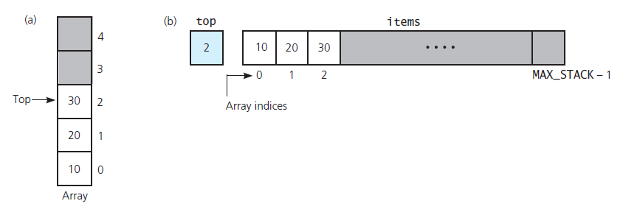
An Array-Based Implementation (1/9)
The basic idea
Source: FIGURE 7-1 in [Carrano and Henry 2013].

Slide 4
An Array-Based Implementation (2/9)
/** ADT stack: Array-based implementation.
@file ArrayStack.h */
#ifndef _ARRAY_STACK
#define _ARRAY_STACK
#include "StackInterface.h"
const int MAX_STACK = maximum-size-of-stack;
template<class ItemType>
class ArrayStack: public StackInterface<ItemType>
{
private:
ItemType items[MAX_STACK];
// Array of stack items
int top; // Index to top of stack

Slide 5
An Array-Based Implementation (3/9)
What if you did not hide items and top, i.e., declare them as private?
  The client could access any element in the stack, not just the top element.
  This violates the specifications of the ADT stack.

Slide 6
An Array-Based Implementation (4/9)
public:
ArrayStack(); // Default constructor
bool isEmpty() const;
bool push(const ItemType& newEntry);
bool pop();
ItemType peek() const;
}; // end ArrayStack
#include "ArrayStack.cpp"
#endif

Slide 7
An Array-Based Implementation (5/9)
/** @file ArrayStack.cpp */
#include <cassert> // For assert
#include "ArrayStack.h" // Header file
template<class ItemType>
ArrayStack<ItemType>::ArrayStack(): top(-1)
{
} // end default constructor
// Copy constructor and destructor are
// supplied by the compiler

Slide 8
An Array-Based Implementation (6/9)
template<class ItemType>
bool ArrayStack<ItemType>::isEmpty() const
{
return top < 0;
} // end isEmpty
items
MAX_STACK-1
…
top
-1
1
0

Slide 9
An Array-Based Implementation (7/9)
template<class ItemType>
bool ArrayStack<ItemType>::push(const
ItemType& newEntry)
{
bool result = false;
if (top < MAX_STACK - 1) {
// Stack has room for newEntry
top++;
items[top] = newEntry;
result = true;
} // end if
return result;
} // end push
items
MAX_STACK-1
…
top
-1
1
0
0

Slide 10
An Array-Based Implementation (8/9)
template<class ItemType>
bool ArrayStack<ItemType>::pop()
{
bool result = false;
if (!isEmpty ()) {
top--;
result = true;
} // end if
return result;
} // end pop
items
MAX_STACK-1
…
top
0
1
-1
0

Slide 11
An Array-Based Implementation (9/9)
template<class ItemType>
ItemType ArrayStack<ItemType>::peek() const
{
assert (!isEmpty()); // Enforce precondition
// Stack is not empty; return top
return items[top];
} // end peek
// end of implementation file
returned item
items
MAX_STACK-1
…
top
1
1
0

Slide 12
Using the Stack Implementation
#include <iostream>
#include <string>
#include "ArrayStack.h“
using namespace std;
int main()
{
StackInterface<string>* stackPtr =
new ArrayStack<string>();
string anItem = “”;
cout << “Enter a string”;
cin >> anItem; // Read an item
stackPtr->push(anItem); // Push item onto stack
…
}

Slide 13
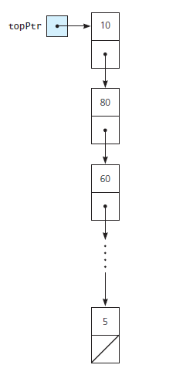
A Link-Based Implementation (1/11)
The basic idea:
  A pointer-based implementation enables the stack to grow and shrink dynamically.
  topPtr is a pointer to the head of a linked list of items.
Because of the dynamically allocated memory, we must write a copy constructor and a destructor.
Source: FIGURE 7-2 in [Carrano and Henry 2013].

Slide 14
A Link-Based Implementation (2/11)
/** ADT stack: Link-based implementation.
@file LinkedStack.h */
#ifndef _LINKED_STACK
#define _LINKED_STACK
#include "StackInterface.h"
#include "Node.h“
template<class ItemType>
class LinkedStack: public StackInterface<ItemType>
{
private:
Node<ItemType>* topPtr; // Pointer to first node in the chain;
// this node contains the stack’s top
public:
// Constructors and destructor:
LinkedStack(); // Default constructor
LinkedStack(const LinkedStack<ItemType>& aStack);
// Copy constructor
virtual ~LinkedStack(); // Destructor

Slide 15
A Link-Based Implementation (3/11)
// Stack operations:
bool isEmpty() const;
bool push(const ItemType& newItem);
bool pop();
ItemType peek() const;
}; // end LinkedStack
#include "LinkedStack.cpp"
#endif

Slide 16
A Link-Based Implementation (4/11)
/** @file LinkedStack.cpp */
#include <cassert> // For assert
#include "LinkedStack.h" // Header file
template<class ItemType>
LinkedStack<ItemType>::LinkedStack(): topPtr(nullptr)
{
} // end default constructor
template<class ItemType>
LinkedStack<ItemType>::
LinkedStack(const LinkedStack<ItemType>& aStack)
{
// Point to nodes in original chain
Node<ItemType>* origChainPtr = aStack->topPtr;
if (origChainPtr == nullptr)
topPtr = nullptr; // Original stack is empty
else {
// Copy first node
topPtr = new Node<ItemType>();
topPtr->setItem(origChainPtr->getItem());
// Point to first node in new chain
Node<ItemType>* newChainPtr = topPtr;
topPtr points to nowhere
when stack is empty.

Slide 17
A Link-Based Implementation (5/11)
// Copy remaining nodes
while (origChainPtr != nullptr) {
// Advance original-chain pointer
origChainPtr = origChainPtr->getNext();
// Get next item from original chain
ItemType nextItem = origChainPtr->getItem();
// Create a new node containing the next item
Node<ItemType>* newNodePtr = new Node<ItemType>(nextItem);
// Link new node to end of new chain
newChainPtr->setNext(newNodePtr);
// Advance pointer to new last node
newChainPtr = newChainPtr->getNext();
} // end while
newChainPtr->setNext(nullptr); // Flag end of chain
} // end if
} // end copy constructor

Slide 18
A Link-Based Implementation (6/11)
Copy first node
Copy remaining nodes
origChainPtr
aStack::topPtr
topPtr
origChainPtr
origChainPtr
aStack::topPtr
newChainPtr
topPtr

Slide 19
A Link-Based Implementation (7/11)
Flag end of new chain
origChainPtr
aStack::topPtr
NULL
newChainPtr
topPtr

Slide 20
A Link-Based Implementation (8/11)
template<class ItemType>
LinkedStack<ItemType>::~LinkedStack()
{
// Pop until stack is empty
while (!isEmpty ())
pop();
} // end destructor
template<class ItemType>
bool LinkedStack<ItemType>::isEmpty() const
{
return topPtr == nullptr;
} // end isEmpty
responsible for returning
dynamically allocated memory
to system.

Slide 21
A Link-Based Implementation (9/11)
template<class ItemType>
bool LinkedStack<ItemType>::push(const ItemType & newItem)
{
Node<ItemType>* newNodePtr = new Node<ItemType>(newItem, topPtr);
topPtr = newNodePtr;
newNodePtr = nullptr;
return true;
} // end push
newNodePtr
topPtr

Slide 22
A Link-Based Implementation (10/11)
template<class ItemType>
bool LinkedStack<ItemType>::pop()
{
bool result = false;
if (!isEmpty()) {
// Stack is not empty; delete top
Node<ItemType>* nodeToDeletePtr = topPtr;
topPtr = topPtr->getNext();
// Return deleted node to system
nodeToDeletePtr->setNext(nullptr);
delete nodeToDeletePtr;
nodeToDeletePtr = nullptr;
result = true;
} // end if
return result;
} // end pop
nodeToDeletePtr
topPtr

Slide 23
A Link-Based Implementation (11/11)
template<class ItemType>
ItemType LinkedStack<ItemType>::peek() const
{
assert(!isEmpty()); // Enforce precondition
// Stack is not empty; return top
return topPtr->getItem();
} // end peek
// end of implementation file

Slide 24
Using Exceptions (1/3)
/** @file PrecondViolatedExcep.h */
#ifndef _PRECOND_VIOLATED_EXCEP
#define _PRECOND_VIOLATED_EXCEP
#include <stdexcept>
#include <string>
using namespace std;
class PrecondViolatedExcep: public logic_error
{
public:
PrecondViolatedExcep(const string& message = "");
}; // end PrecondViolatedExcep
#endif

Slide 25
Using Exceptions (2/3)
/** @file PrecondViolatedExcep.cpp */
#include "PrecondViolatedExcep.h"
PrecondViolatedExcep::PrecondViolatedExcep(const string& message):
logic_error("Precondition Violated Exception: " + message)
{
} // end constructor

Slide 26
Using Exceptions (3/3)
Change to the declaration of peek:
Change to the implementation of peek:
ItemType peek() const throw(PrecondViolatedExcep);
template<class ItemType>
ItemType LinkedStack<ItemType>::peek() const
throw(PrecondViolatedExcep)
{
// Enforce precondition
if (isEmpty())
throw PrecondViolatedExcep(“peek() called with empty stack”);
// Stack is not empty; return top
return topPtr->getItem();
} // end peek

Slide 27
Comparing Implementations
Fixed versus dynamic sizes:
  A statically allocated array-based implementation.
    The size is known in advance, e.g., 80 characters in one line.
    Prevents the push operation from adding an item to the stack, if the array is full.
  A dynamically allocated pointer-based (or dynamically allocated array-based) implementation.
    No size restriction on the stack.
    Copy data between dynamically allocated data structures.

