Slide 1
Graphs
Yih-Kuen Tsay
Dept. of Information Management
National Taiwan University
Based on [Carrano and Henry 2013]
With help from Chien Chin Chen

Slide 2
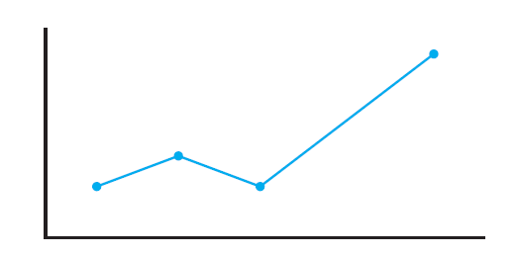
Concepts and Terms (1/8)
Graphs provide a way to illustrate data and have significant applications in many fields.
We will consider the kind of graphs with points that are joined by lines, like in a line graph.
An ordinary line graph
Source: FIGURE 20-1 in [Carrano and Henry 2013].

Slide 3
Concepts and Terms (2/8)
A graph G = (V, E) consists of two sets:
  A set V of vertices, or nodes.
  A set E of edges , or links, that connect the vertices.
A subgraph consists of a subset of a graph’s vertices and a subset of its edges.
Two vertices are adjacent it they are joined by an edge.

Slide 4
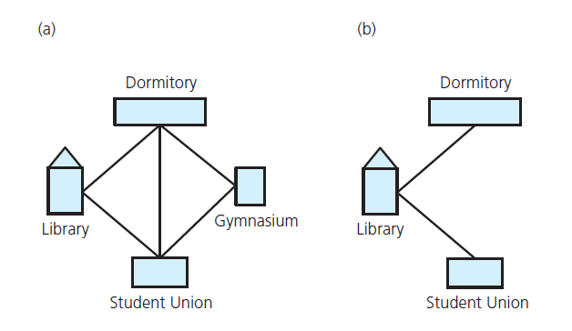
Concepts and Terms (3/8)
(a) A campus map as a graph; (b) a subgraph
Source: FIGURE 20-2 in [Carrano and Henry 2013].

Slide 5
Concepts and Terms (4/8)
A path is a sequence of edges that begins at one vertex and ends at another vertex.
  A path may pass through the same vertex more than once.
A simple path is a path that passes through a vertex at most once.
A cycle is a path that begins and ends at the same vertex.
A simple cycle is a cycle that does not pass through other vertices more than once.

Slide 6
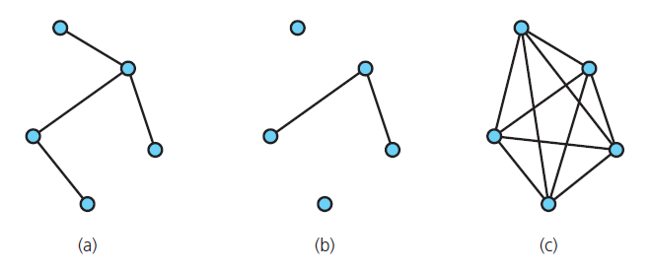
Concepts and Terms (5/8)
A graph is connected if each pair of distinct vertices has a path between them; it is disconnected, otherwise.
A graph is complete if each pair of distinct vertices has an edge between them.
Source: FIGURE 20-3 in [Carrano and Henry 2013].

Slide 7
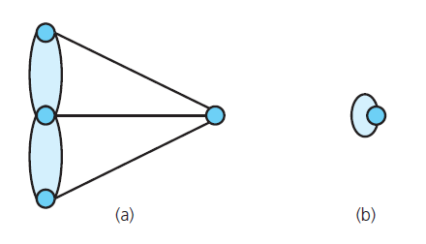
Concepts and Terms (6/8)
A multigraph allows multiple edges between vertices.
By definition, a multipgraph is not a (simple) graph.
Special kinds of graphs: (a) a multigraph; (b) a node with a self loop
Source: FIGURE 20-4 in [Carrano and Henry 2013].

Slide 8
Concepts and Terms (7/8)
Weighted graph
  A graph whose edges have numeric labels.
Undirected graph
  Edges do not indicate a direction.
Directed graph (digraph)
  Each edge has a direction, and is called a directed edge.
  A digraph may have two edges between a pair of vertices, one in each direction.
  Vertex y is adjacent to vertex x if there is a directed edge from x to y.
  A directed path is a sequence of directed edges between two vertices.

Slide 9
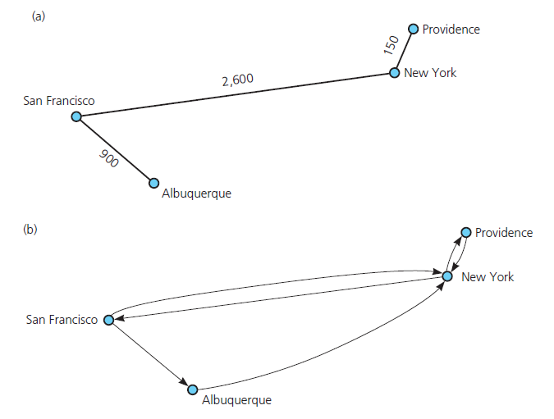
Concepts and Terms (8/8)
(a) A weighted graph; (b) a directed graph
Source: FIGURE 20-5 in [Carrano and Henry 2013].

Slide 10
Graphs as ADTs (1/6)
Variations of an ADT graph are possible
  Vertices may or may not contain values.
    Many problems have no need for vertex values.
    Relationships among vertices is what is important.
  Either directed or undirected edges.
  Either weighted or unweighted edges.
Insertion and deletion operations for graphs apply to vertices and edges.
Graphs can have traversal operations.

Slide 11
Graphs as ADTs (2/6)
Operations:
  Test whether a graph is empty.
  Get the number of vertices in a graph.
  Get the number of edges in a graph.
  Determine whether an edge exists between two given vertices.
  Insert a vertex in a graph.
  Insert an edge between two given vertices in a graph.
  Delete a particular vertex from a graph.
  Delete the edge between two given vertices.
  Retrieve the vertex that contains a given search key.

Slide 12
Graphs as ADTs (3/6)
/** An interface for the ADT undirected, connected graph.
@file GraphInterface.h */
#ifndef _GRAPH_INTERFACE
#define _GRAPH_INTERFACE
template<class LabelType>
class GraphInterface
{
public:
/** Gets the number of vertices in this graph.
@pre None.
@return The number of vertices in the graph. */
virtual int getNumVertices() const = 0;
/** Gets the number of edges in this graph.
@pre None.
@return The number of edges in the graph. */
virtual int getNumEdges() const = 0;

Slide 13
Graphs as ADTs (4/6)
/** Creates an undirected edge in this graph between two
vertices that have the given labels. If such vertices
do not exist, creates them and adds them to the graph
before creating the edge.
@param start A label for the first vertex.
@param end A label for the second vertex.
@param edgeWeight The integer weight of the edge.
@return True if the edge is created; false, otherwise. */
virtual bool add(LabelType start, LabelType end,
int edgeWeight) = 0;
/** Removes an edge from this graph. If a vertex has no
other edges, it is removed from the graph since this
is a connected graph.
@pre None.
@param start A label for the first vertex.
@param end A label for the second vertex.
@return True if the edge is removed; false, otherwise. */
virtual bool remove(LabelType start, LabelType end) = 0

Slide 14
Graphs as ADTs (5/6)
/** Gets the weight of an edge in this graph.
@return The weight of the specified edge. If no such edge
exists, returns a negative integer. */
virtual int getEdgeWeight(LabelType start, LabelType end)
const = 0;
/** Performs a depth-first search of this graph beginning
at the given vertex and calls a given function once for
each vertex visited.
@param start A label for the first vertex.
@param visit A client-defined function that performs an
operation on or with each visited vertex. */
virtual void depthFirstTraversal(LabelType start,
void visit(LabelType&)) = 0;

Slide 15
Graphs as ADTs (6/6)
/** Performs a breadth-first search of this graph beginning
at the given vertex and calls a given function once for
each vertex visited.
@param start A label for the first vertex.
@param visit A client-defined function that performs an
operation on or with each visited vertex. */
virtual void breadthFirstTraversal(LabelType start,
void visit(LabelType&)) = 0;
}; // end GraphInterface
#endif

Slide 16
Representing Graphs (1/9)
Two most common representations of a graph:
  Adjacency matrix
  Adjacency list
An adjacency matrix for a graph with n vertices numbered 0, 1, …, n – 1 is an n by n array matrix such that matrix[i][j] indicates whether an edge exists from vertex i to vertex j.
An adjacency list for a graph with n vertices numbered 0, 1, …, n – 1 is an array of n linked lists, where the i-th linked list has a node for vertex j if and only if an edge exists from vertex i to vertex j.

Slide 17
Representing Graphs (2/9)
The adjacency matrix for an undirected graph is symmetrical; that is, matrix[i][j] equals matrix[j][i].
For an unweighted graph, matrix[i][j] is
  1 (or true) if an edge exists from vertex i to vertex j, or
  0 (or false) if no edge exists from vertex i to vertex j.
For a weighted graph, matrix[i][j] is
  the weight of the edge from vertex i to vertex j, or
  ∞ if no edge exists from vertex i to vertex j.

Slide 18
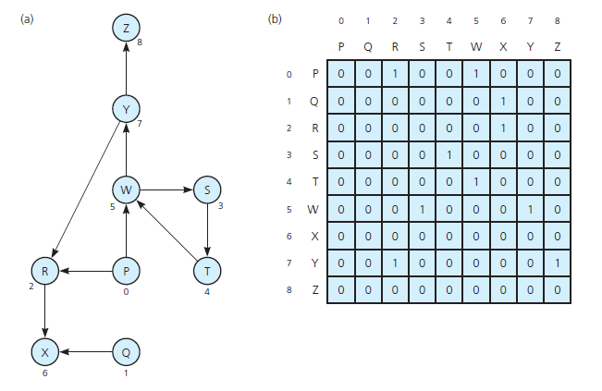
Representing Graphs (3/9)
(a) A directed graph and (b) its adjacency matrix
Source: FIGURE 20-6 in [Carrano and Henry 2013].

Slide 19
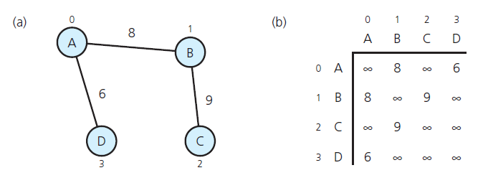
Representing Graphs (4/9)
(a) A weighted graph and (b) its adjacency matrix
Source: FIGURE 20-7 in [Carrano and Henry 2013].

Slide 20
Representing Graphs (5/9)
In the adjacency list for a graph with n vertices numbered 0, 1, …, n – 1, the i-th list’s node can contain:
  Vertex j’s value, if any, or an indication of vertex j’s identity,
  Edge weight, and
  A pointer pointing to the next node.
In the adjacency list for an undirected graph, each edge is treated as if it were two directed edges in opposite directions.

Slide 21
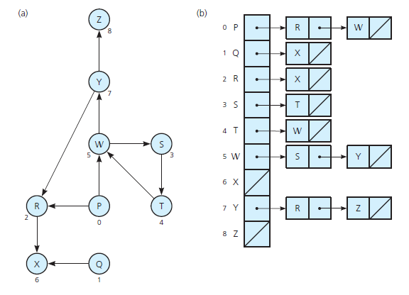
Representing Graphs (6/9)
(a) A directed graph and (b) its adjacency list
Source: FIGURE 20-8 in [Carrano and Henry 2013].

Slide 22
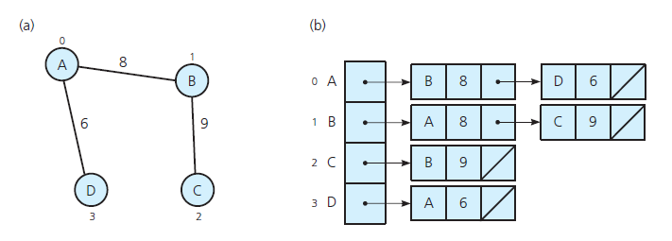
Representing Graphs (7/9)
(a) A weighted graph and (b) its adjacency list
Note that each edge is treated as if it were two directed edges in opposite
directions.
Source: FIGURE 20-9 in [Carrano and Henry 2013].

Slide 23
Representing Graphs (8/9)
Which of these two representations is better?
  Depends on how your application uses the graph.
Two common operations on graphs:
  Check whether there is an edge from vertex i to vertex j.
  Find all vertices adjacent to a given vertex i.
The case of adjacency matrix:
  Supports operation 1 more efficiently.
  Only need to examine the value of matrix[i][j].
The case of adjacency list:
  Supports operation 2 more efficiently.
  Traverse the i^{th} linked list.

Slide 24
Representing Graphs (9/9)
Space requirements of the two representations:
  The adjacency matrix always has n² entries.
  The number of nodes in an adjacency list equals the number of edges in a graph (twice for an undirected graph).
    Each node contains both a value and a pointer.
    The list also has n head pointer.
    Often requires less space than an adjacency matrix.
In summary, you must consider:
  What operations are needed.
  Memory requirements (the number of edges).

Slide 25
Graph Traversals (1/3)
A graph traversal visits all the vertices that it can reach by following edges, from a given vertex.
  A traversal that starts at vertex v will visit all vertices w for which there is a path between v and w.
  A traversal visits all vertices of the graph if and only if the graph is connected.
If a graph is not connected, a graph traversal will visit only a subset of the graph’s vertices.
  The subset of vertices visited during a traversal that begins at a given vertex is called a connected component.

Slide 26
Graph Traversals (2/3)
If a graph contains a cycle, a graph-traversal algorithm may loop indefinitely.
To prevent indefinite loops,
    Mark each vertex during a visit, and
    Never visit a vertex more than once.
Two basic graph-traversal strategies (algorithms):
  depth-first search (DFS) and
  breadth-first search (BFS).
Both DFS and BFS can apply to either directed or undirected graphs.

Slide 27
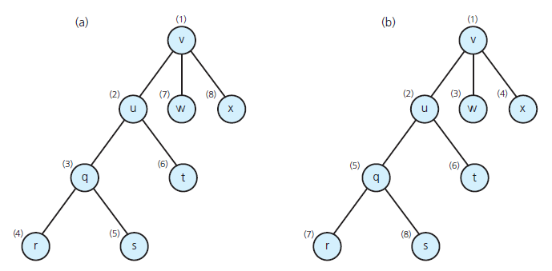
Graph Traversals (3/3)
(a) A depth-first search (DFS); (b) a breadth-first search (BFS)
Source: FIGURE 20-10 in [Carrano and Henry 2013].

Slide 28
DFS Traversal (1/7)
From a given vertex v, DFS proceeds along a path from v as deeply into the graph as possible before backing up.
It has a simple recursive form:
// Traverses a graph beginning at vertex v by using a
// depth-first search: Recursive version.
dfs(v: Vertex)
Mark v as visited
for (each unvisited vertex u adjacent to v)
dfs(u)

Slide 29
DFS Traversal (2/7)
dfs(v: Vertex)
Mark v as visited
for (each unvisited vertex u adjacent to v)
dfs(u)
1
v
dfs(v)
v
dfs(w)
dfs(x)
2
7
8
u
u
w
w
x
dfs(u)
x
3
6
q
q
t
dfs(q)
t
dfs(t)
4
5
dfs(r)
r
r
s
s
dfs(s)

Slide 30
DFS Traversal (3/7)
DFS is a “last visited, first explored” strategy.
It has an iterative form that uses a stack.
dfs(v: Vertex)
s = a new empty stack
s.push(v)
Mark v as visited
while (!s.isEmpty()) {
if (no unvisited vertices are adjacent to
the vertex on the top of the stack)
s.pop() // Backtrack
else {
Select an unvisited vertex u adjacent to
the vertex on the top of the stack
s.push(u)
Mark u as visited
}
}

Slide 31
DFS Traversal (4/7)
1
v
dfs(v)
v
2
7
8
u
u
w
w
x
x
r
s
6
q
3
t
u
w
q
x
q
t
t
v
4
5
stack
r
r
s
s

Slide 32
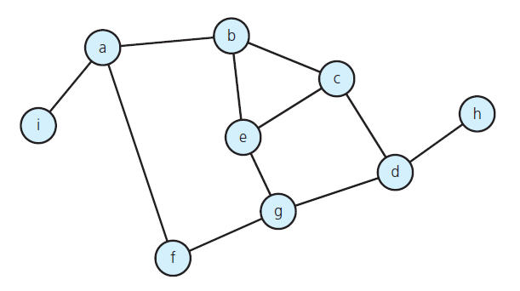
DFS Traversal (5/7)
A connected graph with cycles
Source: FIGURE 20-11 in [Carrano and Henry 2013].

Slide 33
DFS Traversal (6/7)
2
1
3
9
6
8
4
5
7
A depth-first traversal of the graph in Figure 20-11
Source: FIGURE 20-11 in [Carrano and Henry 2013].

Slide 34
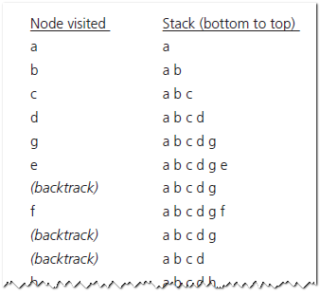
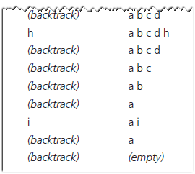
DFS Traversal (7/7)
A depth-first traversal of the graph in Figure 20-11
Source: FIGURE 20-12 in [Carrano and Henry 2013].

Slide 35
BFS Traversal (1/4)
BFS visits every vertex adjacent to a vertex v that it can before visiting any other vertex.
It is a “first visited, first explored” strategy, and can be implemented in an iterative form, using a queue.
bfs(v: Vertex)
q = a new empty queue
q.enqueue(v)
Mark v as visited
while (!q.isEmpty()) {
w = q.peekFront()
q.dequeue()
for (each unvisited vertex u adjacent to w) {
Mark u as visited
q.enqueue(u)
}
}

Slide 36
BFS Traversal (2/4)
1
v
bfs(v)
v
2
3
4
u
u
w
w
x
x
5
6
q
q
t
t
7
8
r
r
s
s
queue
v
u
w
x
q
t
r
s

Slide 37
BFS Traversal (3/4)
2
1
5
4
6
9
8
7
3
A breadth-first traversal of the graph in Figure 20-11
Source: FIGURE 20-11 in [Carrano and Henry 2013].

Slide 38
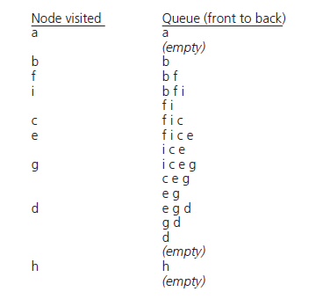
BFS Traversal (4/4)
A breadth-first traversal of the graph in Figure 20-11
Source: FIGURE 20-13 in [Carrano and Henry 2013].

Slide 39
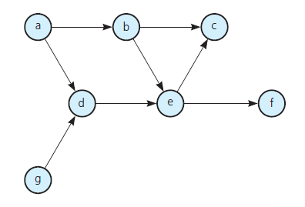
Topological Sorting (1/6)
Topological order:
  A list of vertices in a directed graph without cycles (like the one below) such that vertex x precedes vertex y if there is a directed edge from x to y in the graph.
A directed graph without cycles
Source: FIGURE 20-14 in [Carrano and Henry 2013].

Slide 40
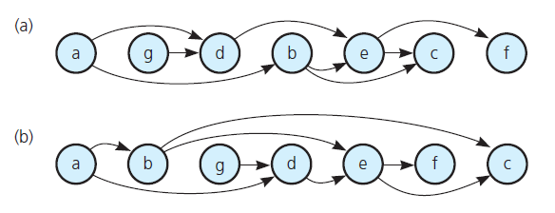
Topological Sorting (2/6)
  Several topological orders are possible for a given graph.
The graph in Fig. 20-14 arranged in two different topological orders
Source: FIGURE 20-15 in [Carrano and Henry 2013].

Slide 41
Topological Sorting (3/6)
Topological sorting:
  Arranging the vertices into a topological order.
topSort1
  Find a vertex that has no successor.
  Add the vertex to the beginning of a list.
  Remove that vertex from the graph, as well as all edges that lead to it.
  Repeat the previous steps until the graph is empty.
When the loop ends, the list of vertices will be in topological order.

Slide 42
Topological Sorting (4/6)
a
b
c
d
e
f
g
List:
a
g
d
b
e
c
f

Slide 43
Topological Sorting (5/6)
topSort2(theGraph: Graph, aList: list)
s = a new empty stack
for (each vertex v in theGraph)
if (v has no predecessors) {
s.push(v)
Mark v as visited
}
while (!s.isEmpty()) {
if (all vertices adjacent to the vertex on
the top of the stack have been visited) {
s.pop(v)
aList.insert(1, v)
}
else {
Select an unvisited vertex u adjacent to
the vertex on the top of the stack
s.push(u)
Mark u as visited
}
}

Slide 44
Topological Sorting (6/6)
a
a
b
b
c
c
c
f
e
d
d
e
e
f
f
d
g
b
a
g
g
List:
a
b
g
d
e
f
c
stack
Push (and mark) all vertices that have no predecessor onto a stack.
DFS while loop

Slide 45
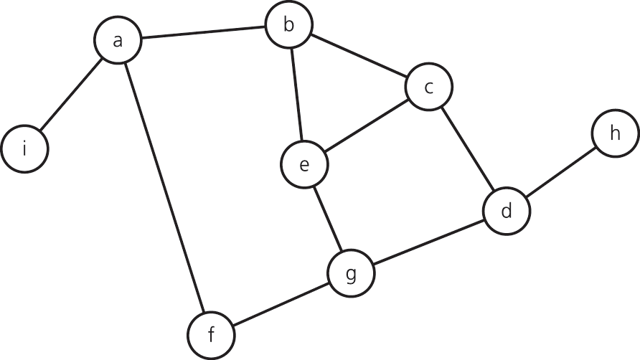
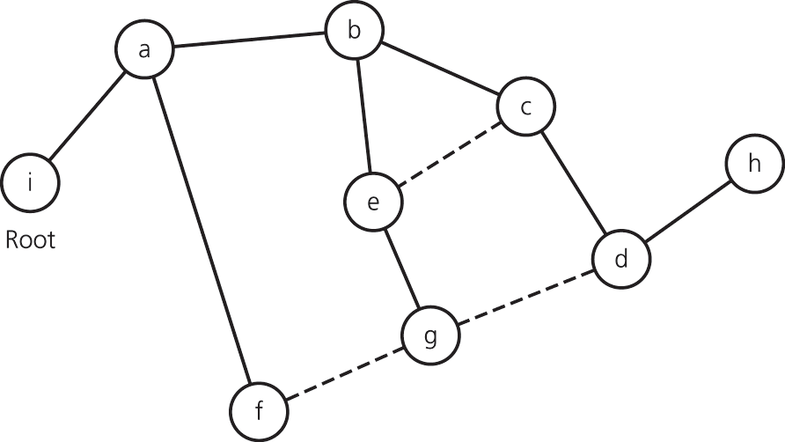
Spanning Trees (1/7)
A tree is an undirected connected graph without cycles.
A spanning tree of a connected undirected graph G is a subgraph of G that contains all of G’s vertices and enough of its edges to form a tree.

Slide 46
Spanning Trees (2/7)
There may be several spanning trees for a given graph.
To obtain a spanning tree from a connected undirected graph with cycles, one may remove edges until there are no cycles.
Detecting a cycle in an undirected connected graph:
  A connected undirected graph that has n vertices must have at least n – 1 edges.
  A connected undirected graph that has n vertices and exactly n – 1 edges cannot contain a cycle.
  A connected undirected graph that has n vertices and more than n – 1 edges must contain at least one cycle.
You can determine whether a connected graph contains a cycle simply
by counting its vertices and edges.

Slide 47
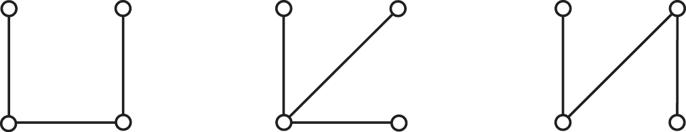
Spanning Trees (3/7)
Two algorithms for determining a spanning tree of a graph:
  The DFS spanning tree.
  THE BFS spanning tree.

Slide 48
Spanning Trees (4/7)
To create a depth-first search (DFS) spanning tree,
  Traverse the graph using a depth-first search and mark the edges that you follow.
  After the traversal is complete, the graph’s vertices and marked edges form the spanning tree.
To create a breath-first search (BFS) spanning tree,
  Traverse the graph using a bread-first search and mark the edges that you follow.
  When the traversal is complete, the graph’s vertices and marked edges form the spanning tree.

Slide 49
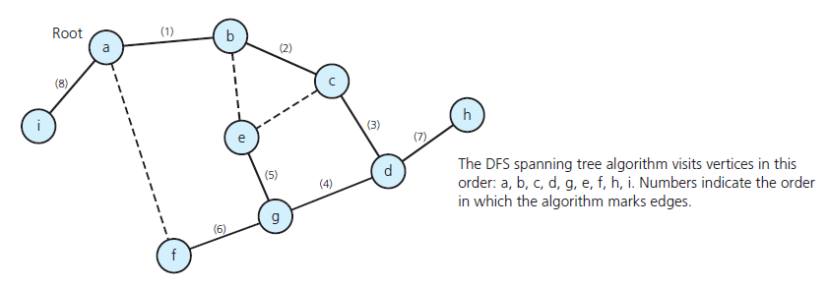
Spanning Trees (5/7)
A DFS spanning tree for the graph in Fig. 20-11
Source: FIGURE 20-20 in [Carrano and Henry 2013].

Slide 50
Spanning Trees (6/7)
The DFS spanning tree rooted at vertex a.
root
(1)
a
a
b
b
(2)
e
f
(8)
g
c
h
c
h
(3)
h
d
i
i
e
e
c
(5)
(7)
b
d
i
d
f
a
f
(6)
g
g
(4)
stack

Slide 51
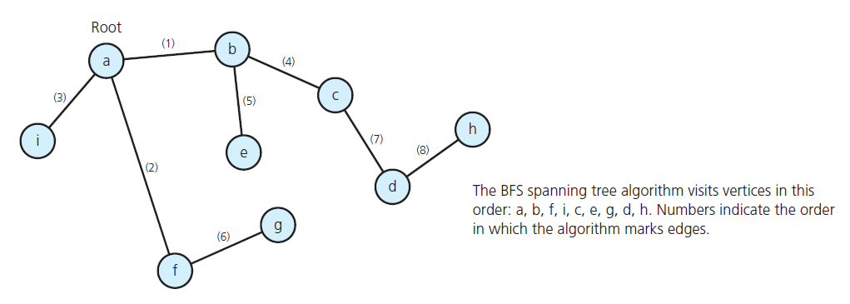
Spanning Trees (7/7)
A BFS spanning tree for the graph in Fig. 20-11
Source: FIGURE 20-21 in [Carrano and Henry 2013].

Slide 52
Minimum Spanning Trees (1/4)
Suppose you are building a telephone system of a country.
  Vertices: cities.
  Edges: weighted, the installation cost of the telephone line.
Cost of the spanning tree:
  Sum of the costs of the edges of the spanning tree.
a
6
a
b
b
7
2
9
c
c
4
h
3
4
h
i
i
e
e
1
8
d
d
f
5
f
2
g
g
Source: FIGURE 20-22 in [Carrano and Henry 2013].

Slide 53
Minimum Spanning Trees (2/4)
A minimum spanning tree of a connected undirected graph has a minimal edge-weight sum.
  A particular graph could have several minimum spanning trees.
Prim’s algorithm:
  A method finds a minimum spanning tree that begins at any vertex.

Slide 54
Minimum Spanning Trees (3/4)
// Determines a minimum spanning tree for a weighted,
// connected, undirected graph whose weights are
// nonnegative, beginning with any vertex v.
primsAlgorithm(v: Vertex)
Mark vertex v as visited and include it in the minimum
spanning tree
while (there are unvisited vertices) {
Find the least-cost edge (v, u) from a visited
vertex v to some unvisited vertex u
Mark u as visited
Add the vertex u and the edge (v, u) to the minimum
spanning tree
}

Slide 55
Minimum Spanning Trees (4/4)
primsAlgorithm(a)
a
6
a
a
b
b
b
7
2
9
c
c
c
4
h
h
3
4
h
i
i
i
e
e
e
1
8
d
d
d
f
5
f
f
2
g
g
g

Slide 56
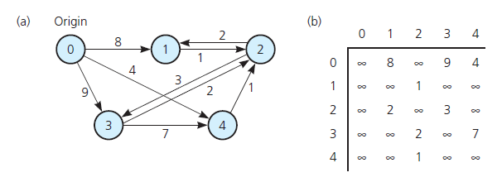
Shortest Paths (1/6)
(a) A weighted directed graph and (b) its adjacency matrix
Source: FIGURE 20-24 in [Carrano and Henry 2013].

Slide 57
Shortest Paths (2/6)
A map of airline routes:
  The vertices are cities.
  The edges indicate existing flights between cities.
  The edge weights represent the mileage between cities.
Shortest path between two vertices in a weighted graph is:
  The path that has the smallest sum of its edge weights.

Slide 58
Shortest Paths (3/6)
Dijkstra’s Algorithm:
  Find the shortest paths between a given origin and all other vertices.
For convenience, the starting vertex (origin) is labeled 0, and the other vertices are labeled from 1 to n-1.
Adjacency matrix
 | 0 | 1 | 2 | 3 | 4
0 | ∞ | 8 | ∞ | 9 | 4
1 | ∞ | ∞ | 1 | ∞ | ∞
2 | ∞ | 2 | ∞ | 3 | ∞
3 | ∞ | ∞ | 2 | ∞ | 7
4 | ∞ | ∞ | 1 | ∞ | ∞
8
2
0
1
2
4
1
3
9
2
1
3
4
7

Slide 59
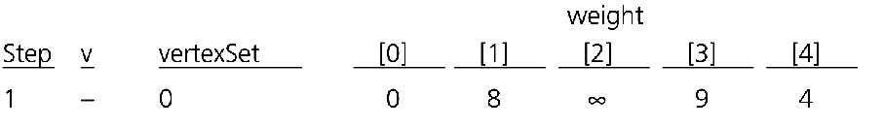
Shortest Paths (4/6)
Dijkstra’s algorithm uses:
  A set vertexSet of selected vertices.
  An array weight, where weight[v] is the weight of the shortest path from vertex 0 to vertex v that passes through vertices in vertexSet.
Initially, vertexSet contains only vertex 0, and weight contains the weights of the single-edge paths from vertex 0 to all other vertices.

Slide 60
Shortest Paths (5/6)
After initialization, you find a vertex v that is not in vertexSet and that minimizes weight[v].
  Add v to vertexSet.
  For all vertices u not in vertexSet, you check the values weight[u] to ensure that they are indeed minimums.
  weight[u] = min{ weight[u],
  weight[v] + matrix[v][u] }
The final values in weight are the weights of the shortest path.

Slide 61
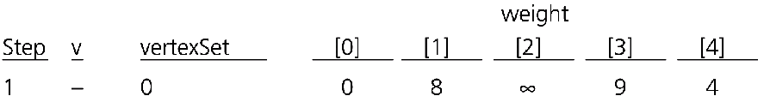






Shortest Paths (6/6)
Adjacency matrix
 | 0 | 1 | 2 | 3 | 4
0 | ∞ | 8 | ∞ | 9 | 4
1 | ∞ | ∞ | 1 | ∞ | ∞
2 | ∞ | 2 | ∞ | 3 | ∞
3 | ∞ | ∞ | 2 | ∞ | 7
4 | ∞ | ∞ | 1 | ∞ | ∞
8
2
0
1
2
4
1
3
9
2
1
3
4
7
Source: FIGURE 20-25 in [Carrano and Henry 2013].

Slide 62
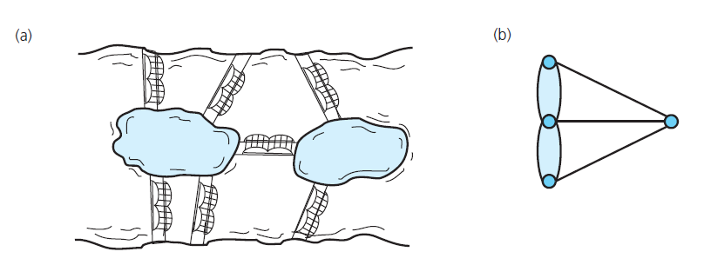
Eulerian Circuits (1/4)
An Eulerian circuit is a cycle (circuit) that begins at a vertex v, passes through every edge exactly once, and terminates at v.
(a) Euler’s bridge problem and (b) its multigraph representation
Source: FIGURE 20-27 in [Carrano and Henry 2013].

Slide 63
Eulerian Circuits (2/4)
An Eulerian circuit exists if and only if each vertex touches an even number of edges.
Does the graph has Euler circuit?
Find an Eulerian circuit:
  Use a depth-first search that marks edges instead of vertices as they are traversed.
  When you find a cycle, launch a new traversal beginning with the first vertex along the cycle that touches an unvisited edge.
a
b
c
d
e
f
g
h
i
j
k
l
Eulerian circuit:
a
b
e
f
j
i
h
d
c
g
h
k
l
i
e
d
a

Slide 64
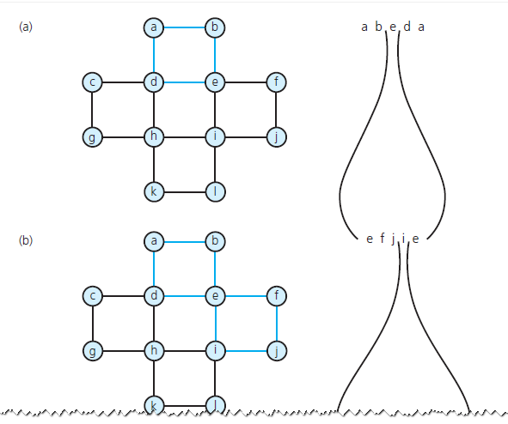
Eulerian Circuits (3/4)
The steps to determine an Euler circuit applied to Fig. 20-29
Source: FIGURE 20-30 in [Carrano and Henry 2013].

Slide 65
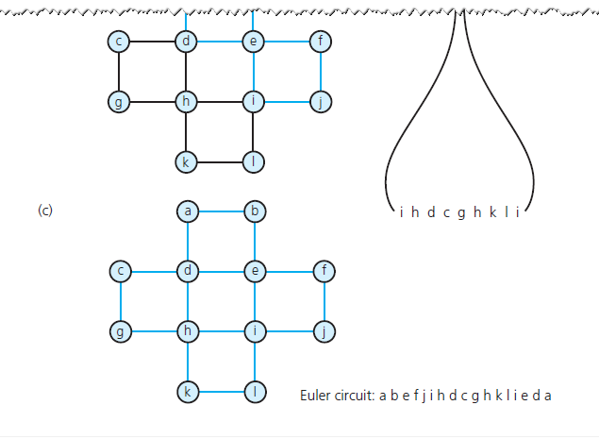
Eulerian Circuits (4/4)
The steps to determine an Euler circuit applied to Fig. 20-29
Source: FIGURE 20-30 in [Carrano and Henry 2013].

Slide 66
Some Difficult Problems
The traveling salesman problem (TSP):
  A Hamiltonian circuit begins at a vertex v, passes through every vertex exactly once, and terminates at v.
  For a weighted graph, find a Hamiltonian circuit with the least weight expense.
  The four-color problem.
  A planar graph can be drawn so that no two edges cross.
  It has been proven that a planar graph can be colored with four colors so that no adjacent vertices have the same color.

Slide 67
Summary (1/2)
The most common representations of a graph use either an adjacency matrix or an adjacency list.
Graph traversals:
  Depth-first search goes as deep into the graph as it can before backtracking.
    Uses a stack.
  Bread-first search visits all possible adjacent vertices before traversing further into the graph.
    Uses a queue.

Slide 68
Summary (2/2)
Topological sorting produces a linear order of the vertices in a directed graph without cycles.
A spanning tree of a connected undirected graph is a subgraph that contains all the graph’s vertices and enough of its edges to form a tree.
A minimum spanning tree for a weighted undirected graph is a spanning tree whose edge-weight sum is minimal.
The shortest path between two vertices in a weighted directed graph is the path that has the smallest sum of its edge weights.

