Slide 1
Data Structures Midterm Answer
Prepared by Carlos and Po-Chuan
2016/11/21

Slide 2
Problem 6
Sort stacks

Slide 3
The pseudocode
S: initial stack
T: temporary stack
move all elements of S to T, and record the max element, M
while( T not empty )
{
push M onto S
move all elements, except M (dropped), of T to S
move all elements of S to T, but stop at M,
and record the max element, N
M = N
}

Slide 4
Complexity
Time complexity: O(N)
Additional stacks required: 1

Slide 5
Problem 8
Merge process

Slide 6
The output
9 | 4 | 10 | 6 | 12 | 7 | 5 | 1 | 2 | 11 | 3 | 8
4 | 9 | 10 | 6 | 12 | 7 | 5 | 1 | 2 | 11 | 3 | 8
4 | 9 | 10 | 6 | 12 | 7 | 5 | 1 | 2 | 11 | 3 | 8
4 | 9 | 10 | 6 | 12 | 7 | 5 | 1 | 2 | 11 | 3 | 8
4 | 9 | 10 | 6 | 7 | 12 | 5 | 1 | 2 | 11 | 3 | 8
4 | 6 | 7 | 9 | 10 | 12 | 5 | 1 | 2 | 11 | 3 | 8
4 | 6 | 7 | 9 | 10 | 12 | 1 | 5 | 2 | 11 | 3 | 8
4 | 6 | 7 | 9 | 10 | 12 | 1 | 2 | 5 | 11 | 3 | 8
4 | 6 | 7 | 9 | 10 | 12 | 1 | 2 | 5 | 3 | 11 | 8
4 | 6 | 7 | 9 | 10 | 12 | 1 | 2 | 5 | 3 | 8 | 11
4 | 6 | 7 | 9 | 10 | 12 | 1 | 2 | 3 | 5 | 8 | 11
1 | 2 | 3 | 4 | 5 | 6 | 7 | 8 | 9 | 10 | 11 | 12

Slide 7
Problem 10
Separate negative and positive numbers (negative ones go first)

Slide 8
The pseudocode
partition( n, L, R ):
n = the array to be partitioned
L, R = partitioning bound
move( L, R )
while( L < R )
swap n[ L ] and n[ R ]
move( L, R )

Slide 9
The pseudocode
move( L, R ):
while n[ L ] < 0
++L
while n[ R ] > 0
--R

Slide 10
Problem 2
ArrayBag delete

Slide 11
2. Rewrite the “remove” function
Can not change the name of arraybag.
The size of arraybag must be changed.

Slide 12
Code
template <typename ItemType>
bool ArrayBag::remove( const ItemType& anEntry )
{
int locatedIndex = getIndexOf( anEntry );
bool canRemoveItem = ( locatedIndex > -1 );
if ( canRemoveItem )
items[ locatedIndex ] = items[ --itemCount ];

Slide 13
if ( itemCount < maxItem / 2 )
{
ItemType* N = new ItemType[ maxItem /= 2 ];
copy( items, item + itemCount, N );
delete[] items;
items = N;
}
return canRemoveItem;
}

Slide 14
Problem 3
Infix to postfix

Slide 15
a * ( b / c – d ) – e * f
(stack from bottom to top)
Ch | Stack | Postfix
a |  | a
* | * | a
( | *( | a
b | *( | ab
/ | *(/ | ab
c | *(/ | abc
- | *(- | abc/
Ch | Stack | Postfix
d | *(- | abc/d
) | * | abc/d-
- | - | abc/d-*
e | - | abc/d-*e
* | -* | abc/d-*e
f | -* | abc/d-*ef
Ø | Ø | abc/d-*ef*-

Slide 16
Problem 9
Stable or unstable
Based on the algorithm on the slides

Slide 17
Selection Sort
for (int idx = 1; idx < size; idx++) {
// At this point, theArray[indexSoFar] >= all entries in
// theArray[0..idx - 1]
if (theArray[idx] > theArray[indexSoFar])
indexSoFar = idx;
} // end for
Find the first largest index from the left => move it to the right side of array
Unstable

Slide 18
Bubble Sort
if (theArray[index] > theArray[nextIndex]) {
// Exchange entries
std::swap(theArray[index], theArray[nextIndex]);
sorted = false;
// Signal exchange
} // end if
When two entries are equal => no swap.
Stable

Slide 19
Merge Sort
if (theArray[first1] <= theArray[first2])
tempArray[index++] = theArray[first1++];
else
tempArray[index++] = theArray[first2++];
When the element in first subarray is equal to the element in second subarray => pick the former
Stable

Slide 20
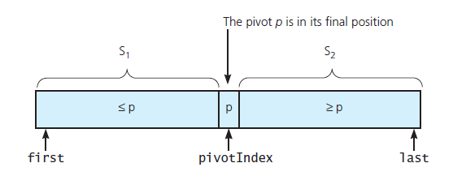
Quick sort
pivotIndex = last(choose the last one as pivot)
Unstable

Slide 21
Single uniform adaption
Record the original index of every elements.
Compare the sort key first.
If the keys are the same, compare the original index.
if ( (Array[index1] > Array[index2]) && (oriIndex1 > oriIndex2) )
{
//operation of changing order
}

Slide 22
Statistics
Average score = 66.7
Standard deviation = 16.8

Slide 23
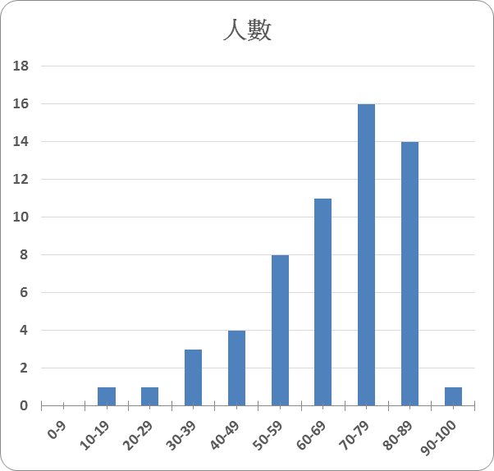
Statistics
組距 | 人數
0-9 | 0
10-19 | 1
20-29 | 1
30-39 | 3
40-49 | 4
50-59 | 8
60-69 | 11
70-79 | 16
80-89 | 14
90-100 | 1

Slide 24
The end~
2016/11/21

