Slide 1
Lists:
The ADT and Its Uses
Yih-Kuen Tsay
Dept. of Information Management
National Taiwan University
Based on [Carrano and Henry 2013]
With help from Chien Chin Chen

Slide 2
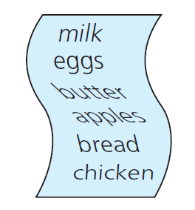
The Notion of a List (1/2)
Examples:
  A list of important dates
  A list of addresses
  A grocery list
A list contains items of the same type.
A list has one first item and one last item.
Source: FIGURE 8-1 in [Carrano and Henry 2013].

Slide 3
The Notion of a List (2/2)
Except for the first and last items, each item has a unique predecessor and a unique successor.
  The head (or front) does not have a predecessor.
  The tail (or end) does not have a successor.
What can we do to a list?
  Count the items on the list
  Add an item to the list
  Remove an item from the list
  Or, look at an item, etc.
Many issues and possibilities …
  Items may be referenced by their position within the list.

Slide 4
The ADT List (1/6)
Let us make it more precise.
A list stores a number of items of the same type.
Operations on a list:
  Test whether a list is empty.
  Get the number of entries on a list.
  Insert an entry at a given position on the list.
  Remove the entry at a given position from the list.
  Look at (get) the entry at a given position on the list.
  Replace (set) the entry at a given position on the list.

Slide 5
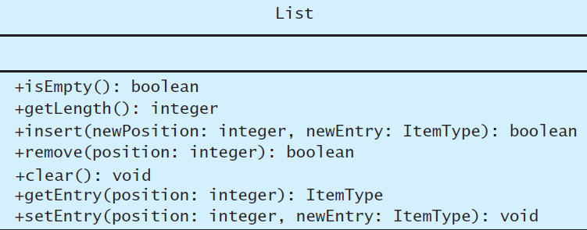
The ADT List (2/6)
A UML class diagram for the ADT list
Source: FIGURE 8-2 in [Carrano and Henry 2013].

Slide 6
The ADT List (3/6)
We must specify the behavior of the list’s operations, without thinking about how we could implement them.
We will first take a closer look at insert and remove, whose behavior is less obvious.
Detailed specifications will be given later when we examine a C++ interface for the ADT list.

Slide 7
The ADT List (4/6)
Pseudocode to create the list:
milk, eggs, butter, apples, bread, chicken
  aList = a new empty list
  aList.insert(1, milk)
  aList.insert(2, eggs)
  aList.insert(3, butter)
  aList.insert(4, apples)
  aList.insert(5, bread)
  aList.insert(6, chicken)
milk
eggs
butter
apples
bread
chicken

Slide 8
The ADT List (5/6)
Perform aList.insert(4, nuts)
All Items at position 4 or greater now have their positions increased by 1.
milk
eggs
butter
apples
bread
chicken
milk
eggs
butter
nuts
apples
bread
chicken

Slide 9
The ADT List (6/6)
Perform aList.remove(5)
All Items at positions greater than 5 now have their positions decreased by 1.
milk
eggs
butter
nuts
apples
bread
chicken
milk
eggs
butter
nuts
bread
chicken
milk
eggs
butter
nuts
bread
chicken

Slide 10
Axioms for the ADT List (1/2)
(new List()).isEmpty() = true
(new List()).getLength() = 0
aList.getLength()=(aList.insert(i, x)).getLength() - 1
aList.getLength()=(aList.remove(i)).getLength() + 1
(aList.insert(i, item)).isEmpty() = false
(new List()).remove(i) = false
(aList.insert(i, x)).remove(i) = aList
Note: insert and remove are assumed here to return the updated list (when the operations are successful).

Slide 11
Axioms for the ADT List (2/2)
(new List()).getEntry(i) = error
(aList.insert(i, x)).getEntry(i) = x
aList.getEntry(i) = (aList.insert(i, x)).getEntry(i + 1)
aList.getEntry(i + 1) = (aList.remove(i)).getEntry(i)
(new List()).setEntry(i, x) = error
(aList.setEntry(i, x)).getEntry(i) = x
Note: insert and remove are assumed here to return the updated list (when the operations are successful).

Slide 12
Using the List Operations (1/3)
Displaying the items on a list:
// Displays the items on the list aList.
displayList(aList)
for (position = 1 through aList.getLength()) {
dataItem = aList.getEntry(position)
Display dataItem
}

Slide 13
Using List Operations (2/3)
Replace an item:
Note that displayList and replace do not depend on how we would implement the list.
// Replace the i-th entry in aList with newEntry
// Returns true if the replacement is successful;
// otherwise returns false.
replace(aList, i, newEntry)
success = aList.remove(i)
if (success)
success = aList.insert(i, newEntry)
return success

Slide 14
Using the List Operations (3/3)
A list is not ordered.
It is the user’s responsibility to maintain a desired order.
To insert Amy, Ellen, Bob, Drew, Aaron, and Carol one by one into a list, while maintaining the list in alphabetic order:
alphaList = a new empty list
alphaList.insert(1, “Amy”) // Amy
alphaList.insert(2, “Ellen”) // Amy Ellen
alphaList.insert(2, “Bob”) // Amy Bob Ellen
alphaList.insert(3, “Drew”) // Amy Bob Drew Ellen
alphaList.insert(1, “Aaron”) // Aaron Amy Bob Drew Ellen
alphaList.insert(4, “Carol”) // Aaron Amy Bob Carol Drew Ellen

Slide 15
A C++ Interface for Lists (1/3)
/** Interface for the ADT list
@file ListInterface.h */
#ifndef _LIST_INTERFACE
#define _LIST_INTERFACE
template<class ItemType>
class ListInterface
{
public:
/** Sees whether this list is empty.
@return True if the list is empty; otherwise returns false. */
virtual bool isEmpty() const = 0;
/** Gets the current number of entries in this list.
@return The integer number of entries currently in the list. */
virtual int getLength() const = 0;

Slide 16
A C++ Interface for Lists (2/3)
/** Inserts an entry into this list at a given position.
@pre None.
@post If 1 <= position <= getLength() + 1 and the insertion is
successful, newEntry is at the given position in the list,
other entries are renumbered accordingly, and the returned
value is true.
@param newPosition The list position at which to insert newEntry.
@param newEntry The entry to insert into the list.
@return True if insertion is successful, or false if not. */
virtual bool insert(int newPosition, const ItemType & newEntry) = 0;
/** Removes the entry at a given position from this list.
@pre None.
@post If 1 <= position <= getLength() and the removal is
successful, the entry at the given position in the list is
removed, other items are renumbered accordingly, and the
returned value is true.
@param position The list position of the entry to remove.
@return True if removal is successful, or false if not. */
virtual bool remove(int position) = 0;

Slide 17
A C++ Interface for Lists (3/3)
/** Removes all entries from this list.
@post List contains no entries and the count of items is 0. */
virtual void clear() = 0;
/** Gets the entry at the given position in this list.
@pre 1 <= position <= getLength().
@post The desired entry has been returned.
@param position The list position of the desired entry.
@return The entry at the given position. */
virtual ItemType getEntry(int position) const = 0;
/** Replaces the entry at the given position in this list.
@pre 1 <= position <= getLength().
@post The entry at the given position is newEntry.
@param position The list position of the entry to replace.
@param newEntry The replacement entry. */
virtual void setEntry(int position, const ItemType & newEntry) = 0;
}; // end ListInterface
#endif

