Slide 1
Queues:
The ADT and Its Uses
Yih-Kuen Tsay
Dept. of Information Management
National Taiwan University
Based on [Carrano and Henry 2013]
With help from Chien Chin Chen

Slide 2
Queues (1/3)
A queue is like a line of people.
  The first person to join a line is the first person served, that is , to leave the line.
New items enter at the back, or rear, of the queue.
Items leave from the front of the queue.
First-in, first-out (FIFO) property:
  The first item inserted into a queue is the first item to leave.
In contrast, a stack has the LIFO (Last-in, First-out) property.

Slide 3
Queues (2/3)
Queues are appropriate for many real-world situations, e.g.,
  A line to buy a movie ticket
  A line to check out at the bookstore
Applications in computer science
  A request to print a document
These involve waiting and people often study them by simulations, to reduce the wait.

Slide 4
Queues (3/3)
ADT queue operations:
  Determine whether a queue is empty.
  Add a new item to the queue.
  Remove the item that was added earliest.
  Retrieve the item that was added earliest.

Slide 5
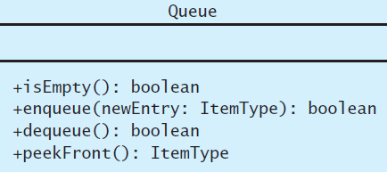
The ADT Queue (1/4)
Source: FIGURE 13-1 in [Carrano and Henry 2013].

Slide 6
The ADT Queue (2/4)
Data
  A finite number of objects, not necessarily distinct, having the same type and ordered by when they were added.
Operations
  isEmpty()
    Task: Determines whether this queue is empty.
    Input: None.
    Output: True if the queue is empty; false, otherwise.
  enqueue(newEntry)
    Task: Adds newEntry at the back of this queue.
    Input: newEntry
    Output: True if the operation is successful; false, otherwise.

Slide 7
The ADT Queue (3/4)
  dequeue()
    Task: Removes the front of this queue. That is, removes the item that was added earliest.
    Input: None.
    Output: True if the operation is successful; false, otherwise.
  peekFront()
    Task: Returns the front of this queue. That is, gets the item that was added earliest. The operation does not change the queue.
    Input: None.
    Output: The front of the queue.

Slide 8
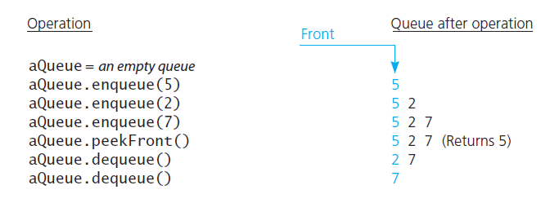
The ADT Queue (4/4)
A scenario
Source: FIGURE 13-2 in [Carrano and Henry 2013].

Slide 9
A C++ Interface for Queues (1/2)
/** @file QueueInterface.h */
#ifndef _QUEUE_INTERFACE
#define _QUEUE_INTERFACE
template<class ItemType>
class QueueInterface
{
public:
/** Sees whether this queue is empty.
@return True if the queue is empty, or false if not. */
virtual bool isEmpty() const = 0;
/** Adds a new entry to the back of this queue.
@post If the operation was successful, newEntry is at the
back of the queue.
@param newEntry The object to be added as a new entry.
@return True if the addition is successful or false if not.*/
virtual bool enqueue(const ItemType& newEntry) = 0;

Slide 10
A C++ Interface for Queues (2/2)
/** Removes the front of this queue.
@post If the operation was successful, the front of the queue
has been removed.
@return True if the removal is successful or false if not. */
virtual bool dequeue() = 0;
/** Returns the front of this queue.
@pre The queue is not empty.
@post The front of the queue has been returned, and the
queue is unchanged.
@return The front of the queue. */
virtual ItemType peekFront() const = 0;
}; // end QueueInterface
#endif

Slide 11
Reading a String of Characters (1/2)
A queue can retain characters in the order in which they are typed:
Once the characters are in a queue, the system can process them as necessary.
// Read a string of characters into a queue
aQueue = a new empty queue
while (not end of line) {
Read a new character into ch
aQueue.enqueue(ch)
}

Slide 12
Reading a String of Characters (2/2)
// Converts digits in a queue aQueue
// into a decimal integer
getInteger(aQueue: Queue): integer
// Get first digit, ignoring blanks
do {
ch = aQueue.peekFront();
aQueue.dequeue();
} while (ch is blank)
// Compute n from digits in queue
n = 0
done = false
do {
n = 10*n + (integer that ch
represents)
done = aQueue.isEmpty()
if (!done) {
ch = aQueue.peekFront();
aQueue.dequeue();
}
} while (!done and ch is a digit)
return n
For example, convert the typed digits into a decimal value:
  ‘247’ → 247.
    2 + (0 × 10) = 2
    4 + (2 × 10) = 24
    7 + (24 × 10) = 247

Slide 13
Recognizing Palindromes (1/4)
Palindrome:
  A string of characters that reads the same from left to right as its does from right to left.
  E.g., abcba (yes), abcbd (no).
To recognize a palindrome, you can use a queue in conjunction with a stack.
  A stack reverses the order of occurrences.
  A queue preserves the order of occurrences.

Slide 14
Recognizing Palindromes (2/4)
A recognition algorithm for palindromes:
  As you traverse the character string from left to right, insert each character into both a queue and a stack.
  Compare the characters at the front of the queue and the top of the stack.
String:
a
b
c
b
d
Queue:
FIFO
a
b
c
b
d
front
back
Stack:
LIFO
d
b
c
b
a
front
Source: FIGURE 13-3 in [Carrano and Henry 2013].

Slide 15
Recognizing Palindromes (3/4)
// Tests whether a given string is a palindrome.
isPalindrome(someString: string): boolean
// Create an empty queue and an empty stack
aQueue = a new empty queue
aStack = a new empty stack
// Add each character of the string to both
// the queue and the stack
length = length of someString
for (i = 1 through length) {
nextChar = i-th character of someString
aQueue.enqueue(nextChar)
aStack.push(nextChar)
}

Slide 16
Recognizing Palindromes (4/4)
// Compare the queue characters with the stack characters
charactersAreEqual = true
while (aQueue is not empty and charactersAreEqual) {
queueFront = aQueue.peekFront()
stackTop = aStack.peek()
if (queueFront equals stackTop) {
aQueue.dequeue()
aStack.pop()
}
else
charactersAreEqual = false
}
return charactersAreEqual

Slide 17
Priority Queues
Example : triage in a hospital’s emergency room
Operations
  Test whether the priority queue is empty.
  Add a new entry to the priority queue in its sorted position based on priority value.
  Remove from priority queue the entry with the highest priority value.
  Get the entry in the priority queue with the highest priority value.

Slide 18
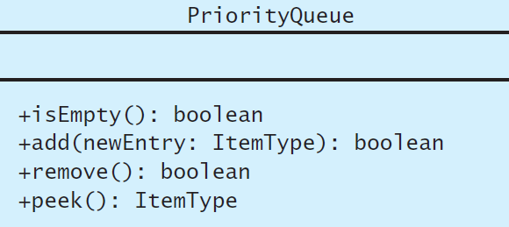
The ADT Priority Queue (1/3)
Source: FIGURE 13-4 in [Carrano and Henry 2013].

Slide 19
The ADT Priority Queue (2/3)
Data
  A finite number of objects, not necessarily distinct, having the same type and ordered by priorities.
Operations
  isEmpty()
    Task: Determines whether this priority queue is empty.
    Input: None.
    Output: True if the priority queue is empty; false, otherwise.
  add(newEntry)
    Task: Adds newEntry to this priority queue.
    Input: newEntry
    Output: True if the operation is successful; false, otherwise.

Slide 20
The ADT Priority Queue (3/3)
  remove()
    Task: Removes the entry with the highest priority from this priority queue.
    Input: None.
    Output: True if the operation is successful; false, otherwise.
  peek()
    Task: Returns the entry in this priority queue with the highest priority. The operation does not change the priority queue.
    Input: None.
    Output: The entry with the highest priority.

Slide 21
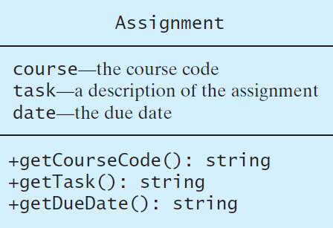
Application: Tracking Assignments (1/2)
Note : should also provide an operation for comparing the due dates
of two assignments.
Source: FIGURE 13-5 in [Carrano and Henry 2013].

Slide 22
Application: Tracking Assignments (2/2)
assignmentLog = a new priority queue using due date as
the priority value
project = a new instance of assignment
essay = a new instance of assignment
task = a new instance of assignment
errand = a new instance of assignment
assignmentLog.add(project)
assignmentLog.add(essay)
assignmentLog.add(task)
assignmentLog.add(errand)
cout << “I should do the following first: ”
cout << assignmenLog.peek()

Slide 23
Application: Simulation (1/12)
Simulation:
  A technique for modeling the behavior of both natural and human-made systems.
Goal:
  Generate statistics that summarize the performance of an existing system.
  Predict the performance of a proposed system.
Example:
  A simulation of the behavior of a bank.
    How long (on average) does a customer have to wait for service?
    Predict the effect of hiring more tellers in the bank.

Slide 24
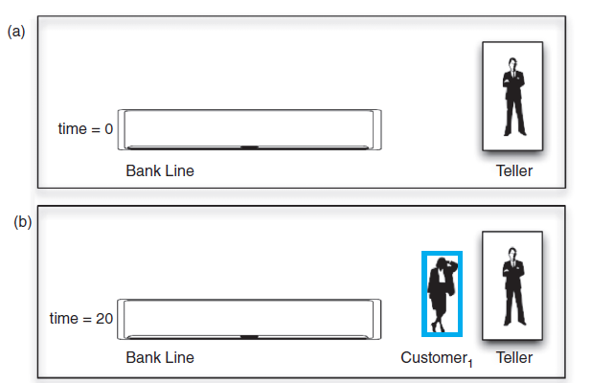
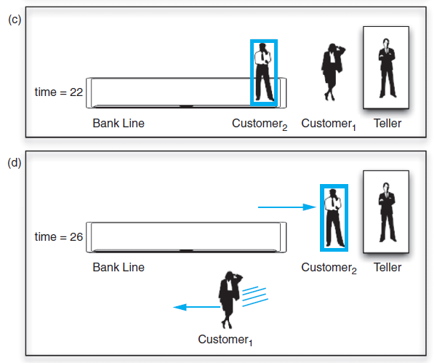
Application: Simulation (2/12)
Central to a simulation is the concept of simulation time.
  At time 0: no customers.
  At time 20: the first customer arrives.
    Begin the customer’s transaction directly.
    Wait 0 minutes.
  At time 22: a second customer arrives.
    Wait in line.
  At time 26: the first transaction completes.
    The second customer waits (26-22) = 4 minutes to begin a transaction.
  Average waiting time: (0+4)/2 = 2 minutes.
Source: FIGURE 13-6 in
[Carrano and Henry 2013].

Slide 25
Application: Simulation (3/12)
The first step in simulating a system such as a bank is to construct a mathematical model:
  Capture the relevant information about the system.
  For example:
    How many tellers does the bank employ?
    How often do customers arrive?
      A Poisson process with an average arrival rate λ (customers/minute).
    How long do transactions require?
      an exponential distribution with an average service time, μ (minute).

Slide 26
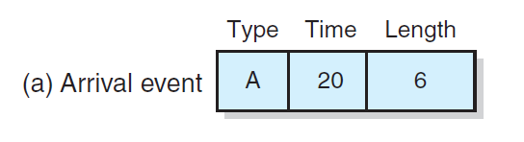
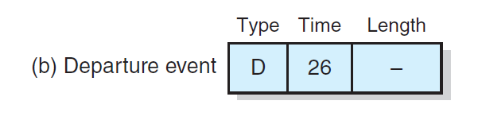
Application: Simulation (4/12)
A typical instance of (a) an arrival event; (b) a departure event
Source: FIGURE 13-7 in [Carrano and Henry 2013].

Slide 27
Application: Simulation (5/12)
An event-driven simulation:
  Arrival events are generated by using a mathematical model based on statistics and probability.
6
4
23 2
30 3
An arrival event:
Time of each customer’s arrival.
The duration of that customer’s transaction.
Customer 1 arrive at time 20 and the transaction
requires 6 minutes to complete.
Generated (simulated) events,
usually stored in a file.

Slide 28
Application: Simulation (6/12)
The file does not contain departure events. The simulation must determine when departures occurs.
  By using the arrival time and the transaction length, the simulation can easily determine the time at which a customer departs.
arrival
length
start
departure
wait
Customer 1: 20 6
20
26
0
Customer 2: 22 4
26
30
4
Customer 3: 23 2
30
32
7
Customer 4: 30 3
32
35
2
average: 3.25

Slide 29
Application: Simulation (7/12)
Implementation of the event-driven bank simulation:
  Use an event list to keep track of arrival and departure events that will occur but have not occurred yet.
    The times of the events in the event list are in ascending order.
    The next event to be processed is always at the beginning of the list.
  Use a queue to represent the line of customers in the bank.

Slide 30
Application: Simulation (8/12)
// Performs the simulation.
simulate(): void
Create an empty queue bankQueue to represent the bank line
Create an empty priority queue eventListPQueue for the
event list
tellerAvailable = true
// Create and add arrival events to event list
while (data file is not empty) {
Get next arrival time a and transaction time t from file
newArrivalEvent = a new arrival event containing a and t
eventListPQueue.add(newArrivalEvent)
}

Slide 31
Application: Simulation (9/12)
// Event loop
while (eventListPQueue is not empty) {
newEvent = eventListPQueue.peek()
// Get current time
currentTime = time of newEvent
if (newEvent is an arrival event)
processArrival(newEvent, eventListPQueue, bankQueue)
else
processDeparture(newEvent, eventListPQueue, bankQueue)
}

Slide 32
Application: Simulation (10/12)
// Processes an arrival event.
processArrival(arrivalEvent: Event,
eventListPQueue:PriorityQueue,
bankQueue:Queue)
// Remove this event from the event list
eventListPQueue.remove()
customer = customer referenced in arrivalEvent
if (bankQueue.isEmpty() && tellerAvailable) {
departureTime = currentTime + transaction time in
arrivalEvent
newDepartureEvent = a new departure event with
departureTime
eventListPQueue.add(newDepartureEvent)
tellerAvailable = false
}
else bankQueue.enqueue(customer)

Slide 33
Application: Simulation (11/12)
// Processes a departure event.
processDeparture(departureEvent: Event,
eventListPQueue:PriorityQueue,
bankQueue:Queue)
// Remove this event from the event list
eventListPQueue.remove()
if (!bankQueue.isEmpty()) {
// Customer at front of line begins transaction
customer = bankQueue.peek()
bankQueue.dequeue()
departureTime = currentTime + transaction time in
customer
newDepartureEvent = a new departure event with
departureTime
eventListPQueue.add(newDepartureEvent)
}
else
tellerAvailable = true

Slide 34
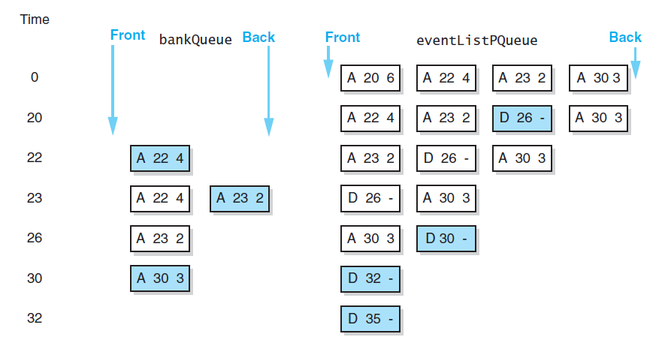

Application: Simulation (12/12)
data
A trace of the bank simulation algorithm
Source: FIGURE 13-8 in [Carrano and Henry 2013].

Slide 35
Position-Oriented vs. Value-Oriented ADTs
Position-oriented ADTs:
  Operations defined in terms of the positions of their data items, e.g.,
    Stack: only one end position can be accessed
    List: all positions can be accessed
    Queue: only the two end positions can be accessed.
Value-Oriented ADTs:
  Operations defined in terms of the values of their data items, e.g.,
    Sorted list (not covered)
    Priority queue: entries ordered according to their priorities
The ADT bag is neither of these two categories.

Slide 36
Stack vs. Queue
Stacks and queues are very similar.
Their operations can be paired off as:
  isEmpty vs. isEmpty.
  push vs. enqueue.
  pop vs. dequeue.
  peek vs. peekFront.
The difference lies in whether a function manipulates the front or the back of the ADT.

Slide 37
List vs. Stack and Queue
You can insert into, delete from, and inspect the item at any position of the ADT list.
So, you can view the ADT list as general versions of the ADT stack and queue.
  getLength can emulate isEmpty
  insert can emulate push and enqueue
  remove can emulate pop and dequeue
  getEntry can emulate peek and peekFront

