Slide 1
Trees
Yih-Kuen Tsay
Dept. of Information Management
National Taiwan University
Based on [Carrano and Henry 2013]
With help from Chien Chin Chen

Slide 2
Data-Management Operations
Operations on stacks, lists, sorted lists, queues, and priority queues fit into at least one of these categories:
  Insert data into a data collection.
  Delete data from a data collection.
  Ask questions about the data in a data collection.
Position-oriented ADTs (stack, queue, and list)
  Insert data into the i^{th} position.
  Delete data from the i^{th} position.
  Ask a question about the data in the i^{th} position.
Value-oriented ADTs (sorted list and priority queue)
  Insert data according to its value.
  Delete data knowing only its value.
  Ask a question about data knowing only its value.

Slide 3
Data Organization
Stacks, lists, and queues are linear in their organization of data.
  Data are stored one after another.
We will study trees, which organize data in a nonlinear, hierarchical form.
  An item can have more than one immediate successor.
Will focus on two ADTs.
  Position-oriented ADT: binary tree
  Value-oriented ADT: binary search tree

Slide 4
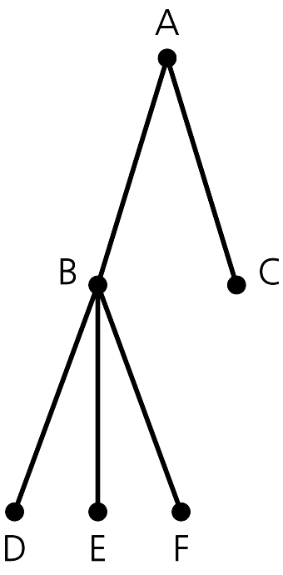
Terminology (1/3)
Trees, as a special kind of graphs, are composed of nodes (vertices) and edges.
Trees are hierarchical.
  Parent-child relationship between two nodes, e.g., B and C are children of A.
Each node in a tree, except the root, has one parent.
  The root, A, has no parent.
A node that has no children is called a leaf of the tree, e.g., C, D, E, F.
Source: FIGURE 15-1 in [Carrano and Henry 2013].

Slide 5
Terminology (2/3)
Sibling relationship: children of the same parent, e.g., B and C.
Ancestor-descendant relationships among nodes.
  A is an ancestor of D.
  D is a descendant of A.
  The root of any tree is an ancestor of every node in that tree.
Subtree of a tree: any node and its descendants.
A subtree example.
Source: FIGURE 15-1 in [Carrano and Henry 2013].

Slide 6
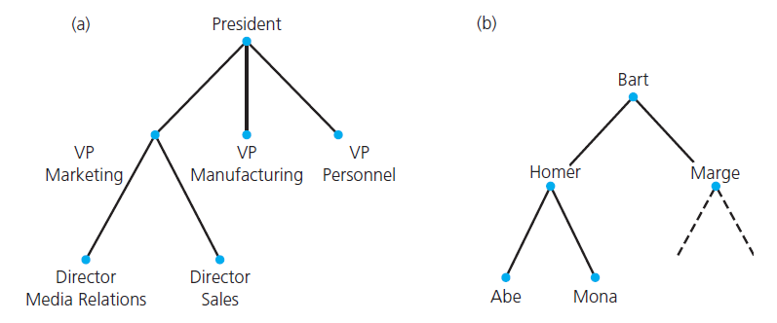
Terminology (3/3)
The hierarchical property of a tree:
  Can be used to represent information that itself is hierarchical in nature, e.g., organization chart or family tree.
Source: FIGURE 15-2 in [Carrano and Henry 2013].

Slide 7
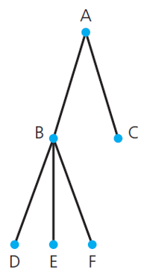
Kinds of Trees
A general tree T is a set of one or more nodes such that T is partitioned into disjoint subsets:
  A single node r, the root.
  Sets that are empty or general trees, called subtrees of r.
An n-ary tree T is a set of nodes that is either empty or partitioned into disjoint subsets:
  A single node r, the root.
  n possibly empty sets that are n-ary subtrees of r.
An example of 3-ary tree

Slide 8
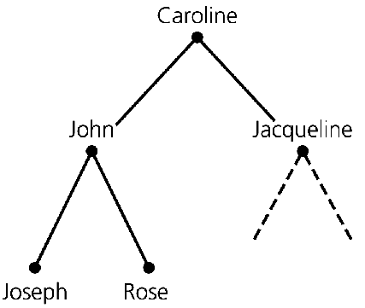
Binary Trees (1/2)
A binary tree is a set T of nodes such that either:
  T is empty, or
  T is partitioned into disjoint subsets:
    A single node r, the root.
    Two possibly empty sets that are binary trees, called the left subtree of r and the right subtree of r.
Each node in a binary tree has no more than two children.
Source: FIGURE 15-2 in [Carrano and Henry 2013].

Slide 9
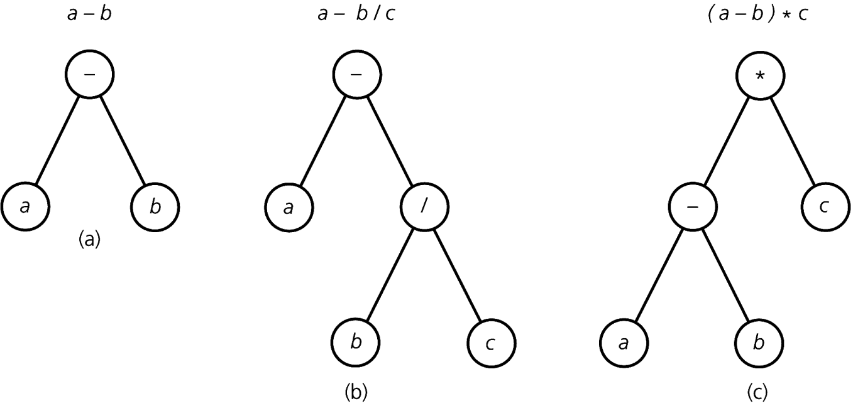
Binary Trees (2/2)
You can use binary trees to represent algebraic expressions.
  Leaves are operands.
  Evaluation order: bottom-up.
    The hierarchy specifies an unambiguous order for evaluating an expression.
    Parentheses do not appear in these trees.
Source: FIGURE 15-3 in [Carrano and Henry 2013].

Slide 10
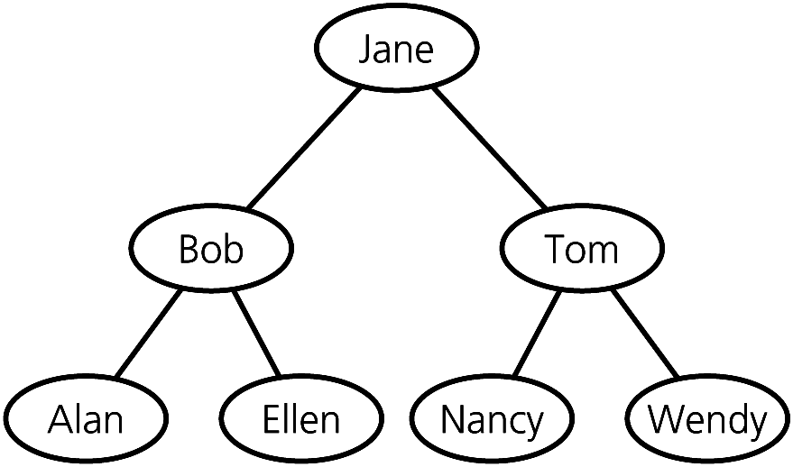
Binary Search Trees
A binary search tree is a binary tree,
But has the following properties for each node n:
  n’s value is > all values in n’s left subtree T_{L}.
  n’s value is < all values in n’s right subtree T_{R}.
  Both T_{L} and T_{R} are binary search trees.
Source: FIGURE 15-4 in [Carrano and Henry 2013].

Slide 11
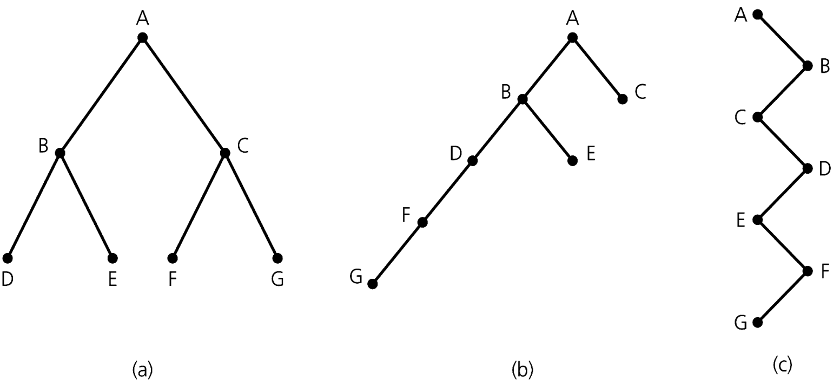
The Height of a Tree (1/3)
Height of a tree:
  Number of nodes along the longest path from the root to a leaf.
Height 3
Height 5
Height 7
Source: FIGURE 15-5 in [Carrano and Henry 2013].
Trees with the same nodes but different heights.

Slide 12
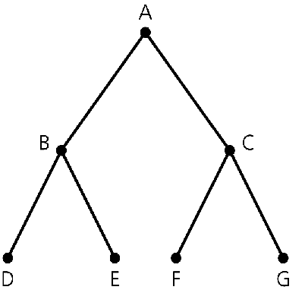
The Height of a Tree (2/3)
Level of a node n in a tree T:
  If n is the root of T, it is at level 1.
  If n is not the root of T, its level is 1 greater than the level of its parent.
Level 1
Level 2
Level 3
Source: FIGURE 15-5 in [Carrano and Henry 2013].

Slide 13
The Height of a Tree (3/3)
Height of a tree T defined in terms of the levels of its nodes.
  If T is empty, its height is 0.
  If T is not empty, its height is equal to the maximum level of its nodes.
A recursive definition of height
  If T is empty, its height is 0.
  If T is not empty,
  height(T) = 1 + max{height(T_{L}), height(T_{R})}.
r
T_{L}
  T_{R}

Slide 14

Full Binary Trees
A binary tree of height h is full if nodes at levels < h have two children each.
Recursive definition:
  If T is empty, T is a full binary tree of height 0.
  If T is not empty and has height h > 0, T is a full binary tree if the root’s subtrees are both full binary trees of height h – 1.
Source: FIGURE 15-6 in [Carrano and Henry 2013].

Slide 15
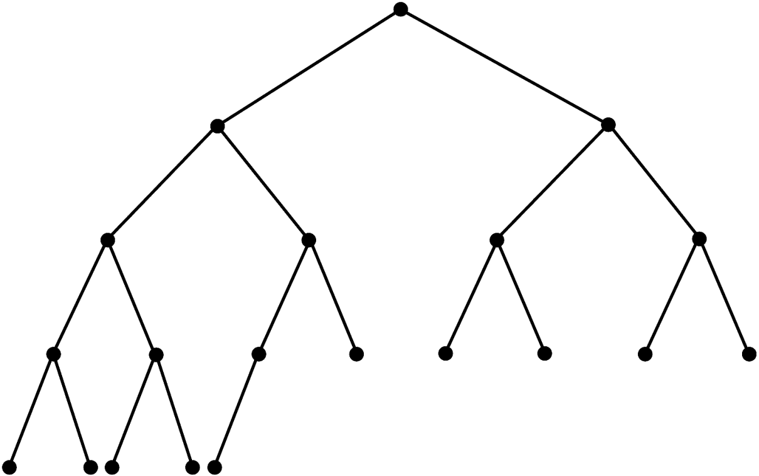
Complete Binary Trees (1/2)
A binary tree of height h is complete if
  It is full to level h – 1 and
  Level h is filled from left to right.
Source: FIGURE 15-7 in [Carrano and Henry 2013].

Slide 16

Complete Binary Trees (2/2)
Another definition:
A binary tree of height h is complete if
  All nodes at levels <= h – 2 have two children each,
  When a node at level h – 1 has children, all nodes to its left at the same level have two children each, and
  When a node at level h – 1 has one child, it is a left child.
Level 1
Level 2
Level 3
Level 4
Level 5

Slide 17

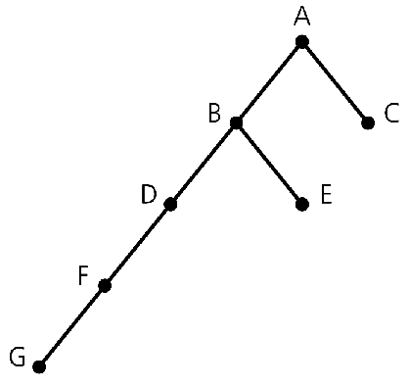
Balanced Binary Trees
A binary tree is balanced if the heights of any node’s two subtrees differ by no more than 1. (Could be more general.)
  Complete binary trees are balanced.
  Full binary trees are complete and balanced.
balanced
unbalanced
Source: FIGURE 15-7 and 15-5 in [Carrano and Henry 2013].

Slide 18
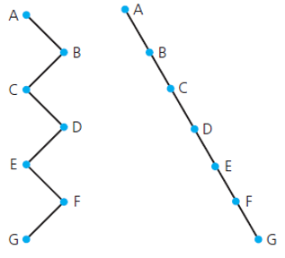
The Maximum Height of a Binary Tree
The maximum height of an n-node binary tree is n, by giving each internal node exactly one child.
Source: FIGURE 15-5 in [Carrano and Henry 2013].

Slide 19
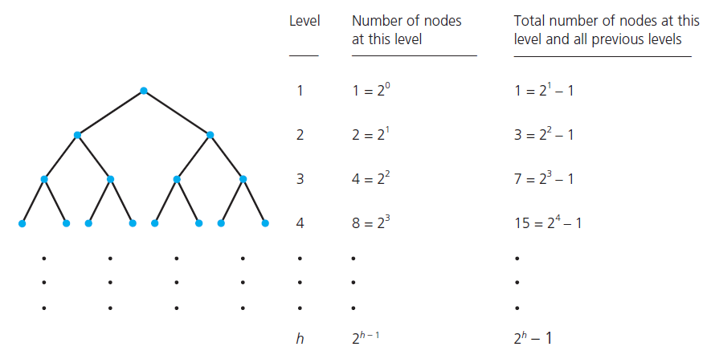
The Minimum Height of a Binary Tree (1/2)
To minimize the height of a binary tree given n nodes, you must fill each level of the tree as completely as possible.
Source: FIGURE 15-9 in [Carrano and Henry 2013].

Slide 20
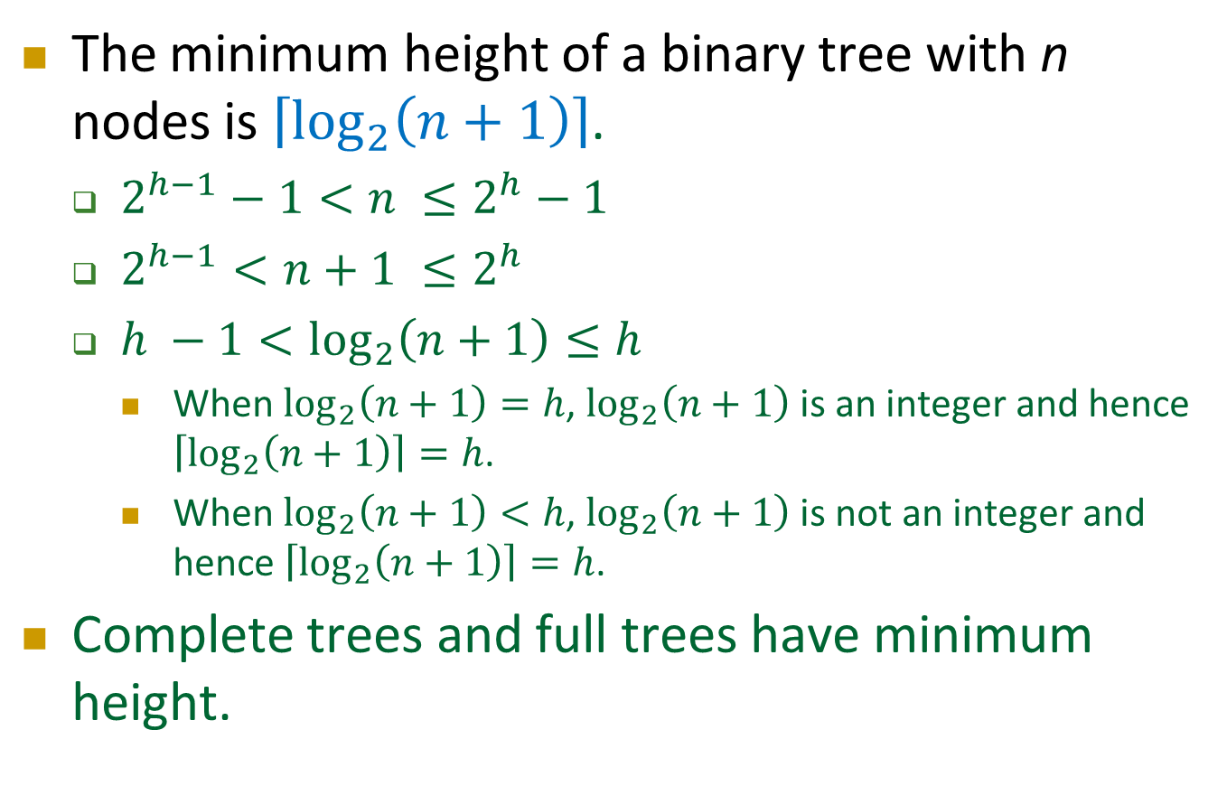
The Minimum Height of a Binary Tree (2/2)
The minimum height of a binary tree with n nodes is $\left\lceil \log_{2}\left(n+1\right)\right\rceil$.
  $2^{h−1}−1<n ≤2^{h}$ $− 1$
  $2^{h−1}<n+1 ≤2^{h}$
  $h −1<\log_{2}\left(n+1\right)≤h$
    When $\log_{2}\left(n+1\right)=h$, $\log_{2}\left(n+1\right)$ is an integer and hence $\left\lceil \log_{2}\left(n+1\right)\right\rceil =h$.
    When $\log_{2}\left(n+1\right)<h$, $\log_{2}\left(n+1\right)$ is not an integer and hence $\left\lceil \log_{2}\left(n+1\right)\right\rceil =h$.
Complete trees and full trees have minimum height.

Slide 21
The ADT Binary Tree
As an abstract data type, the binary tree has operations that:
  Add or remove a node
  Set or retrieve the data in the root
  Test whether the tree is empty
  Traverse the nodes, i.e., visit every node, in the tree
    Visit → doing something with or to the node.

Slide 22
Traversals of a Binary Tree (1/7)
A traversal visits each node in a tree.
  You do something with or to the node during a visit.
  For example, display or modify the data in the node.
    Will assume that visiting means displaying data.
With the recursive definition of a binary tree, you can construct a recursive traversal algorithm.
  If the tree is not empty, the traversal algorithm must perform these tasks:
    Display the data in the root.
    Traverse the two subtrees (recursive … smaller problems).
  The base case: If the tree is empty, the algorithm takes no action.

Slide 23
Traversals of a Binary Tree (2/7)
The algorithm has three choices of when to visit the root:
  Preorder traversal
    Visit root before visiting its subtrees, i.e., before the recursive calls.
  Inorder traversal
    Visit root between visiting its subtrees, i.e., between the recursive calls.
  Postorder traversal
    Visit root after visiting its subtrees, i.e., after the recursive calls.

Slide 24
Traversals of a Binary Tree (3/7)
The preorder traversal algorithm:
preorder(binTree: Binarytree): void
if (binTree is not empty) {
Visit the root of binTree
preorder(Left subtree of binTree’s root)
preorder(Right subtree of binTree’s root)
}
60
20
70
Preorder:
60
20
10
40
30
50
70
10
40
30
50

Slide 25
Traversals of a Binary Tree (4/7)
The inorder traversal algorithm:
inorder(binTree: Binarytree): void
if (binTree is not empty) {
inorder(Left subtree of binTree’s root)
Visit the root of binTree
inorder(Right subtree of binTree’s root)
}
60
20
70
Inorder:
10
20
30
40
50
60
70
10
40
30
50

Slide 26
Traversals of a Binary Tree (5/7)
The postorder traversal algorithm:
postorder(in binTree:Binarytree): void
if (binTree is not empty) {
postorder(Left subtree of binTree’s root)
postorder(Right subtree of binTree’s root)
Visit the root of binTree
}
60
20
70
Postorder:
10
30
50
40
20
70
60
10
40
30
50

Slide 27
Traversals of a Binary Tree (6/7)
Each of these traversals visits every node in a binary tree exactly once.
  n visits occur for a tree of n nodes.
Each visit performs the same operations on each node, independently of n.
  It must be O(1).
Thus, each traversal is O(n).

Slide 28
Traversals of a Binary Tree (7/7)
The task of a tree traversal can be more than to display each item when you visit it.
  Copy the item or even alter it.
  Thus, you might devise many different traversal operations:
    preorderTraverseAndDisplay, preorderTraverseAndCopy, …
A better solution: devise a traversal operation that can call a function to perform a task on each item in the tree.
  Function of displaying, copying, or altering items.
  The client defines and passes this function as an argument to the traversal operation.
  For instance: bintree.preorderTraverse(display);
  Next chapter will discuss the implementation details.

Slide 29
Binary Tree Operations (1/5)
isEmpty() | Task: Tests whether this binary tree is empty. Input: None. Output: True if the binary tree is empty; otherwise false.
getHeight() | Task: Gets the height of this binary tree. Input: None. Output: The height of the binary tree.
getNumberOfNodes() | Task: Gets the number of nodes in this binary tree. Input: None. Output: The number of nodes in the binary tree.

Slide 30
Binary Tree Operations (2/5)
getRootData() | Task: Gets the data that is in the root of this binary tree. Input: none. Output: The root’s data
setRootData(newData) | Task: Replaces the data item in the root of this binary tree with newData, if the tree is note empty. However, if the tree is empty, inserts a new root node whose data item is newData into the tree Input: newData is the data item. Output: None.
add(newData) | Task: Adds a new node containing a given data item into this binary tree. Input: newData is the data item. Output: True if the addition is successful, or false if not.
The specification of add is intentionally vague, and gives the programmer flexibility.

Slide 31
Binary Tree Operations (3/5)
remove(data) | Task: Removes the node containing the given data item from this binary tree. Input: data is the data item. Output: True if the removal is successful, or false if not.
clear() | Task: Removes all nodes from this binary tree. Input: None. Output: None. (The tree is empty.)
getEntry(anEntry) | Task: Gets a specific entry in this binary tree. Input: anEntry is the desired data item. Output: The entry in the binary tree that matches anEntry. Throws an exception if the entry is not found.

Slide 32
Binary Tree Operations (4/5)
contains(data) | Task: Tests whether the given data item occurs in this binary tree. Input: data is the data item. Output: True if the binary tree contains the given data item, or false if not.
preorderTraverse(visit) inorderTraverse(visit) postorderTraverse(visit) | Task: Traverses this binary tree in preorder/inorder/postorder and calls the function visit once for each node. Input: visit is a client-defined function that performs an operation on or with the data in each visited node. Output: None.

Slide 33
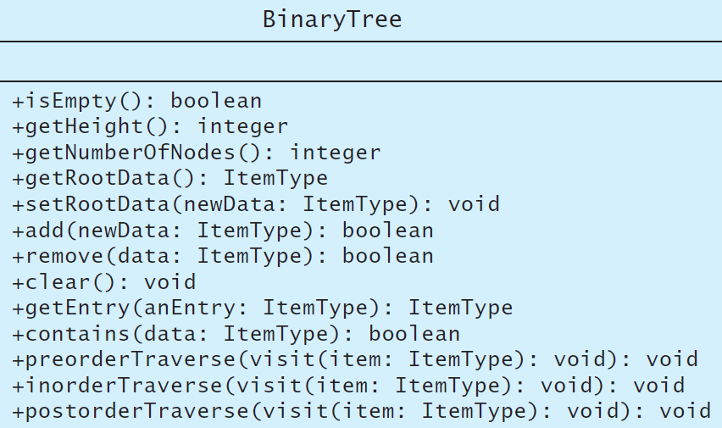
Binary Tree Operations (5/5)
UML diagram for the class BinaryTree
Source: FIGURE 15-12 in [Carrano and Henry 2013].

Slide 34
A C++ Interface for the ADT Binary Tree (1/4)
#ifndef _BINARY_TREE_INTERFACE
#define _BINARY_TREE_INTERFACE
template<class ItemType>
class BinaryTreeInterface
{
public:
/** Tests whether this binary tree is empty.
@return True if the binary tree is empty, or false if not. */
virtual bool isEmpty() const = 0;
/** Gets the height of this binary tree.
@return The height of the binary tree. */
virtual int getHeight() const = 0;
/** Gets the number of nodes in this binary tree.
@return The number of nodes in the binary tree. */
virtual int getNumberOfNodes() const = 0;

Slide 35
A C++ Interface for the ADT Binary Tree (2/4)
/** Gets the data that is in the root of this binary tree.
@pre The binary tree is not empty.
@post The root’s data has been returned, and the binary tree is
unchanged.
@return The data in the root of the binary tree. */
virtual ItemType getRootData() const = 0;
/** Replaces the data item in the root of this binary tree
with the given data, if the tree is not empty. However, if
the tree is empty, inserts a new root node containing the
given data into the tree.
@pre None.
@post The data in the root of the binary tree is as given.
@param newData The data for the root. */
virtual void setRootData(const ItemType& newData) = 0;
/** Adds a new node containing the given data to this binary tree.
@param newData The data for the new node.
@post The binary tree contains a new node.
@return True if the addition is successful, or false not. */
virtual bool add(const ItemType& newData) = 0;

Slide 36
A C++ Interface for the ADT Binary Tree (3/4)
/** Removes the node containing the given data item from this
binary tree.
@param data The data value to remove from the binary tree.
@return True if the removal is successful, or false not. */
virtual bool remove(const ItemType& data) = 0;
/** Removes all nodes from this binary tree. */
virtual void clear() = 0;
/** Gets a specific entry in this binary tree.
@post The desired entry has been returned, and the binary tree is
unchanged. If no such entry was found, an exception is thrown.
@param anEntry The entry to locate.
@return The entry in the binary tree that matches the given entry.
@throw NotFoundException if the given entry is not in the tree. */
virtual ItemType getEntry(const ItemType& anEntry) const
throw(NotFoundException) = 0;

Slide 37
A C++ Interface for the ADT Binary Tree (4/4)
/** Tests whether a given entry occurs in this binary tree.
@post The binary search tree is unchanged.
@param anEntry The entry to find.
@return True if the entry occurs in the tree, or false if not. */
virtual bool contains(const ItemType& anEntry) const = 0;
/** Traverses this binary tree in preorder (inorder, postorder) and
calls the function visit once for each node.
@param visit A client-defined function that performs an operation on
or with the data in each visited node. */
virtual void preorderTraverse(void visit(ItemType&)) const = 0;
virtual void inorderTraverse(void visit(ItemType&)) const = 0;
virtual void postorderTraverse(void visit(ItemType&)) const = 0;
}; // end BinaryTreeInterface
#endif

Slide 38
The ADT Binary Search Tree
The ADT binary search tree is suitable for searching a tree for a particular data item.
For each node n in a binary search tree,
  n’s value is greater than all values in its left subtree T_{L} ,
  n’s value is less than all values in its right subtree T_{R} , and
  both T_{L} and T_{R} are binary search trees.
This organization of data enables you to search a binary search tree for a particular data item efficiently.
Source: FIGURE 15-12 in
[Carrano and Henry 2013].

Slide 39
Binary Search Tree Operations (1/2)
As an ADT, the binary search tree has operations of inserting, removing, and retrieving data.
  Unlike the position-oriented ADTs stack, list, and queue, but like the ADT sorted list, the insertion, removal, and retrieval operations are by value, not by position.
  The traversal operations that you just saw for a binary tree apply to a binary search tree without change.
    Because a binary search tree is a binary tree!

Slide 40
Binary Search Tree Operations (2/2)
add(newEntry) | Task: Inserts newEntry into this binary search tree such that the properties of a binary search tree are maintained. Input: newEntry is the data item to be inserted. Assumes the entries in the tree are distinct and differ from newEntry Output: True if the insertion is successful, or false if not.
remove(anEntry) | Task: Removes the given entry from this binary search tree such that the properties of a binary search tree are maintained. Input: anEntry is the entry to remove. Output: True if the removal is successful, or false if not.
The methods isEmpty, getHeight, getNumberOfNodes, getRootData, clear,getEntry, contains, preorderTraverse, inorderTraverse, and postorderTraverse have the same specifications as for a binary tree.

Slide 41
ADT Binary Search Tree: Search (1/4)
Because a binary search tree is recursive by nature, it is natural to formulate recursive algorithms for operations on the tree.
search(bstTree: BinarySearchTree, target: ItemType)
  if (bstTree is empty)
  The desired item is not found
  else if (target == data item in the root of bstTree)
  The desired item is found
  else if (target < data item in the root of bstTree)
  search(Left subtree of bstTree, target)
  else
  search(Right subtree of bstTree, target)

Slide 42
ADT Binary Search Tree: Search (2/4)
Suppose you want to locate Elisa’s record in the binary tree.
Elisa< Jane
Jane
Elisa > Bob
Bob
Tom
Alan
Elisa
Nancy
Wendy
Elisa == Elisa
Bingo!
Source: FIGURE 15-16 in [Carrano and Henry 2013].

Slide 43
ADT Binary Search Tree: Search (3/4)
As you will see, this search algorithm is the basis of the other operations on a binary search tree.
Note that the shape of the tree in no way affects the validity of the search algorithm.
However, the search algorithm works more efficiently on some trees than on others.

Slide 44
ADT Binary Search Tree: Search (4/4)
The shape of a binary search tree affects the efficiency of its operations.
The more balanced a binary search tree is, the farther it is from a linear structure.
  The behavior of the search algorithm will be to a binary search of an array!

Slide 45
ADT Binary Search Tree: Insertion (1/2)
Suppose that you want to insert a record for Frank into the binary search tree.
Imagine that you instead want to search for the item with Frank.
  Frank must be the right child of Elisa!!
Jane
Bob
Tom
Alan
Elisa
Nancy
Wendy
Frank

Slide 46
ADT Binary Search Tree: Insertion (2/2)
Search always tells you the insertion point.
  It will always terminate at an empty subtree.
  Or, search always tells you to insert the item as a new leaf!

Slide 47
ADT Binary Search Tree: Traversal
Traversals for a binary search tree are the same as the traversals for a binary tree.
The inorder traversal of a binary search tree visits the tree’s nodes in sorted search-key order.

Slide 48
Efficiency of Binary Search Tree Operations (1/7)
Each operation compares the a specified value v to the entries in the nodes along a path through the tree.
  Start at the root.
  Terminate at the node that contains v (or an empty subtree).
Elisa < Jane
Jane
Elisa > Bob
Bob
Tom
Alan
Elisa
Nancy
Wendy
Elisa == Elisa
Bingo!
3 comparisons

Slide 49
Efficiency of Binary Search Tree Operations (2/7)
Thus, the efficiency of each operation is related (proportional) to the number of nodes along the comparison path.
The maximum number of comparisons is the number of nodes along the longest path from root to a leaf—that is, the tree’s height.

Slide 50
Efficiency of Binary Search Tree Operations (3/7)
However, several different binary search trees are possible for the same data!!
To locate “Wendy”:
Alan
Jane
Bob
Bob
Tom
Elisa
Jane
Alan
Elisa
Nancy
Wendy
Nancy
3 comparisons
7 comparisons!!
Tom
Wendy

Slide 51
Efficiency of Binary Search Tree Operations (4/7)
The order in which insertion and deletion operations are performed on a binary search tree affects its height.
Now, we try to analyze the maximum and minimum heights of a binary search tree with n nodes.
The maximum height of a binary tree with n nodes is n.
  By giving each internal node exactly one child.

Slide 52
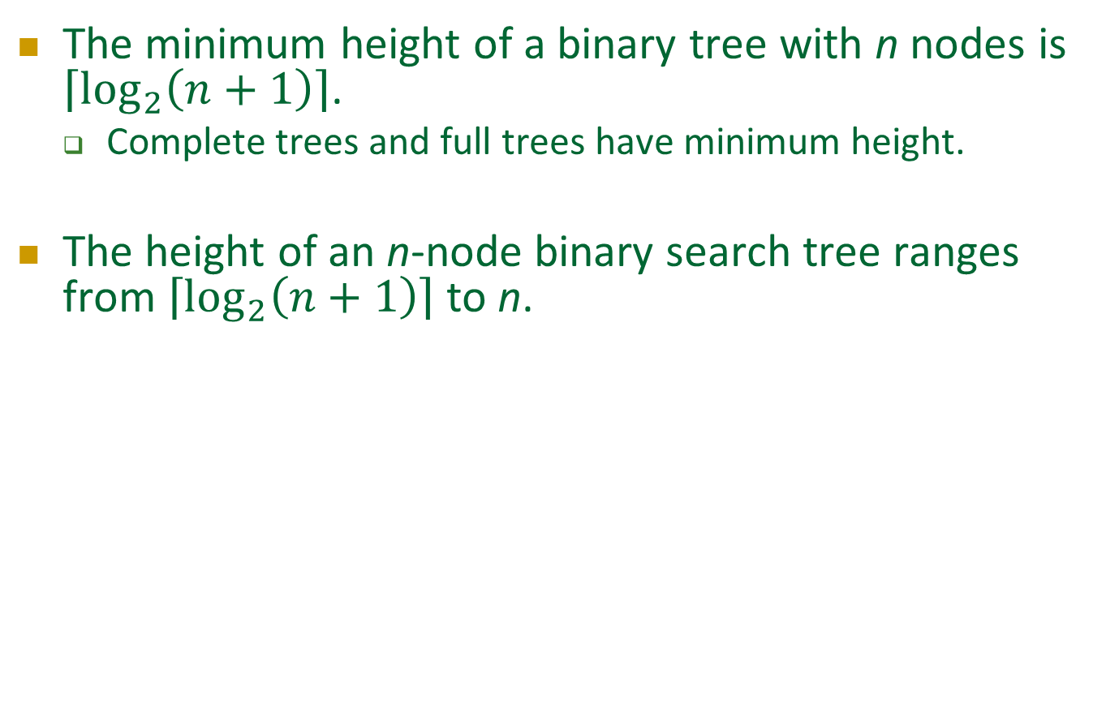
Efficiency of Binary Search Tree Operations (5/7)
The minimum height of a binary tree with n nodes is $\left\lceil \log_{2}\left(n+1\right)\right\rceil$.
  Complete trees and full trees have minimum height.
The height of an n-node binary search tree ranges from $\left\lceil \log_{2}\left(n+1\right)\right\rceil$ to n.

Slide 53
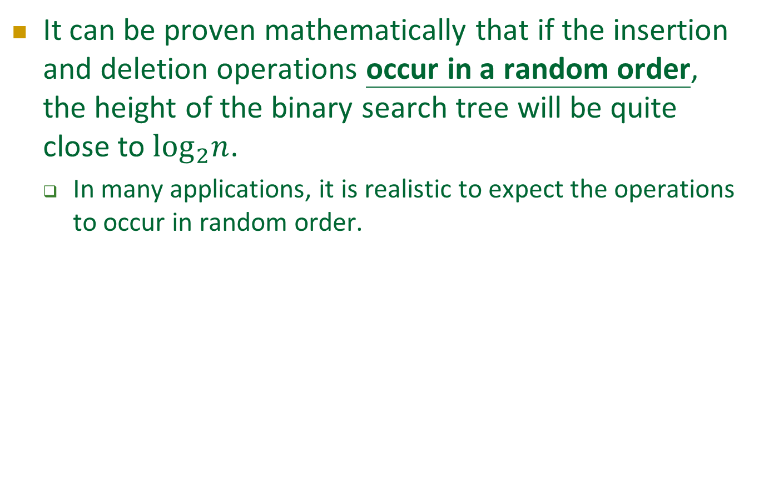
Efficiency of Binary Search Tree Operations (6/7)
It can be proven mathematically that if the insertion and deletion operations occur in a random order, the height of the binary search tree will be quite close to $\log_{2}n$.
  In many applications, it is realistic to expect the operations to occur in random order.

Slide 54
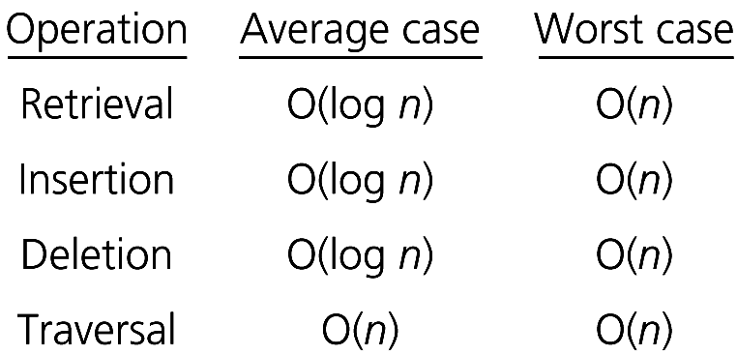
Efficiency of Binary Search Tree Operations (7/7)

