Slide 1
Data Structures TA Session #2
By Carlos and Hung-Chih
2017/10/30

Slide 2
Preface
Few things before we start

Slide 3
When doing you homework
Always write in nice & clear format.
Do forget your student ID and name!
Answer all requirements one by one. Don’t skip them!
Read the problems carefully. Answer what they want! (Not all problems ask you to write code.)

Slide 4
Assignment #3
Average: 67.1

Slide 5
Problem 1
ADT polynomial

Slide 6
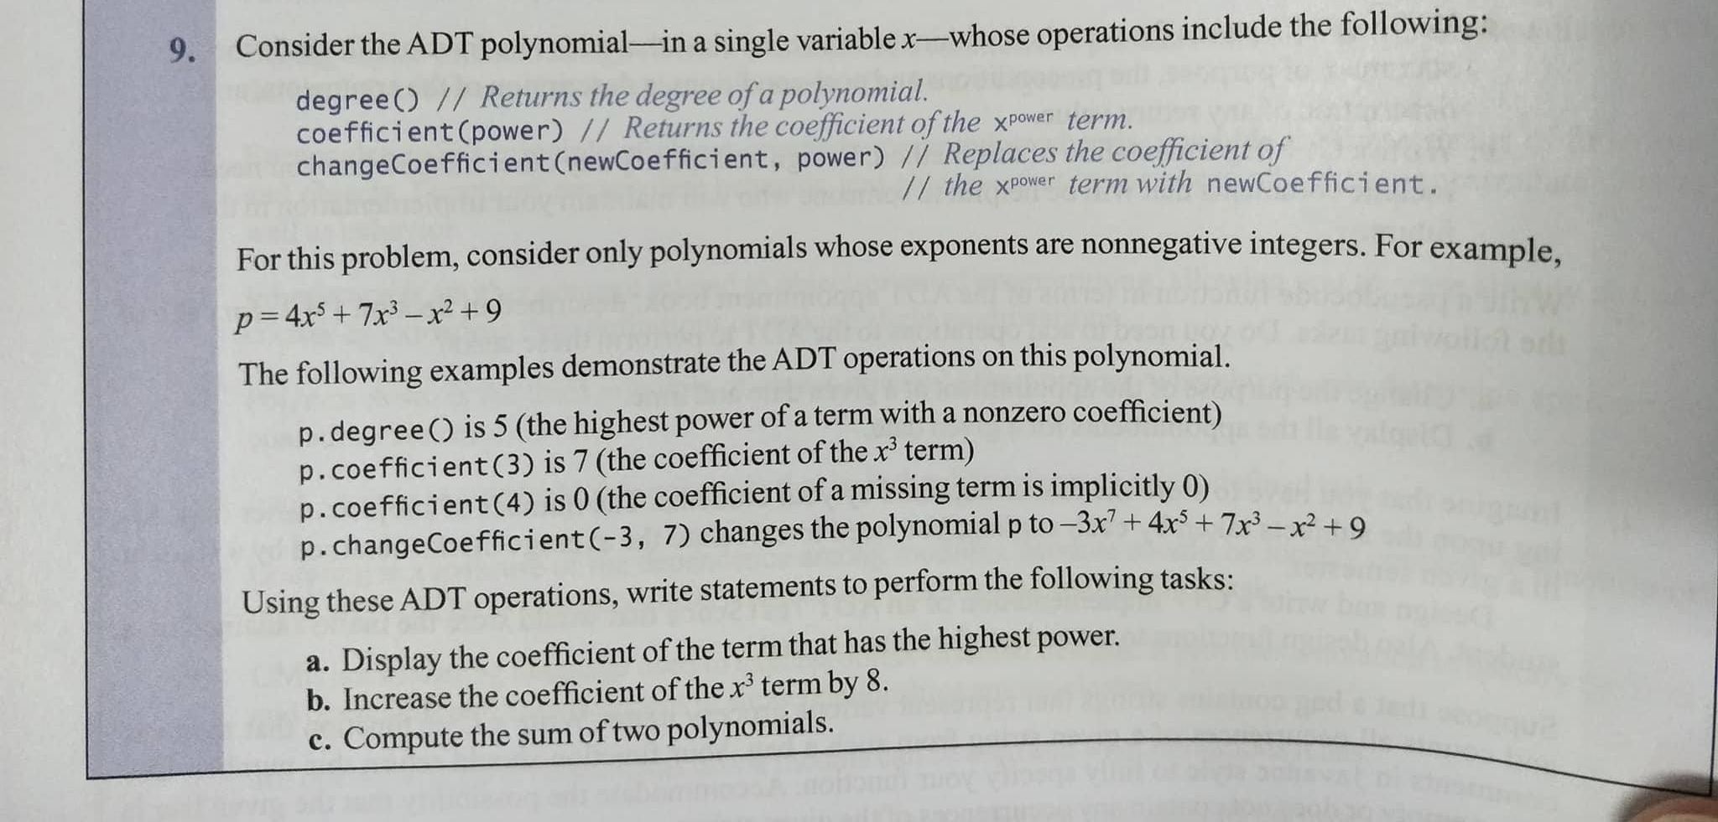
Notes:
沒p. -2

Slide 7
a.
cout << p.coefficient( p.degree() )
b. p.changeCoeffcient(p.cofficient(3)+8,3)
Notes:
4,1
4,1
6,4 邏輯錯全錯

Slide 8
C.
polynomial<double> add( polynomial<double> a, polynomial<double> b)
{
polynomial<double> sum;
int high = max(a.degree(), b.degree());
for(int i = 0; i <= high; i++)
sum.changeCoeffcient
(a.coefficient(i)+b.coefficient(i),i);
return sum;
}

Slide 9
Problem 2
Integer partition

Slide 10
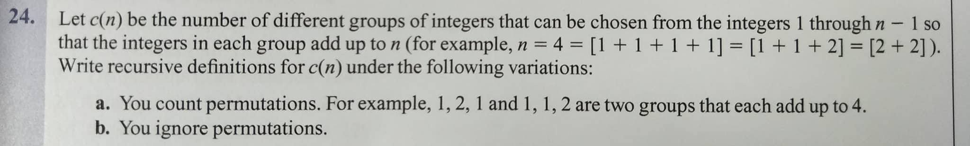
Notes:
a.10
b,10

Slide 11
Exercise 2.24(a)
c(1) = 0
c(2) = 1
c(3) = 3
c(4) = 7
c(5) = 15
C(n) = 0, when n=1
= 1, when n=2
= 2*C(n-1)+1, otherwise

Slide 12
Exercise 2.24(b)
c(1) = 0
c(2) = 1
c(3) = 2
c(4) = 4
c(5) = 6
c(6) = 10
c(7) = 14
c(8) = 21
c(9) = 29
C(n) = b(n,n-1)
b(n, m) = 0, when n<1 or m<1
= 1, when n=1 or m=1
= 1+b(n,n-1), when n=m
= b(n-m, m)+b(n,m-1), otherwise
b( x, y ) means “partition x using numbers no greater than y.”
b(7,3) = (7有3) + b(7,2) = b(4,3) + b(7,2)
3 +
3 +
3 +
.
.
.
3 + 1
2 + 2
2 + 1 + 1
.
.
.
3 + 1
2 + 2
2 + 1 + 1
.
.
.

Slide 13
Exercise 2.24(b)
Some reference for you
OEIS: online encyclopedia of integer sequences
A000041 number of partitions of n
A000065 -1 + number of partitions of n.

Slide 14
Problem 3
ADT inventory

Slide 15
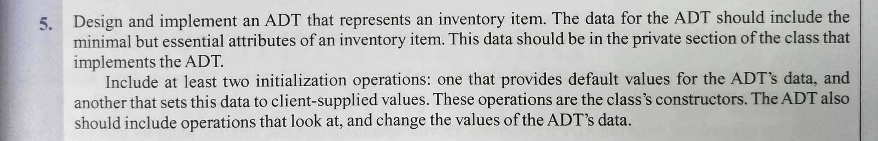
Notes:
Attribute 5
Constructor 7
Getter setter 8

Slide 16
class Inventory {
private:
string name;
int cost, quantity;
public:
Inventory(const string Name, const int Cost,
const int Quantity):name(Name), cost(Cost), quantity(Quantity){}
Inventory():name(“”), cost(0), quantity(0){}

Slide 17
string getName() const {return name;}
void setName(const string val) {name = val;}
int getCost() const {return cost;}
void setCost(const int val) {cost = val;}
int getQuantity() const {return quantity;}
void setQuantity(const int val) {quantity = val;}
}

Slide 18
Problem 4
peek() implementation

Slide 19
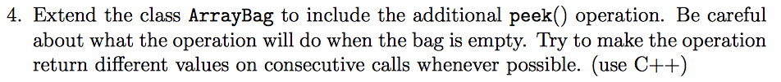
Notes:
5
Different 5
10

Slide 20
The code
string ArrayBag::peek()
{
static int last = -1;
if( isEmpty() )
throw invalid_argument(“The bag is currently empty.”);
if( last == -1 )
return items[ last = 0 ];
int i = rand() % itemCount;
for(i ; i < itemCount; ++i )
if( items[ i ] != items[ last ] )
return items[ last = i ];
return items[ i ];
}

Slide 21
Problem 5
List implement

Slide 22
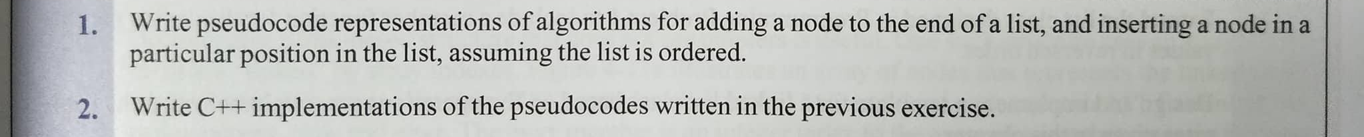

Slide 23
Add at the end
template <class ItemType>
void LinkedBag<ItemType>::addEnd(Node<ItemType>* node)
{
Node<ItemType>* pointer = headPtr;
for(pointer; pointer.getNext() != null; pointer = pointer->getNext()){}
itemCount++;
pointer.setNext(node);
}
Notes:
A, 3 7
B, 3 7

Slide 24
Insert at position
template <class ItemType>
void LinkedBag<ItemType>::insert(Node<ItemType>* node,int position)
{
Node<ItemType>* prev = headPtr;
Node<ItemType>* current = headPtr;
itemCount++;
if(position >= itemCount) {
position = itemCount
return;
}
eles if(position == 1){
node.setNext(headPtr);
headPtr = node;
return;
}
for (int i = 1; i < position; i++)
{
prev = current;
current = current -> getNext();
}
node -> setNext(current);
prev -> setNext(node);
}

Slide 25
Assignment #4
Average:74.5

Slide 26
1. Exercise 4.11

Slide 27
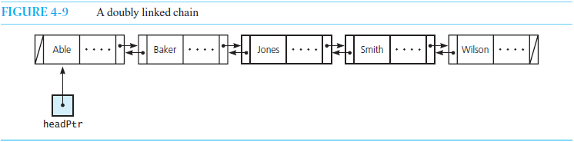
1. Exercise 4.11
List the steps necessary to add a node to the beginning of the doubly linked chain shown in Figure 4-9 .
Construct *newNode
*newNode -> next = *headPtr
*headPtr -> prev = *newNode
*headPtr = *newNode

Slide 28
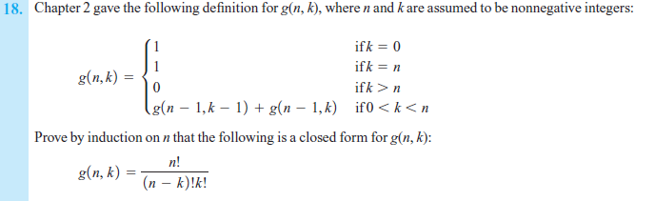
2. Exercise 5.18

Slide 29
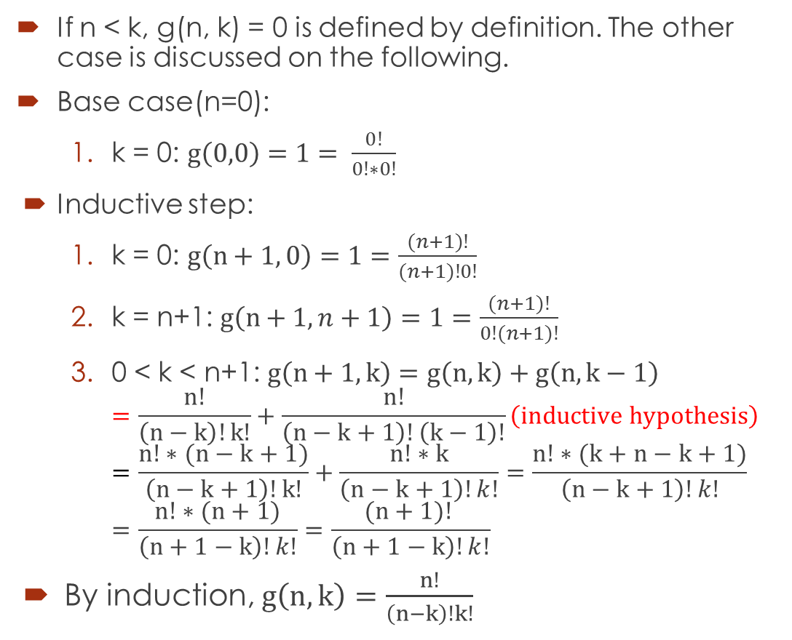
Exercise 5.18
If n < k, g(n, k) = 0 is defined by definition. The other case is discussed on the following.
Base case(n=0):
  k = 0: $g\left(0,0\right)=1= \frac{0!}{0!∗0!}$
Inductive step:
  k = 0: $g\left(n+1, 0\right)=1=\frac{(n+1)!}{(n+1)!0!}$
  k = n+1: $g\left(n+1, n+1\right)=1=\frac{(n+1)!}{0!(n+1)!}$
  0 < k < n+1: $g\left(n+1, k\right)=g\left(n, k\right)+g\left(n, k−1\right)$
  $=\frac{n!}{\left(n−k\right)!k!}+\frac{n!}{\left(n−k+1\right)!\left(k−1\right)!}\left(inductive hypothesis\right)$
  $=\frac{n!∗(n−k+1)}{\left(n−k+1\right)!k!}+\frac{n!∗k}{\left(n−k+1\right)!k!}=\frac{n!∗(k+n−k+1)}{\left(n−k+1\right)!k!}=\frac{n!∗(n+1)}{\left(n+1−k\right)!k!}=\frac{(n+1)! }{\left(n+1−k\right)!k!}$
By induction, $g\left(n, k\right)=\frac{n!}{\left(n−k\right)!k!}$

Slide 30

3. Exercise 6.9(b)(d)

Slide 31
6-9 (b) cbb$bbc
(stack from bottom to top)
Character | Stack contents
c | c
b | c b
b | c b b
$ | c b b
b | c b
b | c
c | ∅
∅ | ∅

Slide 32
6-9 (d) xyyz$zy
(stack from bottom to top)
Character | Stack contents
x | x
y | x y
y | x y y
z | x y y z
$ | x y y z
z | x y y
y | x y
∅ | x y

Slide 33
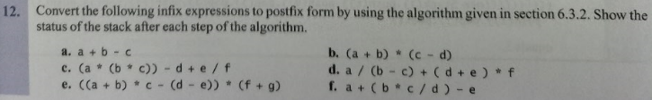
4. Exercise 6.12(b)(c)

Slide 34
6-12 (b) (a+b)*(c-d)
(stack from bottom to top)
Ch | Stack | Postfix
( | ( | ∅
a | ( | a
+ | (+ | a
b | (+ | ab
) | ∅ | ab+
* | * | ab+
Ch | Stack | Postfix
( | *( | ab+
c | *( | ab+c
- | *(- | ab+c
d | *(- | ab+cd
) | ∅ | ab+cd-*

Slide 35
6-12 (c) (a * (b * c)) – d + e / f
(stack from bottom to top)
Ch | Stack | Postfix
( | (
a | ( | a
* | (* | a
( | (*( | a
b | (*( | ab
* | (*(* | ab
c | (*(* | abc
) | (* | abc*
Ch | Stack | Postfix
) | ∅ | abc**
- | - | abc**
d | - | abc**d
+ | + | abc**d-
e | + | abc**d-e
/ | +/ | abc**d-e
f | +/ | abc**d-ef
∅ | ∅ | abc**d-ef/+

Slide 36
5. Exercise 6.15(a)(c)

Slide 37
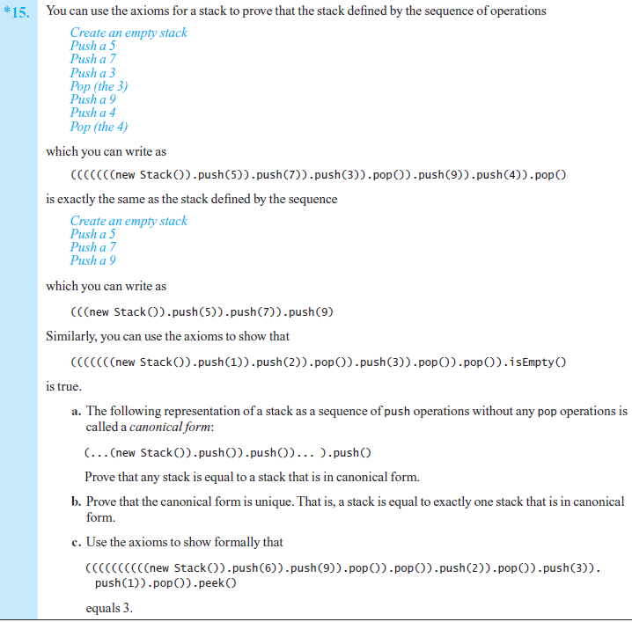

Slide 38
Prove that any stack is equal to a stack that is in canonical form.
Prove by induction on the number of elements in the stack(n).
Base case(n=0): the stack is equal to “new Stack()”, which is canonical form.
Inductive step: a stack has n+1 elements is equal to a stack which has n elements plus push().
From inductive hypothesis, a stack which has n elements is equal to a stack that is in canonical form.
Therefore a stack has n+1 elements is equal to a stack that is in canonical form.(canonical form plus push-operation is still canonical form)
By induction, we prove that any stack is equal to a stack that is in canonical form.

Slide 39
Simplify expression
Axiom1 : (aStack.push(item)).pop() = aStack
Axiom2 : (aStack.push(item)).peek()=item
((((((((((new Stack()).push(6)).push(9)).pop()).pop()).push(2)).pop()).push(3)).push(1)).pop()).peek()
=((((((((new Stack()).push(6)).pop()).push(2)).pop()).push(3)).push(1)).pop()).peek()
=((((((new Stack()).push(2)).pop()).push(3)).push(1)).pop()).peek()
=((((new Stack()).push(3)).push(1)).pop()).peek()
=((new Stack()).push(3)).peek() = 3
Problem assertion is correct.

Slide 40
The end~
Hope you did a good job in this assignment.
By the TAs
2017/10/30

