Slide 1
TA Session #3
Prepared by Carlos and Hung-Chih
2017/11/20

Slide 2
Data Structures Midterm
Avg:70.4
Std:15.3

Slide 3
Problem 3
Adapt Remove function

Slide 4
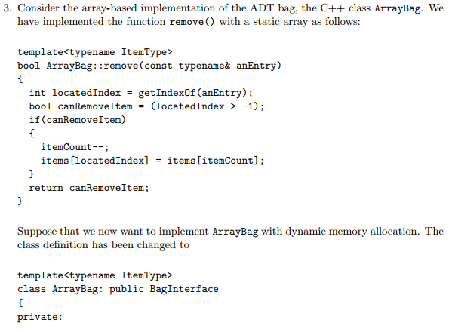
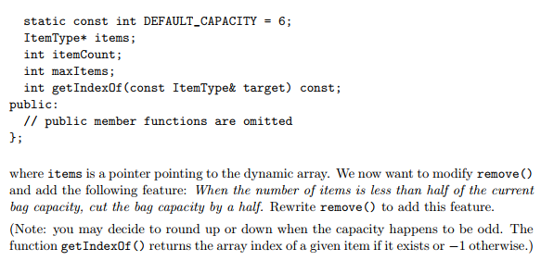

Slide 5
bool ArrayBag::remove( const ItemType& anEntry ) {
    int locatedIndex = getIndexOf( anEntry );
    bool canRemoveItem = ( locatedIndex > -1 );
    if ( canRemoveItem ){
        items[ locatedIndex ] = items[ --itemCount ];
        if ( itemCount <= maxItem / 2 ) {
            ItemType* N = new ItemType[ maxItem /= 2 ];
            copy( items, items + itemCount, N );
            delete[] items;
            items = N;
        }
    }
    return canRemoveItem;
}

Slide 6
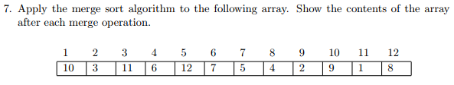
Problem 7
Merge sort

Slide 7
10 | 3 | 11 | 6 | 12 | 7 | 5 | 4 | 2 | 9 | 1 | 8
3 | 10 | 11 | 6 | 12 | 7 | 5 | 4 | 2 | 9 | 1 | 8
3 | 10 | 11 | 6 | 12 | 7 | 5 | 4 | 2 | 9 | 1 | 8
3 | 10 | 11 | 6 | 12 | 7 | 5 | 4 | 2 | 9 | 1 | 8
3 | 10 | 11 | 6 | 7 | 12 | 5 | 4 | 2 | 9 | 1 | 8
3 | 6 | 7 | 10 | 11 | 12 | 5 | 4 | 2 | 9 | 1 | 8
3 | 6 | 7 | 10 | 11 | 12 | 4 | 5 | 2 | 9 | 1 | 8
3 | 6 | 7 | 10 | 11 | 12 | 2 | 4 | 5 | 9 | 1 | 8
3 | 6 | 7 | 10 | 11 | 12 | 2 | 4 | 5 | 1 | 9 | 8
3 | 6 | 7 | 10 | 11 | 12 | 2 | 4 | 5 | 1 | 8 | 9
1 | 2 | 3 | 4 | 5 | 6 | 7 | 8 | 9 | 10 | 11 | 12

Slide 8
Problem 8
Adapt quick sort

Slide 9
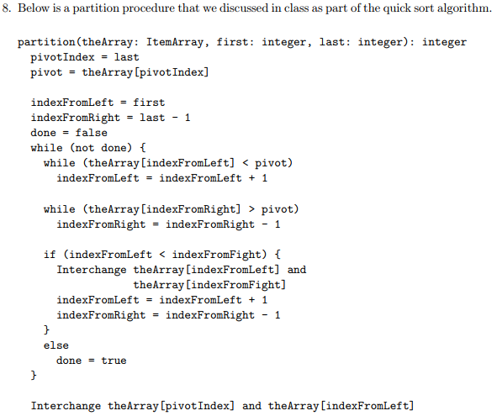
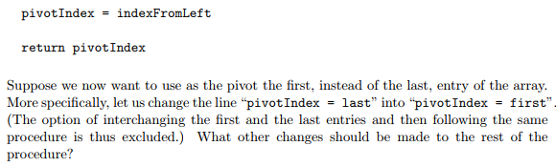

Slide 10
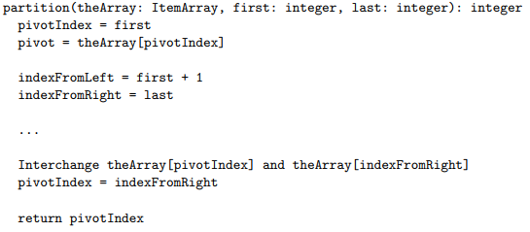
Solution

Slide 11
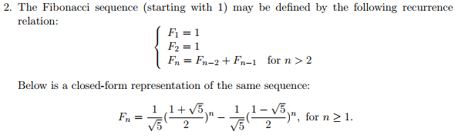
Problem 2
Induction

Slide 12
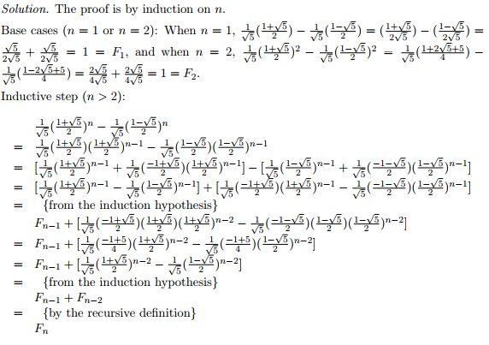
Solution

Slide 13
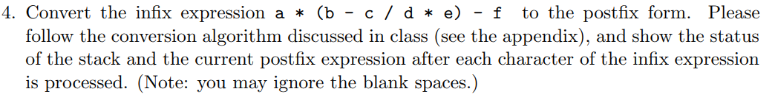
Problem 4
Infix to postfix

Slide 14
a * ( b - c / d * e ) - f
(stack from bottom to top)
Ch | Stack | Postfix
a | Ø | a
* | * | a
( | *( | a
b | *( | ab
- | *(- | ab
c | *(- | abc
/ | *(-/ | abc
Ch | Stack | Postfix
d | *(-/ | abcd
* | *(-* | abcd/
e | *(-* | abcd/e
) | * | abcd/e*-
- | - | abcd/e*-*
f | - | abcd/e*-*f
Ø | Ø | abcd/e*-*f-

Slide 15
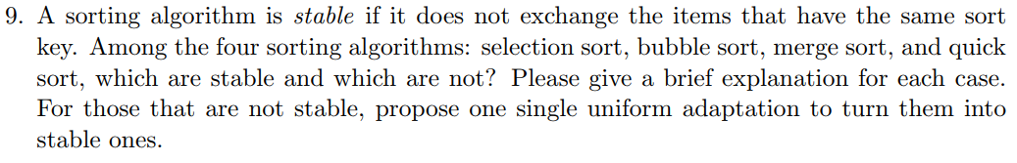
Problem 9
Stable or unstable
Based on the algorithm on the slides

Slide 16
Selection Sort
for (int currentIndex = 1; currentIndex < size;
currentIndex++) {
// At this point, theArray[indexSoFar] >= all entries in
// theArray[0..currentIndex - 1]
if (theArray[currentIndex] > theArray[indexSoFar])
indexSoFar = currentIndex;
} // end for
Find the first largest index from the left => move it to the right side of array
Unstable

Slide 17
Bubble Sort
if (theArray[index] > theArray[nextIndex]) {
// Exchange entries
std::swap(theArray[index], theArray[nextIndex]);
sorted = false;
// Signal exchange
} // end if
When two entries are equal => no swap.
Stable

Slide 18
Merge Sort
if (theArray[first1] <= theArray[first2])
tempArray[index++] = theArray[first1++];
else
tempArray[index++] = theArray[first2++];
When the element in first subarray is equal to the element in second subarray => pick the former
Stable

Slide 19
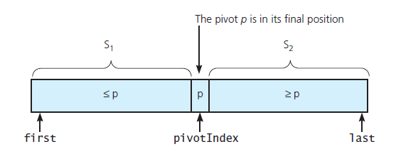
Quick sort
pivotIndex = last(choose the last one as pivot)
Swap step makes quick sort be unstable as well.
Unstable

Slide 20
Single uniform adaption
Record the original index of every elements.
Compare the sort key first.
If the keys are the same, compare the original index.
if ((Array[index1] > Array[index2]) || ((Array[index1] = Array[index2]) && (oriIndex1 > oriIndex2)) )
{
//operation of changing order
}

Slide 21
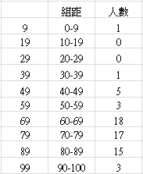
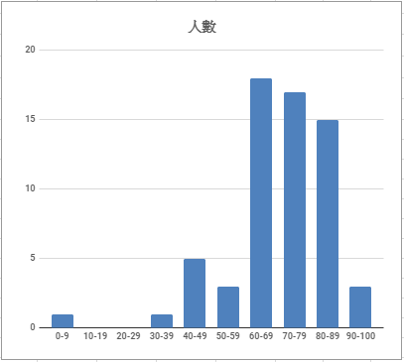

Slide 22
About Homework 5 & 10

Slide 23
Notes
Name of file.
Form of zip file.
Upload executable file if you use the development software which produces not only code file.
Comment must be in the code file.
Because of encoding , English comment is better.

