Slide 1
推薦系統研究分享
陳建錦
國立臺灣大學
資訊管理學系

Slide 2
Recommendation System Research What/Why/How
What?
  To suggest items relevant to user interests!!
Why?
  The Internet now provides a great number of e-services that facilitate various activities.
    For instance, Netflix, one of the most popular online streaming media, currently offers more than 1,455 TV shows and 2,769 movies.
  Individuals are often overwhelmed by too many items.
How?
  Recommendation systems analyze user behavior (e.g., the ratings of items made by users) to acquire user preferences.
  Then suggest items relevant to the preferences.

Slide 3
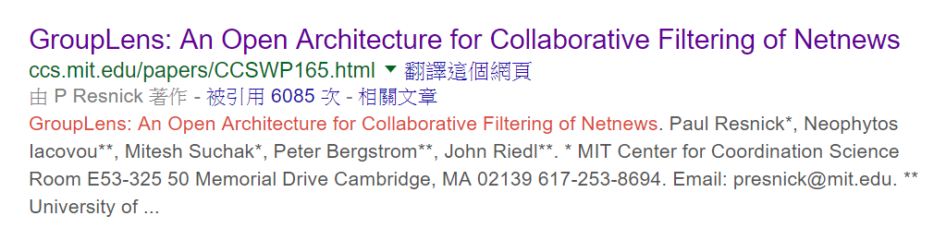
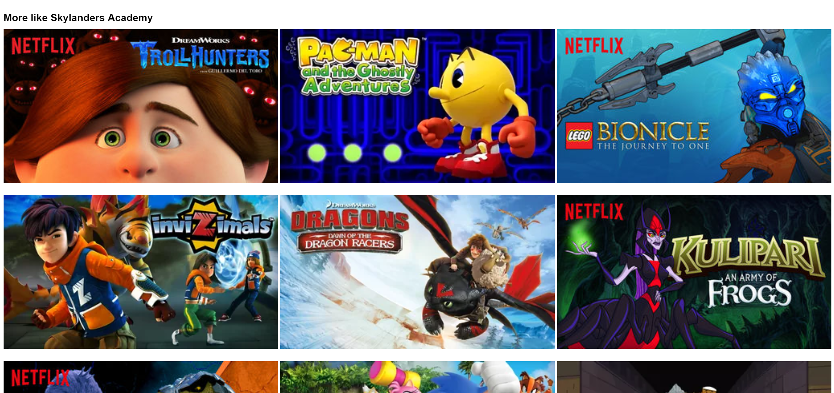

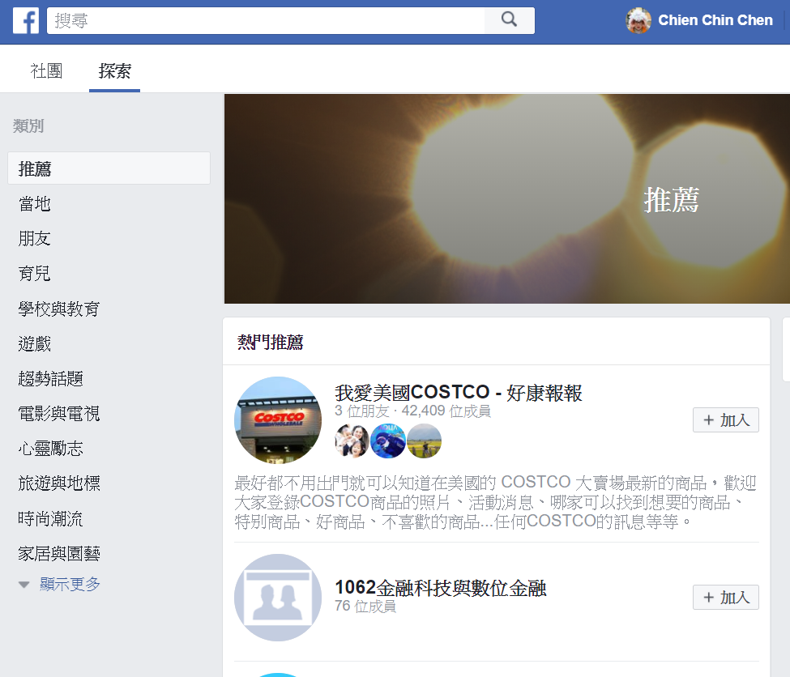
Something about Recommendation Systems (1/2)
It is not a new problem~~
And is everywhere…
published in 1994!!

Slide 4
Something about Recommendation Systems (2/2)
But … new data mining techniques would help develop effective recommendation methods!!
In this presentation:
  We first introduce well-known recommendation methods.
  Then, talk about some recommendation works we have investigated.

Slide 5



Well-known Recommendation Methods (1/8)
Collaborative Filtering (CF)
  Like-minded people prefer similar items.
  The method first identifies a set of reference users whose preferences are similar to those of a target user.
  Then, items that interest the reference users are recommended to the target user.
target user
reference users

Slide 6
Well-known Recommendation Methods (2/8)
But … how to identify the reference users?
  Based on user behavior data (e.g., ratings or purchase records).
  Correlation coefficient, cosine similarity, or Jaccard coefficient.
target user
…
item₁
5
2
2
…
?
2
?
?
4
…
2
?
4
2
1
…
5
1
2
4
?
…
3
3
item₂
…
item₃
Item_{n-1}
item_{n}

Slide 7
Well-known Recommendation Methods (3/8)
A major concern of the CF method – sparsity of the behavior data.
  E-services generally provide thousands of items!!
  Users only rated, browsed, or bought a small portion of them.
The data are too sparse to identify representative reference user.
  Deteriorate the performance of CF-based methods.

Slide 8






Well-known Recommendation Methods (4/8)
To remedy the problem, model-based methods derive users’ implicit preferences (latent topics) from the behavior data.
Latent
Topic 1
4.2
1.6
…
3.1
1
4
4
…
2
3
…
…
Latent
Topic 10
latent
preference
vector
behavior
vector

Slide 9
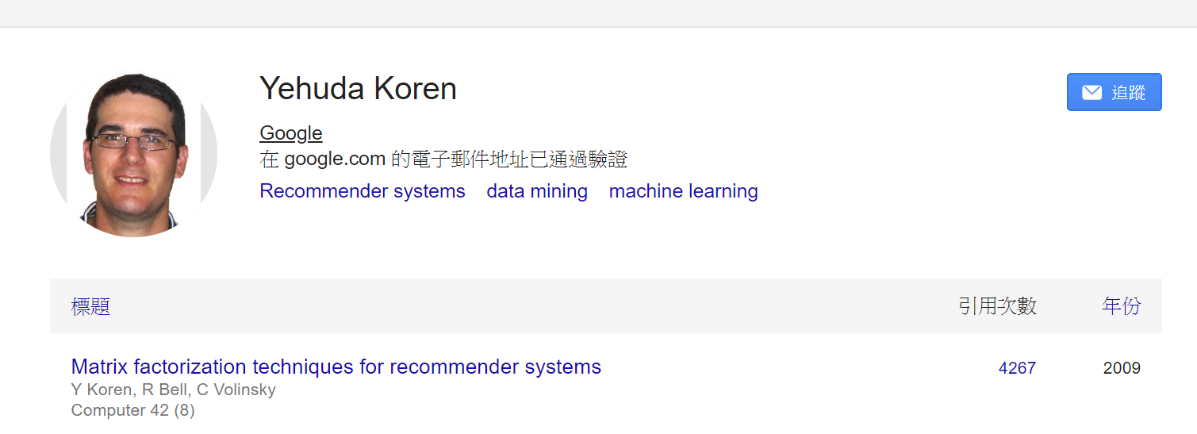
Well-known Recommendation Methods (5/8)
Different approaches were developed to obtain the latent preference vectors.
The matrix factorization method (and its variants) has become a major recommendation method due to its superior performance.
  It won $1 million Netflix context prize in 2009.
Y. Koren, R. Bell, C. Volinsky, Matrix factorization techniques for recommender systems, Computer, 42(8) (2009) 30-37.

Slide 10

Well-known Recommendation Methods (6/8)
user₁
user₂
user_{N-1}
user_{N}
topic₁
topic₁₀
item₁
5 | 2 | … | ? | 3
? | ? | … | 5 | ?
… | … | … | … | …
1 | ? | … | 3 | ?
? | 2 | … | ? | 4
item₁
user₁
user₂
user_{N-1}
user_{N}
3.1 | … | 4.7
4.6 | … | 1.2
… | … | …
0.7 | … | 3.4
5.1 | … | 1.8
item₂
item₂
topic₁
1.4 | 2.7 | … | 3.3 | 4.7
… | … | … | … | …
2.8 | 0.6 | … | 3.1 | 1.6
$$≈$$
item_{M-1}
topic₁₀
item_{M-1}
item_{M}
item_{M}
R
Q^{T}
latent
topic
vector
P

Slide 11
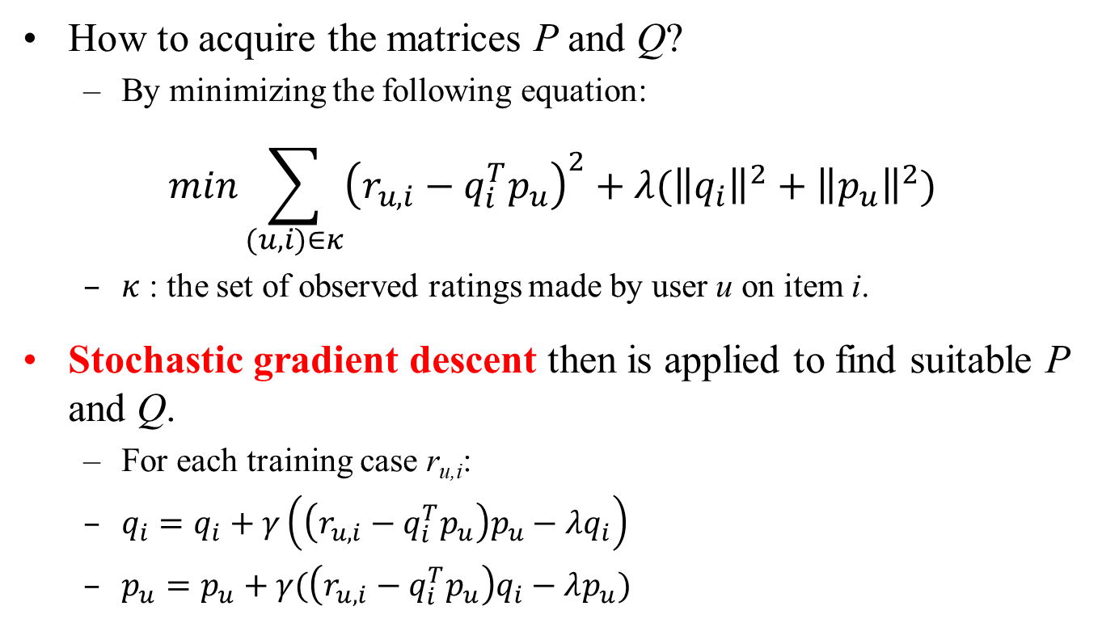
Well-known Recommendation Methods (7/8)
How to acquire the matrices P and Q?
  By minimizing the following equation:
$$min\sum_{(u,i)∈κ}{{\left(r_{u,i}−q_{i}^{T}p_{u}\right)}^{2}+λ({\left\|q_{i}\right\|}^{2}+{\left\|p_{u}\right\|}^{2})}$$
  $κ$ : the set of observed ratings made by user u on item i.
Stochastic gradient descent then is applied to find suitable P and Q.
  For each training case r_{u,i}:
  $q_{i}=q_{i}+γ\left(\left(r_{u,i}−q_{i}^{T}p_{u}\right)p_{u}−λq_{i}\right)$
  $p_{u}=p_{u}+γ(\left(r_{u,i}−q_{i}^{T}p_{u}\right)q_{i}−λp_{u})$

Slide 12
Well-known Recommendation Methods (8/8)
Once we have P and Q (the latent topic vector of each user/item), we can either:
  Recommend items whose topic vectors are similar to that of the target user.
  Find a set of reference users to generate item recommendations.

Slide 13
What We Did on Recommendation Systems
New user cold start problem
  Chien Chin Chen, Yu-Hao Wan, Meng-Chieh Chung, and Yu-Chun Sun, "An Effective Recommendation Method for Cold Start New Users Using Trust and Distrust Networks," Information Sciences, Vol. 224, No. 1, 19-36, 2013.
Social event recommendation
  Chien Chin Chen and Yu-Chun Sun, "Exploring Acquaintances of Social Network Site Users for Effective Social Event Recommendations," Information Processing Letters, Vol. 116, issue 3, 227-235, 2016.
Informative friend recommendation
  Chien Chin Chen, Shun-Yuan Shih, and Meng Lee, "Who Should You Follow? Combining Learning to Rank with Social Influence for Informative Friend Recommendation," Decision Support Systems, Volume 90, Pages 33–45, 2016.
Graphical model-based recommendation
  Fang-Yu Lin, Ming-Chen Wu, and Chien Chin Chen, "Incorporating Pairwise Learning into Latent Dirichlet Allocation for Effective Item Recommendations," accepted by The 22nd Pacific Asia Conference on Information Systems (PACIS 2018)

Slide 14
New User Cold Start Problem (1/7)
Recommendation systems usually have limited information about newcomers.
  E.g., only a few ratings or purchase records.
Therefore have difficulty providing appropriate recommendations.
Providing appropriate item recommendations for newcomers is important!!
  To create a sense of belonging and loyalty!!
  To encourage them to re-visit e-services!!

Slide 15
New User Cold Start Problem (2/7)
Some works enhanced similarity measure of users to identify representative reference users.
  E.g., to consider popularity of items.
Number of recent studies exploited social relations between users to identify reference users.
However, these approaches cannot get rid of the new user cold start phenomenon.
  The friend/trust list of a newcomers is still too short to help generate appropriate recommendations.

Slide 16
New User Cold Start Problem (3/7)
We analyze the web of trust of experienced users to identify trustworthy users.
The preferences of the trustworthy users are aggregated to recommend useful items for cold start new users.

Slide 17




New User Cold Start Problem (4/7)
We first cluster experienced users into K clusters.
Each cluster comprises users with similar item ratings.
  The similarity is based on correlation coefficient.
Clusters are with different rating behavior, so the clusters would represent different tastes of items.
…

Slide 18
New User Cold Start Problem (5/7)
Next, we would like to identify trustworthy users within each cluster!!
  We construct a web of trust for each cluster.
  Then, the well-known PageRank algorithm is employed to determine the most important nodes in the network.

Slide 19
New User Cold Start Problem (6/7)
Finally, to recommend items to a cold start new user:
  We first identify the clusters closely related to the items rated (bought) by the user.
  Then, the experts of the clusters are treated as reference users to generate item recommendations.

Slide 20
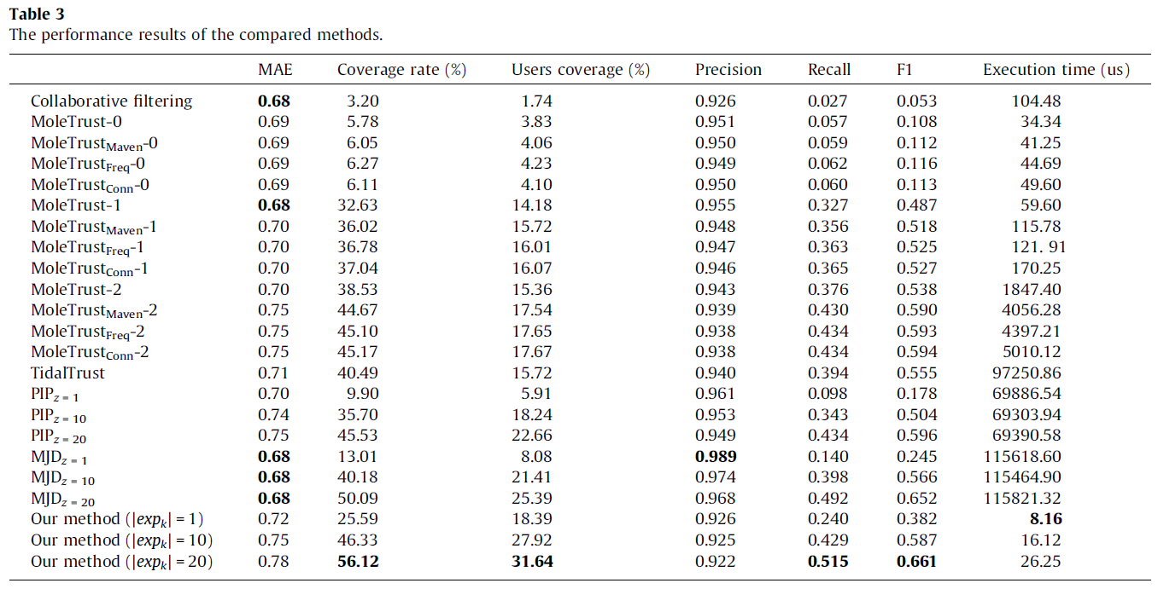
New User Cold Start Problem (7/7)
The Epinions dataset has 132,000 users, and contains 1560,144 reviews and 13,668,319 review ratings.
  71,073 were deemed cold start new users as each one had rated less than five items.

Slide 21
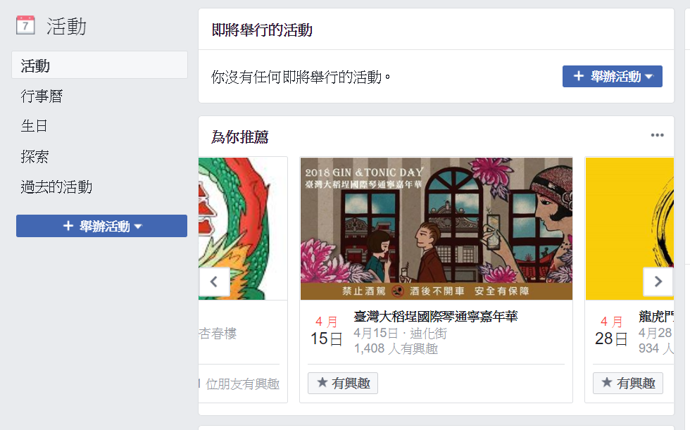
Social Event Recommendation (1/7)
Many social network sites (SNSs) now provide functions that enable users to create or attend a social event.
More than 550 million users use Facebook Events each month!!
  https://newsroom.fb.com/Products/

Slide 22
Social Event Recommendation (2/7)
Users often have difficulty finding social events of interest.
It is therefore essential for service providers to provide users with appropriate social event recommendations.
However … the social event recommendation is different from the traditional recommendation for movies or products.
Social events are one-and-only items.
  Recommending a finished event is meaningless.
  Ratings are generally available when an event is over.

Slide 23
Social Event Recommendation (3/7)
A social event that attracts many of the user’s acquaintances is recommended if its topic (content) is relevant to the user’s preferences.
So, our first step is to identify the acquaintances of a user.
However … social network users may not be are willing to disclose their friend lists due to privacy concerns.
  Or … the friend list may not reflect their real social relationships for some reason.

Slide 24
Social Event Recommendation (4/7)
SNS users who frequently attend social events together would likely prefer similar upcoming social events.
Intuitively, we can use the Jaccard coefficient to measure the friendship of two users u_{m} and u_{n}.
  The degree of overlap between the social events attended by the users.
However … new social events constantly pop up on SNSs … users only attend a few of them.
We thus extend the Jaccard coefficient by considering the textual content of social events.

Slide 25
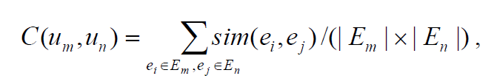
Social Event Recommendation (5/7)
We define the collaborative friendship between u_{m} and u_{n} as follows:
  where sim(e_{i},e_{j}) returns the content similarity between events e_{i} and e_{j}.
  Different approaches to measure the similarity - bag-of-word model or latent topic model.
To identify the acquaintances of u_{m}, we rank all users based on the friendship.
  the top H users are selected as the acquaintances of u_{m}.

Slide 26
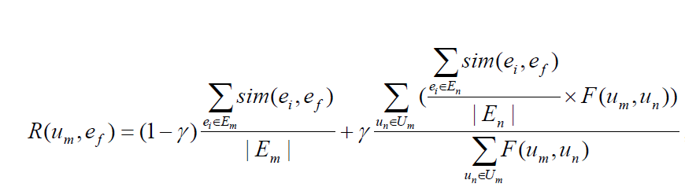
Social Event Recommendation (6/7)
Event recommendation:
  We compute a recommendation score of an upcoming social event e_{f} for a target user u_{m} as follows:
u_{m} likes it or not
The acquaintances of u_{m} like it or not

Slide 27
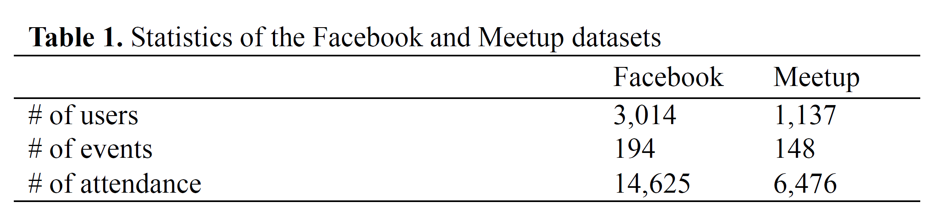
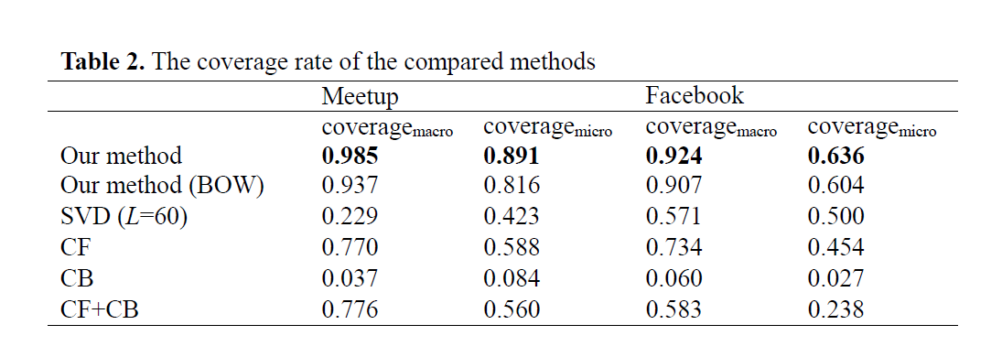
Social Event Recommendation (7/7)

Slide 28
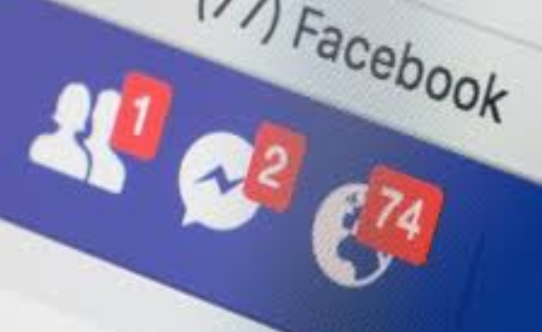
Informative Friend Recommendation (1/5)
Why do we make friends on social network sites?
  Probably because we want to share/receive information (updates) with/from others.
  Updates: posts, photos, or videos.
The updates shared by friends form social update streams which enable social network users to get information.
However … when the quantity of friends reaches a fairly high level, users can be overwhelmed by the amount of fresh social updates.

Slide 29
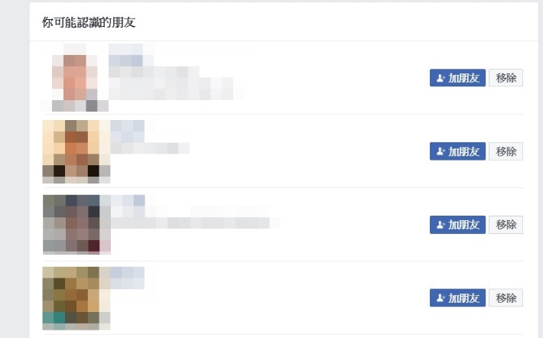
Informative Friend Recommendation (2/5)
A great proportion of friend recommendation methods analyze social network structures to recommend friends to users.
  Friends of friends.
Here, we try to recommend informative friends.
  An informative friend is a friend whose posted updates are relevant to the preferences of the target user.

Slide 30

Informative Friend Recommendation (3/5)
We establish a update-user matrix in terms of users’ feedbacks on updates.
Instead of factorizing the matrix, we incorporated the concept of learning to rank into matrix factorization for preference learning.
user₁
user₂
user_{N-1}
user_{N}
update₁
1 | 1 | … | ? | ?
0 | ? | … | 1 | 0
… | … | … | … | …
1 | 0 | … | 1 | ?
0 | 1 | … | 0 | 1
topic₁
topic₁₀
user_{N-1}
user_{N}
update₁
user₁
user₂
update₂
3.1 | … | 4.7
4.6 | … | 1.2
… | … | …
0.7 | … | 3.4
5.1 | … | 1.8
topic₁
1.4 | 2.7 | … | 3.3 | 4.7
… | … | … | … | …
2.8 | 0.6 | … | 3.1 | 1.6
$$≈$$
update₂
update_{M-1}
update_{M-1}
topic₁₀
update_{M}
update_{M}

Slide 31
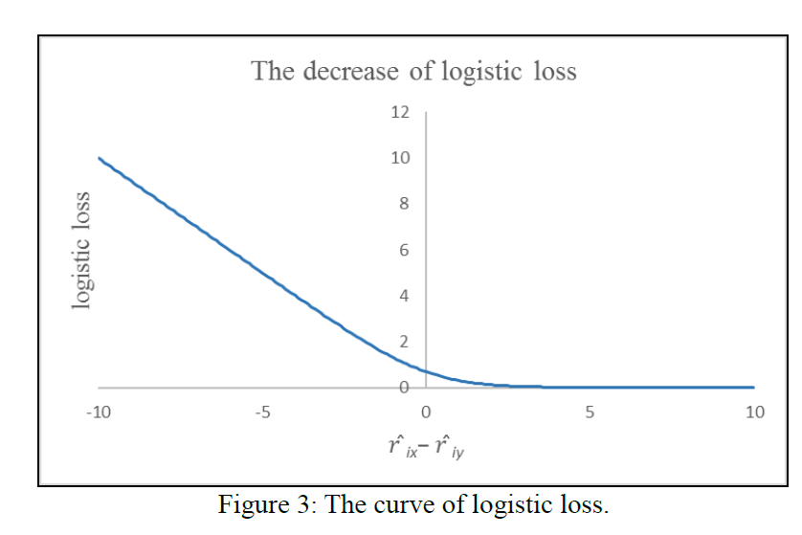
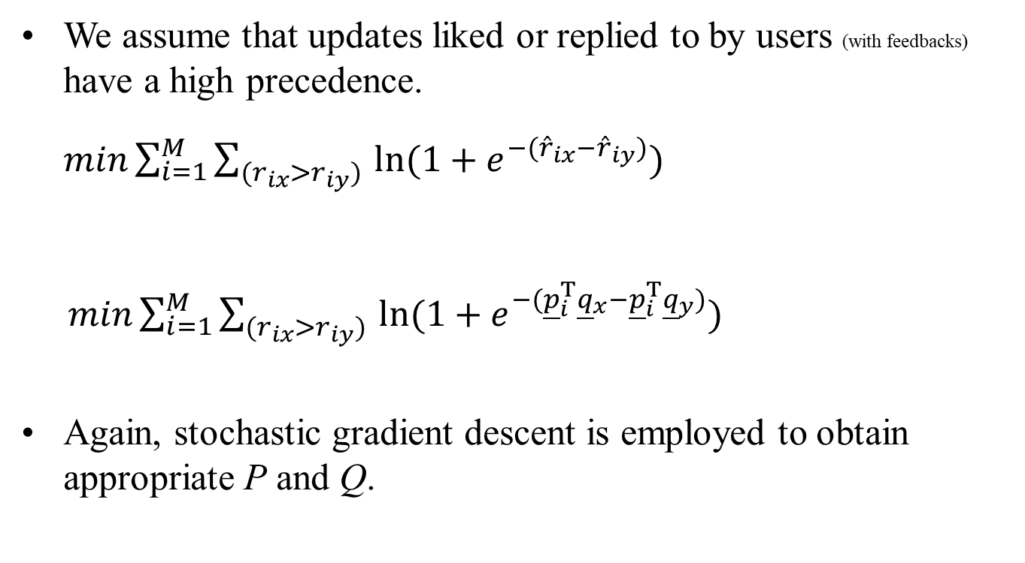
Informative Friend Recommendation (4/5)
We assume that updates liked or replied to by users (with feedbacks) have a high precedence.
$min\sum_{i=1}^{M}{{\sum_{(r_{ix}>r_{iy}) }{ln⁡(1+e^{−({\hat{r}}_{ix}−{\hat{r}}_{iy})})}}^{}}$
$min\sum_{i=1}^{M}{{\sum_{(r_{ix}>r_{iy}) }{ln⁡(1+e^{−({\underline{p}}_{i}^{T}{\underline{q}}_{x}−{\underline{p}}_{i}^{T}{\underline{q}}_{y})})}}^{}}$
Again, stochastic gradient descent is employed to obtain appropriate P and Q.

Slide 32
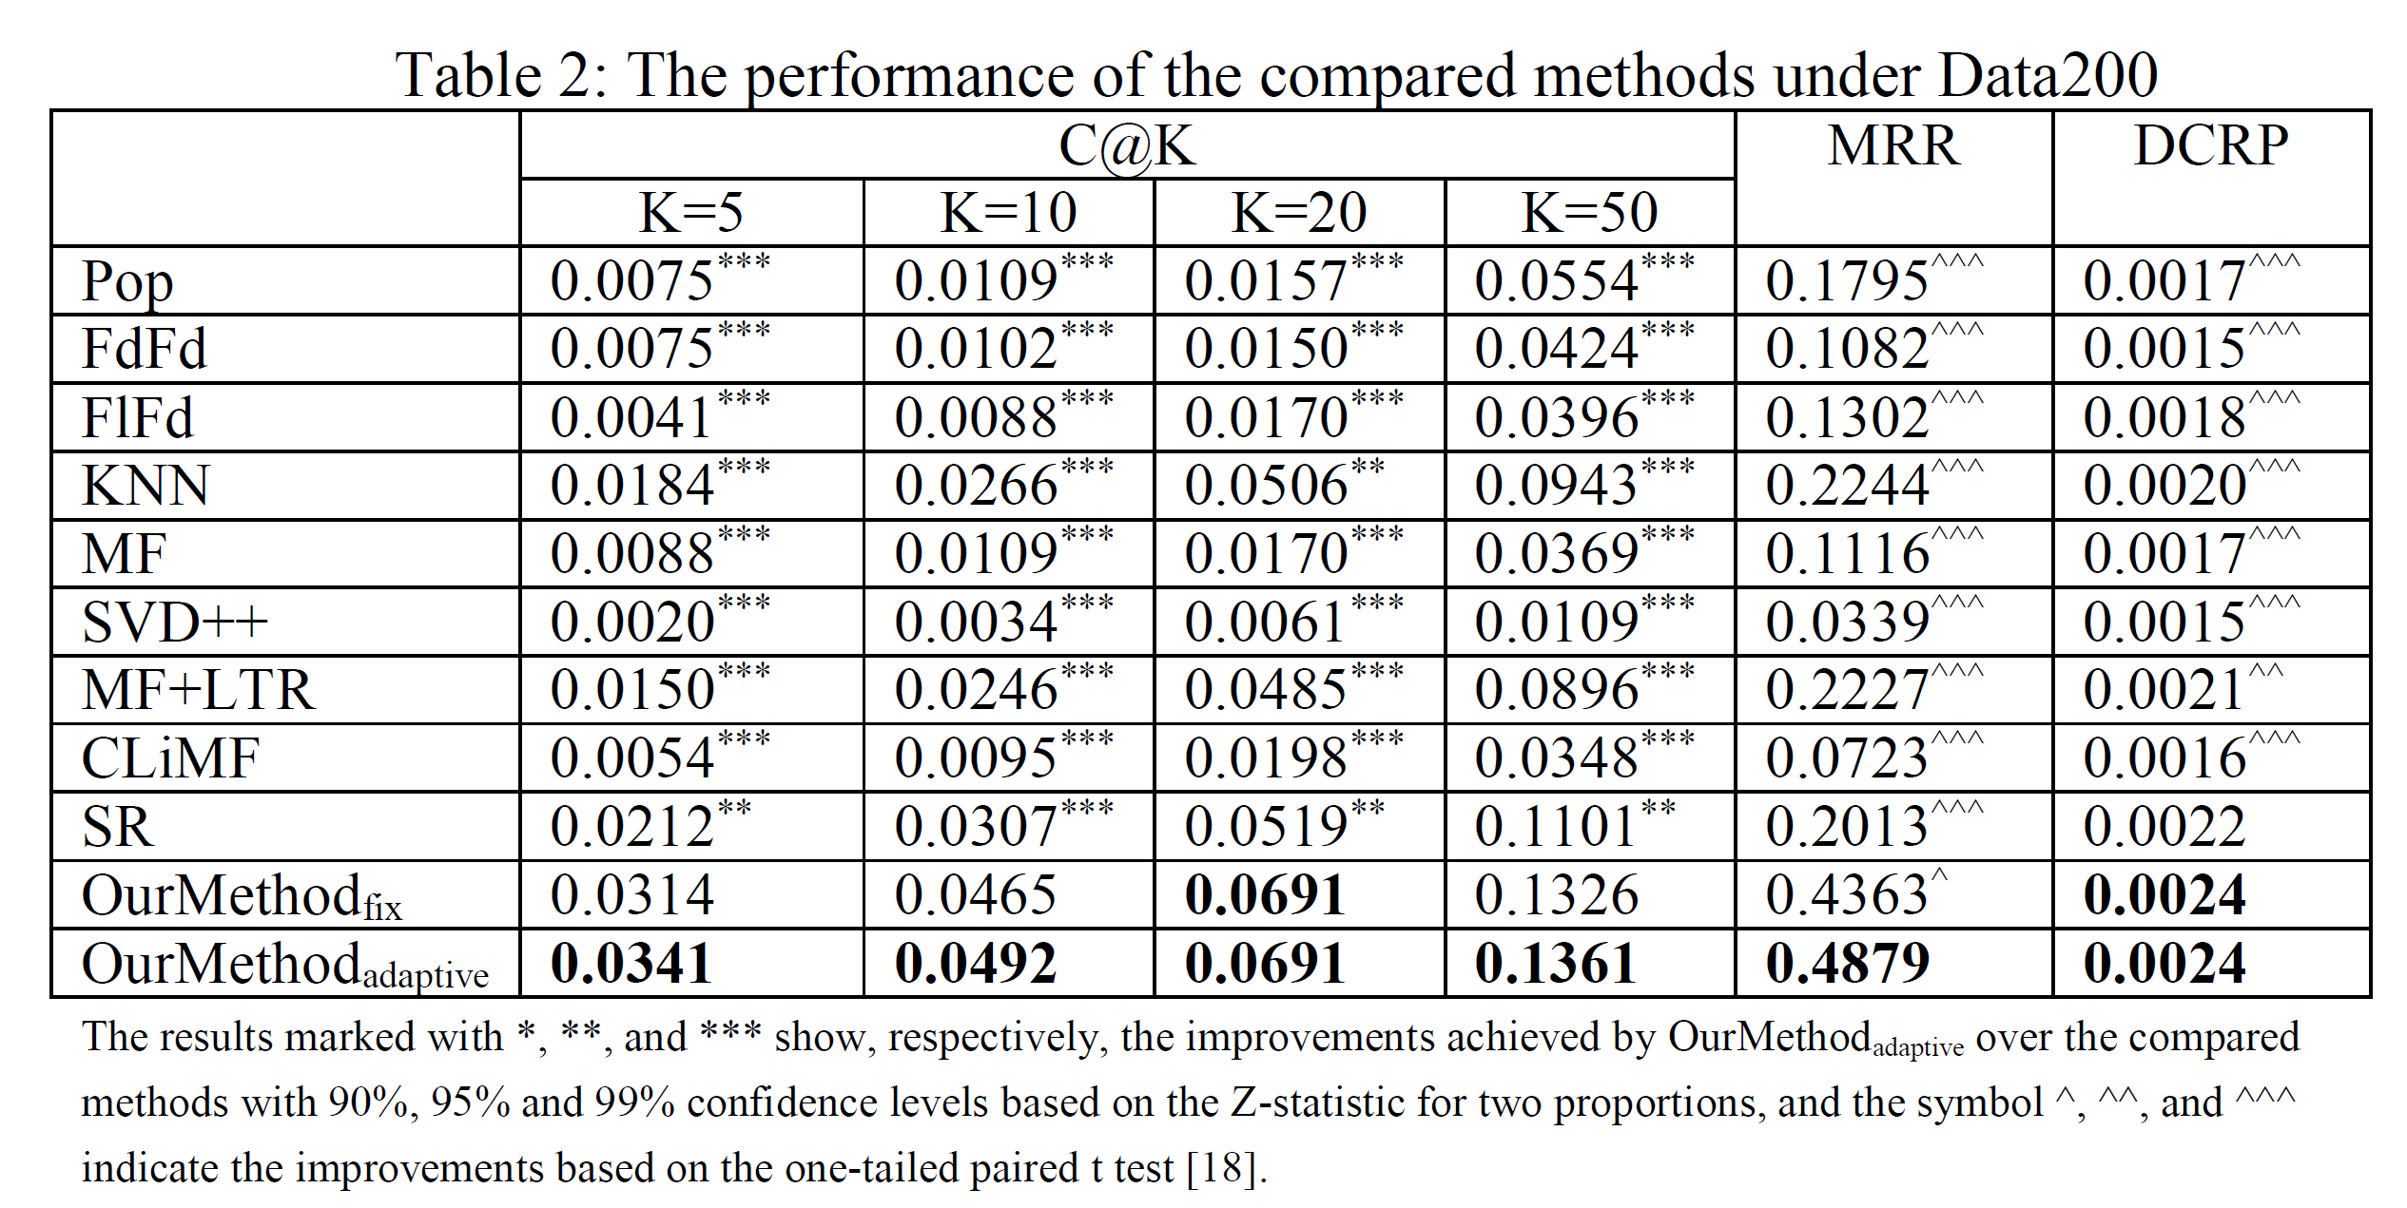
Informative Friend Recommendation (5/5)
Last, informative friends are recommended if the preferences of the updates (q) that they share are highly associated with the preferences of a target user (p).

Slide 33
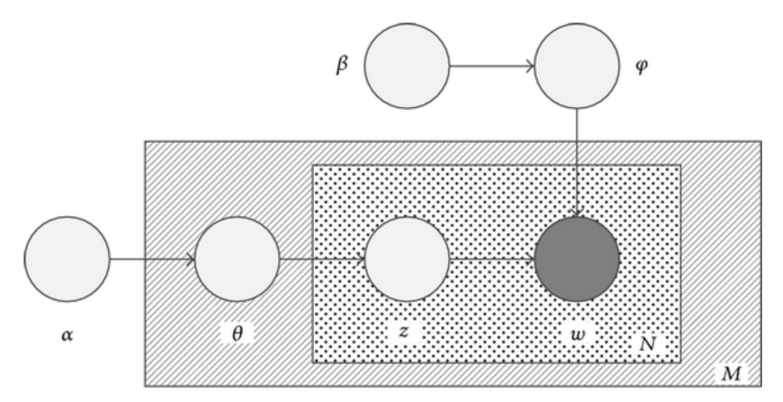
Graphical Model-based Recommendation (1/5)
Latent Dirichlet Allocation (LDA), a well-known graphical model, has been successfully applied to text corpora to discover topics of documents.
  It is a probabilistic generative model that associates the occurrence of a term with a document by means of a set of latent topics.
Given a document corpus, LDA tries to find 𝜃 and 𝜑 that explain the occurrences of terms in the documents.
  𝜃: The topic distribution of a document.
    𝜃^{d}_{z} = P(z|d), the probability that
    document d belongs to topic z.
  𝜑: The term distribution of a topic.
    𝜑^{z}_{w} = P(w|z), the probability of
    seeing (using) word w under z.
documents
terms

Slide 34


Graphical Model-based Recommendation (2/5)
What if … we consider documents as users and terms as items?
  By applying LDA to a set of purchase records or ratings, we may derive the latent preferences of users (i.e., 𝜃) !!
  Then, item recommendations based on theoretical graphical models could be computed!!
It is so sad that some researchers realized the ideal in 2014.
  WenBo Xie, Qiang Dong, and Hui Gao, “A Probabilistic Recommendation Method Inspired by Latent Dirichelt Allocation Model,” Mathematical Problems in Engineering, Volume 2014, Article ID 979147.

Slide 35
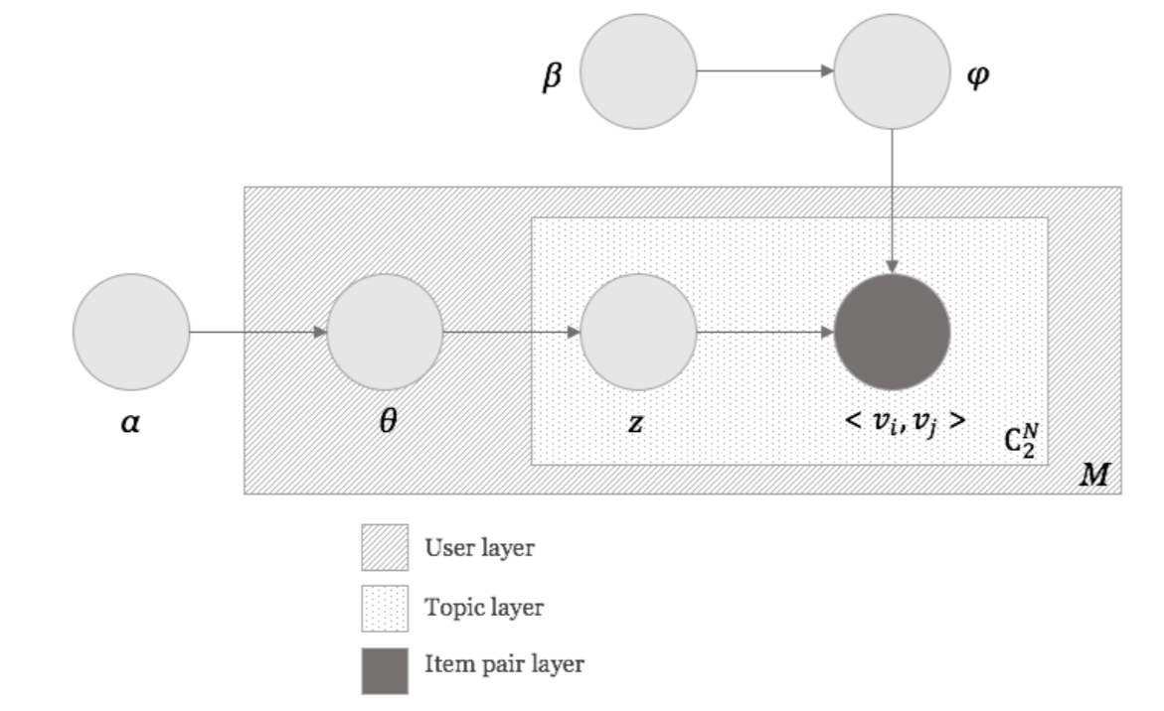


Graphical Model-based Recommendation (3/5)
What about combining pairwise learning with LDA?
  To learn user preferences according to their precedence over items.
  Some users (覺青 maybe) would prefer to watch the documentary “An Inconvenient Truth” instead of the action movie “Transformers.”
We denote <v_{i}, v_{j}> as an item precedence pair that v_{i} is preferable to v_{j}.
< , >

Slide 36
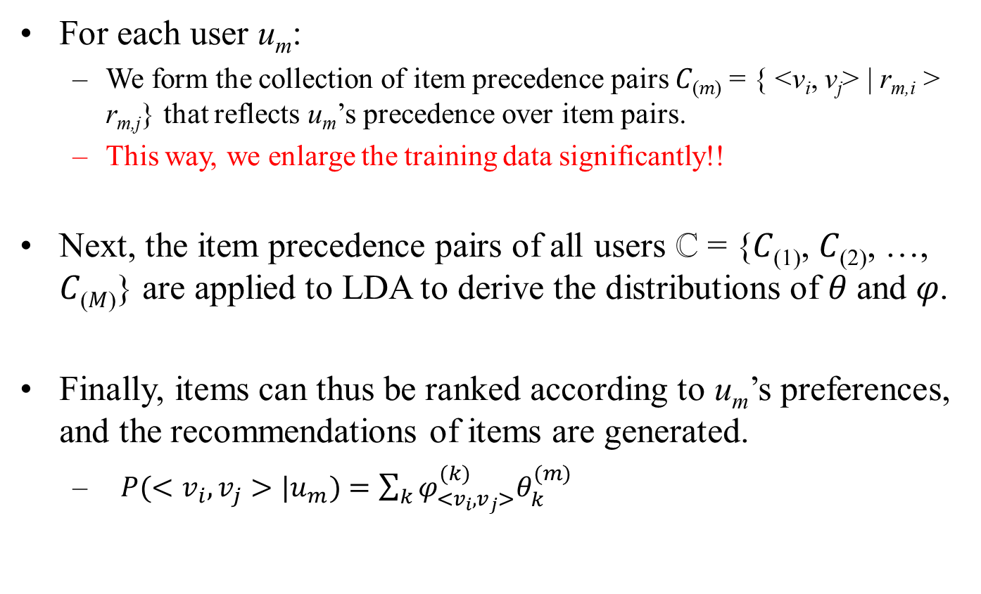
Graphical Model-based Recommendation (4/5)
For each user u_{m}:
  We form the collection of item precedence pairs 𝐶_{(𝑚)} = { <v_{i}, v_{j}> | r_{m,i} > r_{m,j}} that reflects u_{m}’s precedence over item pairs.
  This way, we enlarge the training data significantly!!
Next, the item precedence pairs of all users ℂ = {𝐶₍₁₎, 𝐶₍₂₎, …, 𝐶_{(𝑀)}} are applied to LDA to derive the distributions of 𝜃 and 𝜑.
Finally, items can thus be ranked according to u_{m}’s preferences, and the recommendations of items are generated.
  $P(<v_{i},v_{j}>|u_{m})=\sum_{k}{φ_{<v_{i},v_{j}>}^{(k)}θ_{k}^{(m)}}$

Slide 37
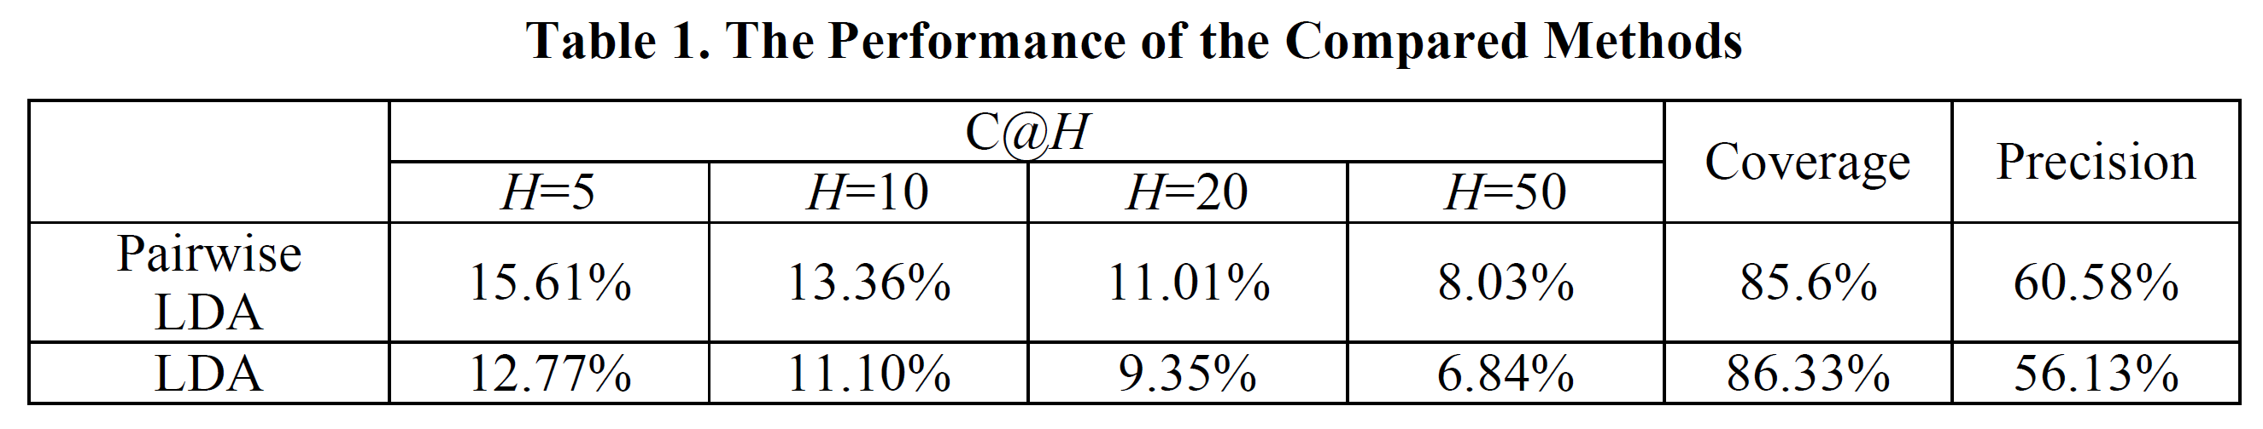
Graphical Model-based Recommendation (5/5)
We conducted experiments using the MovieLens dataset which consists of 100,004 ratings made by 671 users across 9,125 movies.
Ongoing works: better precedence pair selection (generation), new experiments …
  To improve the training time and the quality of the learned preferences.

Slide 38
Sum Up
We employ different data/text mining approaches to recommend items for users.
  Network analysis → cold start user recommendation.
  Text analysis → one-and-only social event recommendation.
  Learning to rank + matrix factorization → informative friend recommendation.
  Graphical model + learning to rank.
Thank you so much~~~

