Slide 1
PL HW#1 Solution
助教 賴瑞舜

Slide 2
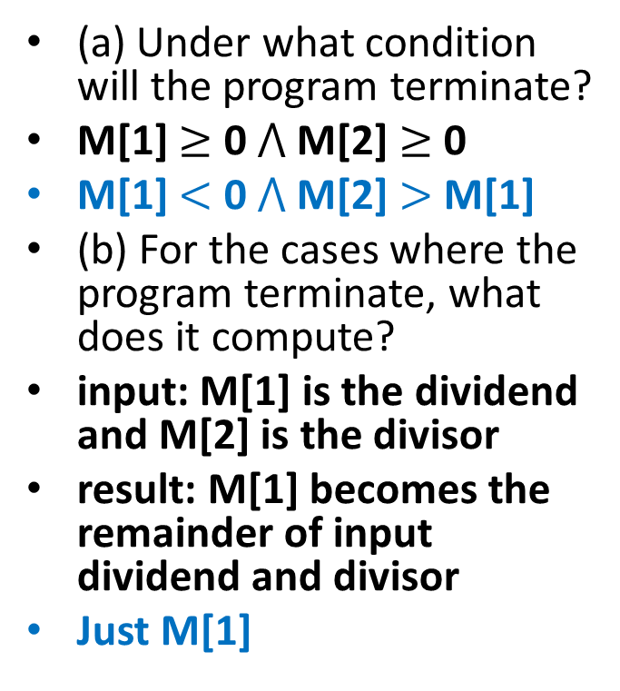
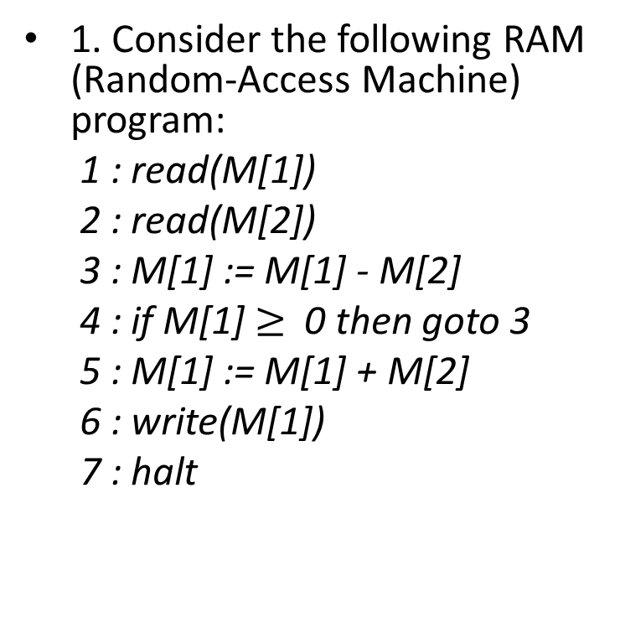
Problem 1
1. Consider the following RAM (Random-Access Machine) program:
1 : read(M[1])
2 : read(M[2])
3 : M[1] := M[1] - M[2]
4 : if M[1] $≥$ 0 then goto 3
5 : M[1] := M[1] + M[2]
6 : write(M[1])
7 : halt
(a) Under what condition will the program terminate?
M[1] $≥$ 0 $⋀$ M[2] $≥$ 0
M[1] $<$ 0 $⋀$ M[2] $>$ M[1]
(b) For the cases where the program terminate, what does it compute?
input: M[1] is the dividend and M[2] is the divisor
result: M[1] becomes the remainder of input dividend and divisor
Just M[1]

Slide 3
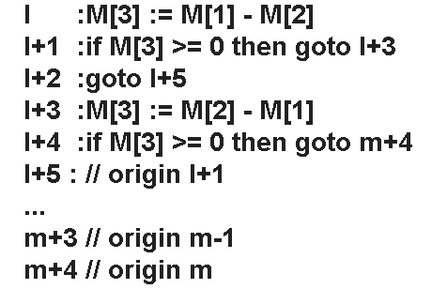
Problem 2
2. Consider the following RAM program segment:
l - 1 :...
l : if M[1] = M[2] then goto m
l + 1 : ...
m :
Suppose now the only conditional allowed is of the form "if M[j] >= 0 then goto i".
(a) How will you translate the program segment into one complying with the restriction?

Slide 4
Problem 2 (cont.)
(b) What assumptions do you need to make about the other parts of the program?
In the origin code after "l", if there have any "goto x", which x > l, the x need to be replaced by x+4 and M[3] is free.

Slide 5
Problem 3
3. Consider the expression (-b + sqrt(b*b - 4*a*c))/(2*a), where sqrt is a function taking the square root of its argument.
(a) Rewrite the expression in prex notation.
/ + - b sqrt - * b b * 4 * a c * 2 a
(b) Rewrite the expression in postx notation.
b - b b * 4 a * c * - sqrt + 2 a * /

Slide 6
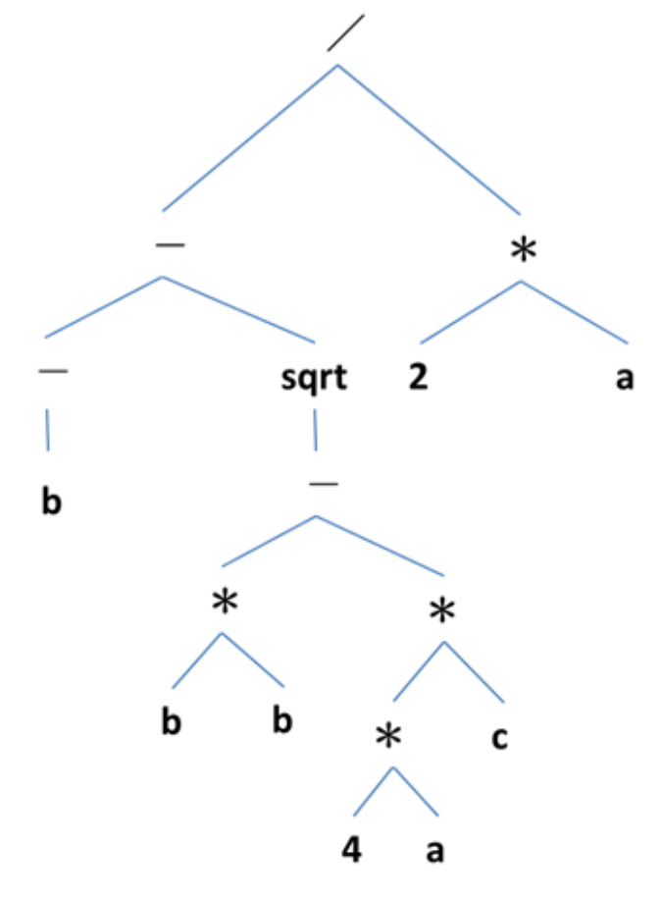
Problem 3 (cont.)
(c) Draw an abstract syntax tree for the expression.

Slide 7
Problem 4
4. Consider the following grammar (that has been discussed in class) for real numbers:
<real-number> ::= <integer-part>.<fraction>
<integer-part> ::= <digit>
| <integer-part><digit>
<fraction> ::= <digit> | <digit><fraction>
<digit> ::= 0 | 1 | 2 | 3 | 4 | 5 | 6 | 7 | 8 | 9

Slide 8
Problem 4 (cont.)
(a) Give a left-most derivation of the string "31.4".
real-number => integer-part . fraction
integer-part digit . fraction
digit digit . fraction
3 digit . fraction
3 1 . fraction
3 1 . digit
3 1 . 4

Slide 9
Problem 4 (cont.)
(b) Draw tree snapshots corresponding to the derivation in Problem 4a.
Real-number
Integer-part
fraction
integer-part
digit
digit
digit
3
1
.
4

Slide 10
Problem 5
5. Consider the following grammar (that has been discussed in class) for arithmetic expres-sions:
E ::= E + T | E T | T
T ::= T * F | T / F | F
F ::= number | name | (E)
For each of the following strings, draw a parse tree with respect to the grammar.

Slide 11
Problem 5 (cont.)
E
(a) 2 + 3 * 4.
(b) (2 + 3) * 4.
T
E
T
F
E
T
F
T
T
F
E
E
T
F
F
T
F
2
+
3
*
4
F
(
2
+
3
)
*
4

