Slide 1
PL HW#4 Solution
助教 賴瑞舜

Slide 2
Problem 1
1. Identify the binding and bound occurrences of variable/function names in the following expressions.
(a) let x = 3 in
let sq x = x * x in
sq x
(b) let rec f x = g 1 x
and g a x = x + a in
let x = 3 in
f x

Slide 3
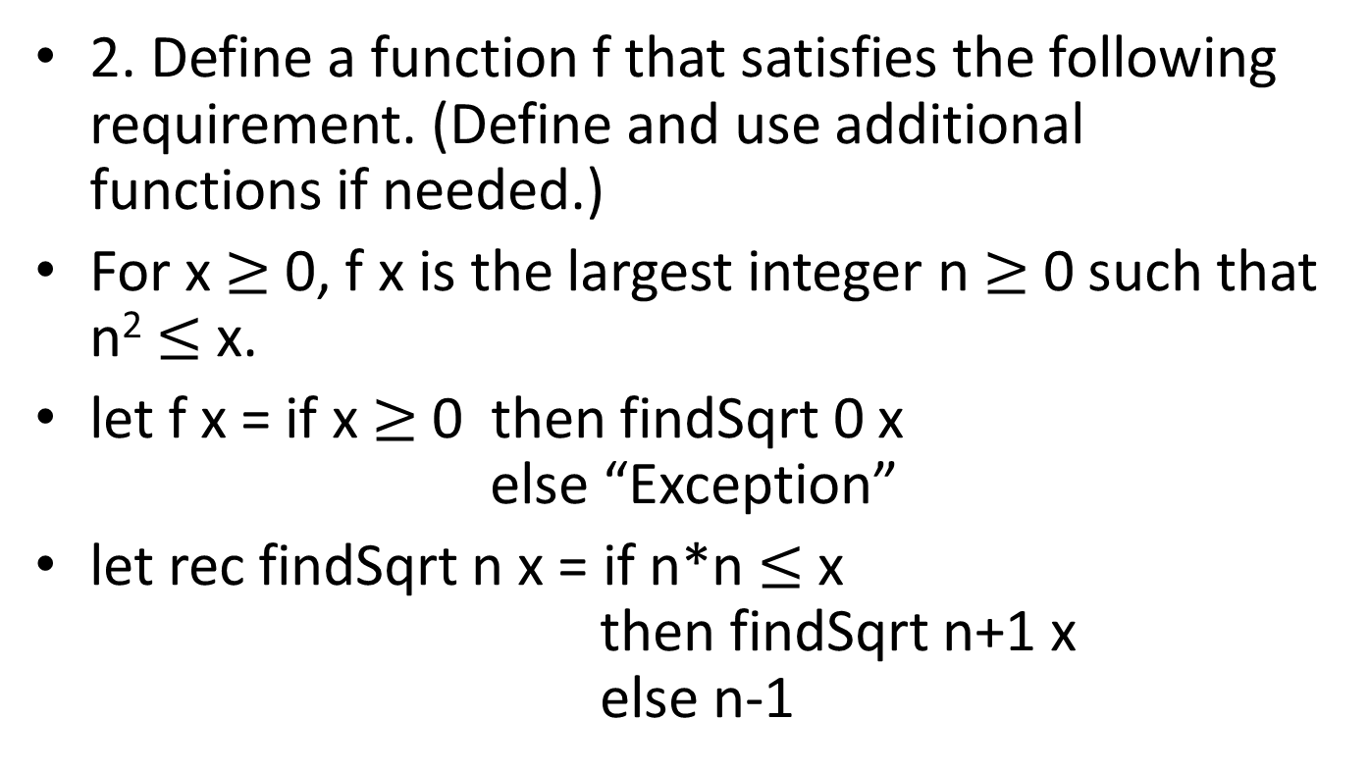
Problem 2
2. Define a function f that satisfies the following requirement. (Define and use additional functions if needed.)
For x $≥$ 0, f x is the largest integer n $≥$ 0 such that n² $≤$ x.
let f x = if x $≥$ 0 then findSqrt 0 x
else “Exception”
let rec findSqrt n x = if n*n $≤$ x
then findSqrt n+1 x
else n-1

Slide 4
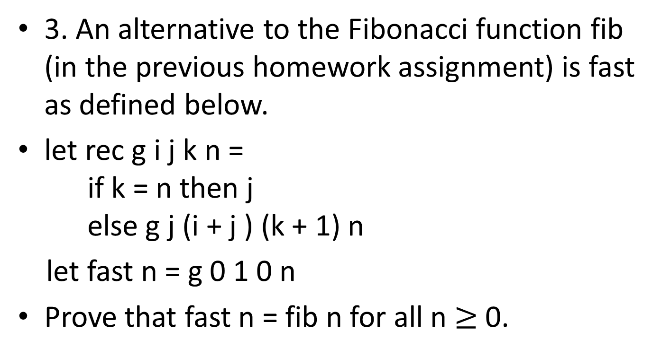
Problem 3
3. An alternative to the Fibonacci function fib (in the previous homework assignment) is fast as defined below.
let rec g i j k n =
if k = n then j
else g j (i + j ) (k + 1) n
let fast n = g 0 1 0 n
Prove that fast n = fib n for all n $≥$ 0.

Slide 5
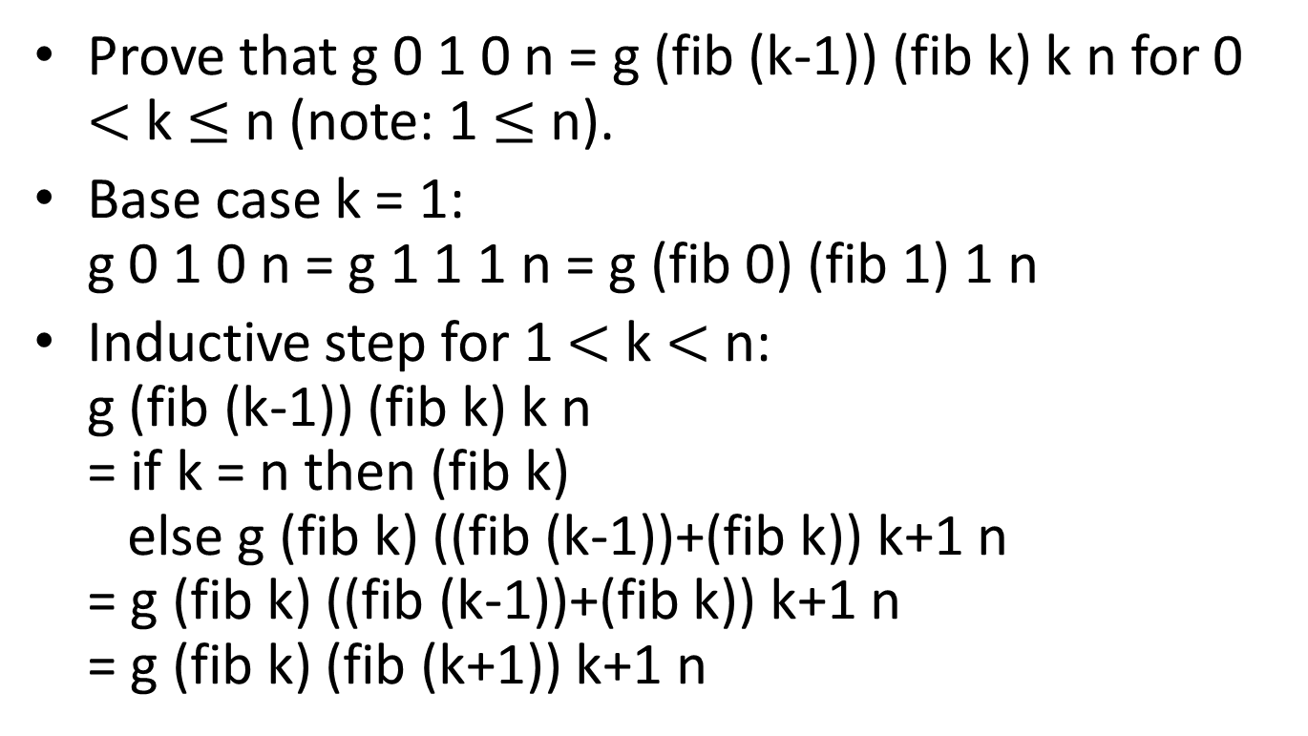
Problem 3 (cont.)
Prove that g 0 1 0 n = g (fib (k-1)) (fib k) k n for 0 $<$ k $≤$ n (note: 1 $≤$n).
Base case k = 1:
g 0 1 0 n = g 1 1 1 n = g (fib 0) (fib 1) 1 n
Inductive step for 1 $<$ k $<$ n:
g (fib (k-1)) (fib k) k n
= if k = n then (fib k)
else g (fib k) ((fib (k-1))+(fib k)) k+1 n
= g (fib k) ((fib (k-1))+(fib k)) k+1 n
= g (fib k) (fib (k+1)) k+1 n

Slide 6
Problem 3 (cont.)
Base case n = 0:
fast 0 = g 0 1 0 0 = 1 = fib 0
Inductive step for n > 0:
fast n+1 = g 0 1 0 n+1
= g (fib n) (fib (n+1)) n+1 n+1
= if n+1 = n+1 then (fib n+1)
else ….
= fib (n+1)

Slide 7
Problem 4
4. Explain why fast (in the preceding problem) is much more efficient than fib (in the previous homework assignment).
fast calculate every number just once, but fib calculate many times for the same input, for example:
fib n = fib (n-1) + fib (n-2), fib (n-1) and fib (n-2) calculate separately, and the fib (n-2) in fib (n-1) = fib (n-2) + fib (n-3) will calculate again, not using the previous result.

Slide 8
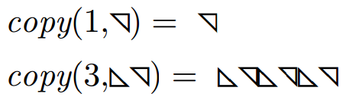
Problem 5
Extend the language of Little Quilt (discussed in class) so that functions behaving as suggested below can be defined.
let rec copy n x =
if n = 1 then x
else sew x (copy (n-1) x)

Slide 9
Problem 5 (cont.)
Extend “expression_slides” p.15
⟨expression⟩ ::= ⟨number⟩
⟨expression⟩ ::= ⟨expression⟩ - ⟨expression⟩
| ⟨expression⟩ = ⟨expression⟩
⟨expression⟩ ::= let rec ⟨declaration⟩
⟨expression⟩ ::= if ⟨expression⟩
then ⟨expression⟩
else ⟨expression⟩

