Slide 1

SDM of Small Company
By Dave Lin

Slide 2
AGENDA
  About Dave Lin
  About Nexdoor
  About Small & Mid-size Company
  About Tools
  About Process
  About People
  About you
  Q & A

Slide 3

About Dave Lin
Who are you?

Slide 4
Personal Profile
Dave Lin (林大維)
NTUIM，B84705007
NTUIM，R89725055
eLand Tech, Engineer (1 year) ← Funded by Bug (楊立偉學長)
BenQ, DSC Product Manager (1 year)
IBM CDL Taipei, Software Engineer (7 year)
Nexdoor Inc., COO (1 year)

Slide 5
About NExdoor
Where are you from?

Slide 7
About Small & Mid-size Company
Who are you represent?

Slide 8
Host a company
It is a TOUGH job
It is about SURVIVAL
Focus
People
Focus!
People!
Focus!!!
People!!!

Slide 9
Software Development
No much text documents, but
Secure your source code
Communication matters!
Still team work
Still process (agile, light weight)
Still tools
And, PEOPLE matters!

Slide 10
Joel’s Test
Do you use source control?
Can you make a build in one step?
Do you make daily builds?
Do you have a bug database?
Do you fix bugs before writing new code?
Do you have an up-to-date schedule?
Do you have a spec?
Do programmers have quiet working conditions?
Do you use the best tools money can buy?
Do you have testers?
Do new candidates write code during their interview?
Do you do hallway usability testing?

Slide 11
About tools
What should I use?

Slide 12
Tools – OS
The base
Windows
  Daily works
  Game
Mac
  Daily works
  iOS development
Unix family (Linux/Mac)
  Environment
  Command line
  Scripts (bash, python, perl, ruby)
Mobile
  iOS
  Android

Slide 13
Tools – Language, IDE & Editor
Target platform, productivity
iOS Development
  Objective-C
  Xcode
Android
  Java
  Eclipse + ADT
Web
  PHP
  Subline
Unix
  Command line
  Bash
  Vi

Slide 14
Tools – VCS
Keep the record, coordination
Traditional Version Control System
  Subversion (svn)
Distributed Version Control System (DVCS)
  Git (git)
  Mercurial (hg)
Host sites
  github

Slide 15
Tools –Issue Tracking
Group To do list
Standalone
  Redmine
  Mantis
Host Sites
  Jira
  Google codes
  github

Slide 16
Tools –Project Repo
Single place of information
Wiki based
  JIRA
  Google code
  Github
File based
  Dropbox
  Google Drive

Slide 17
Tools – CI
Build the code, daily
Hudson

Slide 18
About process
How should I act?

Slide 19
Scrum
Scrum is an agile process that allows us to focus on delivering the highest business value in the shortest time.
It allows us to rapidly and repeatedly inspect actual working software (every two weeks to one month).
The business sets the priorities. Teams self-organize to determine the best way to deliver the highest priority features.
Every two weeks to a month anyone can see real working software and decide to release it as is or continue to enhance it for another sprint.

Slide 20


Scrum
Individuals and interactions
Process and tools
over
Working software
Comprehensive documentation
over
Customer collaboration
Contract negotiation
over
Responding to change
Following a plan
over
Source: www.agilemanifesto.org

Slide 21
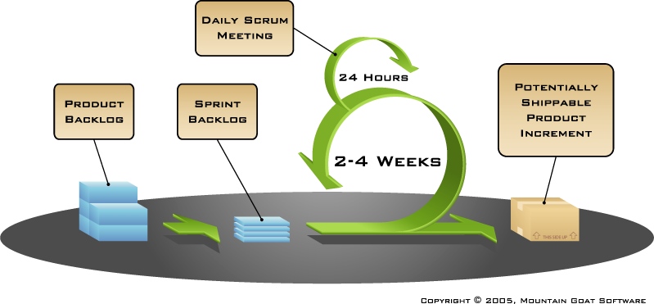
Scrum

Slide 22
UI Flow
Apps is focus on the User Interface (UI) flow and User Experience (UX) than software functions.
UI flow defines:
  Screen to screen flow
  Data on the screen
  Interaction on the screen

Slide 23
Test
Software Always need to be tested
Development vs. Testing
Respect tester.

Slide 24
About People
How should I work with others?

Slide 25
The Truth about People
Single most important thing to know in the world: People
Know yourself
一樣米養百種人
Read other people
Influence matters

Slide 26
About you
What I should learn from this class?

Slide 27
Suggestions
Small company vs. Big company
  Defined vs. Flexibility
  Certainty vs. Uncertainty
  Career ladder vs. Career boost
  Focus vs. Diversity
Keep in mind
  Risk and Return
  Process and People
  Communication
Other things
  Open your mind
  Watch things from the view of your boss
  Leadership always matters

Slide 28
Questions?
Now it is your turn…

Slide 29

Thank You For Listening !!
COO
Dave Lin
Tel：02-2752-5112 ext.118
Mobile：0912-715-66
E-Mail：davelin@nexdoor.cc

