Slide 1
UML: An Overview
(Based on [Booch et al. 2005])
Yih-Kuen Tsay
Dept. of Information Management
National Taiwan University

Slide 2
Outline
Introduction
Basics of Modeling
Overview of the UML
Sample UML Diagrams

Slide 3
Introduction: History of the UML
The UML---Unified Modeling Language, is a standard graphical language for “drawing a system’s blueprints”
It was initially the result of an effort in unifying the Booch, OOSE, and OMT methods
Most major software companies eventually got involved, resulting in UML 1.1 (1997)
Its maintenance was then taken over by OMG
Adoption of a major revision---UML 2.0 was completed in 2005, also an ISO standard
Most recent version: UML 2.5.1 (December 2017)

Slide 4
Intro.: What the UML Is For
For “drawing a system’s blueprints’’
More specifically, for
  Visualizing
  Specifying
  Constructing
  Documenting
  object-oriented, software-intensive systems.
  (This corresponds to the four aims of modeling.)

Slide 5
Intro.: Whom the UML Is For
Analysts and End Users: specify the (structural and behavioral) requirements
Architects: design systems that meet the requirements
Developers: turn the design into executable code
Others: quality assurance personnel (e.g., testers), technical writers, librarians, project managers, …
All roles in software development should know something about the UML.

Slide 6
Importance of Modeling
Mind the scale:
  dog house
  family house
  office building
The use of modeling is a common thread of successful software projects
In fact, modeling can be found in every discipline/profession

Slide 7
Basics of Modeling
What is a model?
  simplification of reality
  blueprints of a system: structural or behavioral
Why do we model?
  To better understand the system under development
  To focus on one aspect at a time (it is not possible to comprehend a complex system in its entirety, so divide and conquer …)

Slide 8
Four Aims of Modeling
To visualize a system
To specify its structure and/or behavior
To provide a guiding template for construction
To document the decisions made

Slide 9
More Tips
Use a common language
Do modeling now, before it is too late
  Things may get more complex than expected

Slide 10
Principles of Modeling
Models influence the solutions (so, choose your models well)
Different levels of precision may be expressed
Good models are connected to reality
No single model is sufficient; multiple models/views are needed

Slide 11
Five Views of an Architecture
The four aims of modeling demand the system be viewed from different perspectives:
Use case view: exposing the requirements
Design view: capturing the vocabulary of the problem/solution space
Interaction view: flow of control and messages
Implementation view: organization of software modules
Deployment view: mapping of runtime entities to the underlying platforms or computing nodes

Slide 12
Object-Oriented Modeling
The main building blocks of all software systems are objects and classes
An object is a thing drawn from the vocabulary of the problem/solution space
Every object has an identity, a number of states, and behavior
A class defines a set of common objects

Slide 13
Overview of the UML
Things
Relationships
Diagrams

Slide 14
The UML in the Software Development Process
The UML allows one to express different views of a system and their interactions
The UML is largely process-independent
The OMG recommends using the UML with the so-called Unified Software Development Process:
  Characteristics: (1) use case driven; (2) architecture-centric; (3) iterative and incremental (a series of executable releases; continuous integration)
  Four phases of a process: inception, elaboration, construction, transition

Slide 15
Things in the UML
Structural Things
  Class, interface, collaboration, use case, active class, component, artifact, node
Behavioral Things
  Interaction (messages, action sequences, links)
  State machine (states, transitions, events)
Grouping Things: packages
Annotational Things

Slide 16
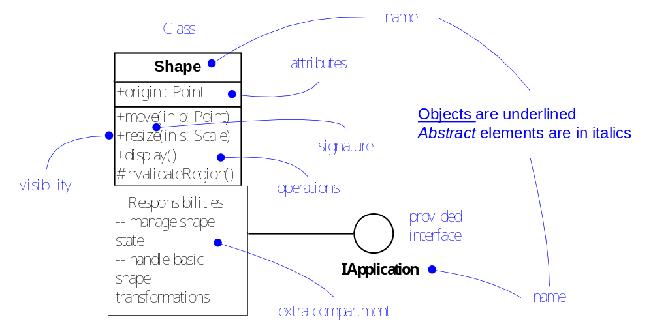
Structural Things (I)

Slide 17
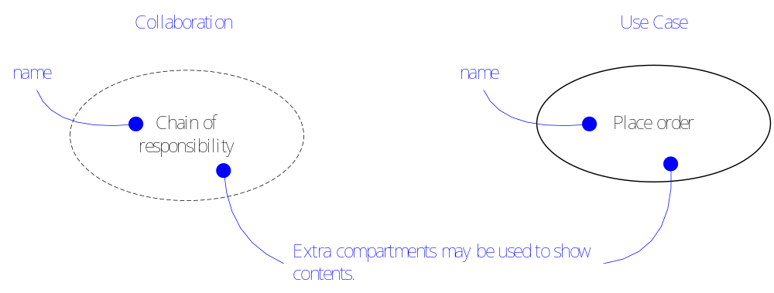
Structural Things (II)

Slide 18
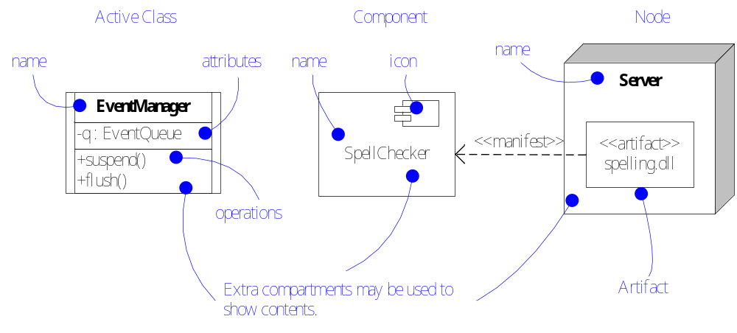
Structural Things (III)

Slide 19
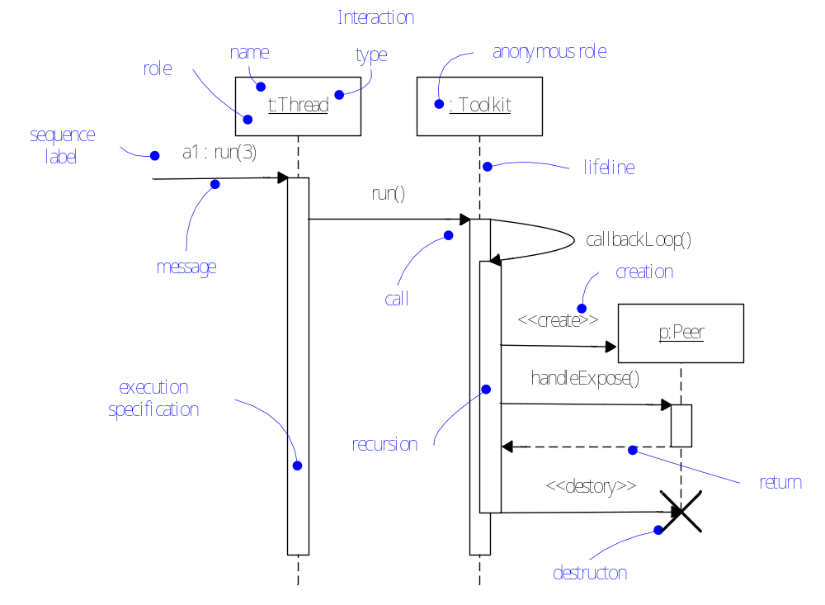
Behavioral Things (I)

Slide 20
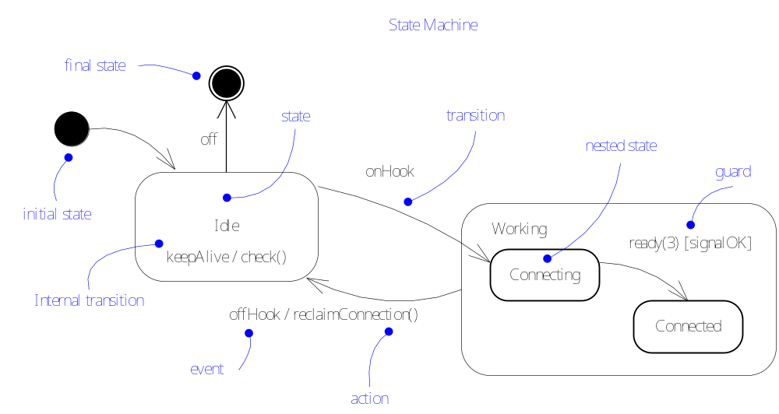
Behavioral Things (II)

Slide 21
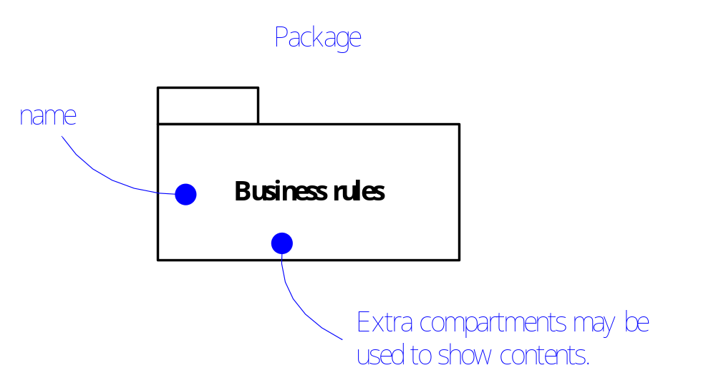
Grouping Things

Slide 22
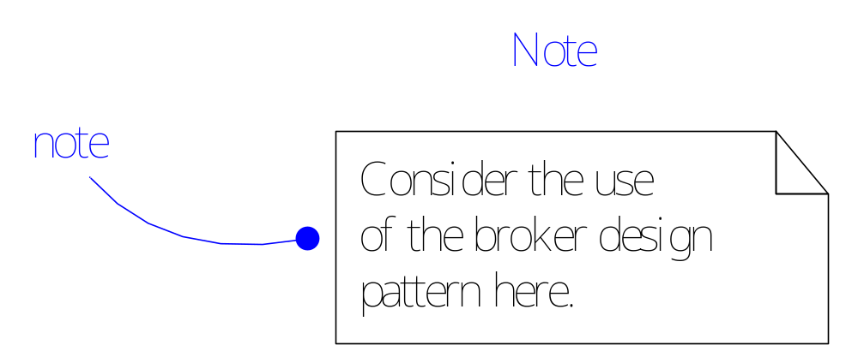
Annotational Things

Slide 23
Relationships in the UML
Dependency
Association
Generalization
Realization

Slide 24
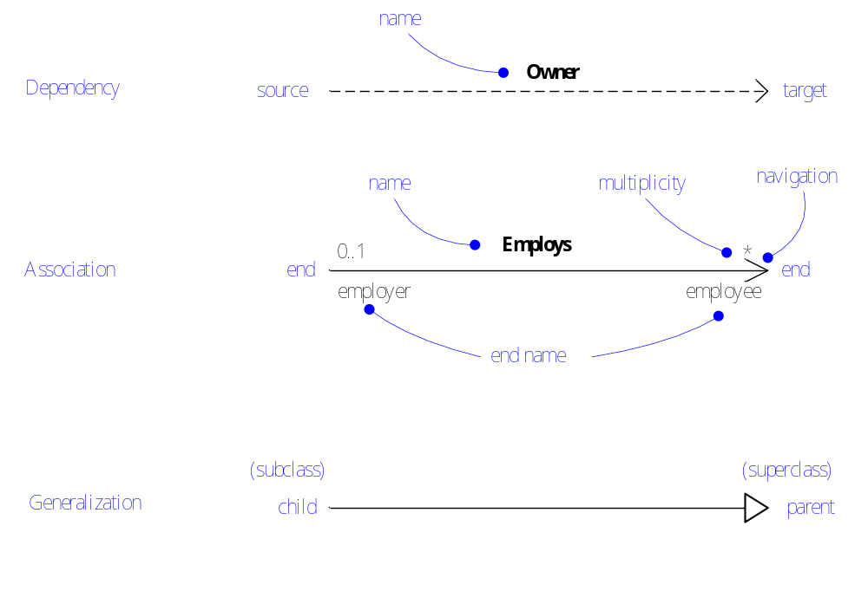
Relationships
Note: direction of an association should now be indicated by a solid triangle ►
following the association name.

Slide 25
Diagrams in the UML
Graphical representations of things and relationships
Structural and Architectural Diagrams:
  class diagrams, object diagrams, component diagrams, composite structure diagrams, deployment diagrams (including artifact diagrams), package diagrams
Behavioral Diagrams:
  use case diagrams, interaction (sequence and communication) diagrams, state diagrams, activity diagrams, timing diagrams, interaction overview diagrams

Slide 26
Rules of the UML
Well-formed models
  Self-consistent
  Following UML rules for
  names, scope, visibility, integrity, execution
Not well-formed models
  Elided: some elements hidden
  Incomplete: some elements missing
  Inconsistent

Slide 27
Common Mechanisms in the UML
Specifications: textual statements behind every graphical element
Adornments
  unique notations for different elements/details
Common divisions
  class vs. object, interface vs. implementation, role vs. type
Extensibility mechanisms
  stereotypes, tagged values, constraints

Slide 28
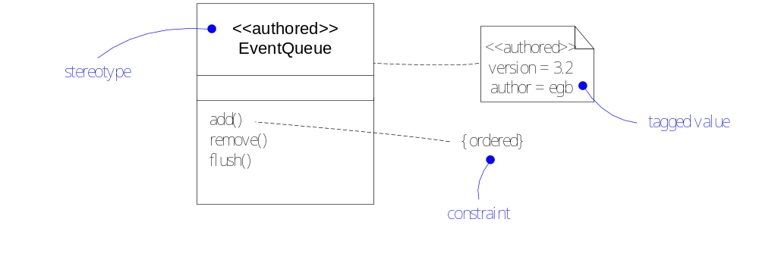
Extensibility

Slide 29
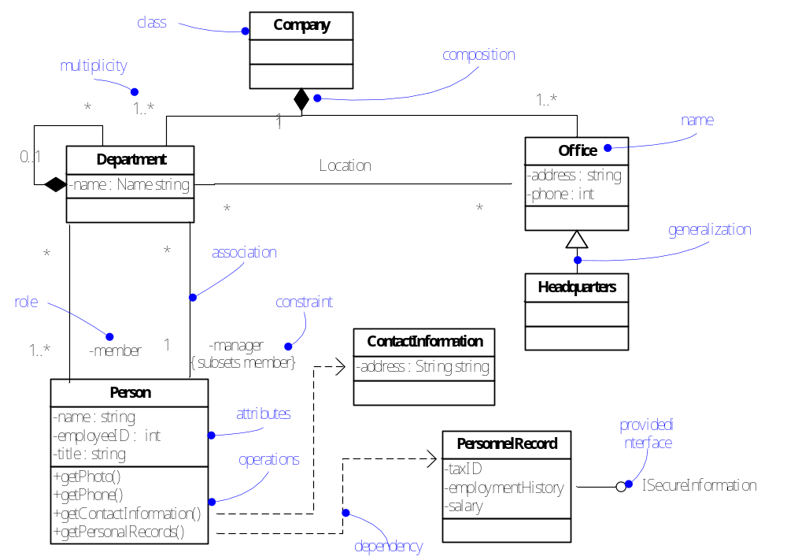
Class Diagram

Slide 30
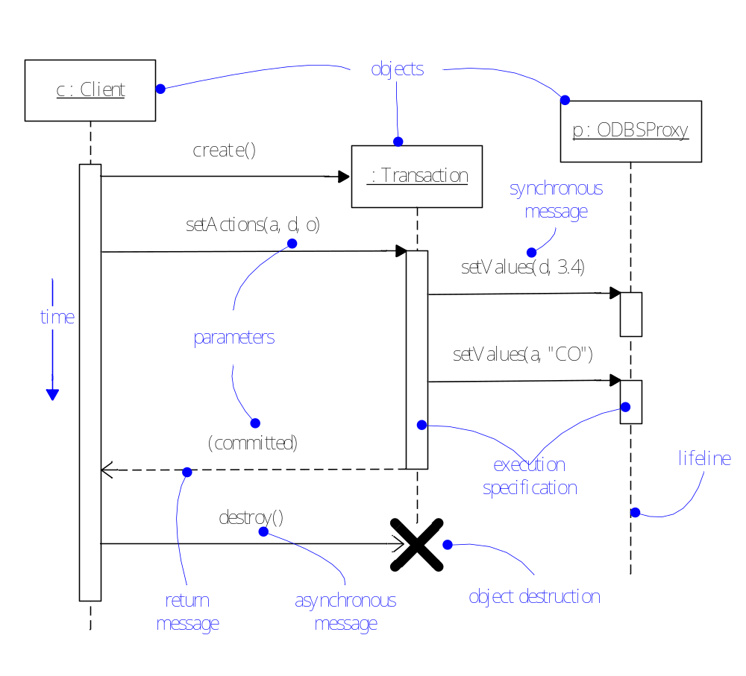
Sequence Diagram

Slide 31
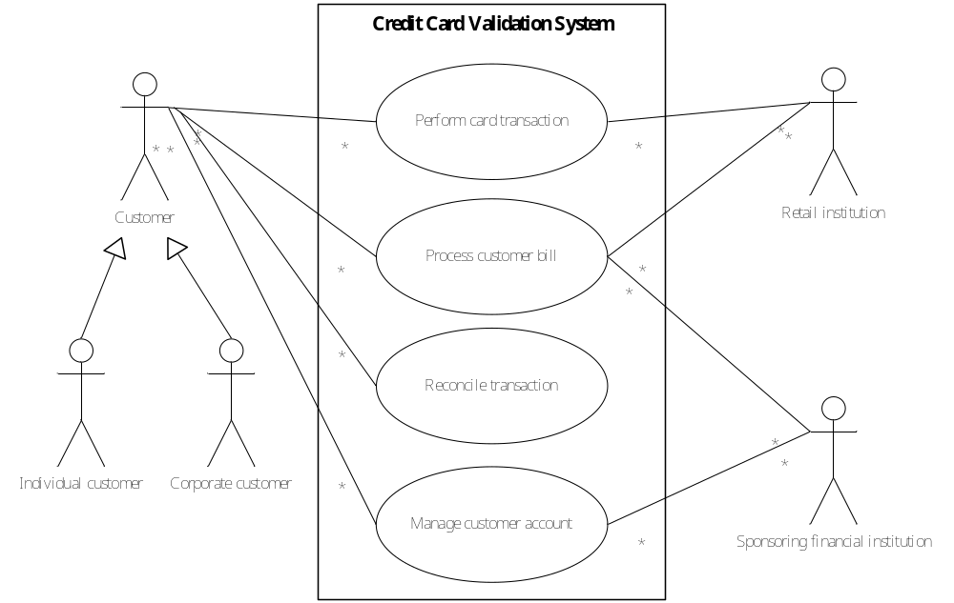
Use Case Diagram
Primary actors
Secondary actors

Slide 32
Remarks
The best way to learn the UML is by actually using it:
  Domain modeling
  Design patterns
  Term project
In follow-up lectures, we will cover
  Basic structural and behavioral diagrams
  Some more advanced UML features
  The Object Constraint Language
Things not covered in class are left for you to explore.

