Slide 1
Theory of Computing
TA times #1
Hsu, Hung-Wei
2014/03/19

Slide 2
To find a proof (Ch0.3) (1/3)
Be patient
Come back to it
Be neat
Be concise

Slide 3
To find a proof (Ch0.3) (2/3)
Be patient – Be patient to what you want to explain, tell a whole story.
Come back to it – Think twice and be sure about what you are writing.
Be neat – Organize a good structure of your logic and intentions.
Be concise – Use brief expressions that generally have clear and precise meaning. (Formal systems are your good friends.)

Slide 4
To find a proof (Ch0.3) (3/3)
Proof Idea
  You should talk about any idea, strategy of your proof here. Better not to let any high level, informal expression goes into your proof parts (below) directly. Those expressions usually are not precise enough, and may cause confusion.
Proof
  In this part, please follow the four guidelines mentioned in the previous slide to construct your proof nicely. You should tell a whole story － each step should have clear logic connections with others, and most importantly, the story should have both a proper beginning, and a conclusive ending. Also, stay close to what you are proving.

Slide 5
CAUTION
Most solutions we showed in TA’s slides are more
like the ideas rather then completed solutions.
You may take them as guides, but shouldn’t
consider them as everything you need
to complete an exercise.

Slide 6
Stats.
Homework #1
  Average 69.8
  Std. Dev. 22.5
Homework #2
  Average 70.8
  Std. Dev. 17.6

Slide 7
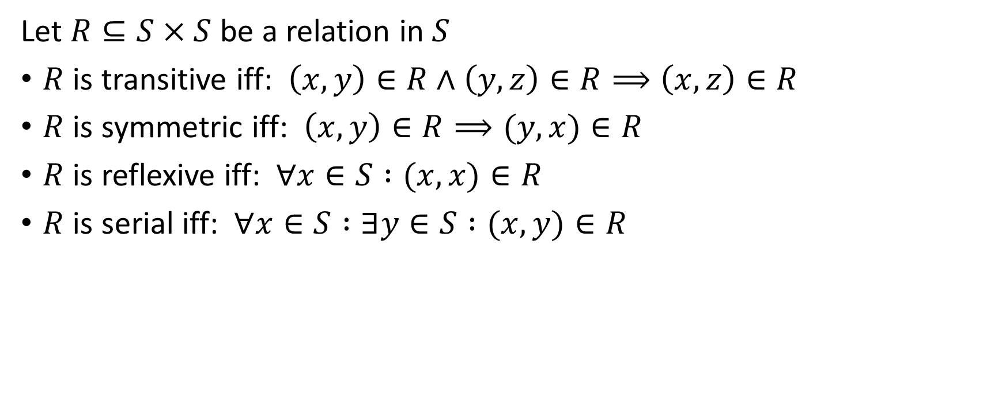
HW#1 – Q1 (1/3)
Let $R⊆S×S$ be a relation in $S$
$R$ is transitive iff: $\left(x,y\right)∈R∧\left(y,z\right)∈R⟹\left(x,z\right)∈R$
$R$ is symmetric iff: $\left(x,y\right)∈R⟹(y,x)∈R$
$R$ is reflexive iff: $∀x∈S :(x,x)∈R$
$R$ is serial iff: $∀x∈S :∃y∈S :(x,y)∈R$

Slide 8
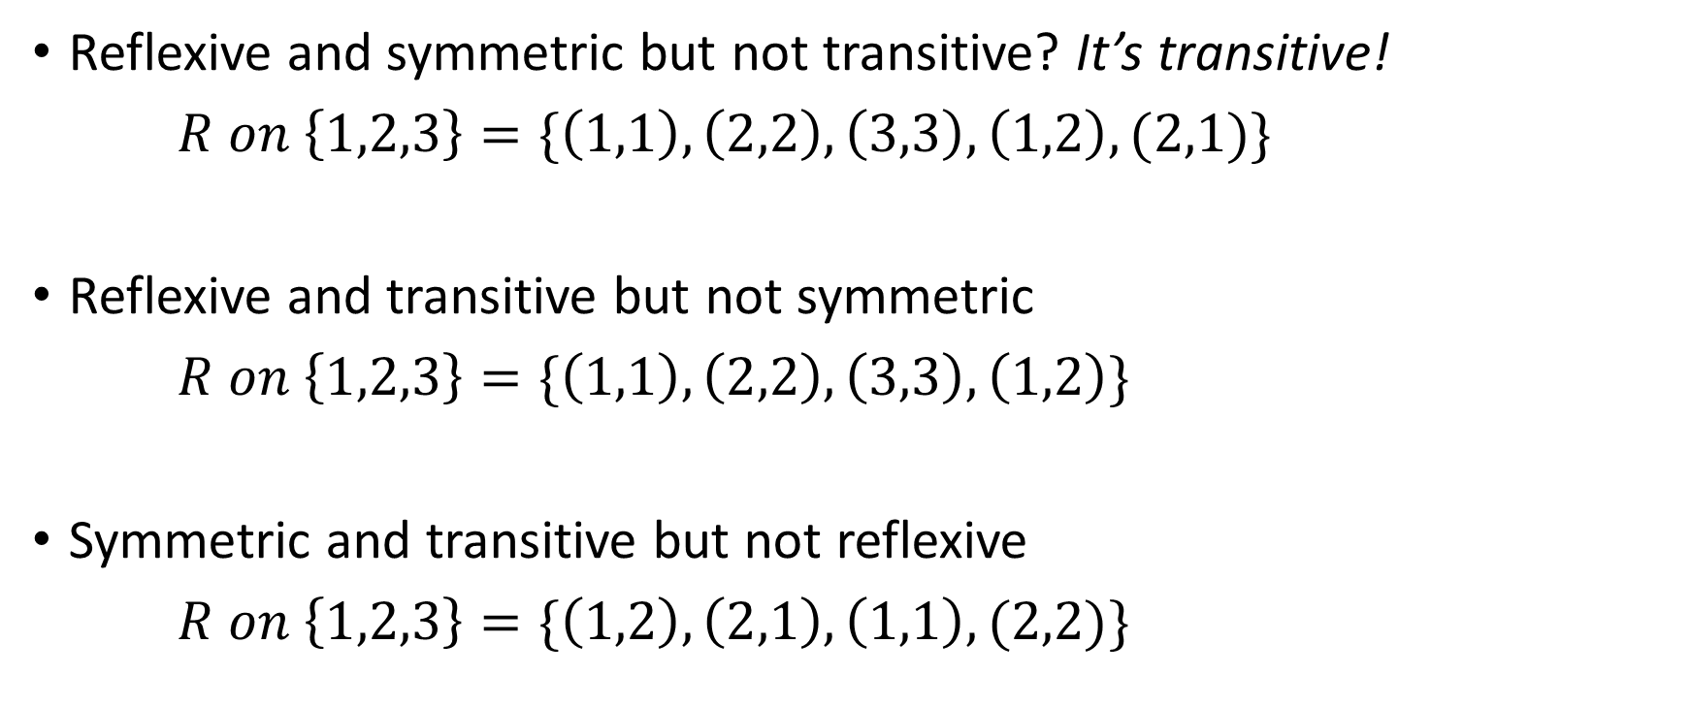
HW#1 – Q1 (2/3)
Reflexive and symmetric but not transitive? It’s transitive!
$R on \left\{1,2,3\right\}=\{\left(1,1\right),\left(2,2\right),\left(3,3\right),\left(1,2\right),(2,1)\}$
Reflexive and transitive but not symmetric
$R on \left\{1,2,3\right\}=\{\left(1,1\right),\left(2,2\right),\left(3,3\right),\left(1,2\right)\}$
Symmetric and transitive but not reflexive
$R on \left\{1,2,3\right\}=\{\left(1,2\right),\left(2,1\right),\left(1,1\right),(2,2)\}$
1
2
3
1
2
3
1
2
3

Slide 9
Symmetric, Transitive therefor Reflexive? (3/3)
It’s a common fallacy. This only happen when the relation is also serial. You can go to the links below to learn more details.
http://www.proofwiki.org/wiki/Symmetric_and_Transitive_therefore_Reflexive
http://www.proofwiki.org/wiki/Symmetric_Transitive_and_Serial_Relation_is_Reflexive

Slide 10
HW#1 – Q3 (1/3)
In the induction step, it needs that when h = 2 ~ k the claim be valid. However, we can easily discover that at the case h = 2, we cannot infer that all the horses are in the same color. Thus the induction step is wrong from the beginning. (You can say that its base case isn’t completed.)
!
Though the color of the horses in the group will still stay consist, in the case h = 2, we only have a horse in the group at a time, no matter what color the horse is, the color of the “horses” in the group would all stay the same.

Slide 11
HW#1 – Q3 (2/3)
Compare to the situation with 3 or more horses:
Once we could be certain that any possible combination of 2 horses are in the same color (then base case completed. However, this can never be true), the induction step would be valid.
The basis of the claim at the induction hypothesis is that, when we take one horse away, there’s still some horses in the group, we can then infer that all the horses in H₁ and H₂ are in the same color.

Slide 12

HW#1 – Q3 (3/3)

Slide 13
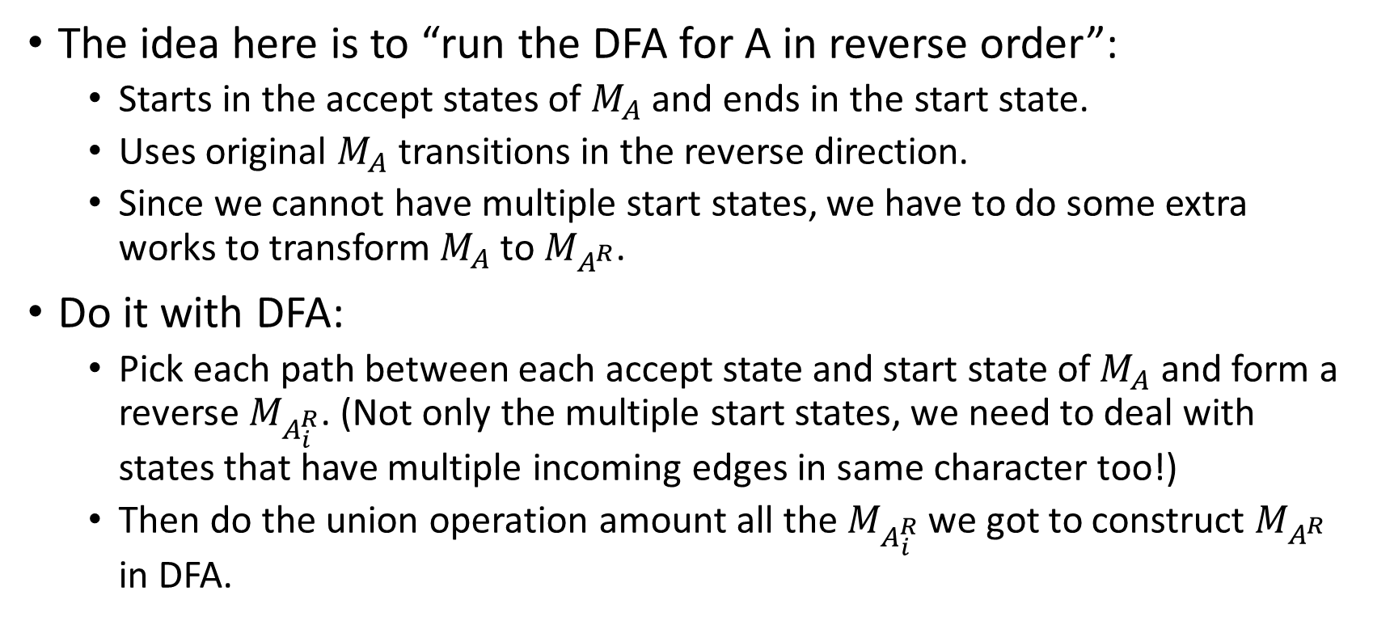
HW#2 – Q5 (1/3)
The idea here is to “run the DFA for A in reverse order”:
  Starts in the accept states of $M_{A}$ and ends in the start state.
  Uses original $M_{A}$ transitions in the reverse direction.
  Since we cannot have multiple start states, we have to do some extra works to transform $M_{A}$ to $M_{A^{R}}$.
Do it with DFA:
  Pick each path between each accept state and start state of $M_{A}$ and form a reverse $M_{A_{i}^{R}}$. (Not only the multiple start states, we need to deal with states that have multiple incoming edges in same character too!)
  Then do the union operation amount all the $M_{A_{i}^{R}}$ we got to construct $M_{A^{R}}$ in DFA.

Slide 14
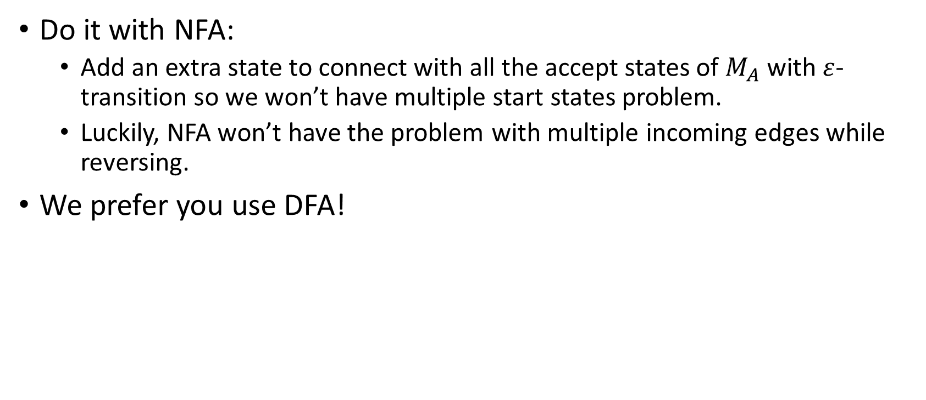
HW#2 – Q5 (2/3)
Do it with NFA:
  Add an extra state to connect with all the accept states of $M_{A}$ with $ε$-transition so we won’t have multiple start states problem.
  Luckily, NFA won’t have the problem with multiple incoming edges while reversing.
We prefer you use DFA!

Slide 15
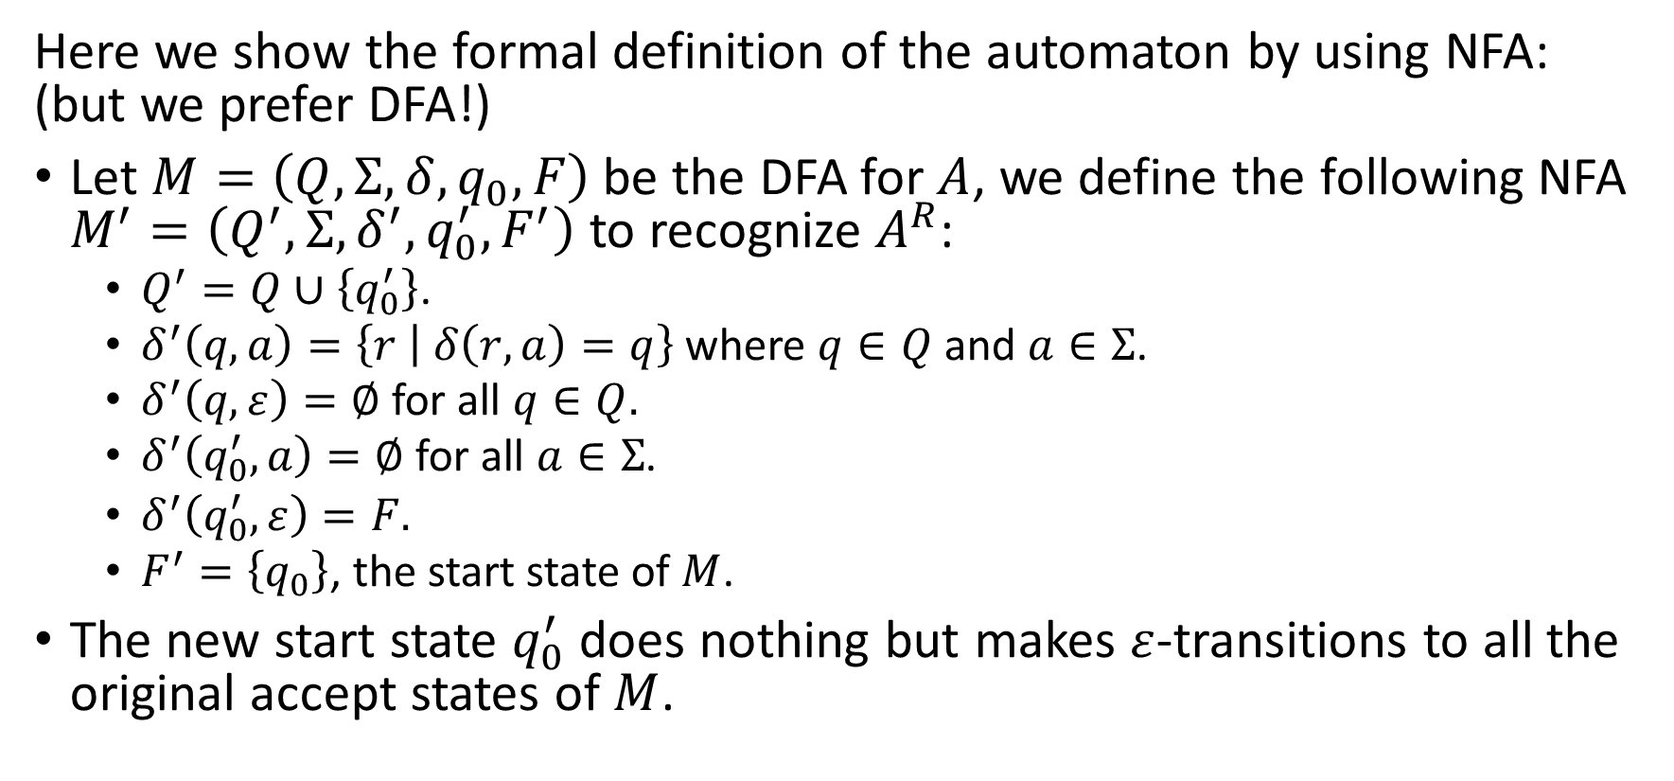
HW#2 – Q5 (3/3)
Here we show the formal definition of the automaton by using NFA: (but we prefer DFA!)
Let $M=\left(Q,Σ,δ,q_{0},F\right)$ be the DFA for $A$, we define the following NFA $M^{′}=\left(Q^{′},Σ,δ^{′},q_{0}^{′},F^{′}\right)$ to recognize $A^{R}$:
  $Q^{′}=Q∪\left\{q_{0}^{′}\right\}$.
  $δ^{′}\left(q, a\right)=\left\{r | δ\left(r, a\right)=q\right\}$ where $q∈Q$ and $a∈Σ$.
  $δ^{′}\left(q,ε\right)=∅$ for all $q∈Q.$
  $δ^{′}\left(q_{0}^{′}, a\right)=∅$ for all $a∈Σ$.
  $δ^{′}\left(q_{0}^{′},ε\right)=F.$
  $F^{′}=\left\{q_{0}\right\}$, the start state of $M$.
The new start state $q_{0}^{′}$ does nothing but makes $ε$-transitions to all the original accept states of $M$.

Slide 16
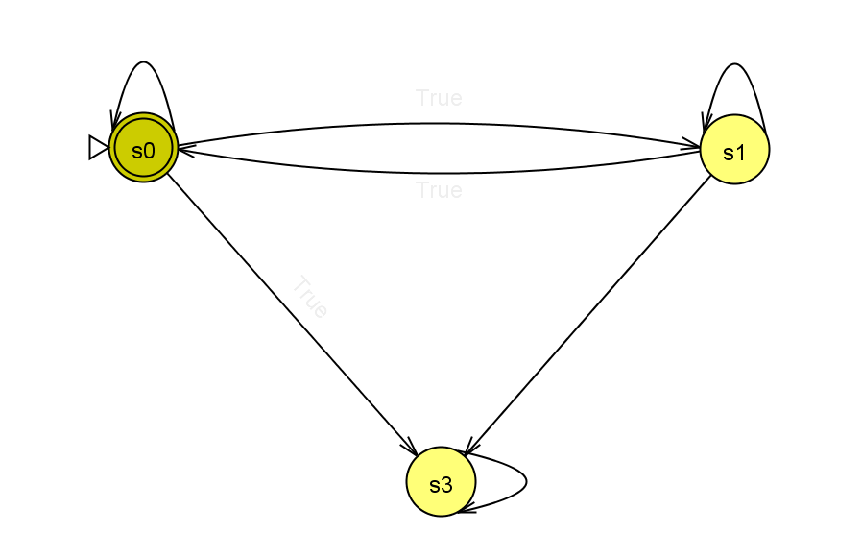
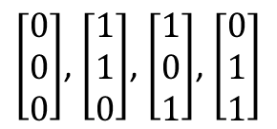
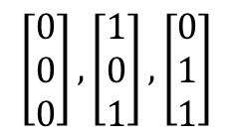
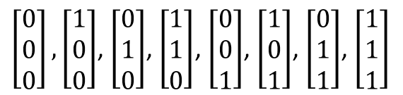


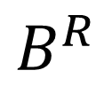
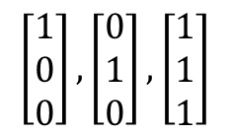
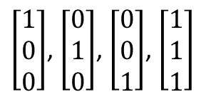
HW#2 – Q6
$$B^{R}$$
$$\left[\begin{matrix}0 \\ 0 \\ 0\end{matrix}\right],\left[\begin{matrix}1 \\ 0 \\ 1\end{matrix}\right],\left[\begin{matrix}0 \\ 1 \\ 1\end{matrix}\right]$$
$$\left[\begin{matrix}1 \\ 0 \\ 0\end{matrix}\right],\left[\begin{matrix}0 \\ 1 \\ 0\end{matrix}\right],\left[\begin{matrix}1 \\ 1 \\ 1\end{matrix}\right]$$
$$\left[\begin{matrix}1 \\ 1 \\ 0\end{matrix}\right]$$
$$\left[\begin{matrix}0 \\ 0 \\ 1\end{matrix}\right]$$
$\left[\begin{matrix}1 \\ 0 \\ 0\end{matrix}\right]$, $\left[\begin{matrix}0 \\ 1 \\ 0\end{matrix}\right]$, $\left[\begin{matrix}0 \\ 0 \\ 1\end{matrix}\right]$, $\left[\begin{matrix}1 \\ 1 \\ 1\end{matrix}\right]$
$\left[\begin{matrix}0 \\ 0 \\ 0\end{matrix}\right]$, $\left[\begin{matrix}1 \\ 1 \\ 0\end{matrix}\right]$, $\left[\begin{matrix}1 \\ 0 \\ 1\end{matrix}\right]$, $\left[\begin{matrix}0 \\ 1 \\ 1\end{matrix}\right]$
$\left[\begin{matrix}0 \\ 0 \\ 0\end{matrix}\right],\left[\begin{matrix}1 \\ 0 \\ 0\end{matrix}\right]$, $\left[\begin{matrix}0 \\ 1 \\ 0\end{matrix}\right]$, $\left[\begin{matrix}1 \\ 1 \\ 0\end{matrix}\right]$, $\left[\begin{matrix}0 \\ 0 \\ 1\end{matrix}\right]$, $\left[\begin{matrix}1 \\ 0 \\ 1\end{matrix}\right]$, $\left[\begin{matrix}0 \\ 1 \\ 1\end{matrix}\right]$, $\left[\begin{matrix}1 \\ 1 \\ 1\end{matrix}\right]$

Slide 17
HW#2 – Q7
Take the union of the alphabets first, then adapt the DFAs into the form that could do the computing on the new alphabet. Finally, apply the union operation on the DFAs adapted as usual, and have your target DFA created.
There are two different policy while dealing with the adaptation of the DFAs (you have to mention this and specify your choice) –– what to do when the DFA reads an input symbol that is not in its original alphabet?
  Strict policy – rejects the input immediately.
  Loosen policy – neglects the symbol and keeps going.
P.S. You should use DFA to construct your proof!!

