Slide 1
Theory of Computing
TA times #1
Ching Chieh Lin
2018/3/28

Slide 2
TA session
Concept / Idea of homework
r05725007@ntu.edu.tw
Scoring / Handing

Slide 3
Hw1.Hw2.
Relation / Graph / Equivalence relation
Proof ?
Finite State Automata
DFA NFA => Find the State !
Closedness property proof

Slide 4
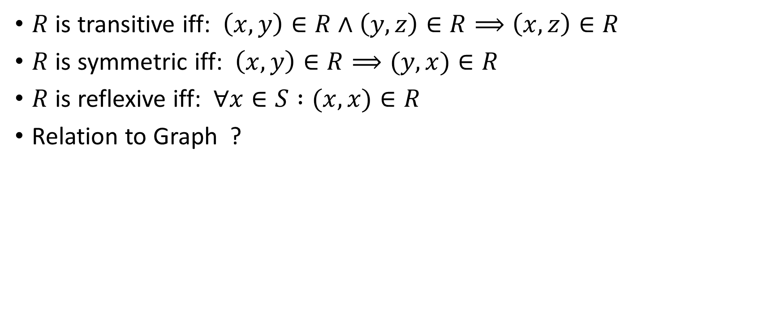
Hw1-Q1. Relation Exampling
$R$ is transitive iff: $\left(x,y\right)∈R∧\left(y,z\right)∈R⟹\left(x,z\right)∈R$
$R$ is symmetric iff: $\left(x,y\right)∈R⟹(y,x)∈R$
$R$ is reflexive iff: $∀x∈S :(x,x)∈R$
Relation to Graph ?

Slide 5
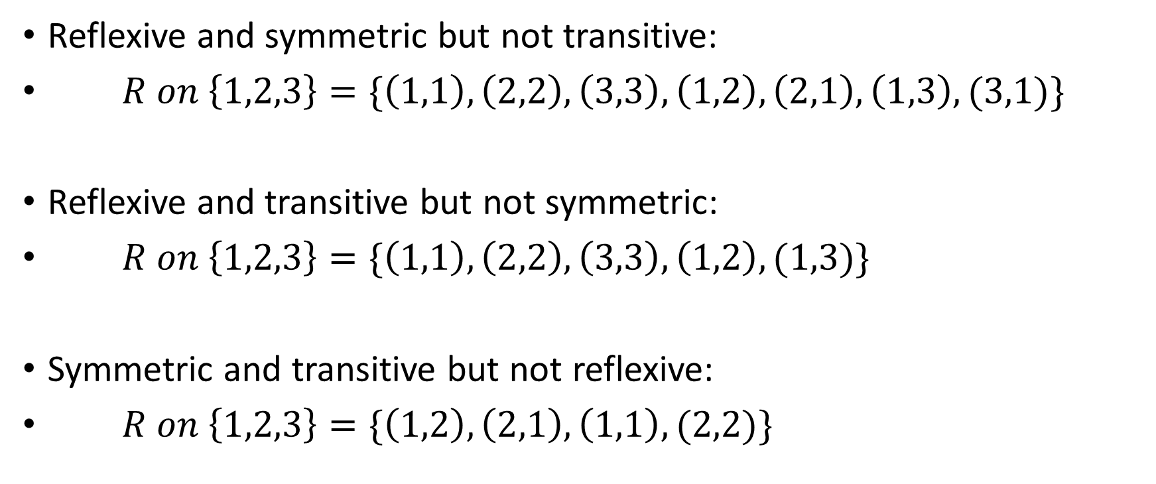
Hw1-Q1. Relation Exampling
Reflexive and symmetric but not transitive:
$R on \left\{1,2,3\right\}=\{\left(1,1\right),\left(2,2\right),\left(3,3\right),\left(1,2\right),\left(2,1\right),\left(1,3\right),(3,1)\}$
Reflexive and transitive but not symmetric:
$R on \left\{1,2,3\right\}=\{\left(1,1\right),\left(2,2\right),\left(3,3\right),\left(1,2\right),(1,3)\}$
Symmetric and transitive but not reflexive:
$R on \left\{1,2,3\right\}=\{\left(1,2\right),\left(2,1\right),\left(1,1\right),(2,2)\}$
1
2
3
1
2
3
1
2
3

Slide 6
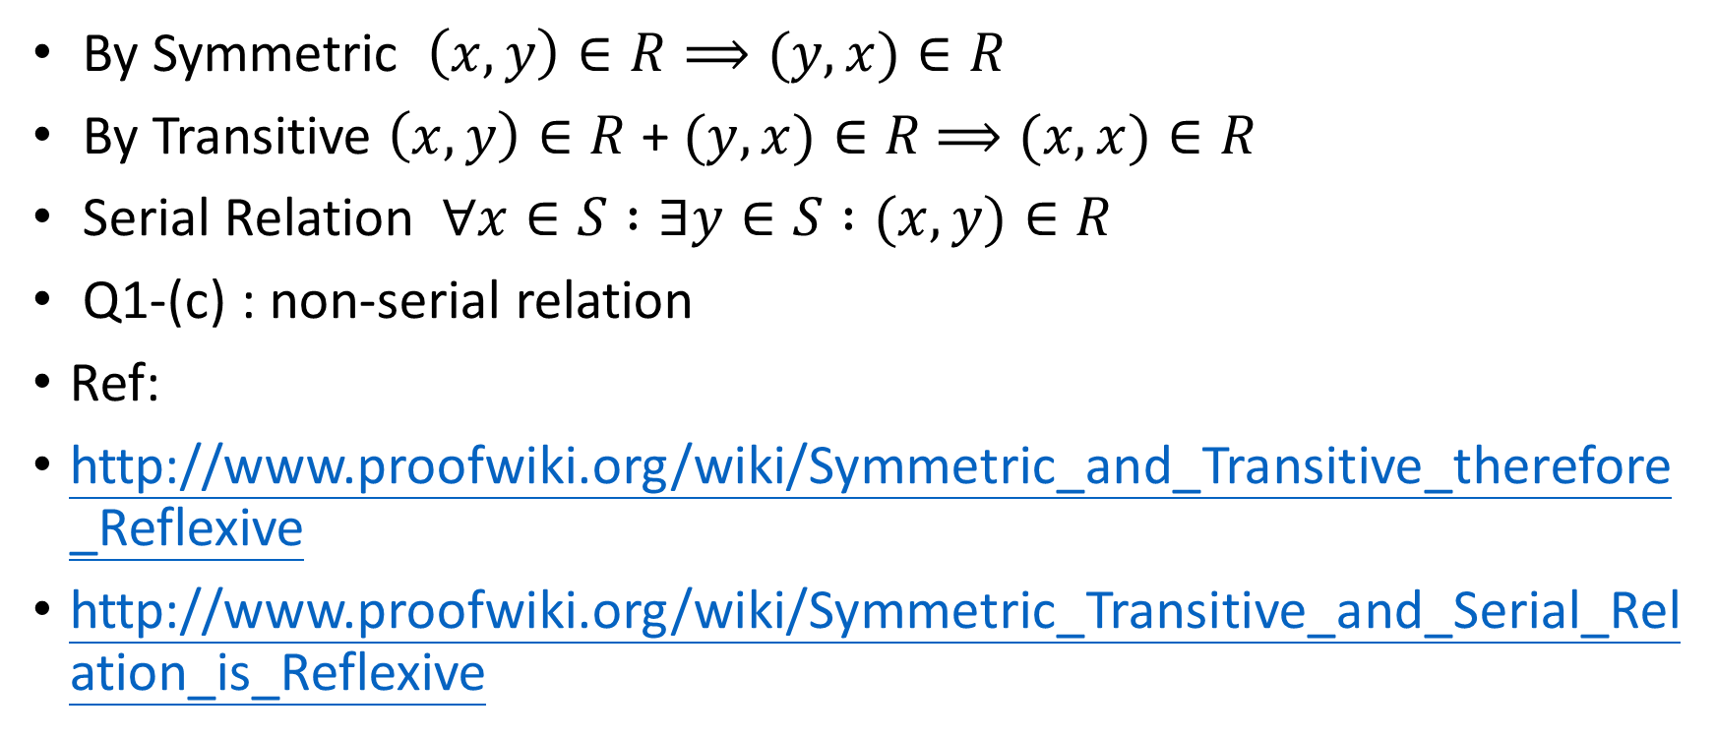
Symmetric + Transitive = Reflexive ?
By Symmetric $\left(x,y\right)∈R⟹(y,x)∈R$
By Transitive $\left(x,y\right)∈R$ + $(y,x)∈R$ $⟹(x,x)∈R$
Serial Relation $∀x∈S :∃y∈S :(x,y)∈R$
Q1-(c) : non-serial relation
Ref:
http://www.proofwiki.org/wiki/Symmetric_and_Transitive_therefore_Reflexive
http://www.proofwiki.org/wiki/Symmetric_Transitive_and_Serial_Relation_is_Reflexive

Slide 7
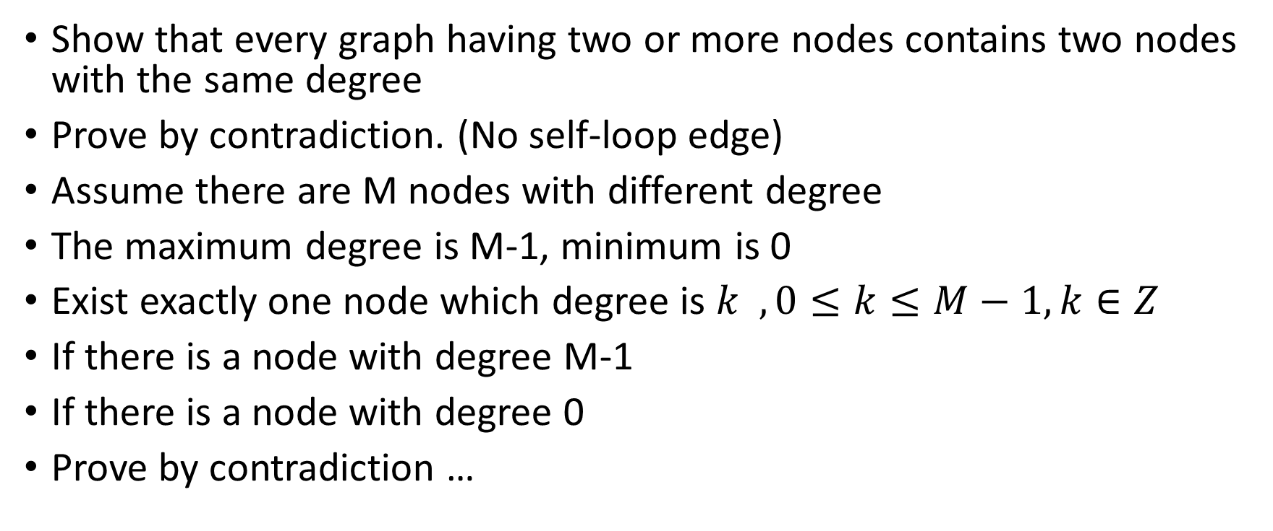
Hw1-Q3. Graph Degree
Show that every graph having two or more nodes contains two nodes with the same degree
Prove by contradiction. (No self-loop edge)
Assume there are M nodes with different degree
The maximum degree is M-1, minimum is 0
Exist exactly one node which degree is $k , 0≤k≤M−1, k∈Z$
If there is a node with degree M-1
If there is a node with degree 0
Prove by contradiction …

Slide 8
Hw1.Q4. Error of Proof.
Inductive Step ?
Error part: H1, H2 and intersection ?
Another view :
Must need 2 base case, but
Basis (h = 1): In any set containing just one horse, all horses clearly are the same color
Basis (h = 2): Cannot be proved. Give a counter example

Slide 9
Hw2-Q4. Closedness of Reversed
Proved by NFA
Why NFA ?
  Multiple initial State
  Multiple incoming edges
Proved by DFA (Concept.)
  Divide all path
  Construct a reverse DFA with a single initial state / incoming edges
  Union

Slide 10
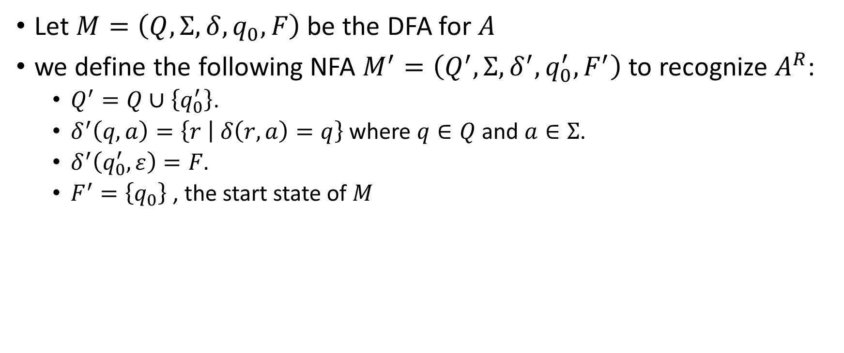
Hw2-Q4. Closedness of Reversed
Let $M=\left(Q,Σ,δ,q_{0},F\right)$ be the DFA for $A$
we define the following NFA $M^{′}=\left(Q^{′},Σ,δ^{′},q_{0}^{′},F^{′}\right)$ to recognize $A^{R}$:
  $Q^{′}=Q∪\left\{q_{0}^{′}\right\}$.
  $δ^{′}\left(q, a\right)=\left\{r | δ\left(r, a\right)=q\right\}$ where $q∈Q$ and $a∈Σ$.
  $δ^{′}\left(q_{0}^{′},ε\right)=F.$
  $F^{′}=\left\{q_{0}\right\}$ , the start state of $M$

Slide 11
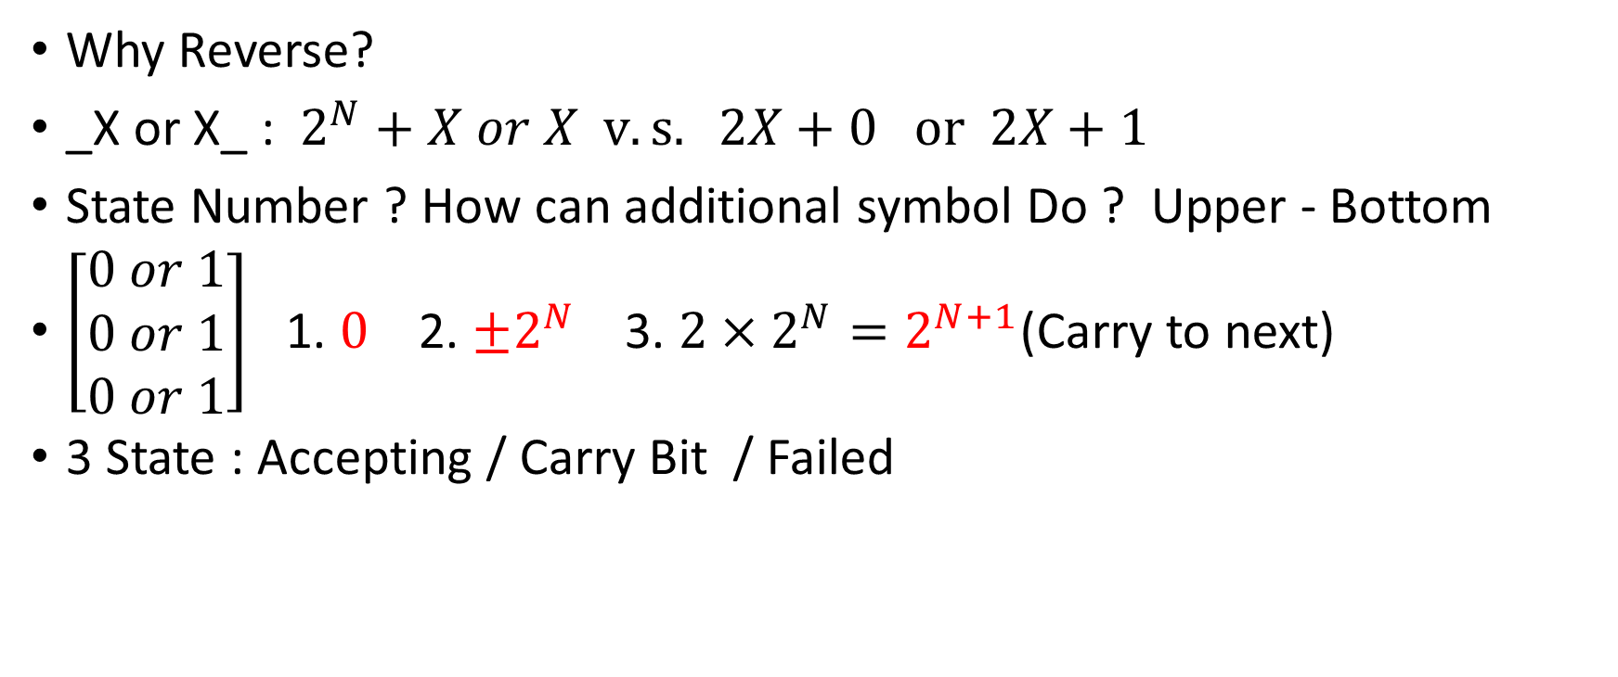
Hw2-Q5. Binary Code
Why Reverse?
_X or X_ : $2^{N}+X or X v.s. 2X+0 or 2X+1$
State Number ? How can additional symbol Do ? Upper - Bottom
$\left[\begin{matrix}0 or 1 \\ 0 or 1 \\ 0 or 1\end{matrix}\right]$ 1. $0$ 2. $±2^{N}$ 3. ${2×2}^{N}=2^{N+1}$(Carry to next)
3 State : Accepting / Carry Bit / Failed

Slide 12
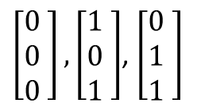

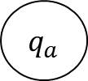
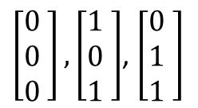


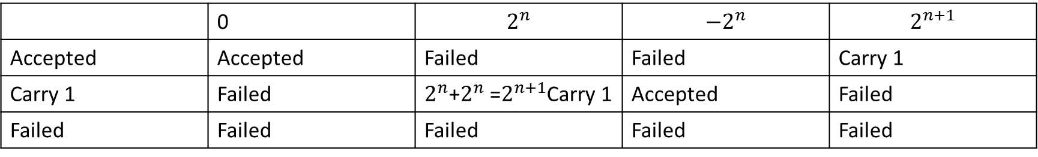

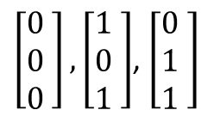
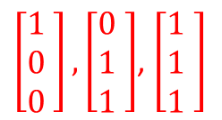
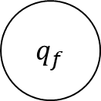

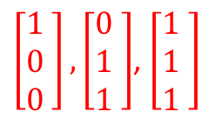
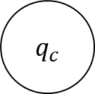
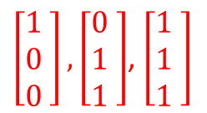

Hw2-Q5. Binary Code
 | 0 | $$2^{n}$$ | $$−2^{n}$$ | $$2^{n+1}$$
Accepted | Accepted | Failed | Failed | Carry 1
Carry 1 | Failed | $2^{n}$+$2^{n}$ =$2^{n+1}$Carry 1 | Accepted | Failed
Failed | Failed | Failed | Failed | Failed
$$\left[\begin{matrix}1 \\ 1 \\ 0 \end{matrix}\right]$$
$\left[\begin{matrix}0 \\ 0 \\ 0 \end{matrix}\right],\left[\begin{matrix}1 \\ 0 \\ 1 \end{matrix}\right]$, $\left[\begin{matrix}0 \\ 1 \\ 1 \end{matrix}\right]$
$q_{c}$
$\left[\begin{matrix}1 \\ 0 \\ 0 \end{matrix}\right],\left[\begin{matrix}0 \\ 1 \\ 1 \end{matrix}\right]$, $\left[\begin{matrix}1 \\ 1 \\ 1 \end{matrix}\right]$
$q_{a}$
$$\left[\begin{matrix}0 \\ 0 \\ 1 \end{matrix}\right]$$
$$\left[\begin{matrix}0 \\ 0 \\ 1 \end{matrix}\right]$$
$\left[\begin{matrix}1 \\ 0 \\ 0 \end{matrix}\right],\left[\begin{matrix}0 \\ 1 \\ 1 \end{matrix}\right]$, $\left[\begin{matrix}1 \\ 1 \\ 1 \end{matrix}\right]$
$\left[\begin{matrix}0 \\ 0 \\ 0 \end{matrix}\right],\left[\begin{matrix}1 \\ 0 \\ 1 \end{matrix}\right]$, $\left[\begin{matrix}0 \\ 1 \\ 1 \end{matrix}\right]$
$$\left[\begin{matrix}1 \\ 1 \\ 0 \end{matrix}\right]$$
$q_{f}$
$\left[\begin{matrix}0 \\ 0 \\ 0 \end{matrix}\right],\left[\begin{matrix}1 \\ 0 \\ 1 \end{matrix}\right]$, $\left[\begin{matrix}0 \\ 1 \\ 1 \end{matrix}\right]$
$\left[\begin{matrix}1 \\ 0 \\ 0 \end{matrix}\right],\left[\begin{matrix}0 \\ 1 \\ 1 \end{matrix}\right]$, $\left[\begin{matrix}1 \\ 1 \\ 1 \end{matrix}\right]$
$$\left[\begin{matrix}0 \\ 0 \\ 1 \end{matrix}\right]$$
$$\left[\begin{matrix}1 \\ 1 \\ 0 \end{matrix}\right]$$

Slide 13

Hw2-Q6. Closedness of Union with different symbol
Suppose
M1 = (Q1, Σ1, δ1, q1, F1) recognizes A1
M2 = (Q2, Σ2, δ2, q2, F2) recognizes A2.
Construct M = (Q, Σ, δ, q0, F) to recognize A1 ∪ A2:
1. Q = {(r1,r2) | r1 ∈ Q1 U {D} and r2 ∈ Q2{D}}.
2. Σ = Σ1 U Σ2
3. For each (r1,r2) ∈ Q and each a ∈ Σ1, b ∈ Σ2
Notice: if r1,r2 = D then D
let δ((r1,r2), a) = (if a in Σ1 then δ1(r1, a) else D,
if a in Σ2 then δ2(r2, a) else D)
4. q0 = (q1, q2).
5. F = {(r1,r2) | r1 ∈ F1 or r2 ∈ F2}.

