Slide 1
Theory of Computing
TA times #2
Ching Chieh Lin
2018/4/18

Slide 2
Hw3.Q2
Is the class of languages recognized by NFAs closed under complement?
Equivalence of DFA /NFA
DFA is closed under complement
NFA is also closed under complement

Slide 3
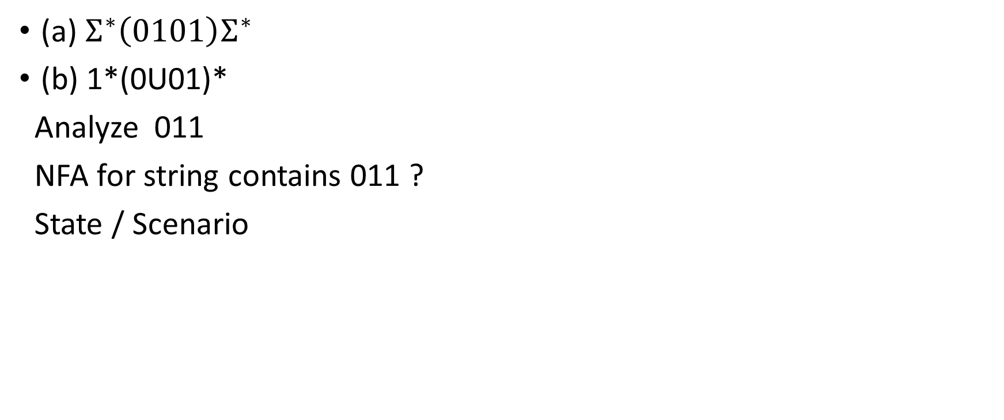
Hw3.Q5
(a) $Σ^{∗}\left(0101\right)Σ^{∗}$
(b) 1*(0U01)*
Analyze 011
NFA for string contains 011 ?
State / Scenario

Slide 4
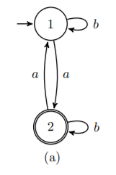


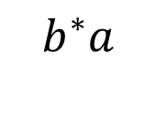

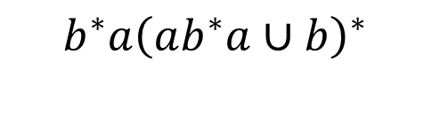










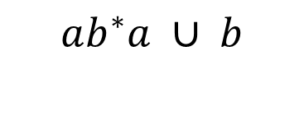



Hw3.Q6-(a)
$$b$$
$$b$$
$$ε$$
$$a$$
$$ε$$
$$S$$
$$1$$
$$2$$
$$A$$
$$a$$
$$ab^{∗}a ∪ b$$
$$b^{∗}a$$
$$ε$$
$$S$$
$$2$$
$$A$$
$$b^{∗}a{\left(ab^{∗}a∪b\right)}^{∗}$$
$$S$$
$$A$$

Slide 5
Hw4.Q2
Regular languages is closed under shuffle
Shuffle & Perfect shuffle ?
Non – Deterministic ?
A or B ?
A’s position
B’s position

Slide 6
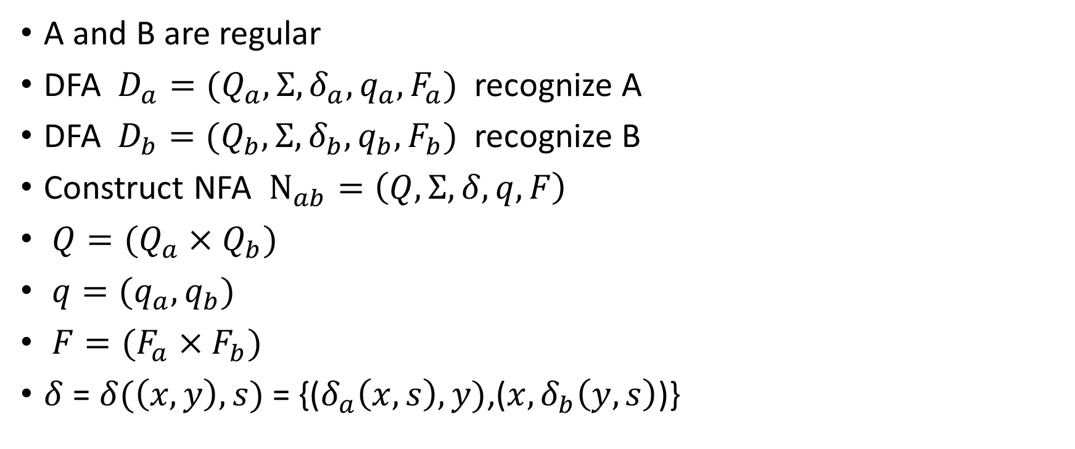
Hw4.Q2
Regular languages is closed under shuffle
A and B are regular
DFA $D_{a}=(Q_{a},Σ,δ_{a},q_{a}, F_{a})$ recognize A
DFA $D_{b}=(Q_{b},Σ,δ_{b},q_{b}, F_{b})$ recognize B
Construct NFA $N_{ab}=\left(Q,Σ,δ,q,F\right)$
$Q=(Q_{a}×Q_{b})$
$q=(q_{a},q_{b})$
$F=(F_{a}×F_{b})$
$δ$ = $δ(\left(x,y\right),s)$ = {($δ_{a}\left(x,s\right),y)$,(${x,δ}_{b}\left(y,s\right)$)}

Slide 7
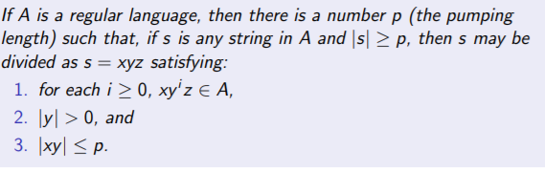
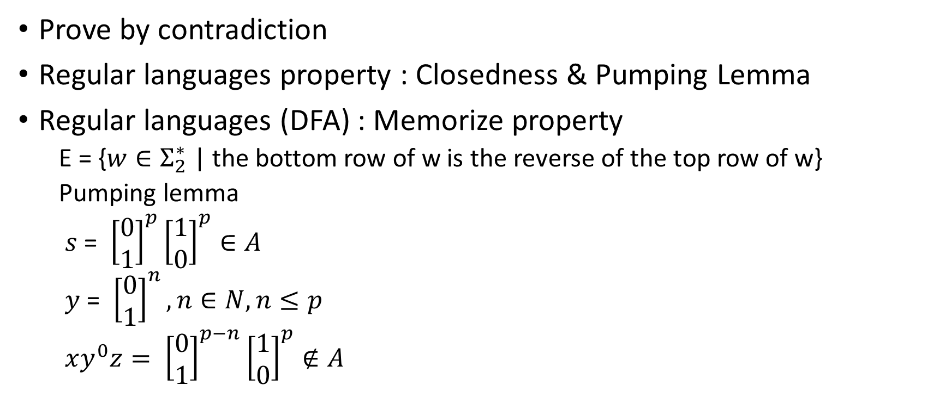
Hw4.Q4 Non-regular Prove
Prove by contradiction
Regular languages property : Closedness & Pumping Lemma
Regular languages (DFA) : Memorize property
  E = {$w∈Σ_{2}^{∗}$ | the bottom row of w is the reverse of the top row of w}
  Pumping lemma
  $s$ = ${\left[\begin{matrix}0 \\ 1\end{matrix}\right]}^{p}{\left[\begin{matrix}1 \\ 0\end{matrix}\right]}^{p}∈A$
  $y$ = ${\left[\begin{matrix}0 \\ 1\end{matrix}\right]}^{n},n∈N,n≤p$
  $xy^{0}z= {\left[\begin{matrix}0 \\ 1\end{matrix}\right]}^{p−n}{\left[\begin{matrix}1 \\ 0\end{matrix}\right]}^{p}∉A$

Slide 8
Hw4.Q6
All – NFA v.s. NFA
Prove Concept.
  1. Complement
  2. NFA to DFA

Slide 9
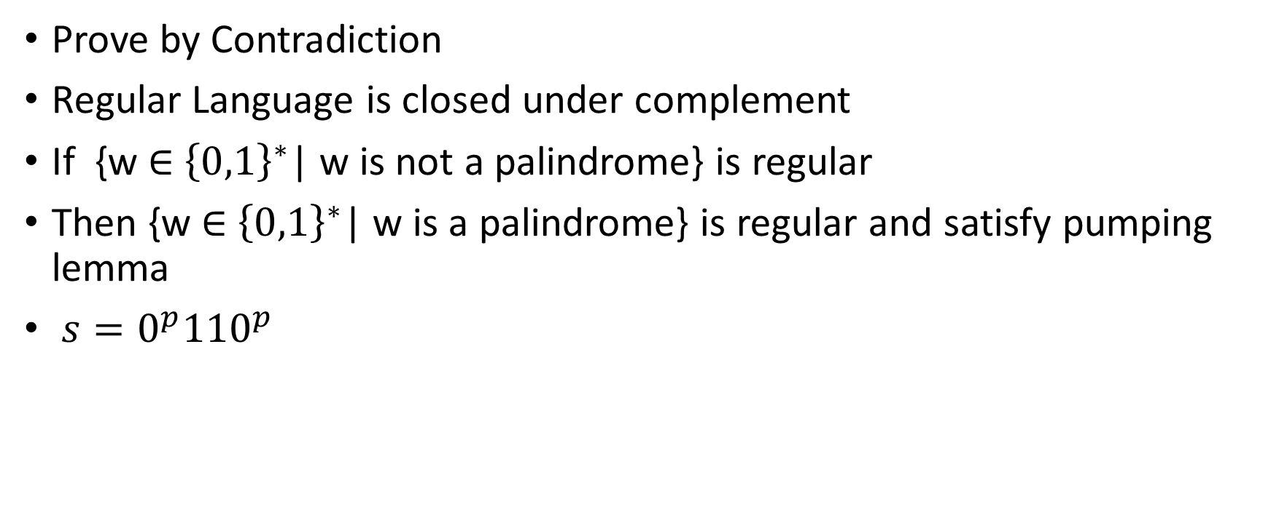
Hw4.Q7
Prove by Contradiction
Regular Language is closed under complement
If {w ∈ ${\left\{0,1\right\}}^{∗}$| w is not a palindrome} is regular
Then {w ∈ ${\left\{0,1\right\}}^{∗}$| w is a palindrome} is regular and satisfy pumping lemma
$s=0^{p}{110}^{p}$

