Slide 1
Enterprise Data Modeling
Wen-Chun Ni
Galaxy Software Services

Slide 2
Wen-Chun Ni (倪文君)
台大資訊工程學系 (class 1985)
叡揚資訊 (Galaxy Software Services)
  創新所 (CII)
  架構辦公室 (CAO)

Slide 3
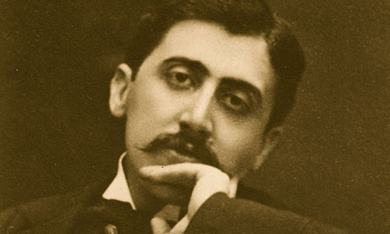
“The real voyage of discovery consists not in seeking new landscapes, but in having new eyes.” -- Marcel Proust
Marcel Proust
Notes:
http://www.quoteyard.com/the-real-voyage-of-discovery-consists-not-in-seeking-new-landscapes-but-in-having-new-eyes/

Slide 4


Model vs. Reality
First ever image of hydrogen atom
Notes:
http://www.impossiblemachine.com/newton.html
http://io9.com/the-first-image-ever-of-a-hydrogen-atoms-orbital-struc-509684901

Slide 5
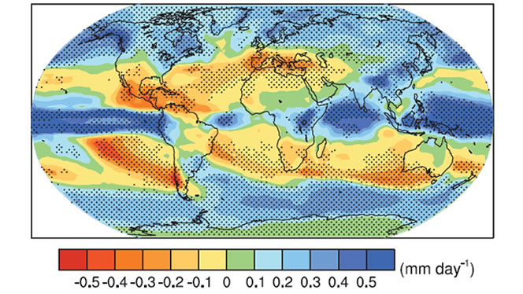

Model vs. Reality

Slide 6
Data Models
Tree Model
Graph Model
List Model
Set Model
Relational Model

Slide 7
Data Structures (Implementations)
Trees
  Binary search trees
  Splay Trees
  Fibonacci trees
  AVL trees
Sets
  Bit-vector sets
  Arrays
  ….

Slide 8
What’s Special about Enterprise?
It’s complex;
It changes a lot;
Every user may have their special needs.
Every business has its own special needs.
Notes:
Hay: CoT (p.235)

Slide 9
Software development is not hard, as long as you don’t have to change code.

Slide 10
Why is Modeling Important?
Make systems simpler and easier
Make changes cheaper and easier
Make business more agile and adaptive
Data models are only a small part of the system with high impact

Slide 11
Zachman Architecture Framework
Data
(What)
Activities
(How)
People
(Who)
Timing
(When)
Motiva-
tion (Why)
Location
(Where)
Objectives/ Scope
List of Important Things
List of Processes
Business Locations
Organi- zational Units
Business Events, Cycles
Business Vision and Mission
Business Owner’s View
Terms, Definitions
Business Process Model
Operations
by Business Location
Org. Chart, Roles
Master Business Schedule
Business Policies and Rules
Architect’s View
Entity/ Relationship Diagram
Essential Functions
Data Links, Processing Locations
Roles+Data
(Use Cases)
State/ transactions, ELH
Business Rule Model
Designer’s View
Tables,
Classes
System Design
Network Architecture (h/w, s/w types)
User Interface, Security
“Control Flow” diagrams
Rule Design
Data, physical storage design
Detailed Program Design
Screens, Security Design
Builder’s View
Network Construction
Timing Definitions
  Rule Specification
Functioning System
Working System

Slide 12
ZAF: Data
Data
(What)
Activities
(How)
People
(Who)
Timing
(When)
Motiva-
tion (Why)
Location
(Where)
Objectives/ Scope
List of Important Things
List of Processes
Business Locations
Organi- zational Units
Business Events, Cycles
Business Vision and Mission
Business Owner’s View
Terms, Definitions
Business Process Model
Operations
by Business Location
Org. Chart, Roles
Master Business Schedule
Business Policies and Rules
Architect’s View
Entity/ Relationship Diagram
Essential Functions
Data Links, Processing Locations
Roles+Data
(Use Cases)
State/ transactions, ELH
Business Rule Model
Designer’s View
Tables,
Classes
System Design
Network Architecture (h/w, s/w types)
User Interface, Security
“Control Flow” diagrams
Rule Design
Data, physical storage design
Detailed Program Design
Screens, Security Design
Builder’s View
Network Construction
Timing Definitions
  Rule Specification
Functioning System
Working System

Slide 13
To be
Continued

Slide 14




In terms of ZAF Data
Architectural Model (Row 3)
Logical Model
(Row 4)
External
Schema 1
Logical
Schema
(Relnl.)
Conceptual
Schema
Logical
Schema
(XML)
External
Schema 2
External
Schema 3
Physical
Schema
Physical
Schema
Physical Model
(Row 5)
Semantic Model
(Row 2)

Slide 15
Notations

Slide 16
Syntax
Common Notations
  Information Engineering
  IDEF1X
  Unified Modeling Language (UML)
  Barker/Oracle/SSADM
Notes:
以下介紹在介紹Domain Model時常見的一些表示法
這些表示法大致上是差不多，學員只要知道即可
上課時將會視講解需要而交叉運用不同表示法，一方面也讓大家可以習慣看到各種不同的表示法

Slide 17
Information Engineering
(one exactly.)
(must be)
(may be)
(one or more)
has
sells in
Notes:
我們以大家容易理解的例子來說
Party是指人或組織，會下採購訂單，每個訂單有細項品名
第一種表示法是Information Engineering
這個蠻容易懂的，我們從右邊往左邊看過去，
一個Party可以下０到多個訂單（不是每個人或組織都會下訂單，也會有人或組織可能下多張訂單）
但每張訂單都必須來自一個且只有一個Partty
每張訂單會有至少一個細項，也會有多個細項，而每個細項則是歸屬於一張且只有一張訂單
同樣的例子我們用另一個表示法：IDEF1X
學員可以看一下兩個的對照關係

Slide 18
IDEF1X
May be more than one
Must be exactly one
Must be more than one
Identifying relationship
Foreign key
Non-identifying relationship
Notes:
我們以大家容易理解的例子來說
Party是指人或組織，會下採購訂單，每個訂單有細項品名
第一種表示法是Information Engineering
這個蠻容易懂的，我們從右邊往左邊看過去，
一個Party可以下０到多個訂單（不是每個人或組織都會下訂單，也會有人或組織可能下多張訂單）
但每張訂單都必須來自一個且只有一個Partty
每張訂單會有至少一個細項，也會有多個細項，而每個細項則是歸屬於一張且只有一張訂單
同樣的例子我們用另一個表示法：IDEF1X
學員可以看一下兩個的對照關係

Slide 19
UML
(must be one or more.)
(must be one exactly.)
(may be one or more.)
lineItem
purchaseOrder
Party
+productType:String
+Quantity:Number
+Price:Money
+PO_number:Integer
+PO_Date:Date
+Terms:String
+name:String
+partyType:String
1..*
1..1
0..*
1..1
has
Is vendor in
(Data type is shown.)
(Visibility is shown.)

Slide 20
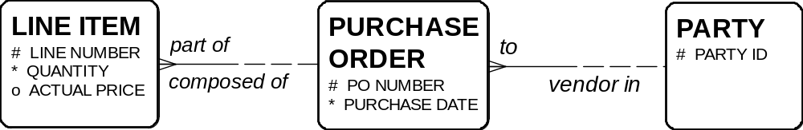
Barker/Oracle
(opposite must be)
(one or more.)
(one and only one)
(opposite may be)

Slide 21
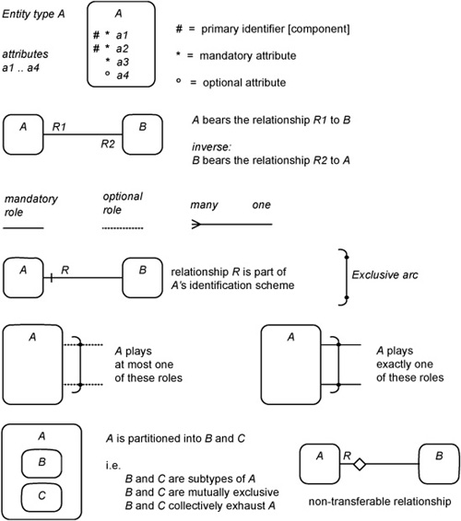
Barker Summary

Slide 22
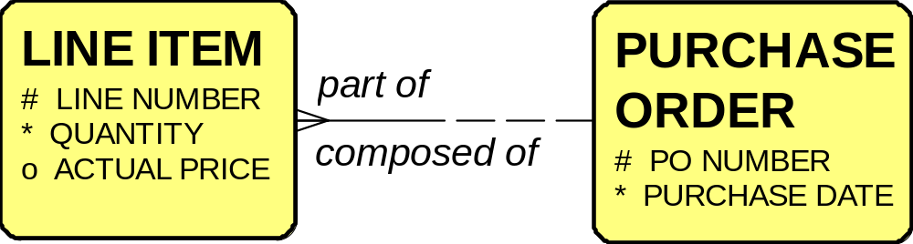
Extracting Methods
public class PurchaseOrder extends Order {
String poNumber;
Date purchaseDate;
List<LineItem> items;
}

Slide 23
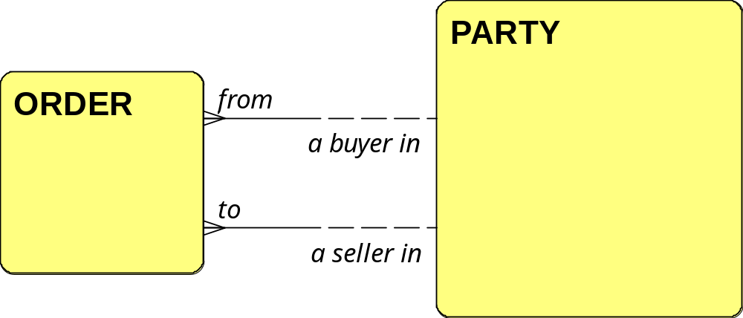
Extracting Methods
public class Order {
List<LineItem> items;
Party buyer;
Party seller;
}

Slide 24
Summary
Opposite side is mandatory
Opposite side is optional
optional, many
mandatory, one
many
one
Oracle / Barker
Information Engineering
optional, many
mandatory, one
optional
+ many
mandatory + one
0..*
1..1
UML
IDEF1X
Notes:
在這次的簡報中，主要是以Oracle/Barker的表示法來說明，用 UML 的工具也可以畫出 Oracle/Barker 的圖
但在使用工具時可以採用UML 的方式會比較直覺(考試時可用UML表示法)

Slide 25
Party: Increasing Insight

Slide 26
ZAF: People
Data
(What)
Activities
(How)
People
(Who)
Timing
(When)
Motiva-
tion (Why)
Location
(Where)
Objectives/ Scope
List of Important Things
List of Processes
Business Locations
Organi- zational Units
Business Events, Cycles
Business Vision and Mission
Business Owner’s View
Terms, Definitions
Business Process Model
Operations
by Business Location
Org. Chart, Roles
Master Business Schedule
Business Policies and Rules
Architect’s View
Entity/ Relationship Diagram
Essential Functions
Data Links, Processing Locations
Roles+Data
(Use Cases)
State/ transactions, ELH
Business Rule Model
Designer’s View
Tables,
Classes
System Design
Network Architecture (h/w, s/w types)
User Interface, Security
“Control Flow” diagrams
Rule Design
Data, physical storage design
Detailed Program Design
Screens, Security Design
Builder’s View
Network Construction
Timing Definitions
  Rule Specification
Functioning System
Working System

Slide 27
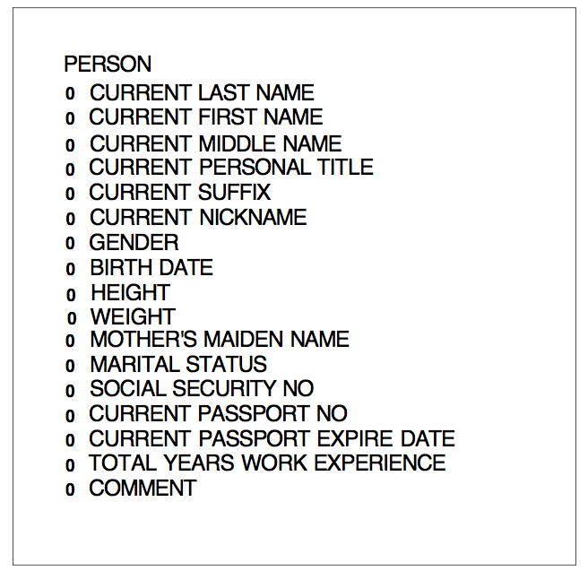

Slide 28
How To Describe A Person
Intrinsic (or snapshot)
  Birth Date
  Mother’s Maiden Name
  SOC No
  Total Work Experience
Extrinsic (changeable)
  Name
  Marital Status
  Passport Status
  Gender
  Physical Characteristics

Slide 29
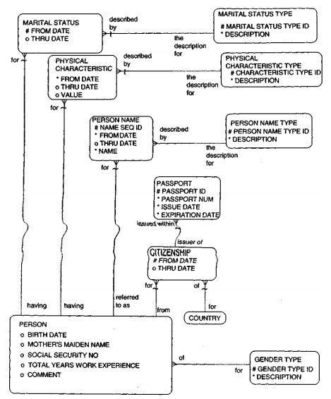
Considering Changes

Slide 30
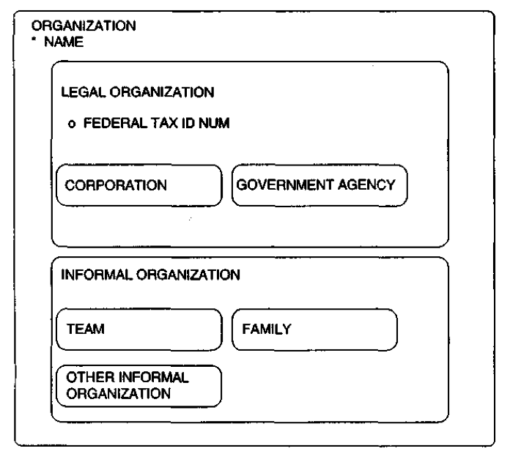
Organization: subtyping

Slide 31
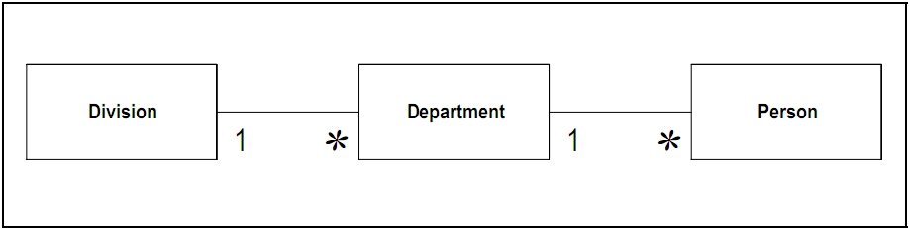
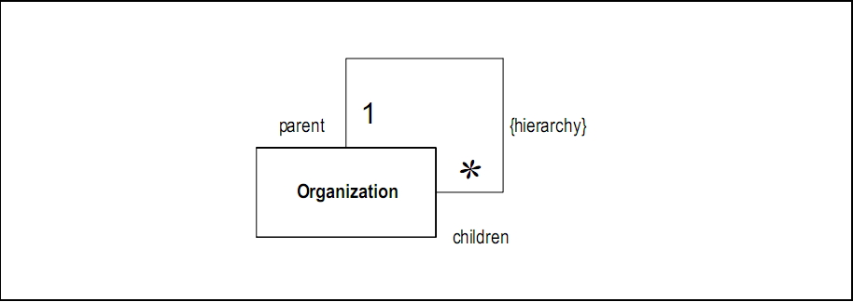
Initial Models

Slide 32
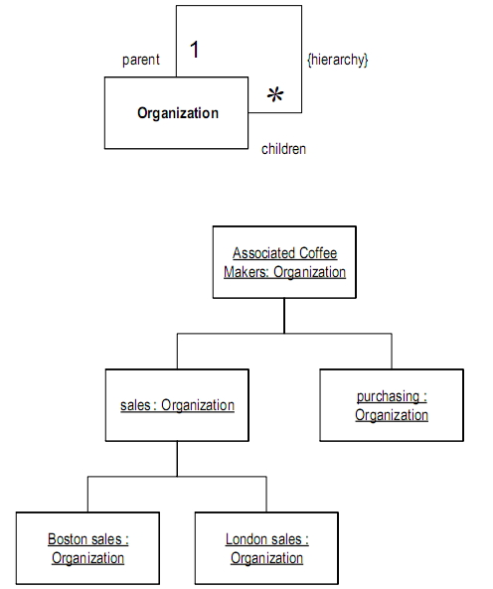

Slide 33
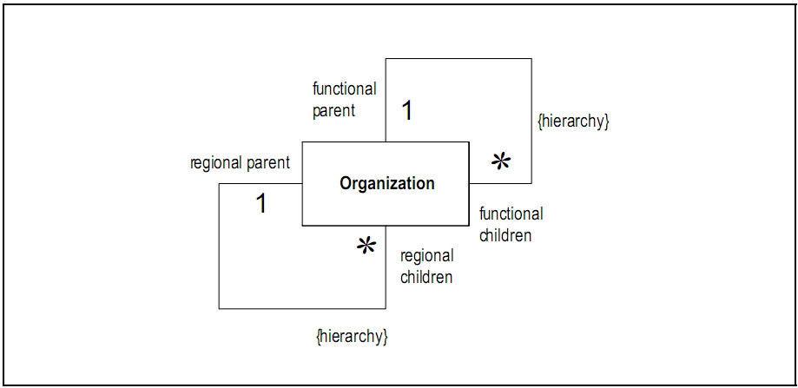
Matrix Organizations

Slide 34
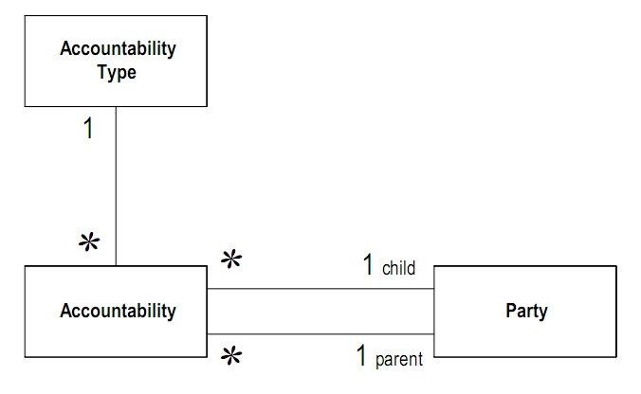
Generalize Reporting Hierarchy

Slide 35
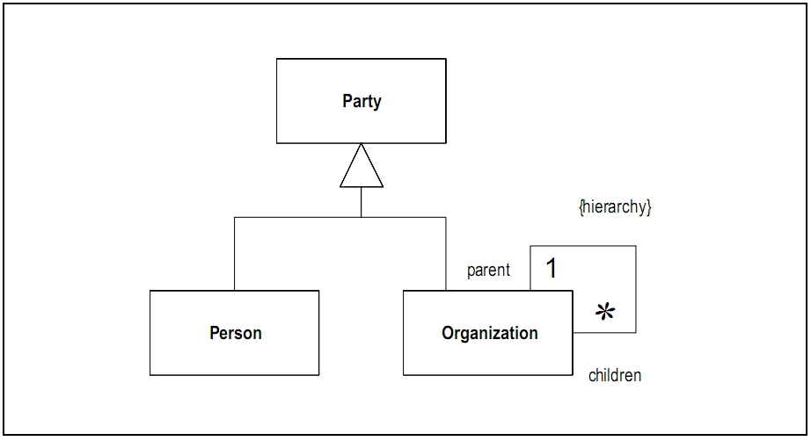

Slide 36
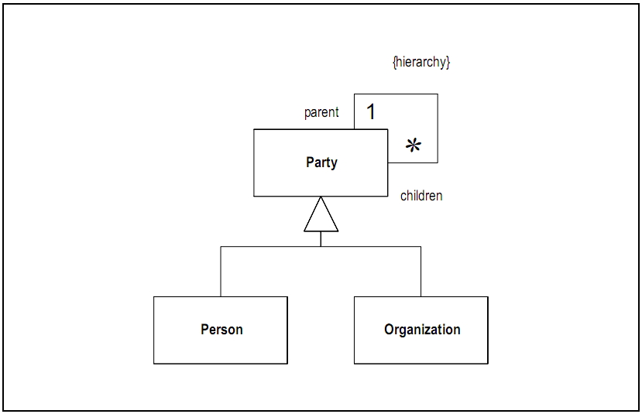
Composite Pattern!

Slide 37
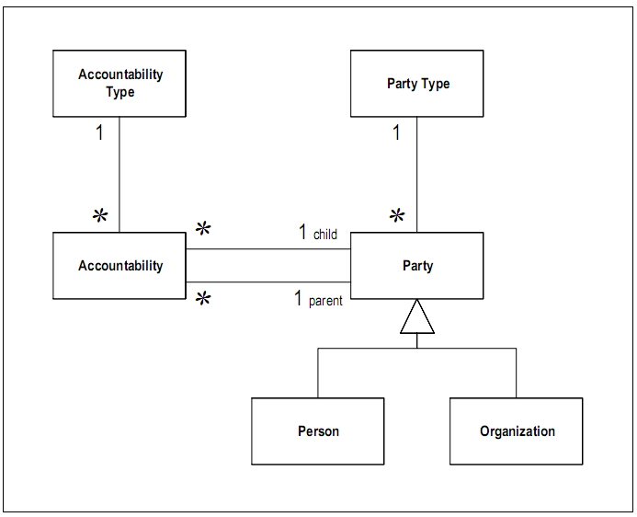
Knowledge Operation Separation

Slide 38
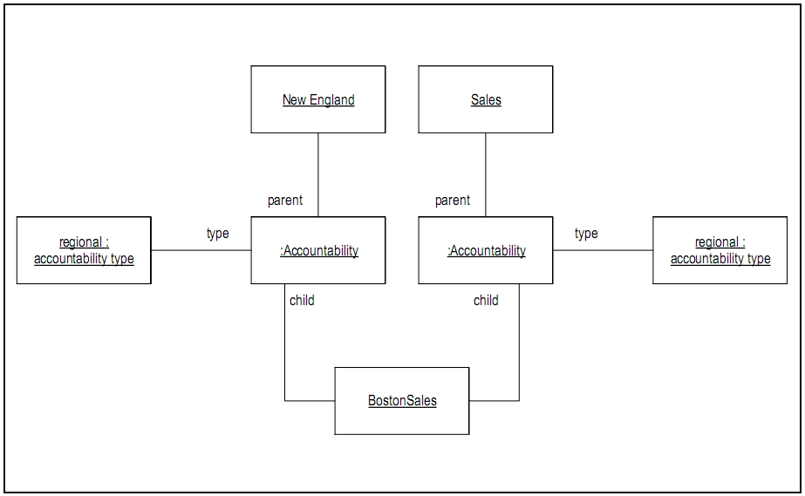
Example of Accountability

Slide 39
Real Objects
New England
Sales
reportTo
reportTo
BostonSales

Slide 40
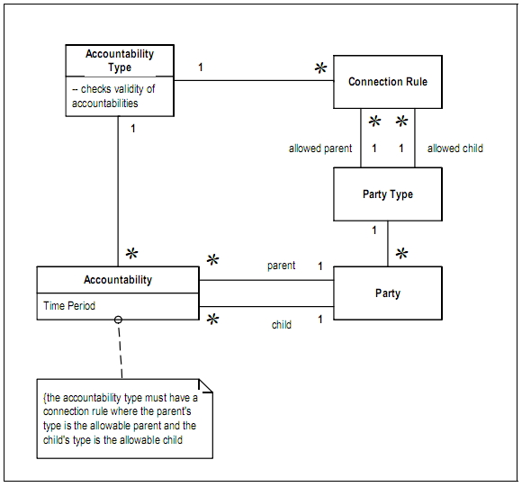
With Type, Connections, Periods

Slide 41
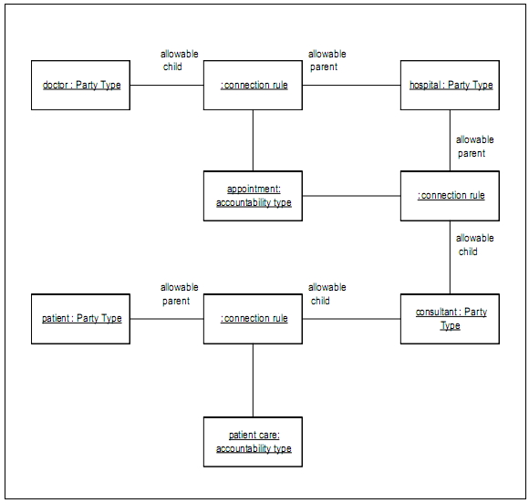

Slide 42
Relationships

Slide 43
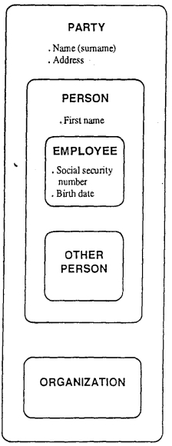
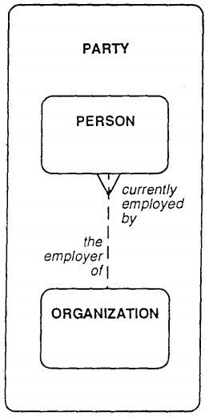
Employee?

Slide 44
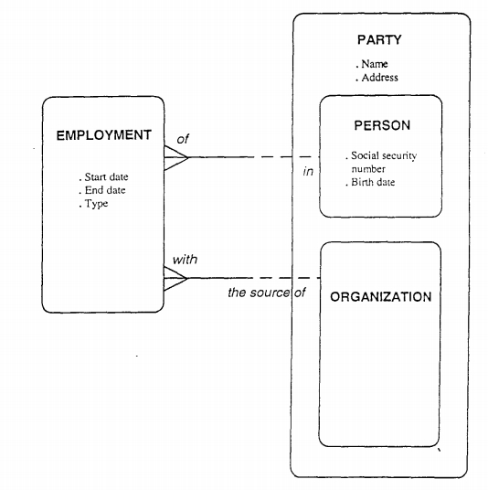
Actually, Employment

Slide 45
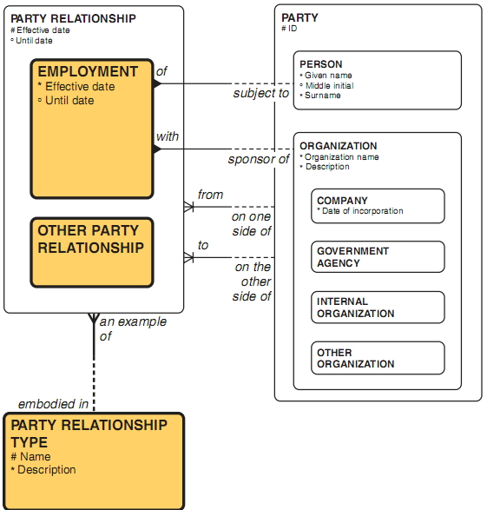
Generalization

Slide 46
The Complexity of An Address
Location

Slide 47
ZAF: Location
Data
(What)
Activities
(How)
People
(Who)
Timing
(When)
Motiva-
tion (Why)
Location
(Where)
Objectives/ Scope
List of Important Things
List of Processes
Business Locations
Organi- zational Units
Business Events, Cycles
Business Vision and Mission
Business Owner’s View
Terms, Definitions
Business Process Model
Operations
by Business Location
Org. Chart, Roles
Master Business Schedule
Business Policies and Rules
Architect’s View
Entity/ Relationship Diagram
Essential Functions
Data Links, Processing Locations
Roles+Data
(Use Cases)
State/ transactions, ELH
Business Rule Model
Designer’s View
Tables,
Classes
System Design
Network Architecture (h/w, s/w types)
User Interface, Security
“Control Flow” diagrams
Rule Design
Data, physical storage design
Detailed Program Design
Screens, Security Design
Builder’s View
Network Construction
Timing Definitions
  Rule Specification
Functioning System
Working System

Slide 48
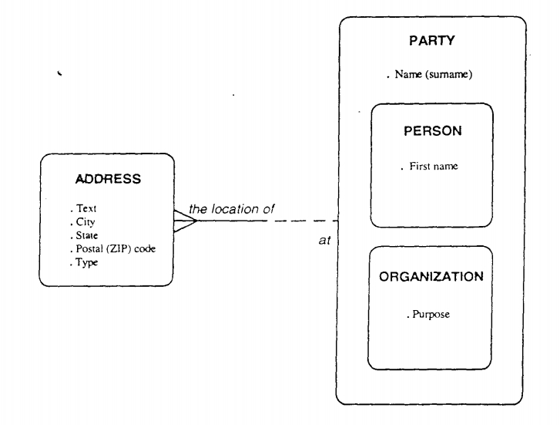

Slide 49
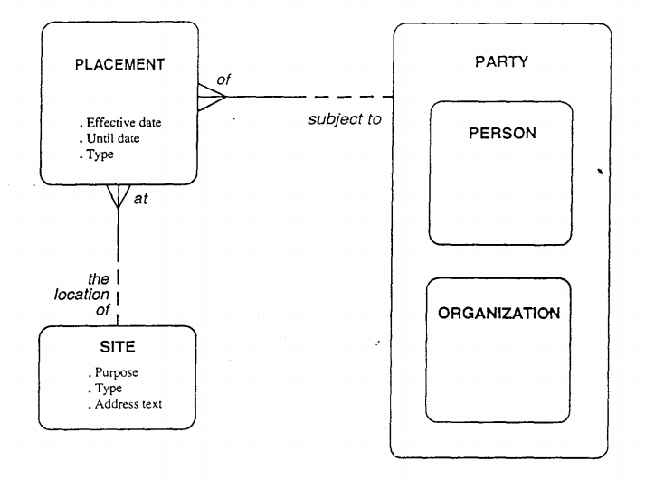

Slide 50
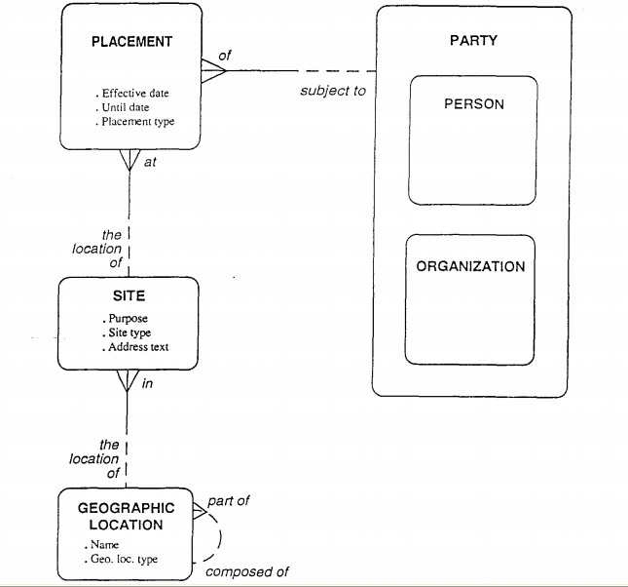

Slide 51
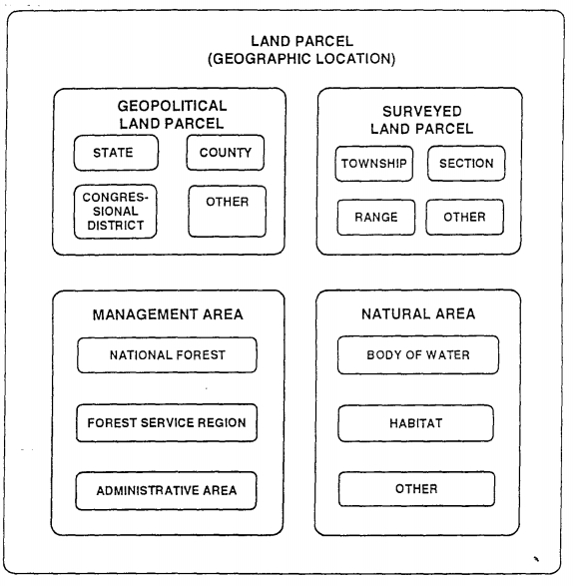

Slide 52
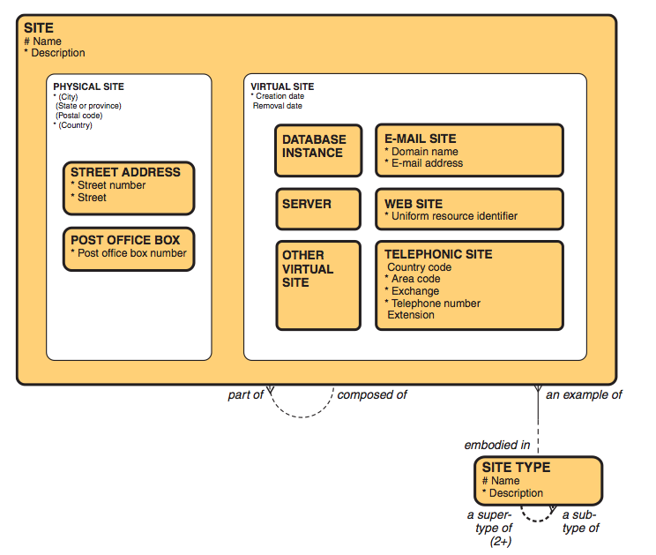

Slide 53
Topics

Slide 54
Fundamental Patterns
Roles
  Declarative roles
  Contextual roles
Classification: types and categories
Involvement: roles
States of data: status
Data organization:
  Hierarchies
  Aggregates
Contact Mechanisms

Slide 55
Common Things
Products and Product Types
Activities and Structures
Data and Structures
Contracts and Commitments

Slide 56

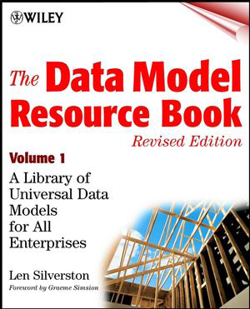

References
Notes:
接下來介紹表示法元素

Slide 57
The Future
Scalability Dilemma

Slide 58
Microsoft Dynamics AX
Type | Total
Class | 7,871
Method | 122,729
Field (of Table) | 59,393
Menu | 6,280
Table | 4,795
Notes:
http://psrcentre.org/images/extraimages/1211187.pdf

Slide 59
ERP Complexity
Complex, rigid, expensive
Full SAP implementation: > 10,000 tables
workday.com: < 10 tables (and flexible)
Notes:
http://www.thespot4sap.com/Articles/Corporate%20Overview.asp

Slide 60
Reducing Complexity
REA triple model (McCarthy 1982)
  Resource
  Event
  Agent
Accounting is not about credit and debit
  It’s about recording business events
Future enterprise system:
  Recording what happened

Slide 61
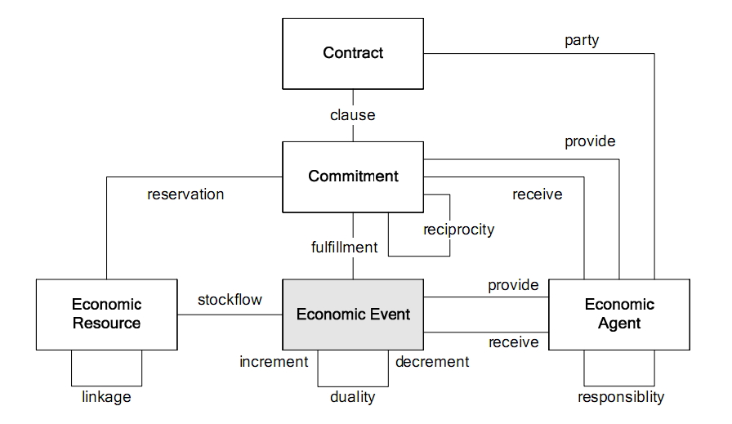

Slide 62
Scalability: Requirements
Triple in workday.com:
  Attribute
  Relationship
  Instance
In-memory object store (SAP wants it too -- Hana)
Abandoning relational data model
Metadata-driven
  modify the data, not the code
Notes:
http://www.thespot4sap.com/Articles/Corporate%20Overview.asp

Slide 63











Workday Architecture Overview
OMS
Processing Engine
Services UI & data requests
Customer Site
UI Server
Entry point for end users
Flash / FLEX based
Wide browser support
Workday Services Architecture
Users
Object Management
Server
(OMS)
UI
Server
Internet
Browser
XML
XML
Systems
Integration
Server
Data
Services
XML / Files
XML
Integration Server
Entry point for data requests
Transformation capabilities
Persistent
Store
Persistent Store
Captures all app changes
Replication & backups

Slide 64
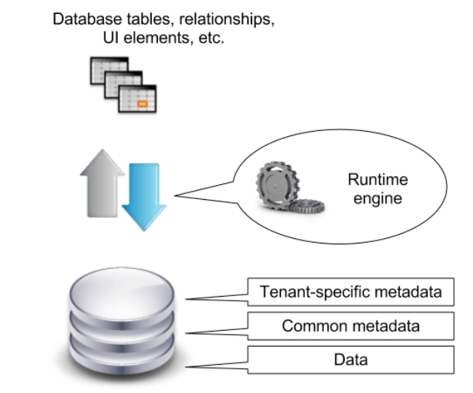
Force.com Basics

Slide 65
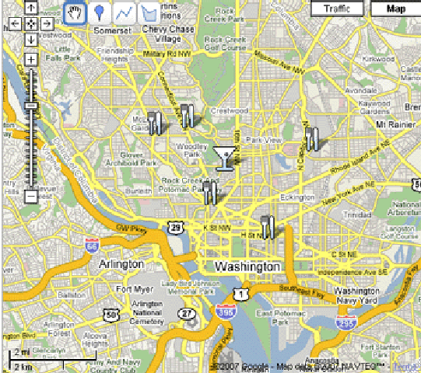






teamKube’s Elements
Documents
Places
Activities
Tasks
Groups
Person
Time

Slide 66





Data in teamKube

Slide 67
Abstract form: multi-graph

Slide 68
Q & A

Slide 69
Exercises

Slide 70
訂便當／飲料
有個網路公司提出一個訂便當／飲料平台
合作廠商可以刊登產品及可搭配的選擇
飲料可選擇是否冰度、甜度（不加價）
飲料可選擇加珍珠或其它配料（要加價）
廠商為回饋客戶，有買N杯送一杯的活動
客戶上網勾選後，系統自動算出總金額
訂購單完成後可直接將項目、數量傳給廠商
每月分析熱銷商品、常客、大戶等資訊，隨同帳單寄給客廠商

Slide 71
選課系統
學校要建置一套選課系統
學校有日間部、夜間部、社區大學等學制
社區大學一年四個學期，其它則是一年兩個學期
學期開始時會安排教師與教室，並將課表公布在網路上，開放學生線上選課
有些日間部博、碩士班學生會在社區大學裡教電腦、網頁設計等
課程有擋修限制，必須上過某些課才可以修
有些課程在轉系時可以和另一堂課抵減
學期結束要列印成績單，並由學生對講師做教學評量

Slide 72
圖書管理
學校希望建置圖書管理系統
圖書泛指書籍、光碟片、錄影/音帶
有些書是單冊，有些書是一套多本，學生不見得整套一起借走
每本書可能一次購買多冊
學生可於線上查到哪些書什麼時候被借走，預計何時歸還
要借的書若都被借走可排候補，只要有人還書就依登記先後順序借閱
逾期未歸還者會收到催還通知
定期統計借閱率最高、候補時間最長、員工借書排行榜

